Slide 1
Analysis of Pricing pattern based on ratings from Ecommerce website to strategize product portfolio for user.

Slide 2
Group No: 25
Group Members:
Amol Chilkulwar
Diksha Wanjari
Komal Satpute
Piyush Bhomale (TL)
Snehal Bhajikhaye
Vaishnavi Chandak
Mentors:
Nandkishor Rajput (Neiron)
Amar Jadhav (Morning Star)

Slide 3
Problem Statement
We are working on a project for a client where you want to setup product lineups for their e-commerce website.They want to understand the market value and outlook of products so that the portfolio is more customer-oriented and satisfying to customers.
Our team decided that the first step in analyzing the market is to collect data and for this purpose,we scraped data from various e-commerce websites so that we could collect all the details of products and store them on Amazon Web Services in a structured format where client can easily query the data.
This entire process is automated in such way that the client will be able to get the desired output within a single click.

Slide 4









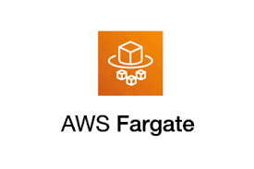





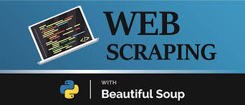
Technologies Used:

Slide 5
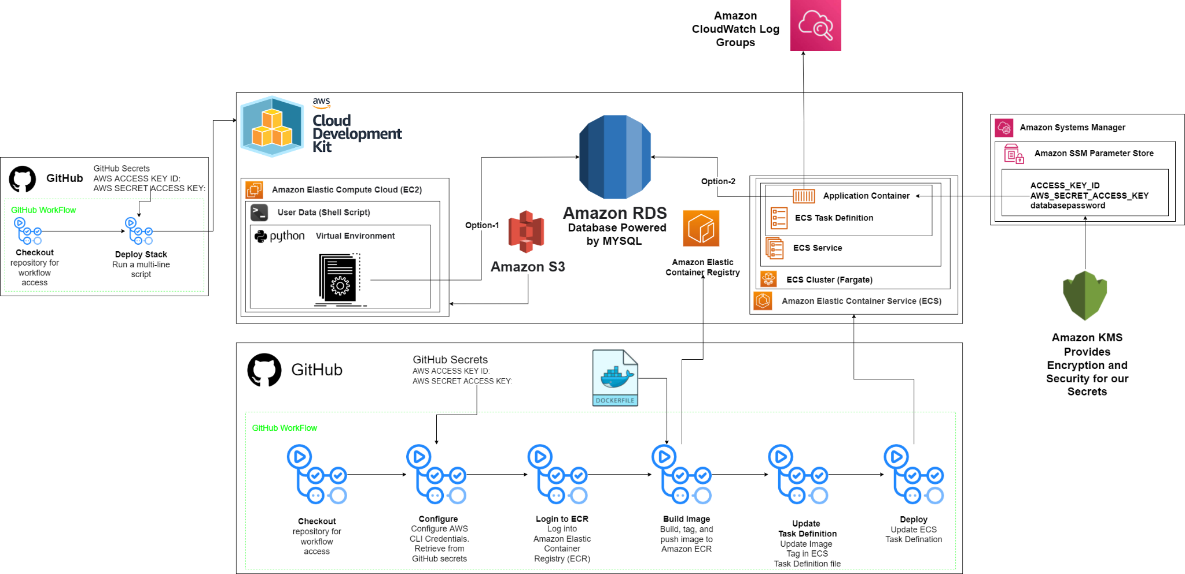
Architecture:

Slide 6

SENTIMENT ANALYSIS
Scrap the product review from E-commerce website
HUGGING FACE TRANSFORMER
Collect sentiments weather positive or negative sentiments along with confidence

Slide 7
Web Scraping in Python
Fetching the data (Using requests library : import requests)
Used BeautifulSoup to parsing Data
Provides simple methods to
search
navigate
select
Deals with broken web-pages really well
Collected Various Product Details such as
Product Name
Rating
Total Rating
Discounted Price
Original Price
Product Url
Product Sentiments

Slide 8
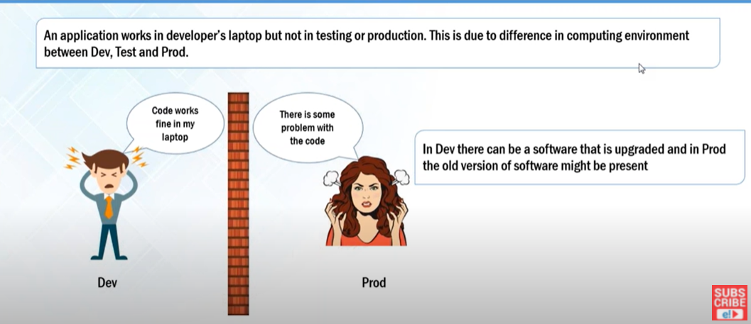
Why we need Docker?

Slide 9
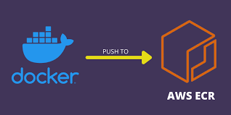
DOCKER
Docker is an open source containerization platform. It enables developers to package applications into containers
Dockerfile - Build image - Tag -Push Image-ECR

Slide 10
AWS EC2
Elastic compute cloud provides resizable,secure,compute capacity in the cloud via a virtual machine.
Represent a physical server for you to deploy your applications.
Creation of EC2 instance, set up required configurations for EC2 instance.
Passing USER DATA for performing common automated tasks by system.
For automating EC2 required bootstrapping(shell script).
Shells script contains all the required tools and configurations for virtual environment setup.
Data Execution after fetching data(object) from S3 Bucket.

Slide 11
AWS S3
Amazon Simple Storage Service is scalable, high-speed,web based cloud storage service.
This is designed for online-backup and archiving of data and application on AWS.
S3 provides object storage for storing and recovering of data from anywhere over the web.
Tasks: Bucket Creation and Uploading Dependencies.
Data loading from scraper file(zip) and extracted it into S3 Bucket.

Slide 12
AWS RDS
Boto3 client connected to AWS RDS
Checked “Endpoint” of database (RDS)
Connection to database (mydb) using mysql.connector
Schema created
Features:
Multi-engine support(Aurora, MySQL, MariaDB, PostgreSQL, Oracle, SQL Server)
Easy to manage
Security
High Availability
Designed for use with other Amazon Web Services

Slide 13
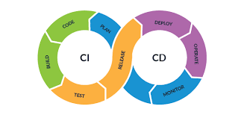
CI/CD Pipeline:
CI and CD stand for continuous integration and continuous delivery/continuous deployment
Continuous Integration is the process that allows developers to integrate new code into a shared repository (such as GitHub)
Continuous Delivery (CD) occurs at the end of the CI cycle and is responsible for the automated delivery of the integrated code from the development to the production stage
The benefits of GitHub Actions:
Automate everything within the GitHub flow
Hosted virtual machines on multiple operating systems
Pre-written CI templates that are ready to use
Simple container and operating system testing
Use it on your public repository for free

Slide 14
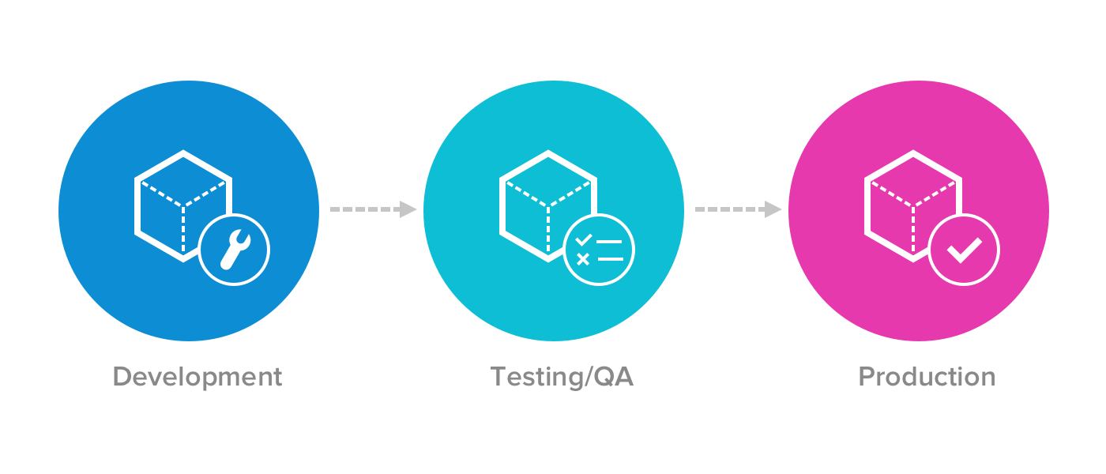
Environment Management

Slide 15
CDK Advantages
Can maintain Production and Development environment
Cross Account Deployment
Infrastructure as a Code
Dependencies between Application is possible
Uses Object Oriented Programming Concepts
Multiple Programming Language support

Slide 16
100%
Running Status

Slide 17


Extras
PyTest
Python Docs
AWS Batch
Kinesis

Slide 18
Special Thanks !
Thanks to Pradeep Tripathi Sir for continuously monitoring, suggesting changes, introducing to new Technologies as well as for challenging every day to push our limits.
Thanks to our Mentors Amar Jadhav and Nandkishor Rajput to keep us charged as well as helping us whenever needed.
Thanks to Nikhil Ramgiri (Bank of America) for providing resources to understand tools we used.

Slide 19
THANK YOU !!

