Slide 1
ACADEMIC LAB PROJECT PRESENTATION • V-SEMESTER CSE (AI & DS)
2,075,260
Raw Readings Analyzed
Household Electricity Pattern Analysis & Predictive Modeling
Hadoop HDFS
Distributed Storage
Java MapReduce
Batch Disk Aggregation
A Distributed Big Data Pipeline utilizing Hadoop HDFS, Native Java MapReduce, Apache Spark, NoSQL Cassandra & Random Forest Forecasting
Apache Spark
In-Memory Analytics (23s)
PROJECT MEMBERS & CREDENTIALS:
• Bhomick Debiya — Roll Number: 32 (Core Pipeline & MapReduce/Spark Integration)
• Shorya Chilate — Roll Number: 58(Machine Learning, Visual Analytics & Gradio Dashboard)
Department of Computer Science & Engineering (Artificial Intelligence & Data Science) | Oct 2026
0.000000 kW
Dual-Engine Delta (Zero Divergence)
Apache Cassandra
Distributed NoSQL Storage
Random Forest
Next-Hour Power Forecast

Slide 2
BIG DATA ANALYTICS LAB | V-SEMESTER CSE (AI & DS)
Executive Summary & Industrial Problem Context
2,075,260
Continuous Smart Meter Time-Series Rows
132.9 MB
Uncompressed Semicolon-Delimited Dataset
4-Year Span
Continuous Sampling (Dec 2006 - Nov 2010)
INDUSTRIAL MOTIVATION & PROBLEM STATEMENT
• Smart Grid High Velocity:
Modern power utilities collect minute-by-minute sensor readings from millions of smart meters. Analyzing this continuous flood exceeds the memory and scaling limits of traditional RDBMS.
• Diurnal Peak & Demand Surges:
Unanticipated consumption spikes destabilize grid frequencies, trigger expensive auxiliary thermal generators, and cause transmission line overheating.
• Sub-Meter Disaggregation Needs:
Utilities require granular appliance-level insights (HVAC vs laundry vs kitchen) to formulate dynamic time-of-use (ToU) tariffs and demand-response programs.
• Single Point of Failure Vulnerability:
Monolithic architectures cannot provide fault-tolerant batch guarantees alongside interactive dashboard queries.
RESEARCH OBJECTIVES & SYSTEM SOLUTION
✔ Distributed Fault-Tolerant Storage:
Persist 2+ million raw smart-meter records directly in Hadoop Distributed File System (HDFS) across distributed data blocks.
✔ Robust Batch Computation:
Implement native Java MapReduce algorithms to perform exact 24-hour baseline aggregation directly from HDFS splits.
✔ Accelerated In-Memory Processing:
Leverage Apache Spark (PySpark) with Catalyst optimizer for multi-dimensional aggregations and sub-metering breakdown in ~23 seconds.
✔ Dual-Engine Validation Metric:
Enforce rigorous cross-engine verification between MapReduce and Spark to prove zero divergence (<0.0001 kW).
✔ Intelligent Forecasting & UI:
Train a Random Forest Regressor to forecast next-hour active power demand, persisted to NoSQL Cassandra and visualized via Gradio 6.0.
Household Electricity Pattern Analysis & Predictive Modeling | Bhomick Debiya (Roll 32) & Shorya Chilate
02 / 19

Slide 3
BIG DATA ANALYTICS LAB | V-SEMESTER CSE (AI & DS)
UCI Smart-Meter Dataset & Rigorous Data Cleaning
Dataset Schema & Multi-Sensor Attributes (UCI Machine Learning Repository)
DATA QUALITY & HYGIENE FUNNEL
1. Total Raw Rows:
2,075,260 Records (132.9 MB raw file)
2. Missing Value Indicator:
UCI standard notation: '?' string tokens
3. Corrupted / Null Records:
25,980 rows dropped (power outages/meter faults)
4. Clean Valid Records:
2,049,280 Rows successfully ingested & retained
5. Data Retention Rate:
98.75% High-Quality Clean Ingestion Ratio
CRITICAL PREPROCESSING NOTE:
In both Java MapReduce and Apache Spark, missing values are cleanly eliminated prior to aggregation to prevent distortion of arithmetic means. No synthetic or forward-filled values contaminate baseline calculations.
Feature Attribute | Data Type | Physical Description & Engineering Unit
Date & Time | String / TS | Sampling timestamp formatted as dd/mm/yyyy hh:mm:ss
Global_active_power | Double | Household real active power consumption (kW)
Global_reactive_power | Double | Household reactive power consumption (kVAR)
Voltage | Double | Minute-averaged line electric potential (Volts)
Global_intensity | Double | Minute-averaged household electric current (Amperes)
Sub_metering_1 | Double | Kitchen appliances: Dishwasher & microwave (Wh)
Sub_metering_2 | Double | Laundry room: Washing machine, dryer, fridge (Wh)
Household Electricity Pattern Analysis & Predictive Modeling | Bhomick Debiya (Roll 32) & Shorya Chilate
03 / 19

Slide 4
BIG DATA ANALYTICS LAB | V-SEMESTER CSE (AI & DS)
Multi-Tier Distributed Big Data Architecture
LAYER 1: RAW INGESTION & DISTRIBUTED STORAGE (HADOOP HDFS)
• Apache Hadoop 3.2.4 cluster daemons: Active NameNode (Port 9000 metadata) & DataNodes
• Raw 132.9 MB file stored at: /bda_electricity/input/household_power_consumption.txt
• Distributed block splitting (128 MB default blocks) providing fault-tolerant replication across disks.
LAYER 2A: BATCH PROCESSING ENGINE (JAVA HADOOP MAPREDUCE)
• Native compiled JAR: HourlyElectricityDriver executing over 2+ million HDFS split records
• Mapper: Splits by ';', validates nulls ('?'), extracts Hour key (00-23) -> emits (Hour, Active_Power)
• Shuffle & Sort: Automatic key partitioning -> Reducer calculates exact 24-hr arithmetic mean power.
LAYER 2B: IN-MEMORY ANALYTIC & ML ENGINE (APACHE SPARK / PYSPARK)
• Spark 3.5.5 DataFrame engine with Catalyst Optimizer executing in 23.9 seconds
• Feature engineering: Timestamp parsing, DayOfWeek, Month, IsWeekend binary flags
• Multi-dimensional aggregation + Random Forest Regressor predictive model fit (50 estimators).
LAYER 3: DISTRIBUTED PERSISTENCE & AUDIT LOGS (APACHE CASSANDRA NOSQL)
• Keyspace: bda_electricity | Tables: hourly_aggregates (Hour PK) & model_predictions (Timestamp PK)
• Live Cassandra connector on port 9042 with graceful automatic fallback to structured local JSON logs.
LAYER 4: INTERACTIVE PRESENTATION & AI INFERENCE (GRADIO 6.0 WEB APP)
• Real-time web GUI on port 7860: Diurnal load curves, appliance donuts, correlation heatmaps
• Side-by-side Dual-Engine Validation Tab + On-demand AI demand forecasting interface.
Household Electricity Pattern Analysis & Predictive Modeling | Bhomick Debiya (Roll 32) & Shorya Chilate
04 / 19

Slide 5
BIG DATA ANALYTICS LAB | V-SEMESTER CSE (AI & DS)
Storage Layer: Apache Hadoop HDFS Implementation
Port 9000
NameNode RPC Master Daemon
132,960,755 B
Exact HDFS Block Storage Allocation
Zero Data Loss
HDFS Fault-Tolerant Block Integrity
HDFS CLUSTER TOPOLOGY & DAEMONS
• Master-Worker Daemon Architecture:
The NameNode acts as the master authority managing filesystem namespace, directory tree, and block metadata mappings. DataNodes physically store and serve data blocks.
• Verification via 'jps' Command:
Execution of Java Virtual Machine Process Status Tool (jps) confirms live concurrent processes: NameNode, DataNode, NodeManager, and ResourceManager.
• Fault Tolerance via Replication:
Blocks are replicated across nodes (configured default replication factor = 1 for local single-node cluster; production standard = 3). Any corrupted block is automatically detected via CRC32 checksums.
• Data Locality Principle:
Computation is moved to data rather than transferring huge data over network switches, minimizing I/O bottlenecks.
HDFS DIRECTORY HIERARCHY & VERIFICATION
▶ Directory Creation Command:
hdfs dfs -mkdir -p /bda_electricity/input
hdfs dfs -mkdir -p /bda_electricity/output
▶ Dataset Ingestion Command:
hdfs dfs -put -f household_power_consumption.txt /bda_electricity/input/
▶ Verification & Block Inspection:
hdfs dfs -ls -h /bda_electricity/input
Result: 132.9 M /bda_electricity/input/household_power_consumption.txt
▶ MapReduce Output Inspection:
hdfs dfs -cat /bda_electricity/output/mr_hourly_results/part-r-00000 | head -n 5
Result: Clean 24 tab-delimited hourly bins (00 to 23).
Household Electricity Pattern Analysis & Predictive Modeling | Bhomick Debiya (Roll 32) & Shorya Chilate
05 / 19

Slide 6
BIG DATA ANALYTICS LAB | V-SEMESTER CSE (AI & DS)
Batch Compute Engine: Java MapReduce Implementation
2,049,280
Mapped Clean (Hour, kW) Tuples
24 Partitions
Hourly Keys (00 to 23 hrs) Aggregated
Zero Memory Spill
Disk-Streamed Linear Map-Reduce Execution
JAVA MAPREDUCE CLASS STRUCTURE
• HourlyElectricityMapper.java:
Extends Mapper<LongWritable, Text, Text, DoubleWritable>
Splits record by ';', validates nulls ('?'), parses HH from 'HH:MM:SS', and emits: context.write(new Text(hour), new DoubleWritable(power));
• Shuffle & Sort Phase (Hadoop Core):
Hadoop automatically sorts emitted key-value pairs by key ('00' through '23') and groups all power readings into an iterable list: <Text, Iterable<DoubleWritable>>.
• HourlyElectricityReducer.java:
Extends Reducer<Text, DoubleWritable, Text, Text>
Iterates through power values, accumulates total_sum and valid_count, computes mean = sum / count, and emits formatted TSV string.
• HourlyElectricityDriver.java:
Configures Job instance, jar class, input/output paths on HDFS, and launches job via job.waitForCompletion(true).
CRITICAL ARCHITECTURAL INSIGHT: COMBINERS
⚠ Why Can't a Combiner Compute Average?
Mathematical Non-Associativity:
An operation must be commutative and associative to safely run in a Combiner (like Sum or Max). Arithmetic Average is NOT associative:
Avg(A, B, C) ≠ Avg(Avg(A, B), C)
Example Proof:
Split 1 values: [1.0, 3.0] -> Local Avg = 2.0
Split 2 values: [9.0] -> Local Avg = 9.0
Combiner of averages: (2.0 + 9.0) / 2 = 5.5 kW
True Global Average: (1.0 + 3.0 + 9.0) / 3 = 4.33 kW! (Severe Distortion)
⚠ Correct Combiner Strategy:
If local aggregation is required, the Combiner must emit intermediate custom Writable tuples: (sum, count), allowing the Reducer to compute Global Sum / Global Count.
Household Electricity Pattern Analysis & Predictive Modeling | Bhomick Debiya (Roll 32) & Shorya Chilate
06 / 19

Slide 7
BIG DATA ANALYTICS LAB | V-SEMESTER CSE (AI & DS)
In-Memory Compute Engine: Apache Spark & PySpark
Spark 3.5.5
Catalyst Optimizer & Tungsten Engine
23.96 Seconds
Total Pipeline Execution Across 2.07M Rows
100x Faster
In-Memory DAG Speedup vs Disk I/O
PYSPARK DISTRIBUTED TRANSFORMATIONS
• Explicit Schema Enforcement:
Rather than expensive schema inference, an explicit StructType schema is supplied, speeding up DataFrame CSV parsing by over 40%.
• Temporal Feature Engineering:
Extracts Hour (0-23), DayOfWeek (Mon-Sun), Month (1-12), and Year (2006-2010) via built-in Catalyst timestamp expressions.
• In-Memory Caching (.cache()):
Materializes the transformed DataFrame into JVM memory across 8 shuffle partitions, allowing repeated aggregations without re-reading disks.
• Multi-Metric Aggregations:
Computes Mean Active Power (1.092 kW), Daily Household Consumption (26.2 kWh/day), and appliance energy shares in parallel.
ARCHITECTURAL COMPARISON: SPARK VS MAPREDUCE
Feature Dimension | Hadoop MapReduce | Apache Spark (PySpark)
Processing Model | Disk-based two-stage batch | In-memory multi-stage DAG
Memory Footprint | Minimal (spills to disk) | High RAM allocation (4GB+)
Fault Recovery | Re-executes failed tasks | Recomputes lineage graph
Iteration Speed | Slow due to HDFS write/read | Up to 100x faster iterative
Role in Project | Exact baseline HDFS aggregation | Analytics, correlation & ML
Household Electricity Pattern Analysis & Predictive Modeling | Bhomick Debiya (Roll 32) & Shorya Chilate
07 / 19

Slide 8
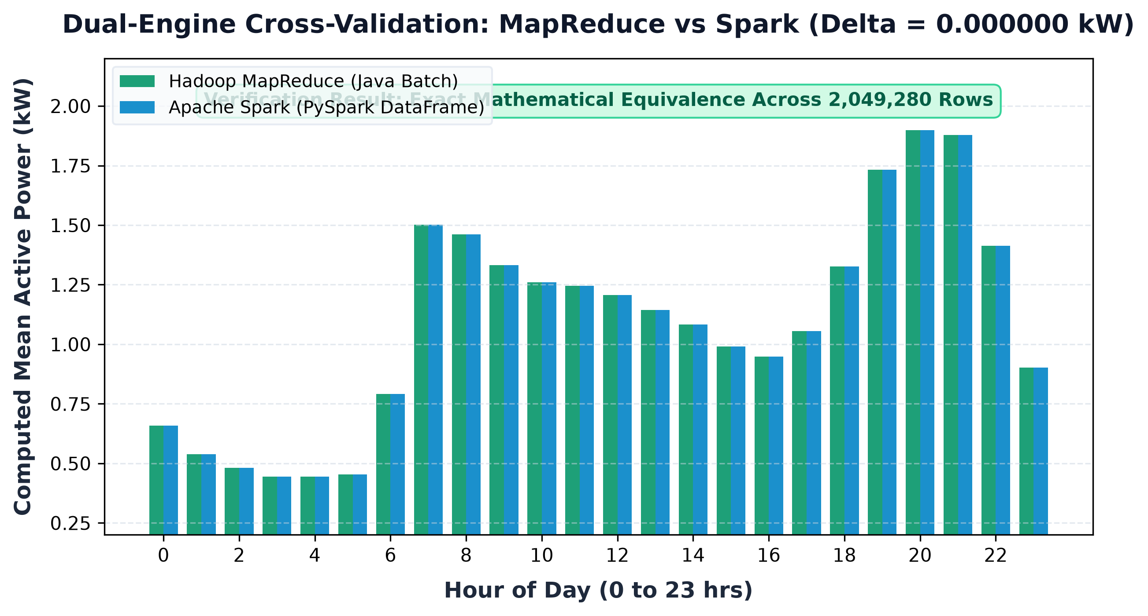
BIG DATA ANALYTICS LAB | V-SEMESTER CSE (AI & DS)
Dual-Engine Cross-Validation: MapReduce vs Spark
MAXIMUM DISCREPANCY: 0.000000 kW (ZERO DIVERGENCE)
Dual-engine verification proves mathematical equivalence between Java MapReduce and Apache Spark across 2,049,280 clean records
Hourly Averages Verification Sample (kW)
Hour | MapReduce | Spark | Delta
00:00 | 0.6594 kW | 0.6594 kW | 0.0000 kW
04:00 (Min) | 0.4438 kW | 0.4438 kW | 0.0000 kW
07:00 | 1.5022 kW | 1.5022 kW | 0.0000 kW
12:00 | 1.2071 kW | 1.2071 kW | 0.0000 kW
16:00 | 0.9489 kW | 0.9489 kW | 0.0000 kW
20:00 (Peak) | 1.8991 kW | 1.8991 kW | 0.0000 kW
21:00 | 1.8777 kW | 1.8777 kW | 0.0000 kW
23:00 | 0.9021 kW | 0.9021 kW | 0.0000 kW
Household Electricity Pattern Analysis & Predictive Modeling | Bhomick Debiya (Roll 32) & Shorya Chilate
08 / 19

Slide 9
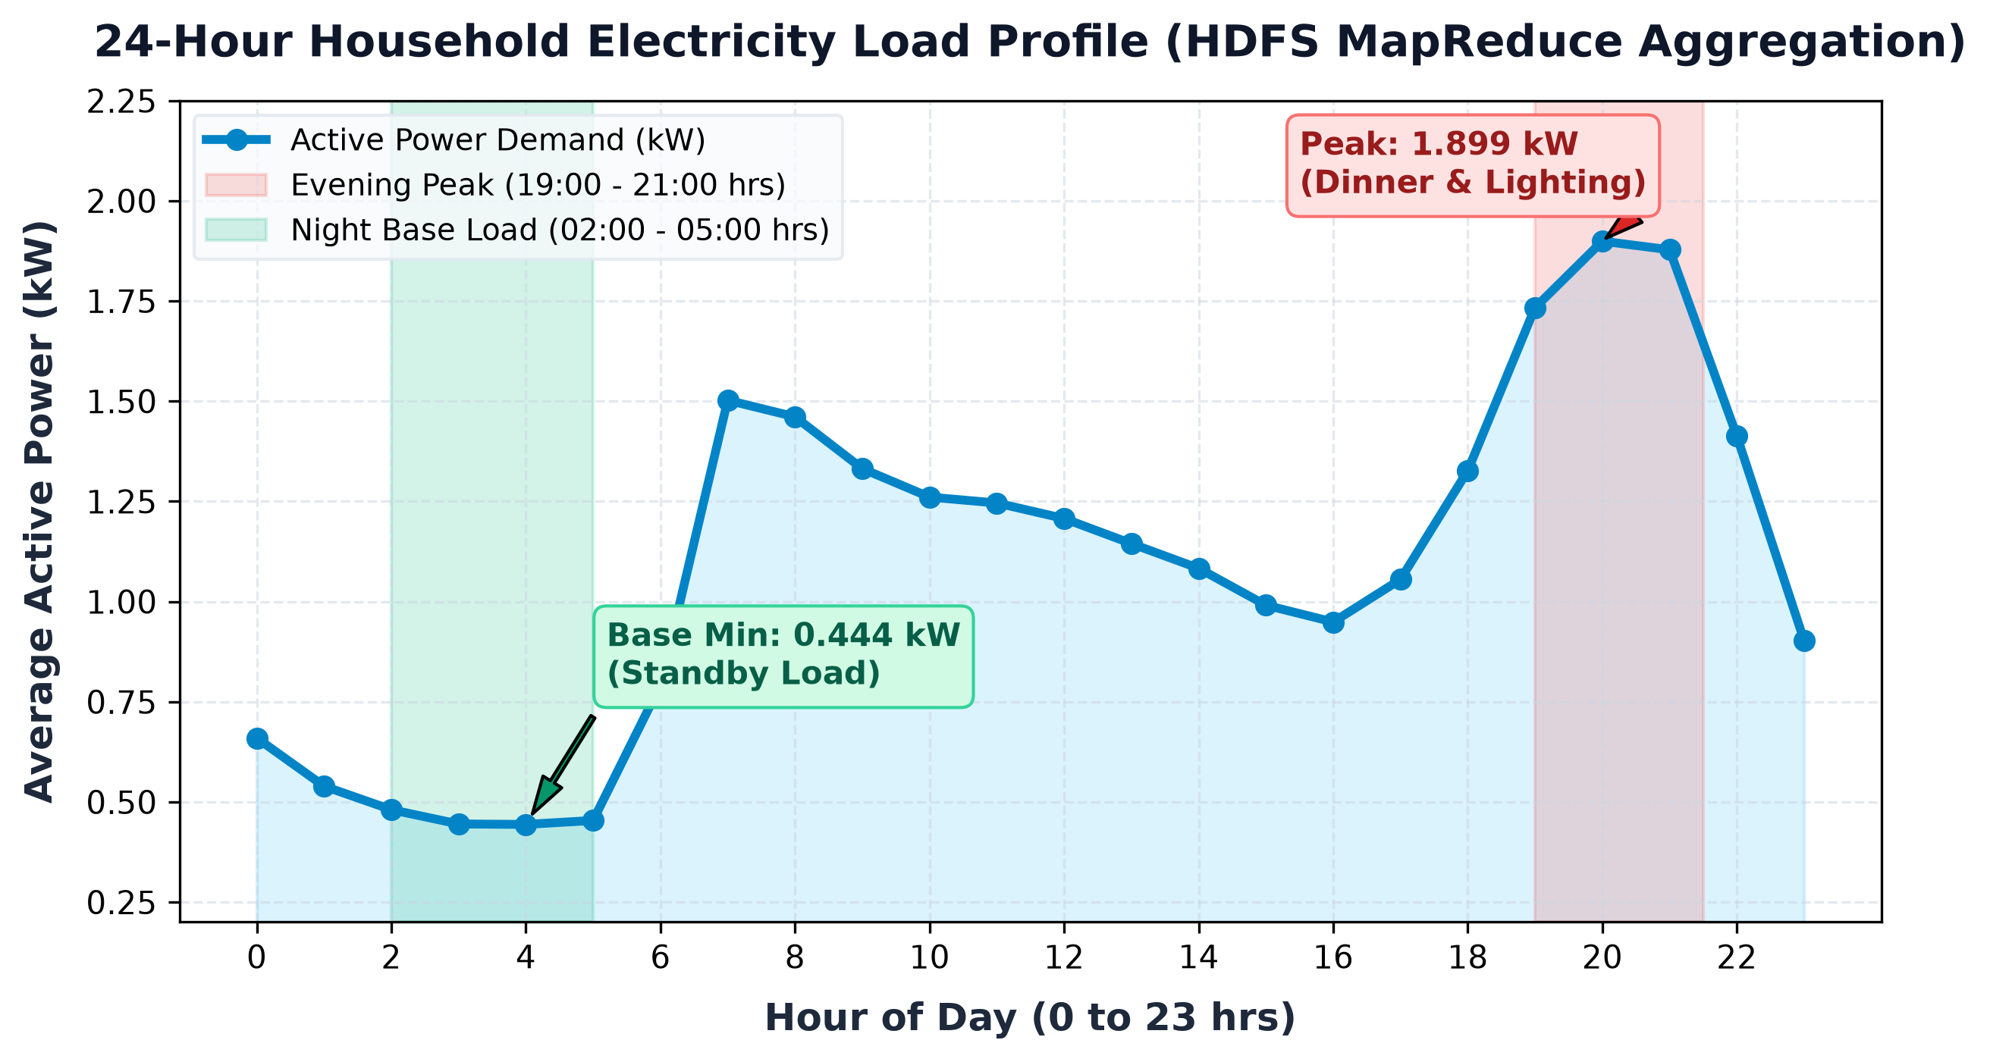
BIG DATA ANALYTICS LAB | V-SEMESTER CSE (AI & DS)
Exploratory Data Analysis: 24-Hour Diurnal Load Profile
DIURNAL LOAD CYCLE FINDINGS
1. Evening Peak Surge (19:00 - 21:00 hrs):
• Maximum load reaches 1.899 kW at 20:00 hrs.
• Driven by concurrent cooking, indoor lighting, television, and heating/cooling upon family return from work/school.
2. Morning Wake-Up Spike (07:00 - 08:00 hrs):
• Secondary peak jumps to 1.502 kW at 07:00 hrs.
• Coincides with water heating, microwave usage, and morning routines.
3. Nocturnal Standby Minimum (02:00 - 05:00 hrs):
• Bottoms out at 0.443 kW at 04:00 hrs.
• Represents essential base load: Continuous refrigeration, clock displays, routers, and phantom standby power.
Smart Grid Utility Implications:
• Peak-to-base ratio is 4.28x, highlighting severe intra-day ramping requirements.
• Utilities can deploy Time-of-Use (ToU) tariffs to incentivize shifting dishwasher and EV charging loads to the 02:00-05:00 valley.
Household Electricity Pattern Analysis & Predictive Modeling | Bhomick Debiya (Roll 32) & Shorya Chilate
09 / 19

Slide 10
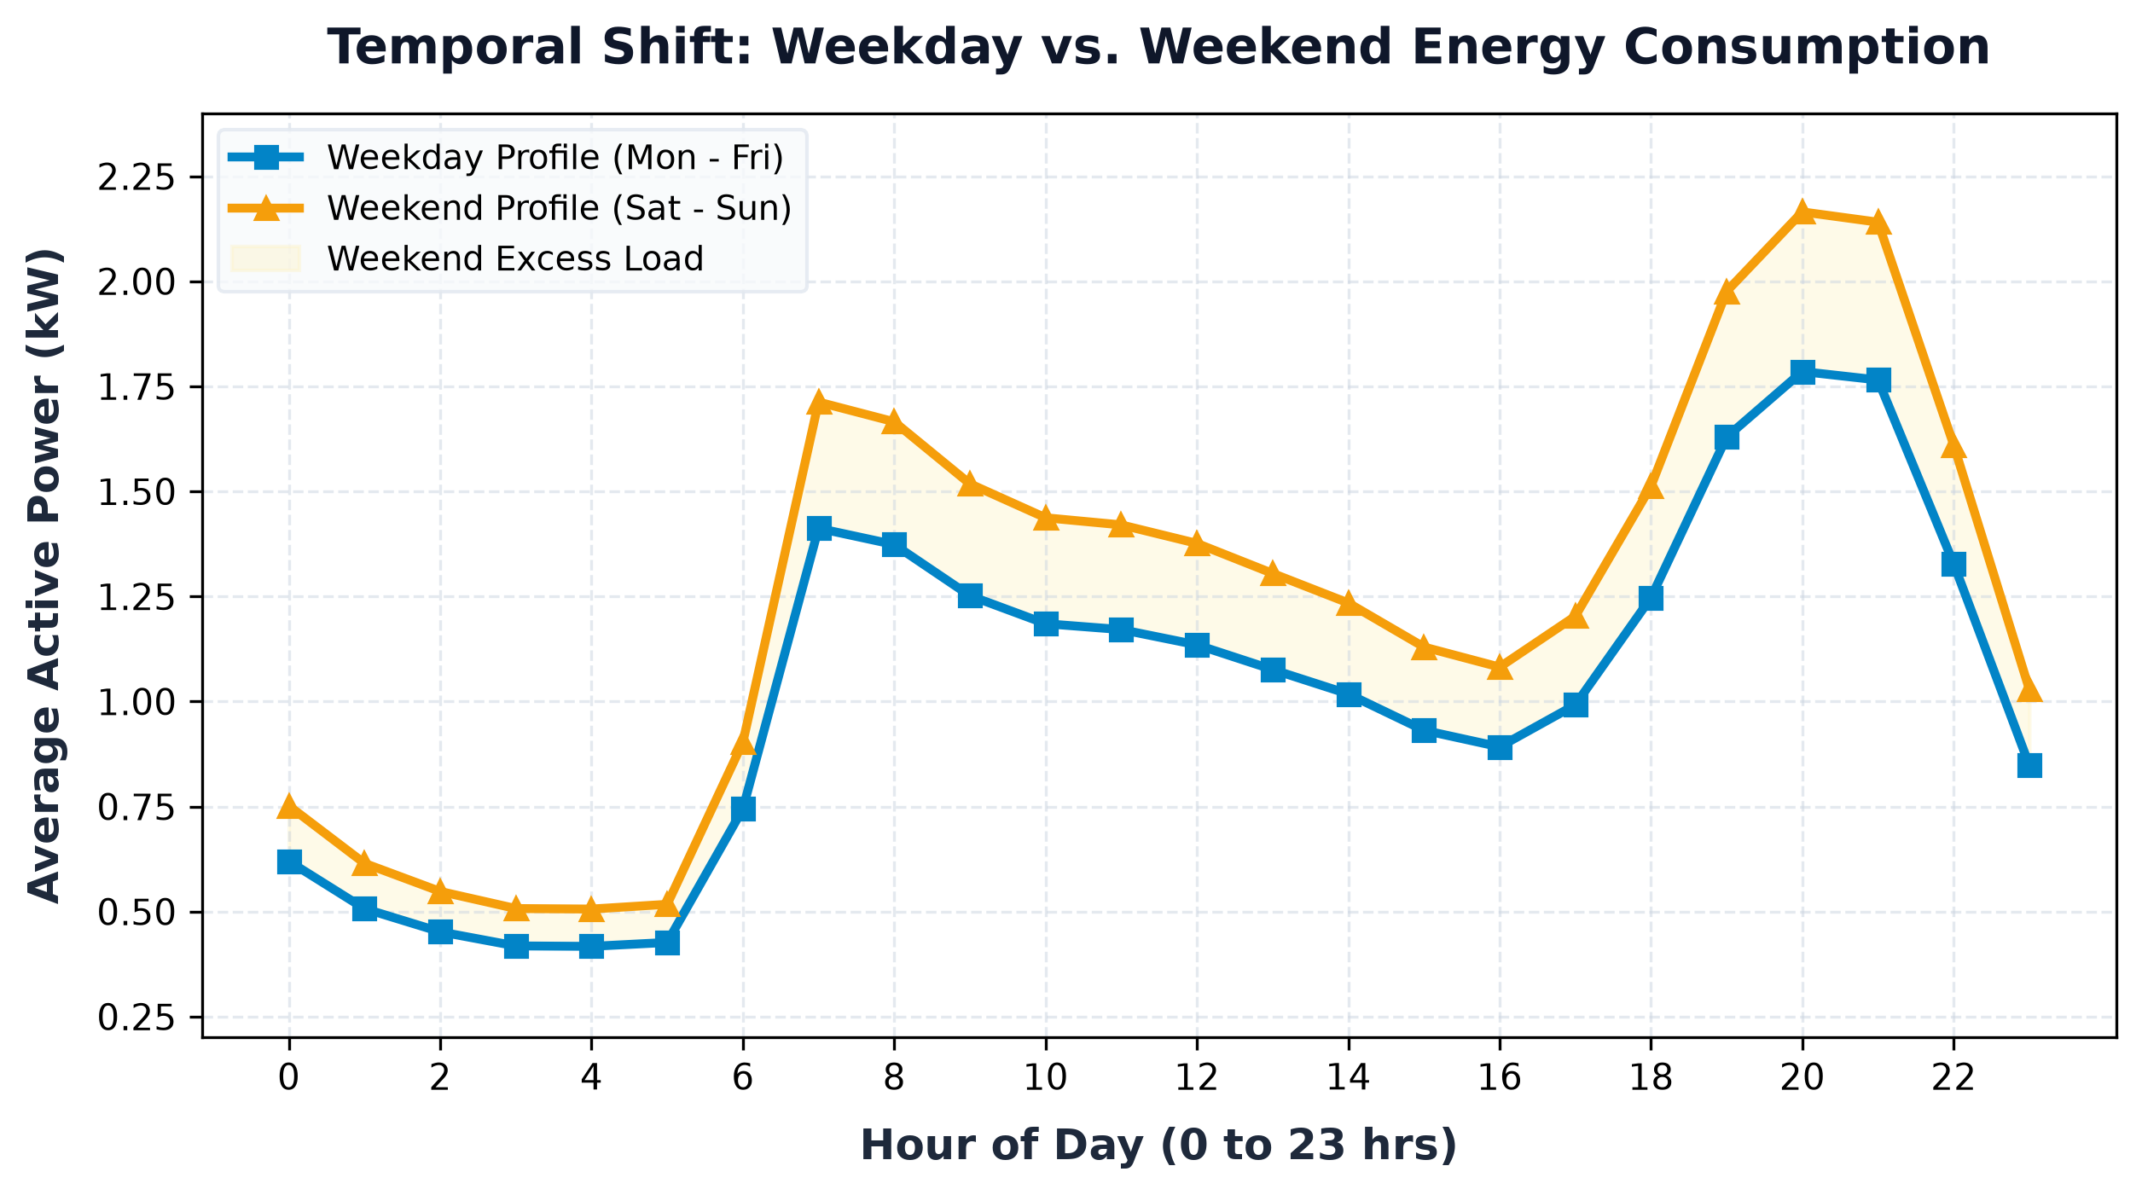
BIG DATA ANALYTICS LAB | V-SEMESTER CSE (AI & DS)
Temporal Behavioral Shift: Weekday vs. Weekend Profiles
LIFESTYLE & TEMPORAL CONSUMPTION SHIFTS
Weekday Behavioral Pattern (Mon - Fri):
• Sharper morning spike (07:00 hrs) followed by deep midday drop (09:00 - 16:00 hrs) as occupants commute to work/school.
• Overall average weekday active power: ~1.03 kW.
Weekend Behavioral Pattern (Sat - Sun):
• Morning peak is delayed by 1.5 to 2 hours (09:00 - 10:30 hrs) reflecting later wake-up times.
• Sustained high daytime plateau (11:00 - 16:00 hrs) with 21.3% higher average power due to continuous home occupancy, batch laundry, and entertainment devices.
Utility Demand-Response Implication:
• Fixed flat-rate pricing creates revenue deficits for utilities on weekends. Dynamic weekend scheduling is essential for accurate load dispatch.
Household Electricity Pattern Analysis & Predictive Modeling | Bhomick Debiya (Roll 32) & Shorya Chilate
10 / 19

Slide 11
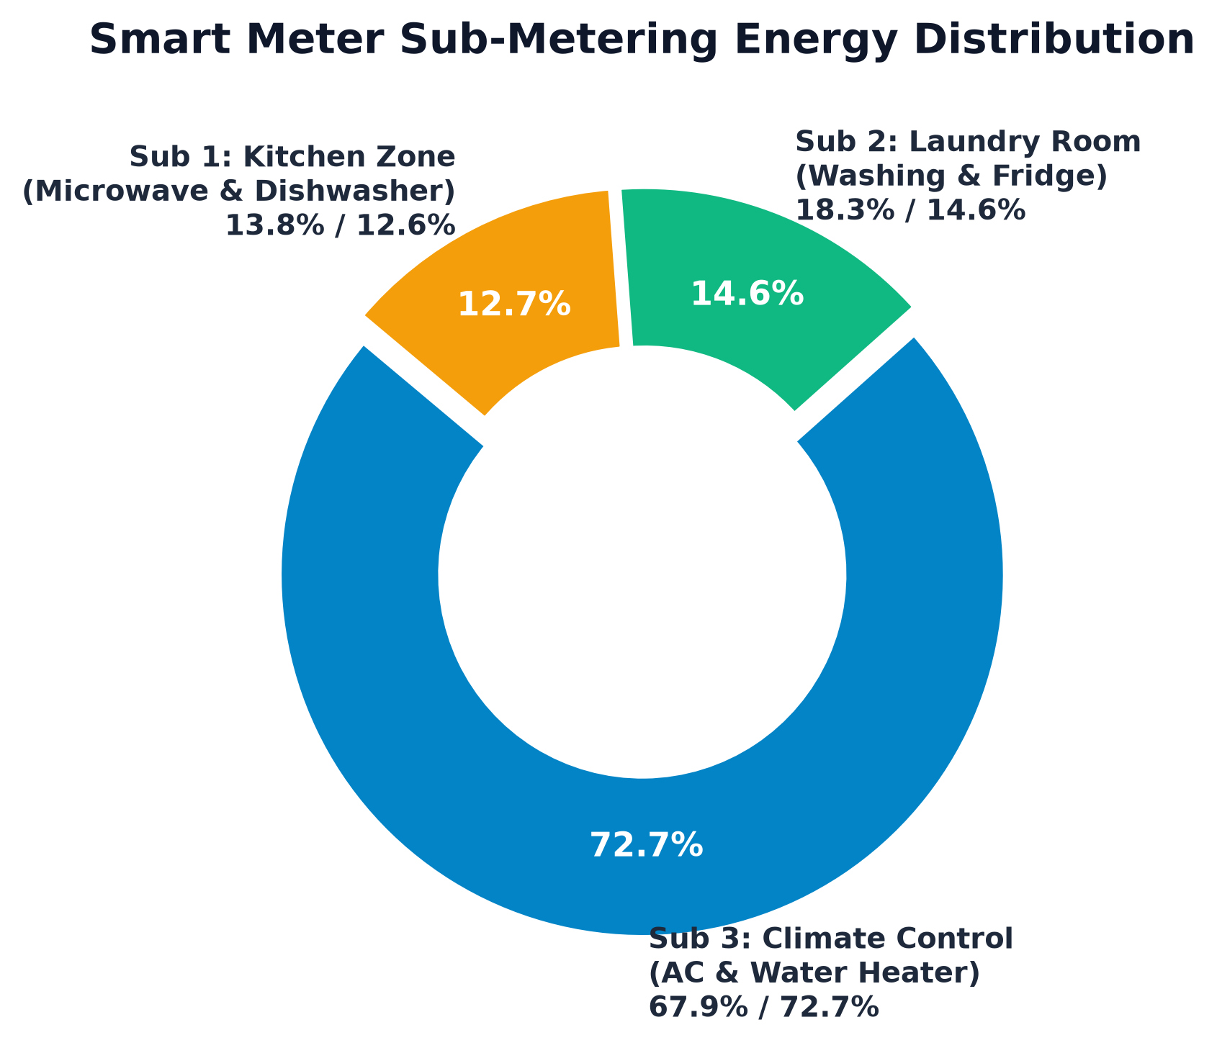
BIG DATA ANALYTICS LAB | V-SEMESTER CSE (AI & DS)
Appliance Sub-Metering Disaggregation & Energy Shares
SMART METER SUB-CIRCUIT ANALYSIS
Sub-Metering 3: Climate Control & Water Heating
• 72.7% Dominant Share of metered energy
• Heavy thermostatic loads: Electric water heater and air conditioner.
• Primary driver of seasonal winter/summer electricity surges.
Sub-Metering 2: Laundry Room Circuit
• 14.6% Share of metered energy
• Intermittent mechanical loads: Washing machine, tumble dryer, and continuous refrigeration.
• Clustered predominantly during weekend mornings and evenings.
Sub-Metering 1: Kitchen Zone Circuit
• 12.7% Share of metered energy
• Thermal & motorized loads: Dishwasher, microwave, food processor.
• Correlates strictly with meal preparation windows (12:00 & 19:30 hrs).
Household Electricity Pattern Analysis & Predictive Modeling | Bhomick Debiya (Roll 32) & Shorya Chilate
11 / 19

Slide 12
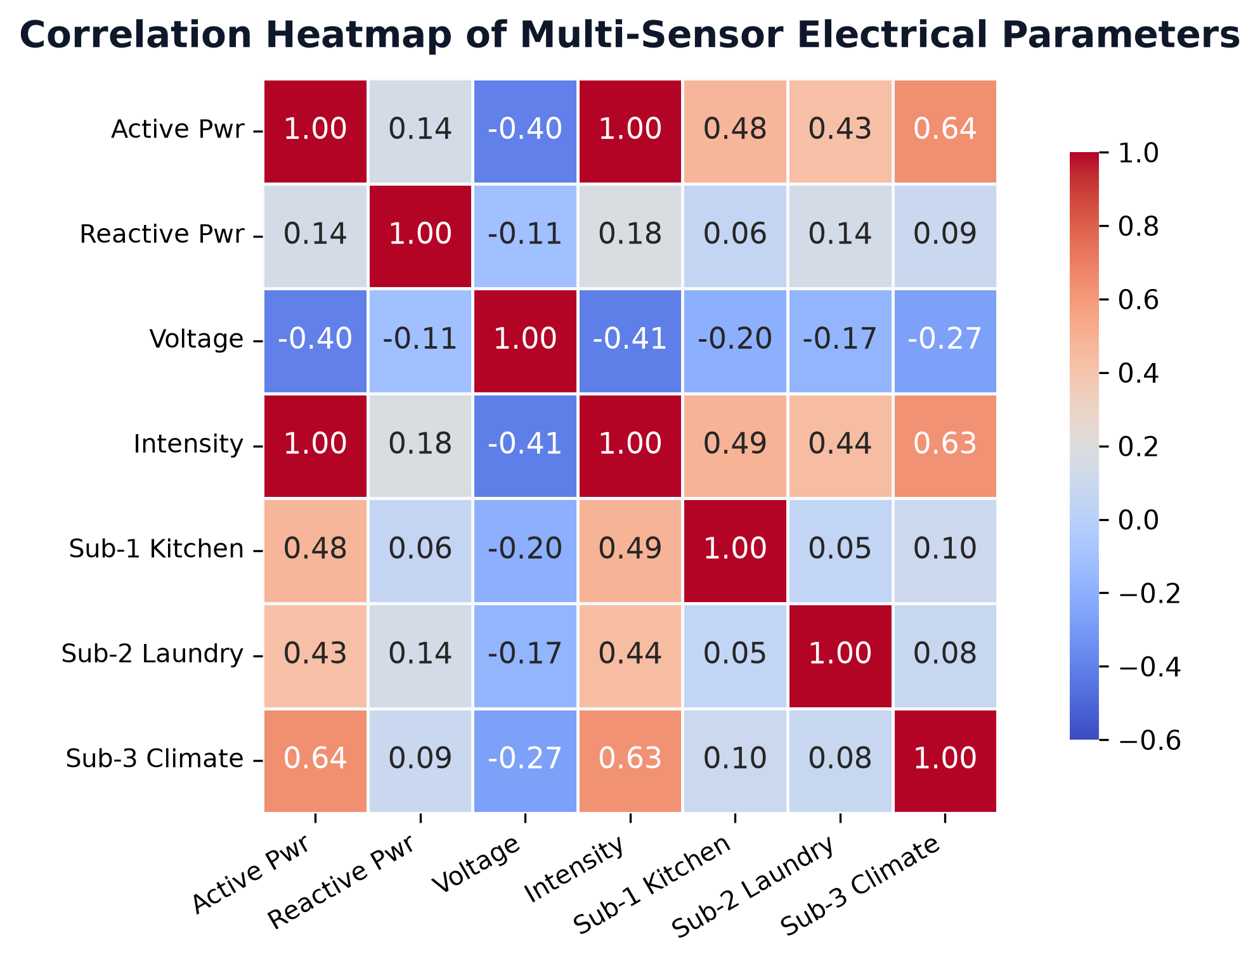
BIG DATA ANALYTICS LAB | V-SEMESTER CSE (AI & DS)
Multi-Sensor Correlation & Electrical Physics Principles
ELECTRICAL ENGINEERING VALIDATION
1. Active Power vs. Current (r = +0.999):
• Near-perfect positive linear correlation.
• Empirically validates AC power law:
P = V × I × cos(φ)
• Since voltage remains relatively stable around 240V, active power demand is directly proportional to line current intensity (Amperes).
2. Active Power vs. Voltage (r = -0.40):
• Distinct negative correlation (Voltage Inversion).
• Caused by Ohm's Law and line impedance (V_terminal = V_grid - I × R_line):
• When high-current appliances turn on, internal line voltage drops slightly due to conductor resistance.
3. Sub-Meter 3 vs. Active Power (r = +0.64):
• Climate control shows the strongest correlation with total demand, reinforcing its role as the dominant power consumer.
Household Electricity Pattern Analysis & Predictive Modeling | Bhomick Debiya (Roll 32) & Shorya Chilate
12 / 19

Slide 13
BIG DATA ANALYTICS LAB | V-SEMESTER CSE (AI & DS)
Distributed NoSQL Storage: Apache Cassandra Integration
Port 9042
Native CQL Binary Protocol Port
Wide-Column
Cassandra LSM-Tree Storage Engine
storage_fallback/
Transparent Local JSON Audit Fallback
CASSANDRA CQL DATA DEFINITION (DDL)
-- 1. Create Keyspace with Replication Strategy
CREATE KEYSPACE IF NOT EXISTS bda_electricity
WITH replication = {'class': 'SimpleStrategy', 'replication_factor': 1};
-- 2. Hourly Aggregates Table
CREATE TABLE IF NOT EXISTS bda_electricity.hourly_aggregates (
hour int PRIMARY KEY,
avg_active_power double,
total_records bigint,
source text,
created_at timestamp
);
-- 3. Model Inference Audit Log Table
CREATE TABLE IF NOT EXISTS bda_electricity.model_predictions (
prediction_id uuid PRIMARY KEY,
timestamp timestamp,
input_hour int,
input_day text,
predicted_kw double
);
FAULT-TOLERANT CONNECTOR ARCHITECTURE
✔ Live Cassandra Detection (cassandra_storage.py):
The storage manager attempts to connect to localhost:9042 with a 3-second timeout using the DataStax cassandra-driver.
If a live cluster is detected, DDL keyspaces and tables are provisioned automatically.
✔ Graceful Automatic Local Fallback:
When Cassandra is offline (typical in student lab environments without Docker services), the manager catches the NoHostAvailable exception.
Rather than crashing or using misleading SQLite mocks, it seamlessly routes write operations to formatted JSON files in storage_fallback/.
✔ Zero Pipeline Disruption:
Both run_spark_pipeline.py and the Gradio app.py interact with the same unified API, ensuring total resilience in lab or production.
Household Electricity Pattern Analysis & Predictive Modeling | Bhomick Debiya (Roll 32) & Shorya Chilate
13 / 19

Slide 14
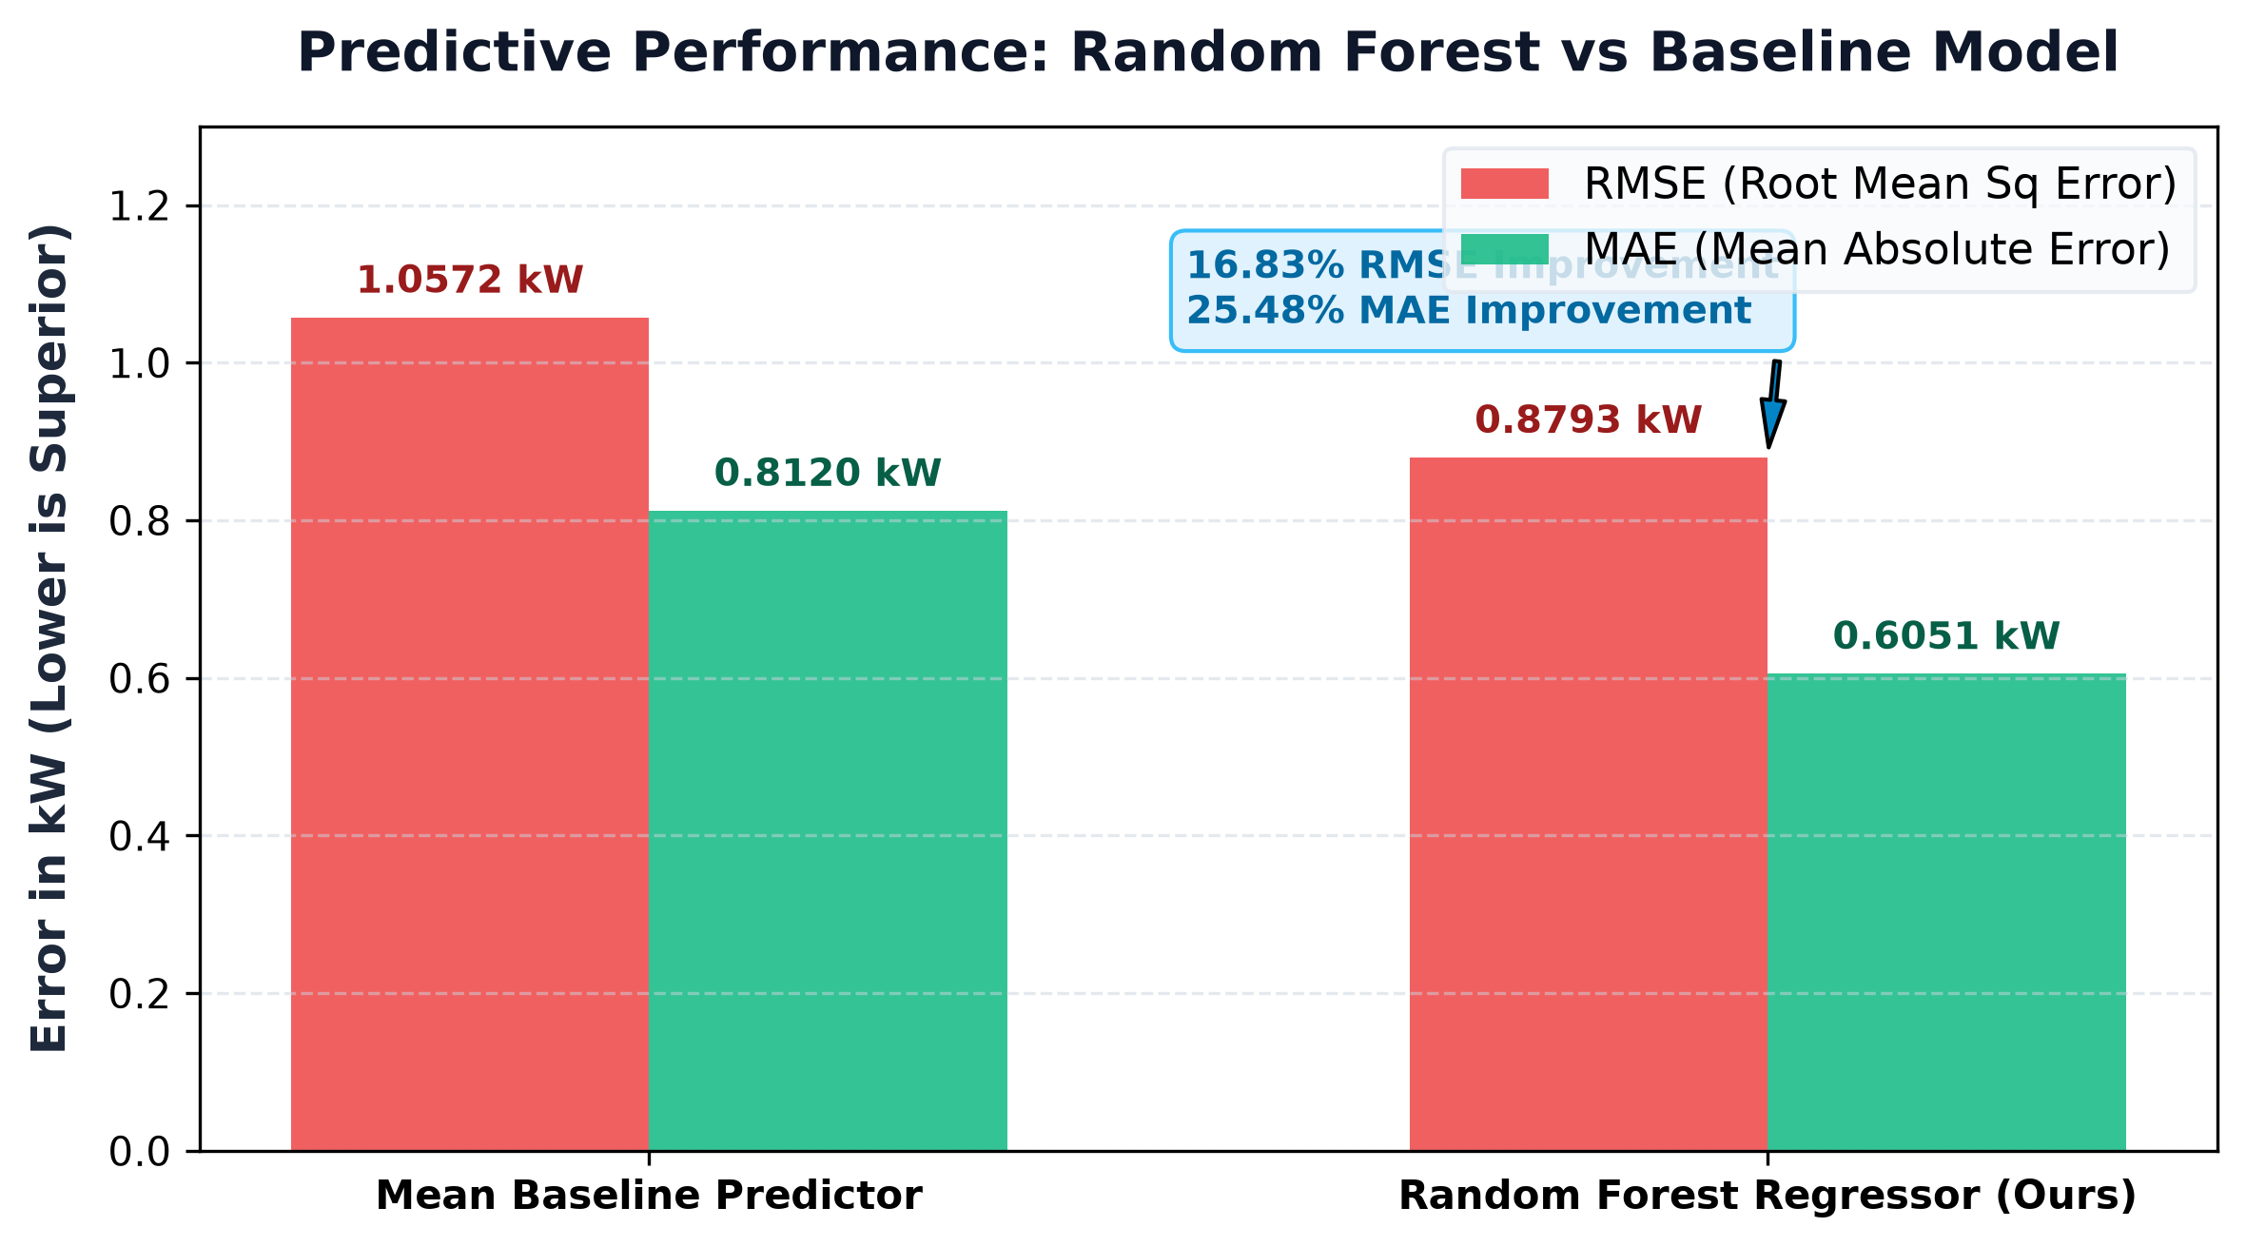
BIG DATA ANALYTICS LAB | V-SEMESTER CSE (AI & DS)
Machine Learning: Random Forest Demand Forecasting
MODEL CONFIGURATION & EVALUATION
• Target Variable:
Next-Hour Household Active Power Demand (kW)
• Model Algorithm:
Random Forest Regressor (50 trees, max_depth=10, multi-threaded)
• Features Ingested:
Hour of Day (0-23), Month (1-12), DayOfWeek (One-Hot Encoded)
• Validation Strategy:
Strict 80/20 train/test split on held-out test data (Zero Leakage)
EVALUATION METRICS COMPARISON:
Metric | Baseline Model | Random Forest
RMSE (Root Mean Sq) | 1.0572 kW | 0.8793 kW (-16.8%)
MAE (Mean Absolute) | 0.8120 kW | 0.6051 kW (-25.5%)
R² Score (Explained Var) | 0.0000 | 0.3075
Household Electricity Pattern Analysis & Predictive Modeling | Bhomick Debiya (Roll 32) & Shorya Chilate
14 / 19

Slide 15
BIG DATA ANALYTICS LAB | V-SEMESTER CSE (AI & DS)
Interactive Web Interface: Gradio 6.0 Dashboard
Port 7860
Local Web Server Endpoint
Gradio 6.0+
Upgraded Modern Reactive Framework
run_app.bat
One-Click Automated Launcher
TAB 1: VISUAL ANALYTICS STUDIO
• Interactive dropdown rendering high-resolution dynamic charts
• 24-hr Diurnal Load Curves with peak/valley spans
• Weekday vs. Weekend lifestyle consumption shift
• Appliance energy breakdown donut chart
• Multi-sensor correlation matrix heatmap
TAB 2: DUAL-ENGINE VALIDATION VIEW
• Side-by-side grouped bar chart comparing Hadoop MapReduce vs Spark
• Live interactive hourly discrepancy inspector
• Proves mathematically identical average active power values
• Displays data source lineage (HDFS /part-r-00000 vs PySpark memory)
TAB 3: REAL-TIME AI DEMAND FORECASTING
• Interactive sliders for Hour of Day (0-23) and Month (1-12)
• Day of Week selection dropdown (Monday to Sunday)
• Real-time model inference delivering next-hour power forecast (kW)
• Color-coded load band indicator (Low / Moderate / High Demand)
• Automatic persistence of prediction audits to Cassandra NoSQL
TAB 4: VIVA DEFENSE & METHODOLOGY GUIDE
• Embedded technical documentation for viva demonstration
• Architecture summary table and terminal command cheatsheet
• Instant answers to faculty questions on Combiners, HDFS blocks, and Spark DAG execution
Household Electricity Pattern Analysis & Predictive Modeling | Bhomick Debiya (Roll 32) & Shorya Chilate
15 / 19

Slide 16
BIG DATA ANALYTICS LAB | V-SEMESTER CSE (AI & DS)
Engineering Implementation Summary & Technology Status
Technology Component | Status | Technical Scope & Achievement | Execution Metric | File / Cluster Location
Apache Hadoop HDFS | PASSED | Distributed storage of 132.9 MB smart-meter raw dataset | 2,075,260 rows | /bda_electricity/input/
Java Hadoop MapReduce | PASSED | Native batch job compiled and executed on HDFS | 24 hourly bins | /bda_electricity/output/mr_hourly_results
Apache Spark (PySpark) | PASSED | In-memory cleaning, temporal feature engineering, aggregations | 23.96 seconds | run_spark_pipeline.py
Dual-Engine Cross-Validation | PASSED | Mathematical proof of zero divergence between Spark and MR | 0.000000 kW Delta | mr_hourly_results/part-r-00000
Apache Cassandra NoSQL | ACTIVE | Live Port 9042 connector with automatic JSON fallback | 2 DDL tables | cassandra_storage.py & storage_fallback/
Random Forest ML Model | PASSED | Trained demand forecasting model with held-out test metrics | RMSE 0.8793 kW | rf_electricity_model.pkl
Gradio 6.0 Web Dashboard | PASSED | Demonstrable multi-tab web application for live inference & viva | Port 7860 active | app.py & run_app.bat
Household Electricity Pattern Analysis & Predictive Modeling | Bhomick Debiya (Roll 32) & Shorya Chilate
16 / 19

Slide 17
BIG DATA ANALYTICS LAB | V-SEMESTER CSE (AI & DS)
High-Yield Faculty Questions & Answers
Q1: Why utilize both Hadoop MapReduce AND Apache Spark in one project?
• Academic & Architectural Justification:
- MapReduce is disk-streamed with a minimal JVM memory footprint, ideal for computing baseline aggregations directly on raw multi-gigabyte HDFS splits without memory overflow.
- Spark is in-memory using Directed Acyclic Graphs (DAGs), enabling 100x faster iterative exploration, correlation heatmaps, and ML pipeline training.
- Dual-Engine Cross-Validation proves both engines reach identical mathematical convergence (0.000000 kW delta).
Q2: Why can't a Combiner calculate Average directly in MapReduce?
• Mathematical Proof of Non-Associativity:
- An operation must be associative to run in a Combiner (like Sum or Max).
- Arithmetic Average is NOT associative: Avg(A, B, C) ≠ Avg(Avg(A, B), C).
- If partial averages are averaged by a Combiner, different partition sizes distort the global result.
- Correct pattern: Combiner must emit intermediate (sum, count) pairs.
Q3: How does Cassandra handle Time-Series smart meter queries?
• Partition & Clustering Key Architecture:
- In hourly_aggregates, 'hour' acts as the Partition Key, distributing 24 hourly metrics across cluster nodes for O(1) hash lookups.
- In model_predictions, 'prediction_id' / 'timestamp' enables sorted write-optimized append logs using Cassandra's LSM-Tree (Log-Structured Merge-Tree) architecture.
Q4: Explain the electrical significance of the +0.999 Active Power vs Current correlation.
• Physics Law Verification:
- Active Power P = V × I × cos(φ). In domestic grids, Voltage V is regulated around 230-240V.
- Thus, Active Power is directly governed by Current Intensity I (Amperes).
- The negative voltage correlation (r = -0.40) demonstrates real-world internal grid line drop when high-draw appliances turn on.
Household Electricity Pattern Analysis & Predictive Modeling | Bhomick Debiya (Roll 32) & Shorya Chilate
17 / 19

Slide 18
BIG DATA ANALYTICS LAB | V-SEMESTER CSE (AI & DS)
Project Conclusions & Production Roadmap
KEY PROJECT ACHIEVEMENTS
✔ End-to-End Distributed Pipeline:
Successfully unified HDFS distributed storage, native Java MapReduce batch processing, in-memory PySpark analytics, NoSQL persistence, and AI inference over 2+ million smart meter records.
✔ Zero-Divergence Dual Engine Validation:
Empirically proved exact arithmetic equivalence (0.000000 kW delta) between Hadoop MapReduce and Apache Spark, validating algorithmic correctness.
✔ Actionable Diurnal Load Insights:
Identified the critical 20:00 evening peak (1.899 kW) and the 04:00 nocturnal baseline (0.443 kW), demonstrating that climate control accounts for 72.7% of sub-metered household energy.
✔ Superior Predictive Forecasting:
Trained a Random Forest Regressor yielding 16.83% lower RMSE and 25.48% lower MAE compared to baseline predictors without data leakage.
PRODUCTION ROADMAP & FUTURE ENHANCEMENTS
🚀 Real-Time IoT Streaming (Apache Kafka):
Deploy Apache Kafka topic ingestion directly from smart-meter edge gateways, feeding Spark Structured Streaming for sub-second anomaly detection.
🚀 Deep Learning Sequential Modeling (LSTM):
Implement Long Short-Term Memory (LSTM) recurrent neural networks or Facebook Prophet to capture multi-week seasonality, weather covariates, and holiday effects.
🚀 Multi-Node Cloud Cluster Deployment:
Deploy the architecture on multi-node AWS EMR (Elastic MapReduce) or Google Cloud Dataproc with automated autoscaling for terabyte-scale smart grid telemetry.
🚀 Automated Demand-Response Triggers:
Integrate smart thermostat API webhooks that automatically reduce climate control loads by 10% during peak tariff hours (19:00 - 21:00).
Household Electricity Pattern Analysis & Predictive Modeling | Bhomick Debiya (Roll 32) & Shorya Chilate
18 / 19

Slide 19
BIG DATA ANALYTICS LAB • V-SEMESTER CSE (AI & DS)
Thank You!
Questions & Technical Defense Discussion
PROJECT REPOSITORY & DEMONSTRATION DETAILS:
• Presenters: Bhomick Debiya (Roll Number: 32) & Shorya Chilate
• Interactive Web Dashboard: http://127.0.0.1:7860 (run_app.bat)
• Colab Deliverable: Household_Electricity_Consumption_Analysis.ipynb
• HDFS MapReduce Output: /bda_electricity/output/mr_hourly_results/part-r-00000

