Slide 1
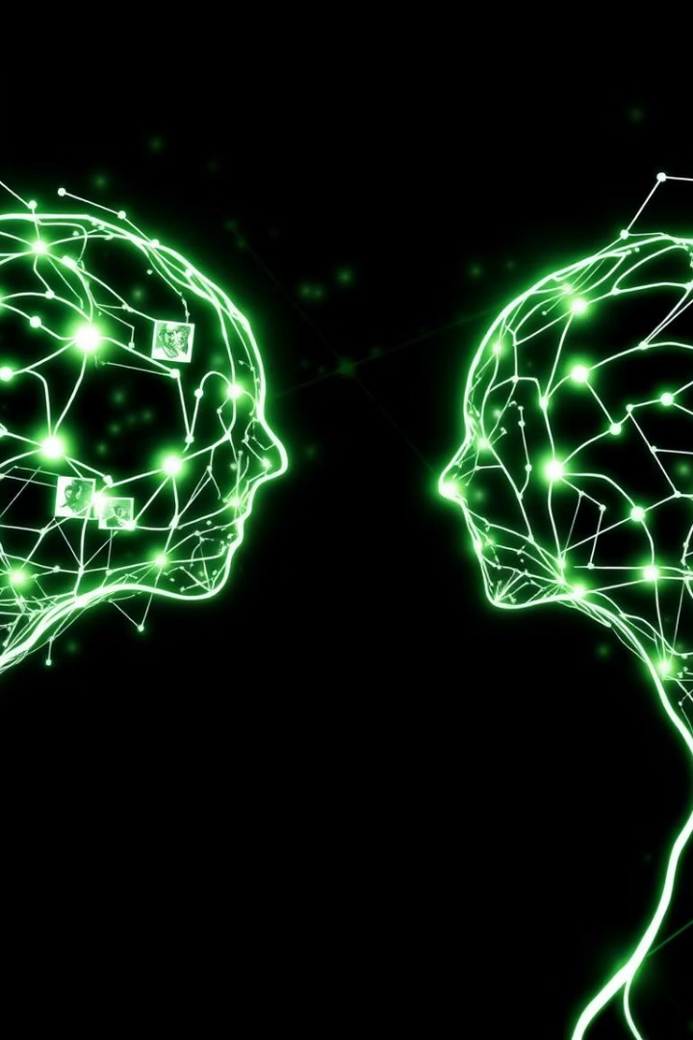
DEEP LEARNING AND REINFORCEMENT LEARNING
Simple Deep Convolutional GAN (DCGAN) on Fashion-MNIST
S N Lalithya 1BG23CS125
R Bhoomika Jain 1BG23CS112

Slide 2
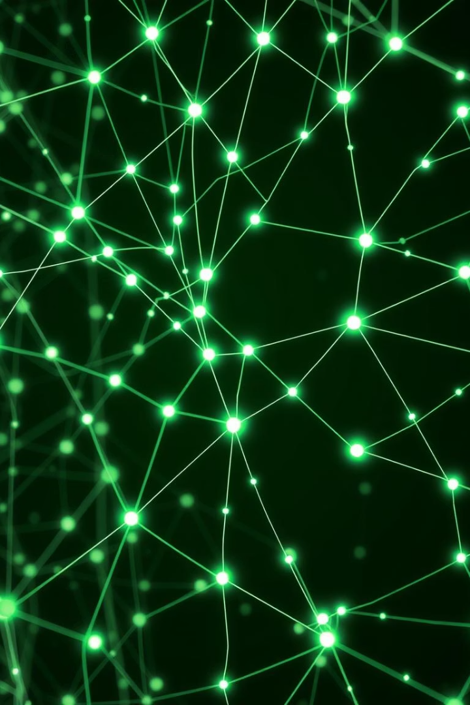
Simple Deep Convolutional GAN (DCGAN) on Fashion-MNIST
This presentation details the implementation of a Deep Convolutional Generative Adversarial Network (DCGAN) from scratch. Our objective is to generate realistic images of clothing using the Fashion-MNIST dataset. This project explores the core concepts of GANs, including the Generator and Discriminator, and the nuances of adversarial training, which is crucial for stabilizing the network and producing high-quality outputs. We will delve into the methodology, challenges, and exciting outcomes of this deep learning endeavor.

Slide 3



Project Objective: Generating Fashion Imagery
Implement DCGAN from Scratch
Build a complete Deep Convolutional Generative Adversarial Network architecture without relying on high-level GAN libraries.
Generate Clothing Images
Train the DCGAN on the Fashion-MNIST dataset to produce novel and realistic images of various apparel items.
Stabilize Adversarial Training
Address the inherent challenges of GAN training to achieve convergence and generate high-quality, diverse samples.
The primary objective of this project is to implement a Deep Convolutional GAN (DCGAN) from the ground up. This involves designing and building both the Generator and Discriminator networks, and then training them in an adversarial fashion. The ultimate goal is to generate new, convincing images of clothing, expanding beyond the original dataset. A key challenge, and thus a core objective, is to achieve stable adversarial training, which is notorious for its complexity in GANs.

Slide 4
Methodology and Workflow
Dataset Loading & Preprocessing
Utilize tensorflow_datasets.load('fashion_mnist') to access the dataset. Normalize pixel values to the range [-1, 1] for optimal GAN performance. Reshape images as needed for convolutional layers.
Discriminator Network Design
Build a convolutional neural network that classifies input images as real or fake. Employ Strided Convolutions for downsampling and Leaky ReLU activations.
1
2
3
4
Generator Network Design
Adversarial Training Loop
Construct a deconvolutional neural network that takes a latent space vector as input and upsamples it to generate an image. Use Batch Normalization and Leaky ReLU activations.
Implement a custom training loop where the Discriminator and Generator are updated iteratively. Use binary cross-entropy for loss functions and Adam optimizers for both networks.
Our methodology centers on a meticulous workflow. We begin by loading and preprocessing the Fashion-MNIST dataset, normalizing image data to optimize it for neural network input. Next, we design the Generator, a deconvolutional network responsible for synthesizing images from random noise vectors. Simultaneously, the Discriminator is engineered as a convolutional network, tasked with distinguishing between real and generated images. The core of our approach is the adversarial training loop, where both networks are continuously refined in a competitive dance, improving each other over many epochs.

Slide 5
Key Assumptions for DCGAN Implementation
Sufficient Data Quality
Discriminator Learning Capacity
Generator Learning Stability
Hyperparameter Optimization
The Fashion-MNIST dataset provides enough diversity and quality for the GAN to learn meaningful representations of clothing, despite its relatively low resolution (28x28 pixels).
The Discriminator is assumed to have sufficient capacity to distinguish real from fake images without overfitting to the training data too quickly, which would collapse the Generator.
The Generator is assumed to be able to learn to produce increasingly realistic images without mode collapse (generating only a limited variety of outputs) or instability during training.
Assumes that appropriate hyperparameters (learning rates, batch sizes, latent dimension, optimizer settings) can be found to ensure stable and effective training convergence for both networks.
Successful DCGAN implementation hinges on several key assumptions. We assume that the Fashion-MNIST dataset, despite its simplicity, contains enough inherent structure for the GAN to learn and replicate fashion patterns. Crucially, we assume the Discriminator possesses the learning capacity to effectively differentiate between real and generated images without becoming too powerful too quickly, which could hinder the Generator's progress. Conversely, we also assume the Generator can learn to produce diverse and realistic outputs without encountering issues like mode collapse. Finally, we anticipate that tuning hyperparameters will lead to stable training, a vital aspect for any GAN.

Slide 6
Model Evaluation and Analysis
Visual Inspection of Generated Images
Monitoring Loss Curves
Inception Score / FID Score (Conceptual)
Analyze the Generator and Discriminator loss over epochs. Aim for a stable, oscillating pattern rather than one dominating the other, indicating balanced training.
Qualitative assessment of image realism, diversity, and coherence. Look for identifiable clothing features and absence of artifacts or noise.
While not directly calculated in this basic implementation, understanding these metrics (measuring image quality and diversity) informs the theoretical evaluation of generated samples.
Evaluation of our DCGAN primarily involves both qualitative and quantitative analysis. Visually inspecting the generated images is critical; we assess their realism, diversity, and the absence of common GAN artifacts. Furthermore, monitoring the loss curves for both the Generator and Discriminator provides insight into the training dynamics. An ideal scenario sees both losses oscillating in a balanced manner, indicating a healthy adversarial process. Though not explicitly implemented, the conceptual understanding of metrics like Inception Score and FID Score guides our interpretation of image quality and diversity.

Slide 7
Project Summary and Outcomes
Successful DCGAN Implementation: We successfully built and trained a DCGAN model capable of generating new images of clothing from the Fashion-MNIST dataset.
Adversarial Training Insights: Gained practical experience in managing the delicate balance of adversarial training, observing the Generator and Discriminator's competitive learning process.
Generated Image Quality: The model produced recognizable, albeit sometimes abstract, fashion items, demonstrating its ability to learn underlying data distributions.
Learning on Unsupervised Generation: Reinforced understanding of unsupervised learning techniques for image generation, a cornerstone of modern deep learning.
In summary, this project culminated in a functional DCGAN implementation, demonstrating the power of generative adversarial networks for image synthesis. We gained invaluable hands-on experience with the intricate process of adversarial training, navigating its inherent challenges to achieve stable learning. The generated images, while not always photorealistic, clearly resembled fashion items, validating the model's capacity to learn complex visual features from the dataset. This endeavor significantly deepened our understanding of unsupervised image generation techniques within the deep learning paradigm.

Slide 8




Future Improvements and Extensions
Larger Datasets
Advanced GAN Architectures
Quantitative Evaluation
Image Inpainting/Outpainting
Train on higher-resolution datasets like CelebA or LSUN for more detailed and realistic image generation.
Implement and utilize metrics such as Inception Score (IS) or Fréchet Inception Distance (FID) for objective comparison and tracking of model performance.
Explore Progressive GANs (PGGAN), StyleGAN, or Conditional GANs (CGAN) for improved generation quality and control.
Extend the GAN's capabilities to fill in missing parts of images or generate content beyond existing boundaries, leveraging learned distributions.
Looking ahead, several avenues exist for enhancing this DCGAN project. Training on larger, higher-resolution datasets would significantly improve image quality and realism. Experimenting with more advanced GAN architectures, such as PGGAN or StyleGAN, could yield breakthrough results in terms of image fidelity and diversity. Incorporating quantitative evaluation metrics like Inception Score or FID would provide objective benchmarks for progress. Furthermore, extending the model's capabilities to tasks like image inpainting or outpainting would demonstrate a deeper understanding of image synthesis.

Slide 9
Reflections and Learning Outcomes
This project was an incredibly insightful journey into the heart of generative models. Here are some key takeaways:
Convolutional Architecture Deep Dive
GAN Training Nuances
Solidified understanding of convolutional and deconvolutional layers, batch normalization, and activation functions in practical application.
Grasped the complexities of balancing Generator and Discriminator training, including common pitfalls like mode collapse and non-convergence.
Problem-Solving in Deep Learning
Unsupervised Learning Power
Developed critical problem-solving skills, particularly in debugging and fine-tuning models to achieve desired generative outcomes.
Appreciated the ability of GANs to learn intricate data distributions without explicit labels, opening doors to diverse applications.
Undertaking this DCGAN project offered profound insights into generative deep learning. We gained a firsthand appreciation for the delicate balance required in GAN training and learned to mitigate common issues like mode collapse. The hands-on construction of convolutional and deconvolutional networks deepened our understanding of their architectural nuances. Most importantly, it highlighted the immense power of unsupervised learning in generating complex data, reinforcing our problem-solving abilities within the dynamic field of deep learning.

