Slide 1
Secure Data Hiding In Images Using Steganography
CAPSTONE PROJECT
Presented By: Bhoomi Mehta
Student Name : Bhoomi Mehta
College Name & Department : JK Lakshmipat University / Bachelor’s in Computer Science

Slide 2
OUTLINE
Problem Statement
Technology used
Wow factor
End users
Result
Conclusion
Git-hub Link
Future scope

Slide 3
Problem Statement
In the digital era, safeguarding data security and privacy is crucial. Conventional encryption techniques are vulnerable to detection and interception. Our project addresses this issue by employing steganography to conceal secret messages within images. This approach provides a discreet communication channel, enhancing data confidentiality while avoiding suspicion.

Slide 4
Technology used
Programming Language: Python
Libraries:
OpenCV for image processing and manipulation.
OS operations(os) for file and directory operations.
String manipulation(string) for string handling and character sets.
Platform: Windows
Tools: Visual Studio Code

Slide 5
Wow factors
Implements secure LSB steganography by embedding the passcode and message length in the image header.
Utilizes lossless PNG format to maintain hidden data integrity.
Offers a modern, user-friendly GUI for seamless encryption and decryption.
Integrates advanced image processing for secure data transmission.

Slide 6
End users
Cybersecurity professionals and ethical hackers.
Students, researchers, and educators exploring data privacy and steganography.
General users seeking enhanced digital security.
Journalists, activists, and government agencies needing discreet communication.
Businesses and organizations requiring secure data transmission.

Slide 7
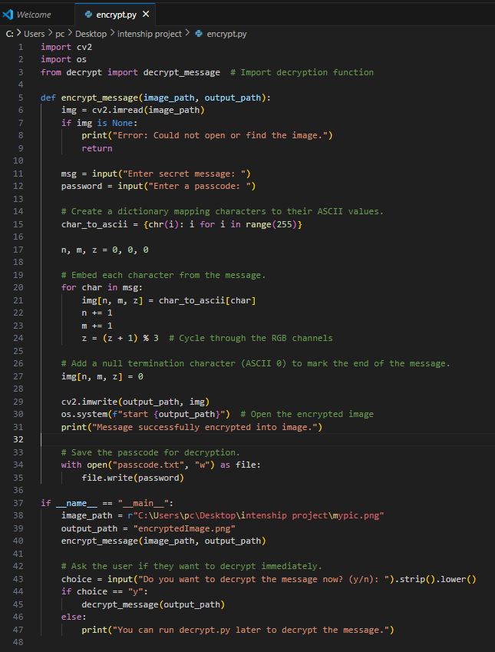
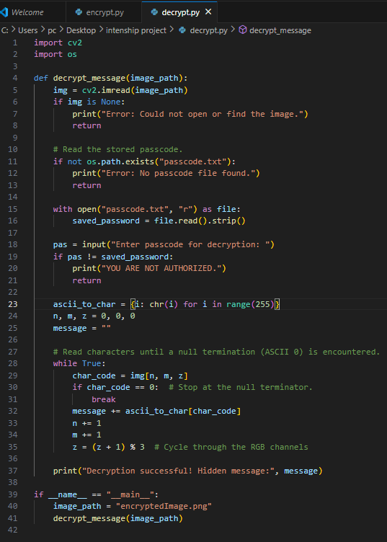
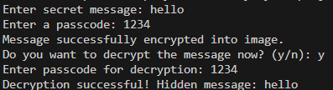
Results

Slide 8
Conclusion
Our project showcases a secure approach to data protection by embedding information within images using LSB steganography.
By incorporating critical header details like passcodes and message lengths, the technique remains discreet and effective.
The intuitive GUI ensures ease of use, making it a practical tool for secure communication.
This work contributes to the advancement of digital privacy and data security.

Slide 9
GitHub Link
https://github.com/Bhoomi2004/Steganography-Project.git

Slide 10
Future scope(optional)
Integrate stronger encryption algorithms to enhance message security.
Implement real-time steganographic analysis for automated detection and extraction.
Enable support for multiple image formats and ultra-high-resolution images.
Develop a web-based or mobile application for broader accessibility.
Optimize performance to ensure minimal image distortion and faster processing.

Slide 11
THANK YOU

