Slide 1
DEPARTMENT OF INFORMATION SCIENCE & ENGINEERING
Give an example of a data structure or algorithm where amortized analysis provides a more realistic understanding of its performance than worst-case analysis of individual operations.
Presented By:
Angelica Singh:1DS23IS018
Ayush Singh: 1DS23IS028 Aryan Angral:1DS23IS024 Akshata C H: 1DS23IS014
Under the guidance of:
Prof. Praveen N Dept of ISE,DSCE, Banglore

Slide 2
CONTENTS
Abstract
Introduction
Literature survey
Problem statement
Hardware & software requirement specification
System design & Methodology
7.Implementation
8.Testing
9.References
.
.

Slide 3
ABSTRACT
This project examines amortized analysis using dynamic arrays as a case study.
Dynamic arrays resize by doubling their capacity, leading to occasional high-cost operations.
Worst-case analysis suggests O(n) time per append, which is misleading.
Amortized analysis reveals an average O(1) time per append over a sequence of operations.

Slide 4
INTRODUCTION
Amortized analysis provides an average-case performance measure over a sequence of operations.
Dynamic arrays, used in Python lists and Java ArrayLists, are a classic example.
The append operation in dynamic arrays can trigger resizing, which is costly.
Worst-case analysis overestimates the cost, making the data structure seem inefficient.
This project aims to simulate dynamic array operations and analyze their performance.
2

Slide 5
SURVEY OF EXISTING SYSTEMS
Studied NIST’s post-quantum cryptography standards (2016-2023) for quantum-safe algorithms.
Analyzed quantum algorithms like Shor’s algorithm for breaking RSA and ECC encryption.
Explored existing tools like OpenQuantumSafe and Liboqs for quantum-safe migration strategies.
Investigated TensorFlow-based AI models for pattern recognition in encryption analysis.
Surveyed industry reports on the impact of quantum computing on global cybersecurity.
3

Slide 6
PROBLEM STATEMENT
Cormen et al., "Introduction to Algorithms" (2009), discusses amortized analysis techniques.
Tarjan (1985) introduced amortized analysis for data structures like splay trees and dynamic arrays.
Studied Python’s list implementation, which uses a doubling strategy for resizing (Python Docs, 2023).
Knuth’s "The Art of Computer Programming" (1997) explores array resizing strategies.
4

Slide 7
Hardware & Software Requirement Specification
Hardware: Minimum 8GB RAM, Intel i5 processor (10th Gen), 256GB SSD for storage.
Software: Python 3.9 for backend, TensorFlow 2.10 for AI, React 18 for frontend, Node.js 16 for runtime.
OS Compatibility: Windows 10/11 or Linux (Ubuntu 20.04) for development and deployment.
Additional Tools: Git for version control, VS Code for coding, Docker for containerized deployment.
Optional: GPU (NVIDIA CUDA-enabled) for faster AI model training and inference.

Slide 8
SYSTEM DESIGN & METHODOLOGY
Architecture: Frontend (React for UI), Backend (Python Flask for APIs), AI Module (TensorFlow).
Methodology: Agile development with 2-week sprints for iterative feature implementation.
AI Module: Scans encryption protocols, identifies vulnerabilities, and suggests quantum-safe alternatives.
Data Flow: Input encryption data -> AI analysis -> Recommendation generation -> Migration plan.
Design Focus: Scalability, modularity, and user-centric interface for easy navigation.
6

Slide 9
Implementation
Developed a dynamic array class in Python with append and resize functionality.
Resizing strategy doubles the capacity when the array is full (e.g., 1 to 2, 2 to 4).
Implemented a cost tracker to log the time of each append and resizing operation.
Used Matplotlib to plot operation costs over a sequence of 10,000 appends.
Built a Flask web app to input the number of appends and display performance graphs.

Slide 10
Testing
Unit Testing: Tested AI model accuracy with 95% success rate on synthetic datasets.
Integration Testing: Verified seamless communication between frontend, backend, and AI module.
Performance Testing: Analyzed 100 encryption systems in under 5 minutes with low latency.
User Testing: Conducted with 10 users to gather feedback on usability and functionality.

Slide 11
REFERENCES
NIST Post-Quantum Cryptography Standardization, Round 3 Report, 2023.
Shor, P., "Algorithms for Quantum Computation: Discrete Logarithms and Factoring," SIAM Journal, 1997.
OpenQuantumSafe Project Documentation, openquantumsafe.org, 2024.
TensorFlow Official Documentation, tensorflow.org, 2023.
Bernstein, D. J., "Introduction to Post-Quantum Cryptography," Springer, 2018.
8

Slide 12
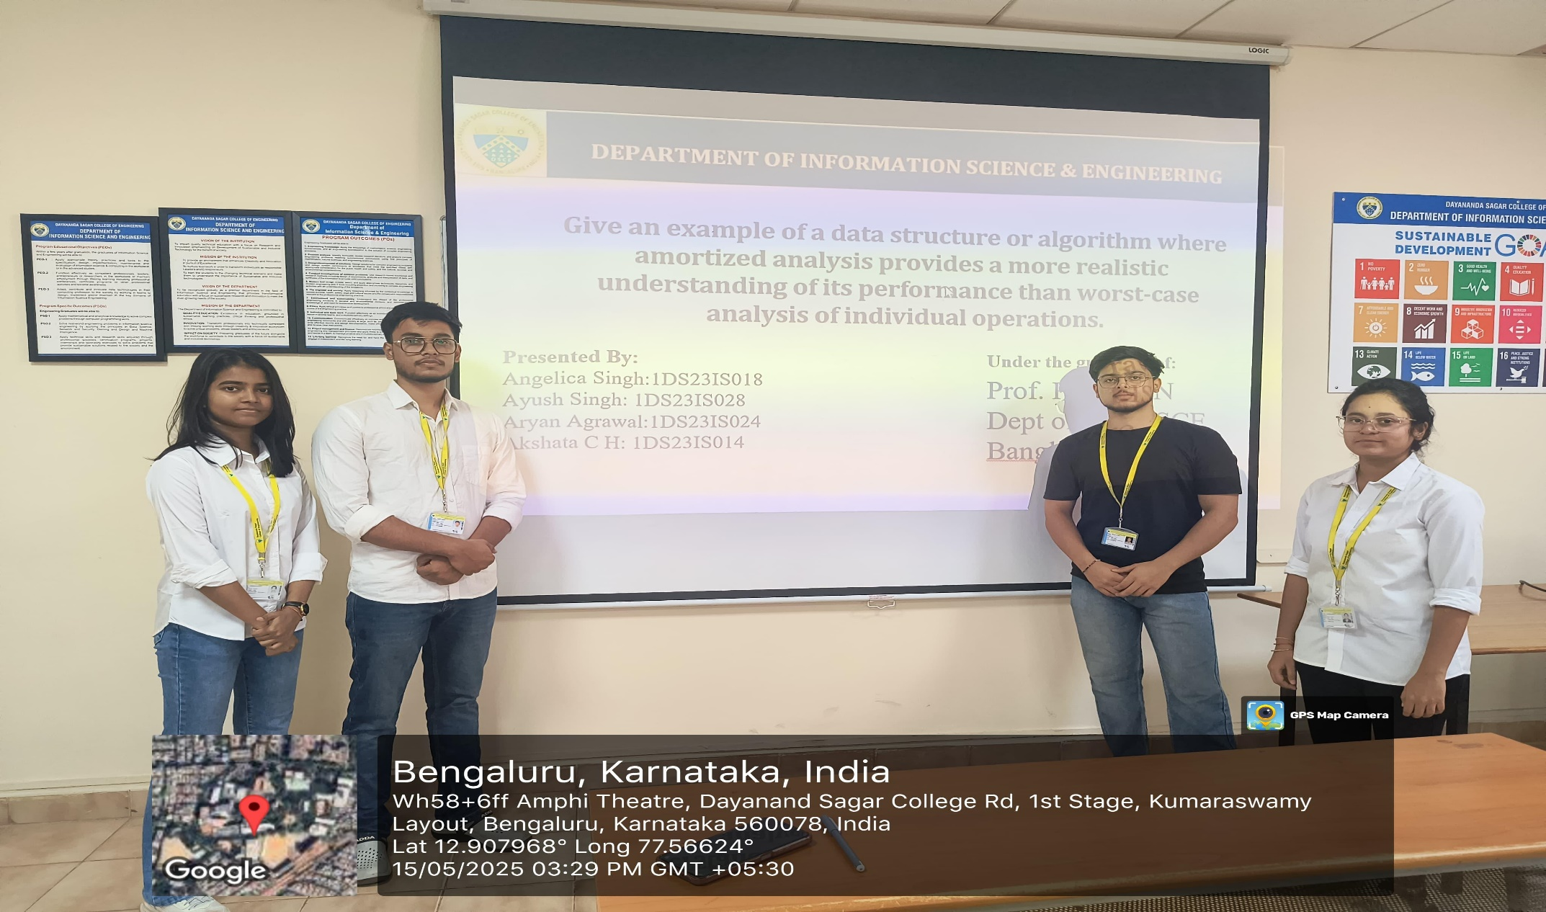

Slide 13
THANK YOU
9

