Slide 1

Ministry Name: Ministry of Law and Justice
PS Code: 1286
Problem Statement Title: Incentives based Design for
onboarding Legal Service Providers on eMarket place for extending Legal Services to Citizens in India
Team Name: Semicolon; Team Leader Name: Manish S Institute Code (AISHE): C-1413
Institute Name: Dayananda Sagar College of Engineering

Slide 2
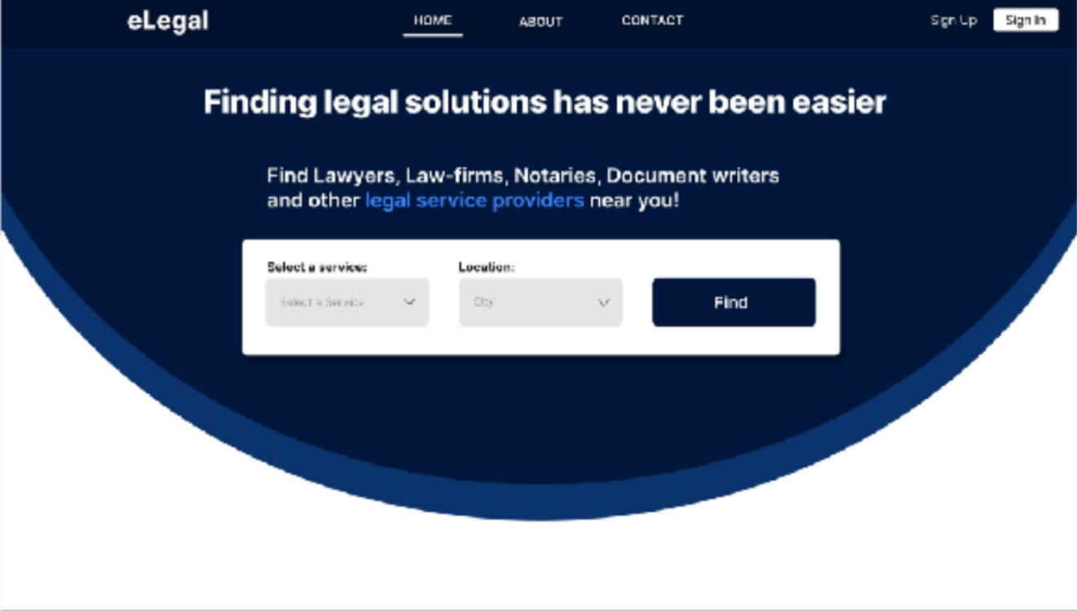





What is eLegal?
eLegal is a connecting platform looking to connect Legal Service Providers with their potential Clients.
Our service is only limited to the first consultation appointment between the provider and the client.

Slide 3
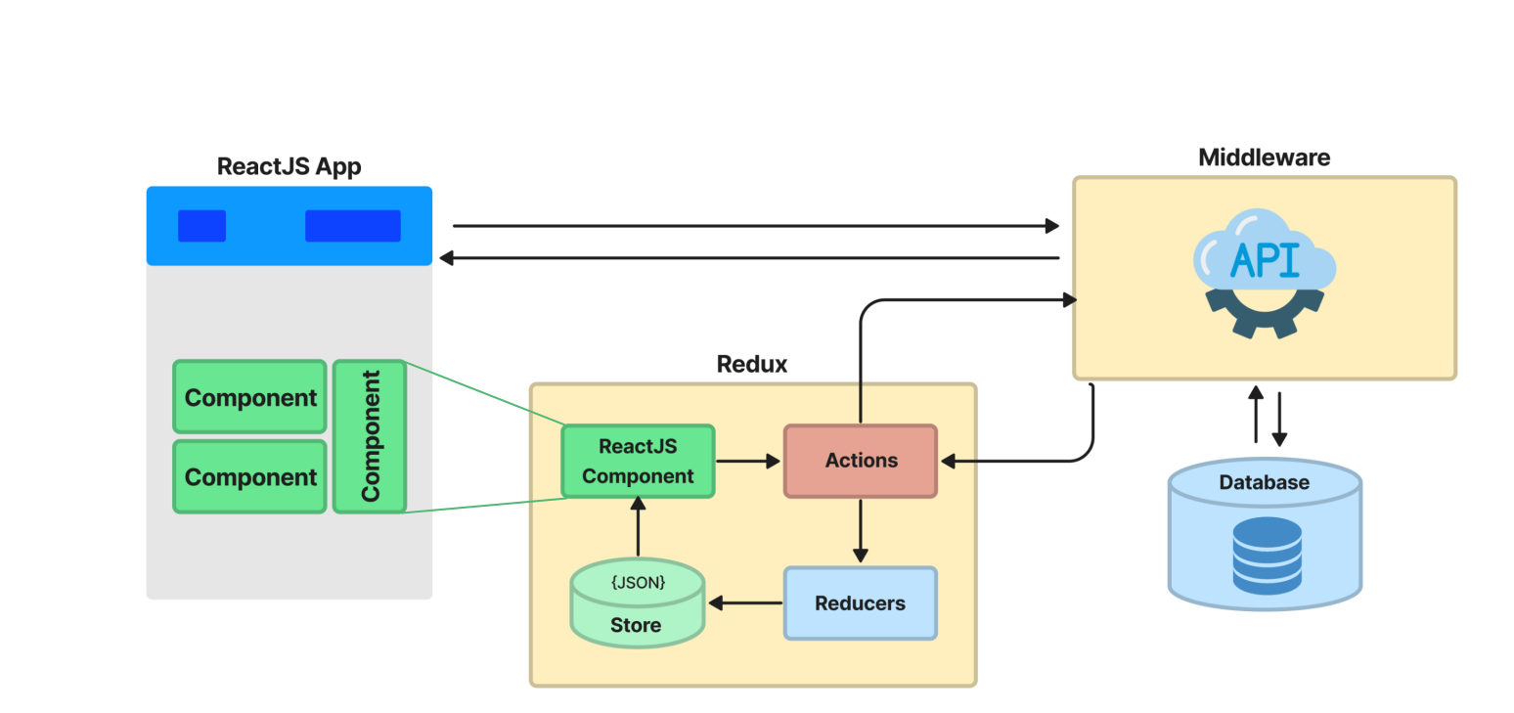
Aim
Approach
Developing a web application which connects legal service providers to potential clients.
A user can sign up and choose to be a client or a legal service provider.
Client: can search and send requests for an appointment.
Provider: can accept and schedule appointments with clients.
To implement models in ways where everyone in the ecosystem is benefited.
To incentivise and bring in more number of
clients to a legal service provider.
To enable any citizen to visit our website and request legal aid by scheduling an appointment.
System Diagram

Slide 4
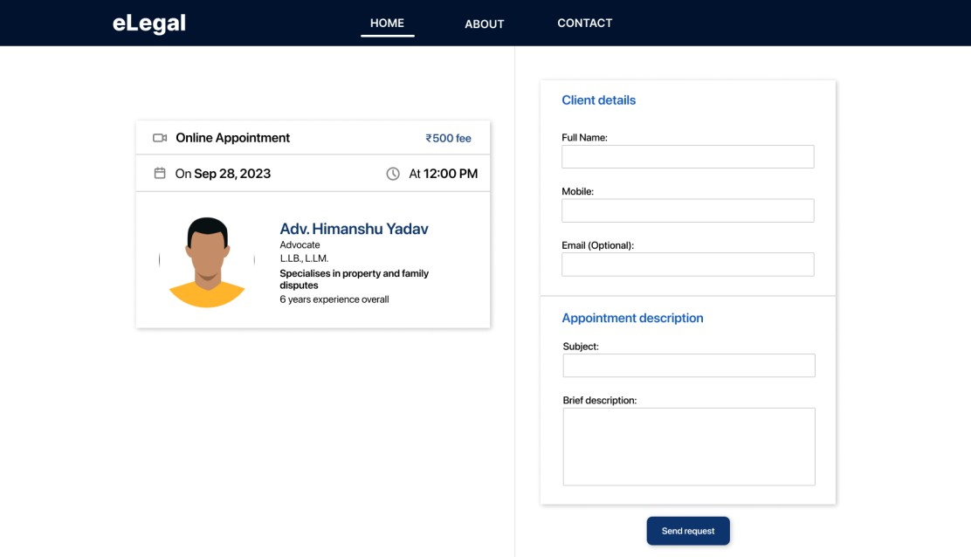
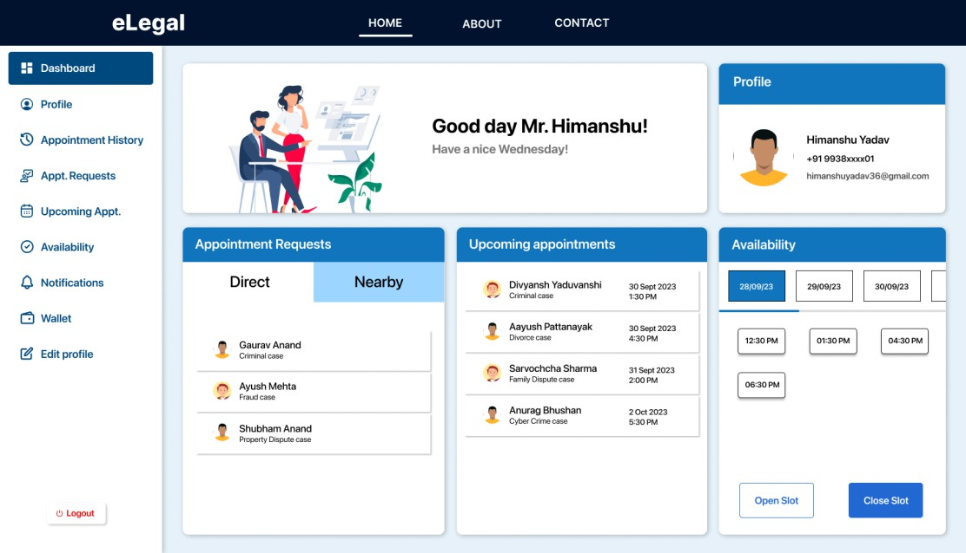
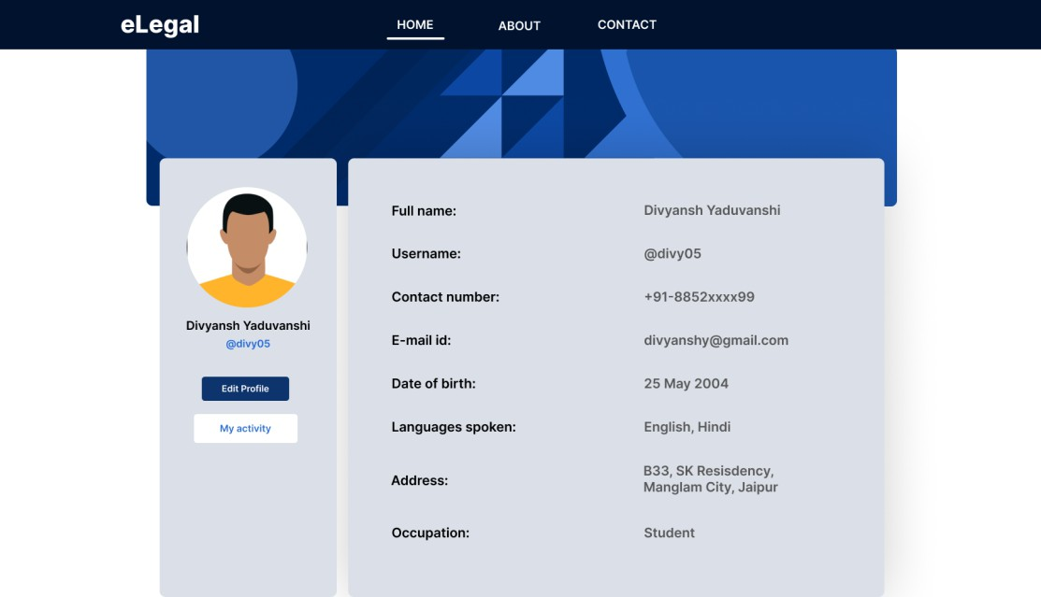






Screenshots
Request Page
Provider Dashboard
Tech-stack
4
Client Profile

Slide 5
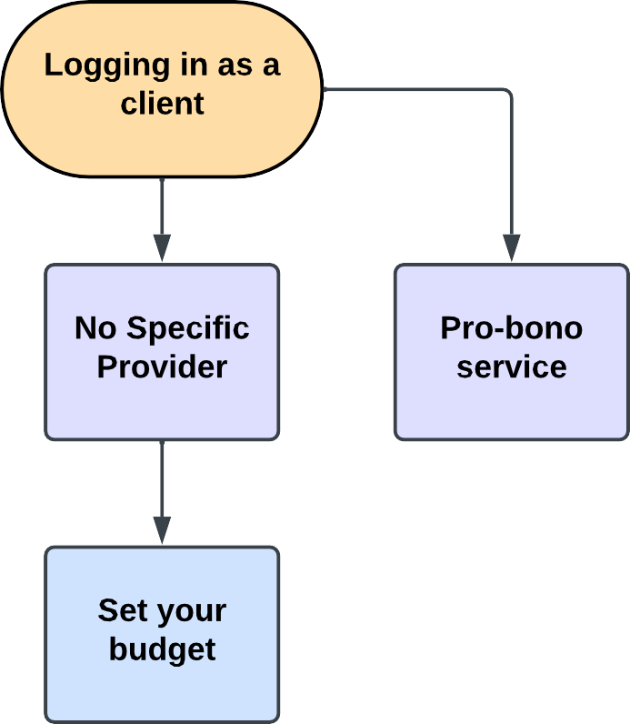
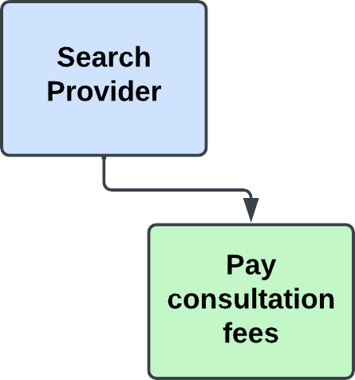
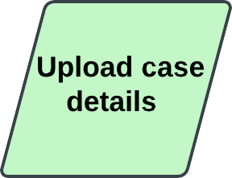
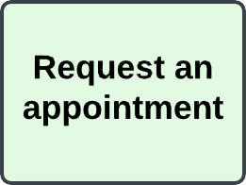
Client
The client can choose the category of provider they are looking for depending on their affordability.
Specific Provider: The client can send an appointment request directly to that provider, along with a brief description of the case particulars.
No Specific Provider: The client gives us a case summary and specifies their budget. Subsequently, these particulars are relayed to the relevant service providers. This operates on a "first come, first served" model, meaning that the provider who responds first gets to confirm an appointment with the client.
Pro-bono: If a client is unable to afford any service provider, they have the option to make use of the pro bono services available on our website.

Slide 6
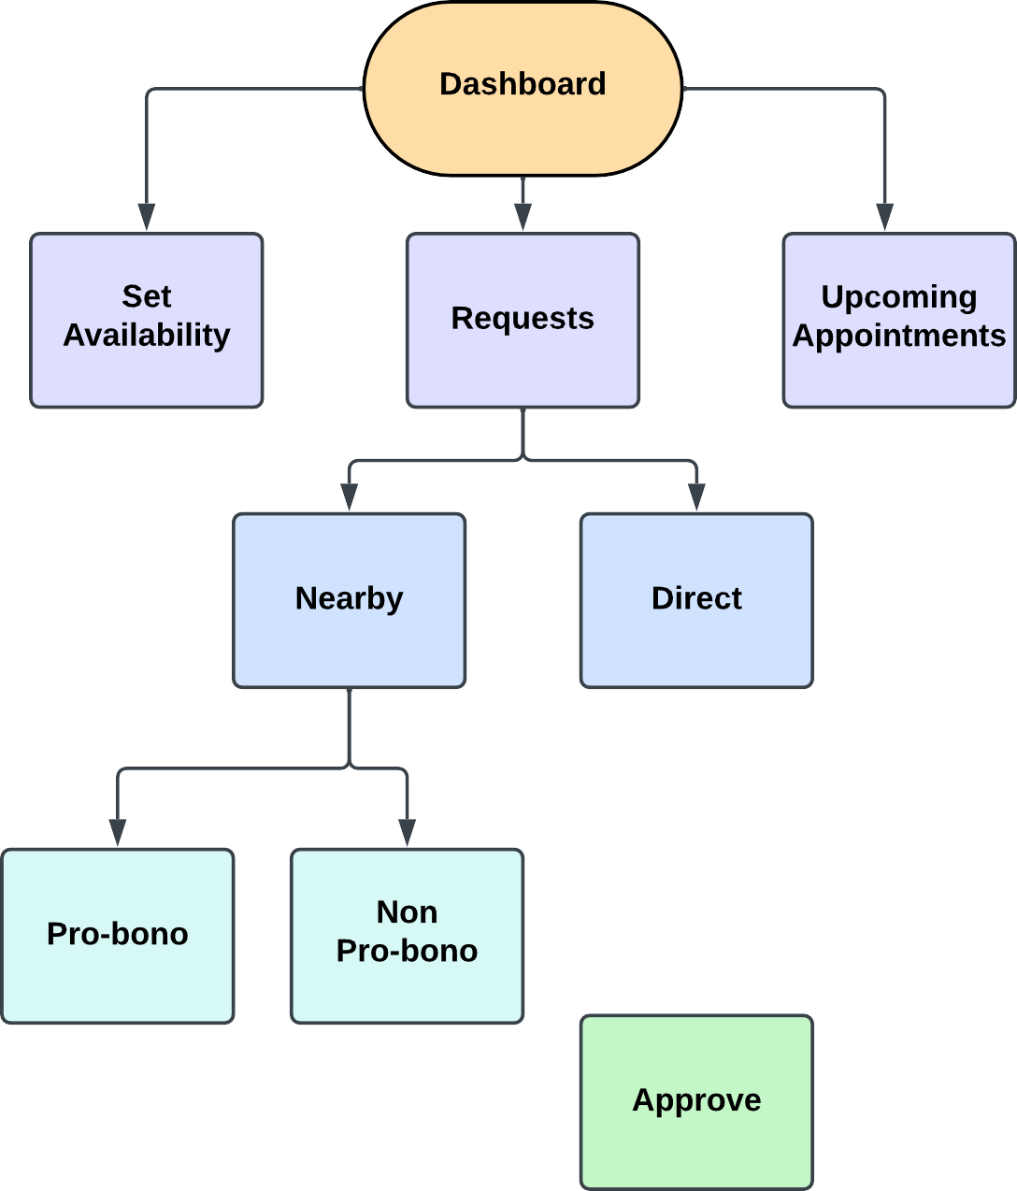
Legal Service Provider
The Legal Service Provider receives appointment requests primarily in two ways:
Direct Requests: The provider gets individual requests, they can accept or reject the case.
Nearby Requests: The providers are shown new cases in their area which can be confirmed on a first come first served basis.
This second option typically helps the unestablished providers who have either just started out with their career or have little experience. It gives an opportunity to providers who have not been getting plenty of cases already.
Dashboard: The dashboard gives an overview to the
provider about their appointments and slots available.

Slide 7
Business Model
We charge a service fee on the legal service provider for each new consultation.
Providers are incentivised for taking up more number of appointments from our website.
Market Analysis
 | Indian Legal Industry | Global Legal Industry | Global Legal Tech Industry
Valuation | USD 1.3B | USD 752.5B | USD 29.8B
Compounded Annual Growth Rate (2022-2032) | 4.3% | 4.6% | 8.9%
Legal tech start-ups in India have received $55 million in investment as of March 2022.
Globally the investment numbers have reached over $10 billion.
The Indian Legal Tech Industry is an emerging market with immense scope of business.

Slide 8
Team Member Details
Team Leader Name: Manish S
Branch: B.E. | Stream: CSE | Year: II
Team Member 1 Name: Sarvochcha Sharma
Branch: B.E. | Stream: ISE | Year: II
Team Member 2 Name: Divyansh Yaduvanshi
Branch: B.E. | Stream: ISE | Year: II
Team Member 3 Name: Shubham Anand
Branch: B.E. | Stream: CSE | Year: II
Team Member 4 Name: Mishika Goyal
Branch: B.E. | Stream: CSDS | Year: II
Team Member 5 Name: Singh Pranshu Chandradeo
Branch: B.E. | Stream: CSE | Year: II

