Slide 1

FOP MINI PROJECT:
ROCK, PAPER AND SCISSOR GAME
GROUP MEMBERS:
Gargi Chincholikar- 1262253218
Laxmi Panjwani- 1262252366
Bhoomi Khabiya- 1262251962
Gargi Dhote- 1262251463
Gayatri Gawade- 1262251008
Page 01

Slide 2
INTERACTIVE USER INPUT VALIDATION:
uses printf() and scanf() for interaction and validates user input to prevent invalid choice.
KEY FEATURES OF OUR GAME:
EFFICIENT USE OF MODULO OPERATOR:
rand() %3 ensures the
random number stays within
valid game options(0, 1, 2).
Page 02

Slide 3


RANDOM COMPUTER CHOICE GENERATION:
uses rand() and srand() to generate unpredictable computer moves.
STRUCTURED GAME LOGIC USING
CONDITION:
implements game rules
using if-else or switch case for accurate decision making.
MULTIPLE ROUNDS WITH SCORE TRACKING:
uses loops to allow replay and variables to maintain user and computer scores.
Page 03

Slide 4
UNDERSTANDING OF HOW OUR
GAME FUNCTIONS:
The program starts in main() and initializes variables.
User enters a choice (rock, paper or scissors).
Computer generates a random choice using rand().
Conditional statements compare both choices.
The result (win/ lose/ tie) is displayed.
The loop allows the game to continue till either the user or the computer earns 3 points and wins the game.
Page 04

Slide 5
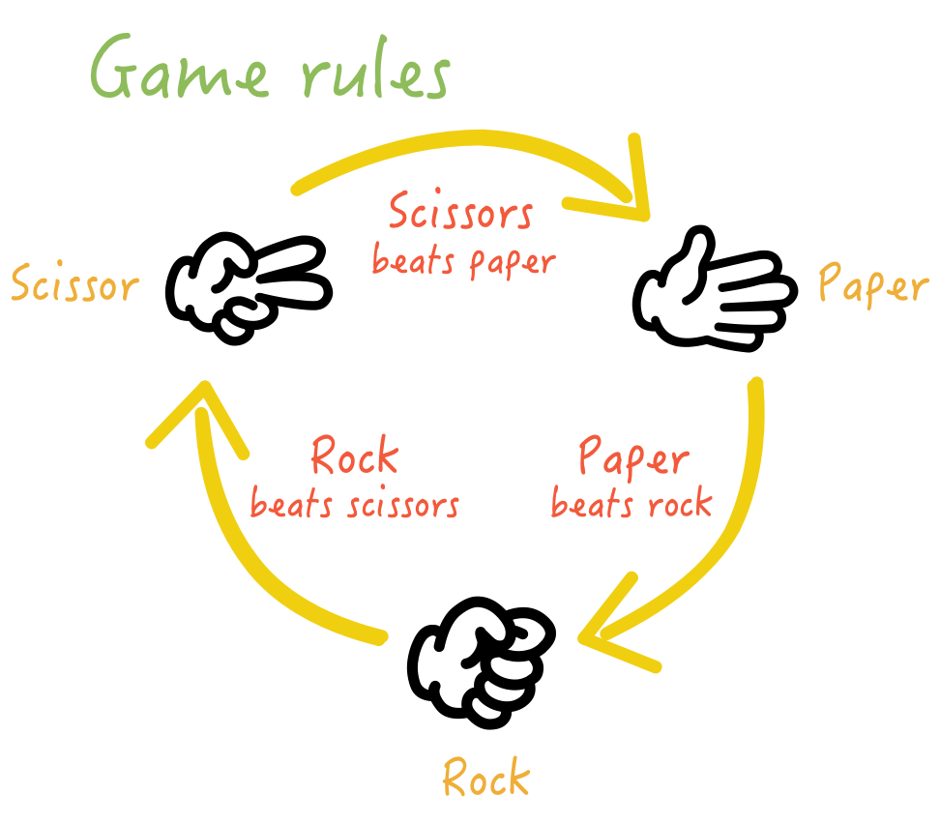
THE GAME LOGIC:
We will have to translate the hand gestures into numbers so the computer understands them, and then handle all the possible win/loss combinations and also makes it user friendly.
To make this work in C, we map the choices to integers-
0 = ROCK
1 = PAPER
2 = SCISSORS
Page 05

Slide 6
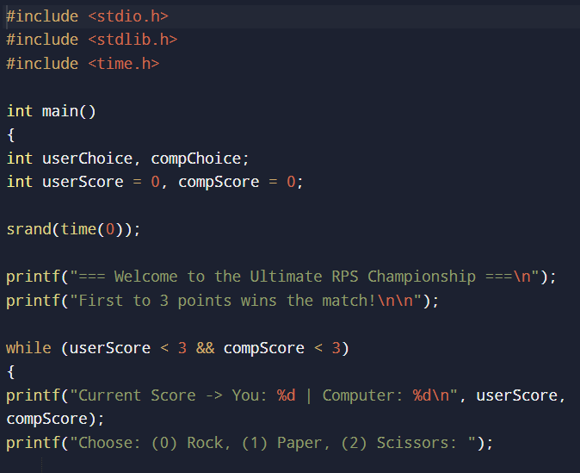
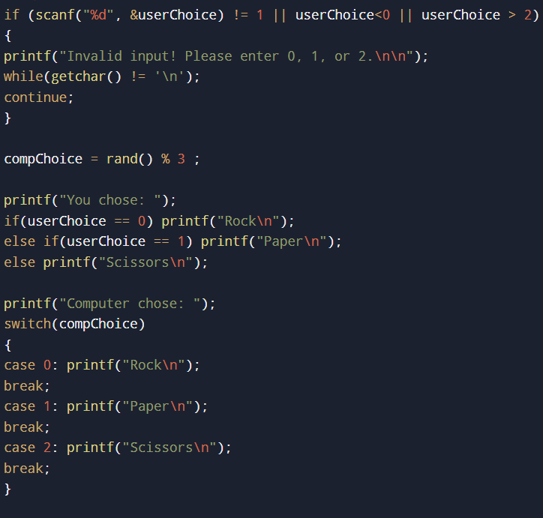
C PROGRAM CODE:
Page 06

Slide 7
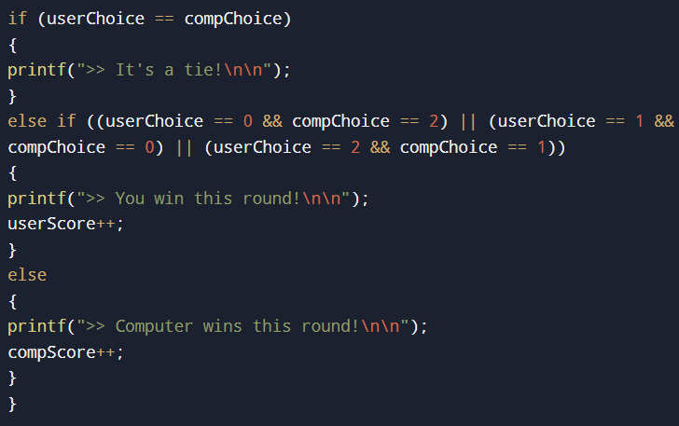
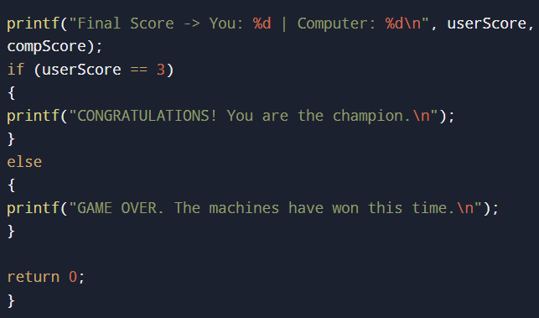
Page 07

Slide 8
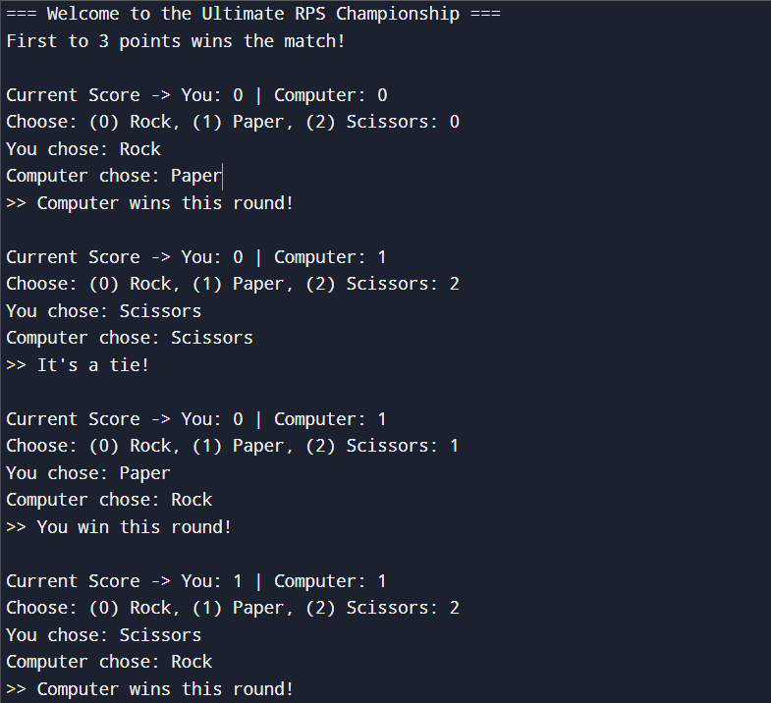
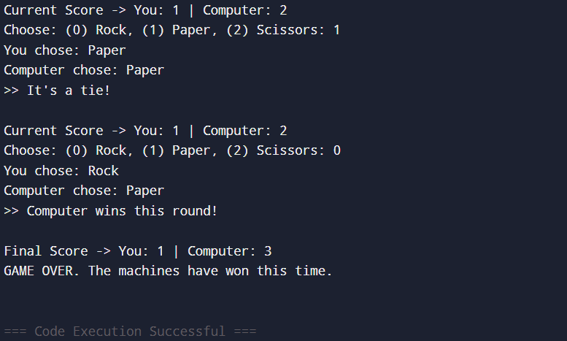
OUTPUT:
Page 08

Slide 9
WHAT WE LEARNED:
Writing structured c programs
Using conditional statements effectively
Working with loops
Generating random numbers
Improving debugging skills
Enhancing logical thinking
Page 09

Slide 10
REAL LIFE APPLICATIONS:
Used in decision making situations
Basic concepts used in game development
Helps understand AI-based decision logic
Foundation for developing larger interactive programs
Page 10

Slide 11
CONCLUSION:
successfully developed a stone paper scissor game in c
improved understanding of programming logic
learned how to use random numbers and conditions
Page 11

Slide 12
Thank
You.
Thank
You.
Thank
You.
Page 12

