Slide 1
A New 2D Hybrid Chaotic Map
Ikeda–Sine–Chebyshev (ISC) Map
A proposed nonlinear map for image-encryption research
Submitted by : Bhoomi Saraf
Supervisor: Dr. Madhu Sharma

Slide 2
Motivation and Proposed Idea
Why combine these three maps?
• Objective: construct a simple 2D hybrid map exhibiting strong and measurable chaotic behaviour.
• Ikeda provides state-dependent rotation and nonlinear coupling, creating the initial complex trajectory.
• The Sine layer adds periodic stretching and folding; its derivative scales with ω, increasing local sensitivity.
• Chebyshev T₂ adds quadratic folding and maps the Sine output back into [−1,1], giving a bounded final state.
• Thus, the sequence is designed so that coupling → periodic folding → quadratic folding act successively, while the system remains 2D.
Sequential architecture
(xₙ, yₙ)
↓
Ikeda transformation
↓
Sine nonlinearity
↓
Chebyshev T₂
↓
(xₙ₊₁, yₙ₊₁)

Slide 3
Mathematical Formulation
The proposed map is exactly two-dimensional.
1. Ikeda layer
tₙ = c − d / (1 + xₙ² + yₙ²)
Fixed parameters
Xₙ = 1 + a(xₙ cos tₙ − yₙ sin tₙ)
a = 0.9
c = 0.4
d = 6
ω = 10
Yₙ = a(xₙ sin tₙ + yₙ cos tₙ)
2. Sine layer
Sₓ = sin(ωXₙ), Sᵧ = sin(ωYₙ)
3. Chebyshev T₂ layer
ω is the principal control parameter explored in the dynamical analysis.
T₂(z) = 2z² − 1
xₙ₊₁ = 2Sₓ² − 1, yₙ₊₁ = 2Sᵧ² − 1

Slide 4
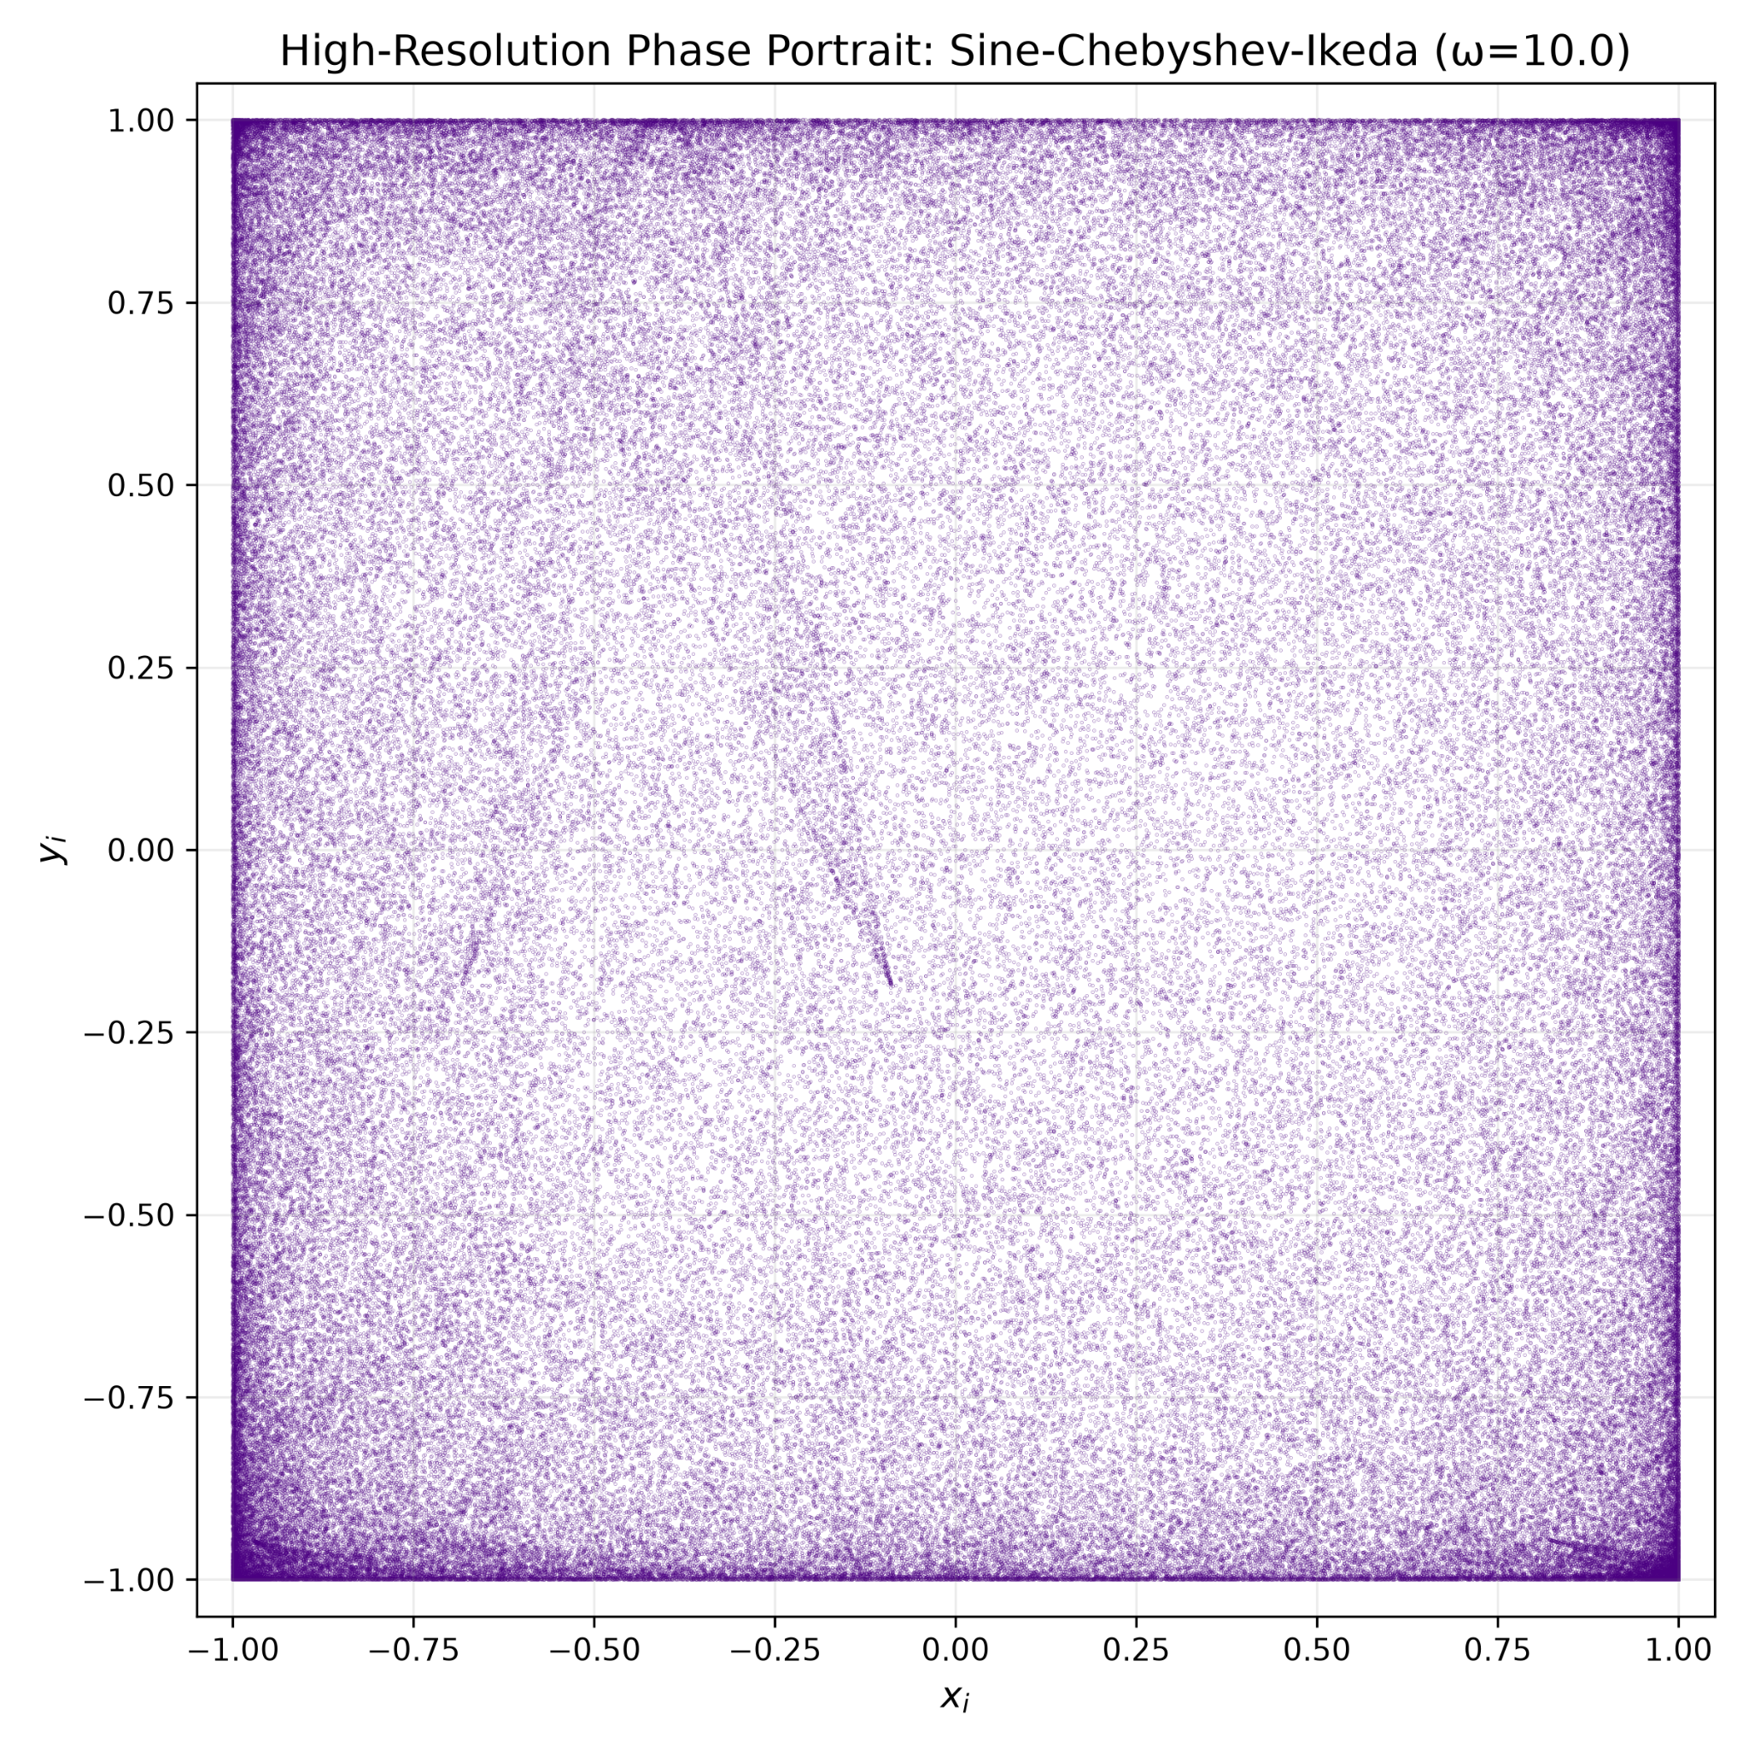
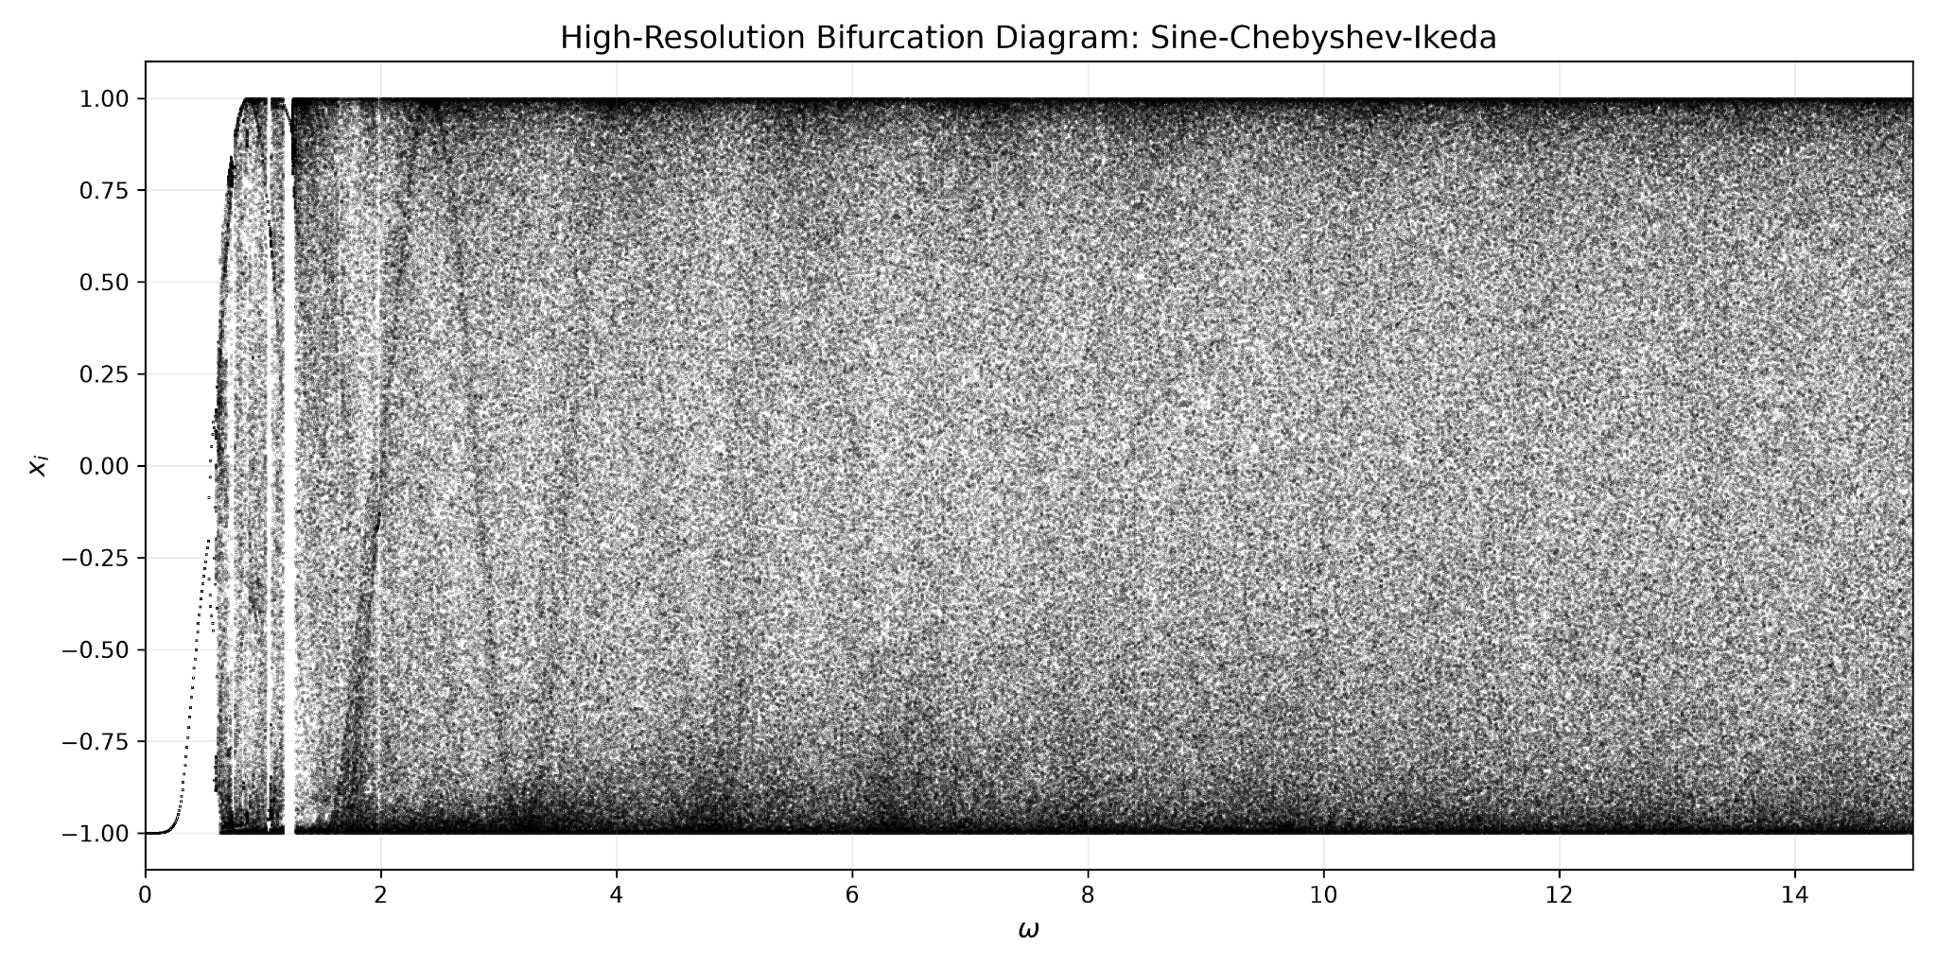
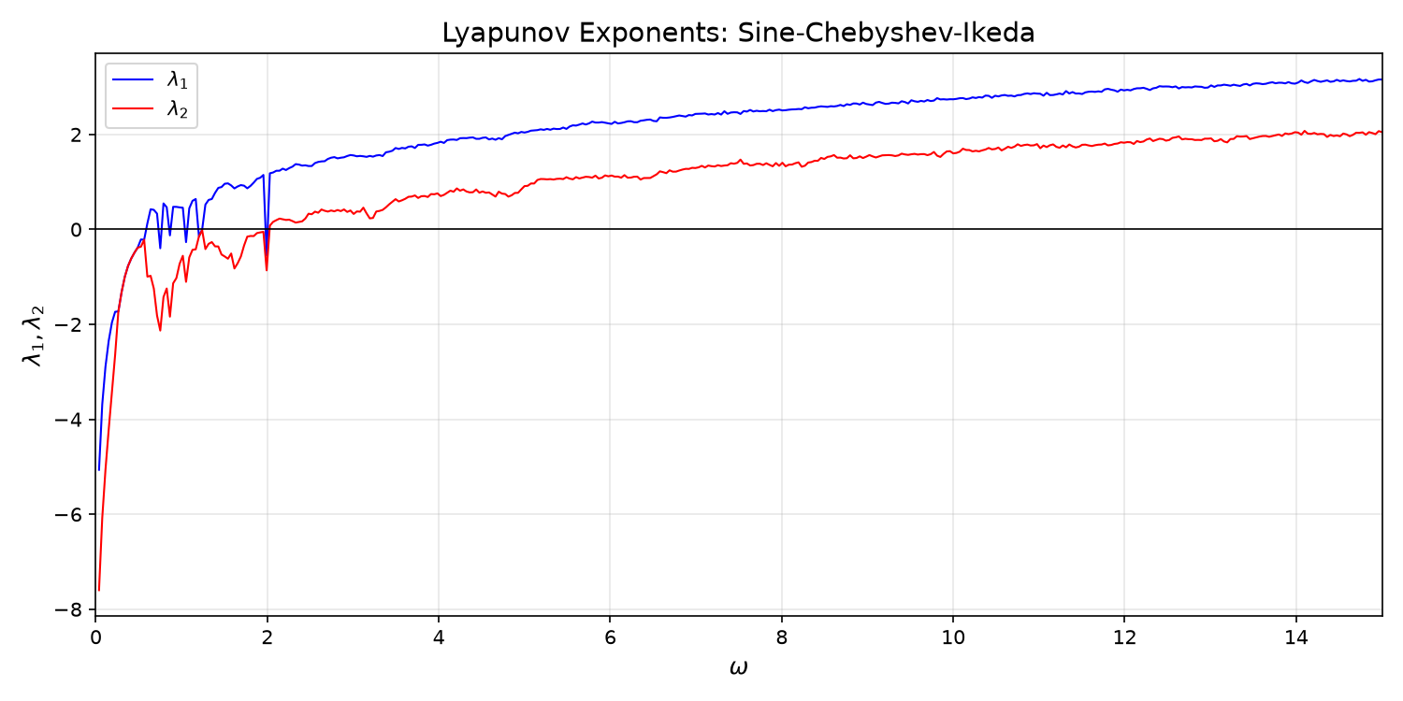
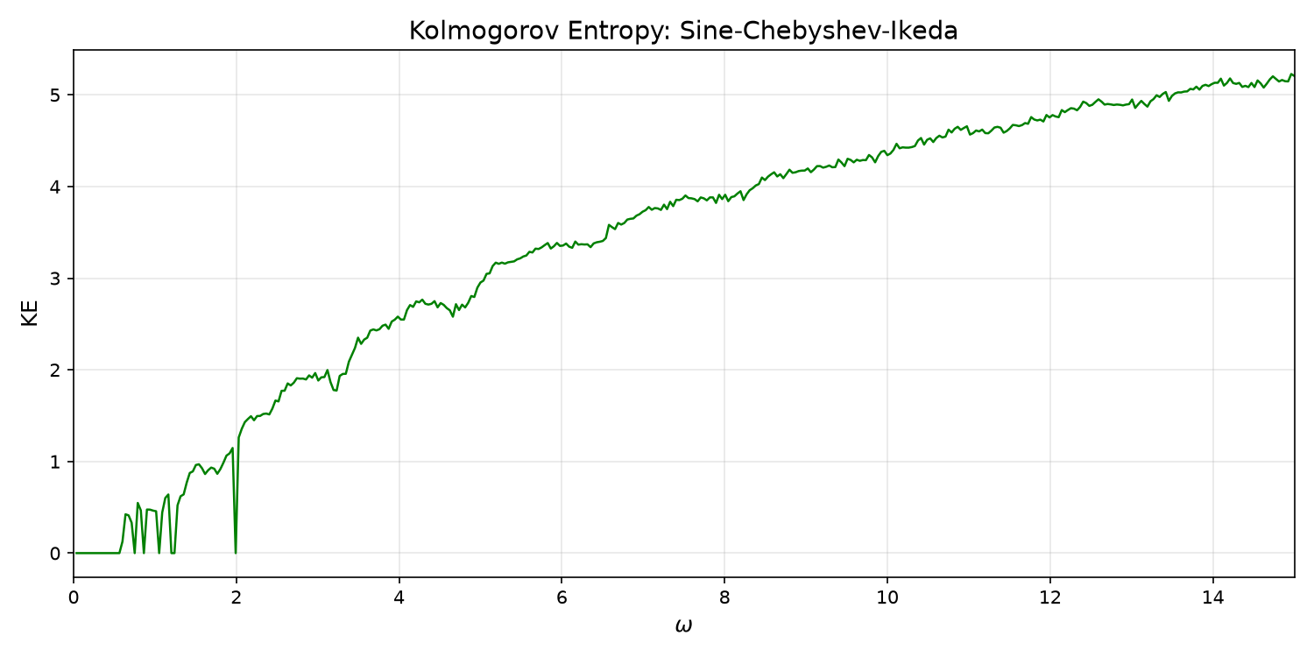
Primary Dynamical Results
High-resolution diagnostics of the proposed ISC map.
Phase portrait
Bifurcation diagram
Dense occupation of the bounded phase space at ω = 10.
Broad chaotic parameter region after the initial transition.
Lyapunov exponents
Kolmogorov–Sinai entropy
Both exponents become positive in the high-ω operating region.
Entropy estimate increases with ω in the explored region.

Slide 5
Key Quantitative Results
Corrected 2D Shannon entropy values at ω = 10.
Phase-space Shannon entropy
Representative dynamical values
Hₓ
7.693507
bits
At ω = 10
λ₁ ≈ 2.73 λ₂ ≈ 1.65 hKS ≈ 4.38
Hᵧ
7.664964
bits
Hₓᵧ
15.083315
bits
Hₓᵧ,max
16.000000
bits
Additional validation
0–1 test: K ≈ 0.998
Normalized Hₓᵧ
0.942707
≈ 94.27%
Initial separation: 10⁻¹⁰
Divergence beyond 1 by iteration 8
256 × 256 bins over [−1,1]²
High joint entropy indicates broad occupancy of the phase-space bins.

Slide 6
Robustness and Mathematical Consistency
Final freeze-validation over ω = 8 to 12.
• Jacobian determinant consistency: relative error ≤ 0.14% at ω = 8, 10, 12.
• λ₁ + λ₂ agrees with the time-averaged log absolute Jacobian determinant.
• Float64: no cycle detected within 10⁶ iterations.
• Float32: cycle detected at 290,196 iterations — relevant for finite-precision implementation.
Parameter scan
ω = 8.00 → 12.00
step = 0.25
Positive λ₁ and λ₂
throughout the tested interval
hKS ≈ 3.87 at ω = 8
hKS ≈ 4.77 at ω = 12
K ≈ 0.998 across the tested range
The evidence supports robust chaotic behaviour in the tested range

Slide 7
Research Contribution and Next Phase
The map is frozen as the chaotic core; cipher security is a separate evaluation.
• Proposes a sequential Ikeda–Sine–Chebyshev composition while retaining a strictly 2D state.
• Demonstrates positive Lyapunov exponents across the tested high-ω region.
• Shows high phase-space Shannon entropy: 15.0833 / 16 bits.
• Shows near-unity 0–1 statistic, supporting chaotic dynamics.
• Next: integrate the map into an image-encryption scheme and evaluate the complete cipher.
Next phase
ISC map
↓
Chaotic sequences
↓
Confusion
+
Diffusion
↓
Encrypted image
↓
Entropy • correlation
NPCR • UACI
key sensitivity • NIST

Slide 8
Comparison with Existing Ikeda-Based Variants
Published variants vs. ISC — metrics are reported as published and are not treated as directly identical when test protocols differ.
Map / variant | Dim. | Construction | Reported dynamical results | ISC @ ω=10
Sine–Ikeda modulated (Hanis, 2023) | 2D | Ikeda + additive sine term | Both Lyapunov exponents reported positive; bifurcation entropy > 4; wide chaotic parameter region. | λ₁ ≈ 2.73 λ₂ ≈ 1.65 hKS ≈ 4.38
Logistic–Hénon–Ikeda hybrid (Cao et al., 2013) | 2D | Composition of Logistic + Hénon + Ikeda | λ = 0.5077, −0.7329 for the reported hybrid setting; one positive LE. | λ₁ ≈ 2.73 λ₂ ≈ 1.65 hKS ≈ 4.38
Ikeda + Arnold cat + enhanced Lorenz (Hikal & Eid, 2020) | Hybrid scheme | Ikeda for sequence generation + Arnold cat permutation + enhanced-Lorenz diffusion | Cipher-image adjacent-pixel correlations reported close to 0; not a single 2D hybrid map, so LE comparison is not reported here. | Single 2D autonomous map; phase-space Hxy ≈ 15.08 bits (94.27% of 16-bit max)
ISC (this work) | 2D | Ikeda → Sine → Chebyshev T₂ | λ₁ ≈ 2.73, λ₂ ≈ 1.65; hKS ≈ 4.38; K ≈ 0.998; no Float64 cycle detected within 10⁶ iterations. | Same as reported dynamical results

Slide 9
References
1. Ikeda, H. et al. — foundational work underlying the Ikeda chaotic map, Physica D (1980).
2. “A New Sine-Ikeda Modulated Chaotic Key for Cybersecurity” (2023) — Sine–Ikeda hybrid comparison.
3. “Mapping Chaos: Bifurcation Patterns and Shrimp Structures in the Ikeda Map” (2024) — dynamical analysis of the Ikeda map.
4. Cao, C.; Li, K.; Chang, Q. et al. “A New Hybrid Chaotic Map and Its Application on Image Encryption and Hiding” (2013), DOI: 10.1155/2013/728375.
5. Kocarev, L.; Tasev, Z. “Public-key encryption based on Chebyshev maps” (2003), ISCAS’03, DOI: 10.1109/ISCAS.2003.1204947.
6. Bergamo, P.; D’Arco, P.; De Santis, A.; Kocarev, L. “Security of public-key cryptosystems based on Chebyshev polynomials” (2005), IEEE TCSI 52(7), 1382–1393, DOI: 10.1109/TCSI.2005.851701.
7. Lu, Y.; Xie, X. “Exploiting 2D improved Sine-Chebyshev chaotic map and adaptive cellular automata permutation for image encryption” (2025), Journal of Modern Optics, DOI: 10.1080/09500340.2025.2519795.
8. Sharma, M.; Ranjan, R. K.; Bharti, V. “An image encryption algorithm based on a novel hyperchaotic Henon sine map” (2022), Multimedia Tools and Applications, DOI: 10.1007/s11042-022-13733-y.
9. Abduljaleel, I. Q. et al. “A Lightweight Hybrid Scheme for Hiding Text Messages in Colour Images Using LSB, Lah Transform and Chaotic Techniques” (2022) — Tent–Ikeda hybrid, DOI: 10.3390/jsan11040066.
10. Hikal, N. A.; Eid, M. “A new approach for palmprint image encryption based on hybrid chaotic maps” (2020) — Ikeda + Arnold cat + enhanced Lorenz, DOI: 10.1016/j.jksuci.2018.09.006.
Thank you

