Slide 1




MINI PROJECT GATE 0
Mini-RDBMS Engine
with Query Processing & Transaction Support
_________________________________________
Under Guidance of - Jyothi Patil Mam
TEAM -1
Bhoomi B 110
Sneha S 131
Shubham M 153
Soumya P 162

Slide 2

The Problem
Current Situation
  Traditional database systems are large and complex for learning and experimentation.
  Query processing and transaction handling are usually hidden inside the DBMS
Why Existing Approach is Inadequate
  Existing DBMSs provide the final result but hide the internal working.
  They do not provide a simple platform to demonstrate DBMS, DAA and OSPP concepts together.
  A lightweight system is needed to understand and demonstrate these concepts practically.
Observed Issue
  Students cannot easily understand how queries are processed internally.
  It is difficult to visualize indexing, query execution, storage management, and transactions together.

Slide 3
Who Is Involved ?
1. Students / Users
  Role: Execute queries and transactions
  Need: Simple database system for learning
  Difficulty: Difficult to understand internal DBMS working
  Expected Benefit: Better practical understanding
2. Faculty
  Role: Guide and evaluate the project
  Need: Easy way to demonstrate concepts
  Difficulty: Existing DBMS hides internal processes
  Expected Benefit: Easier teaching and evaluation
3. Developers / Team Members
  Role: Design and implement the system
  Need: Clear modules and algorithms
  Difficulty: Integrating DBMS, DAA and OSPP concepts
  Expected Benefit: Practical development experience
4. System Administrator
  Role: Manage data and system operations
  Need: Reliable storage and transactions
  Difficulty: Maintaining data consistency
  Expected Benefit: Better data management and reliability

Slide 4


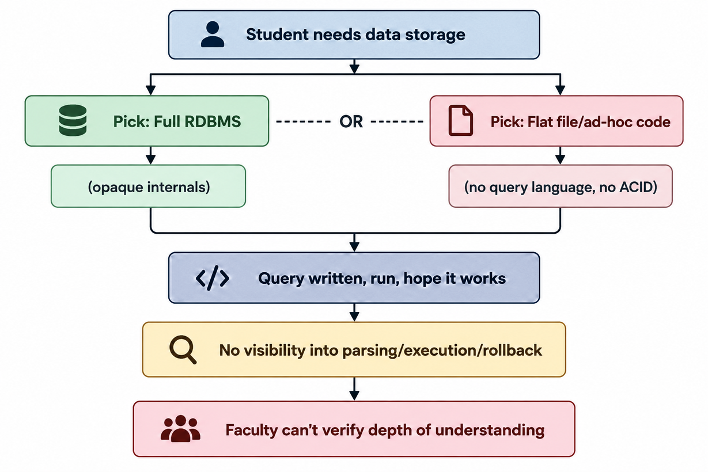

How it works today
AS-IS Workflow
Current Process
Students and developers needing structured data storage today take one of two paths: A)install a full production RDBMS (MySQL, PostgreSQL) and use it purely as a black box, or B)roll ad-hoc storage in code using flat files or in-memory lists.
IN BOTH THE CASES, THE INTERNAL MECHANICS LIKE PARSING, QUERY EXECUTION, TRANSACTION HANDLING WILL STAY INVISIBLE. SQL IS LEARNED AS A SYNTAX TO TYPE NOT A PROCESS TO UNDERSTAND.

Slide 5






Opaque Query Processing
SQL is used as a black box — no visibility into parsing, planning, or execution internals.
No Transactional Safety
No atomicity in typical student-built storage; a crash mid-write leaves corrupted data.
Heavy, Complex Tooling
Full RDBMS installs bring configuration overhead that obscures the concepts being taught.
Bottlenecks & Inefficiencies Identified
No Consistency Guarantees
Flat-file storage enforces no schema, no query language, and no data validation.

Slide 6

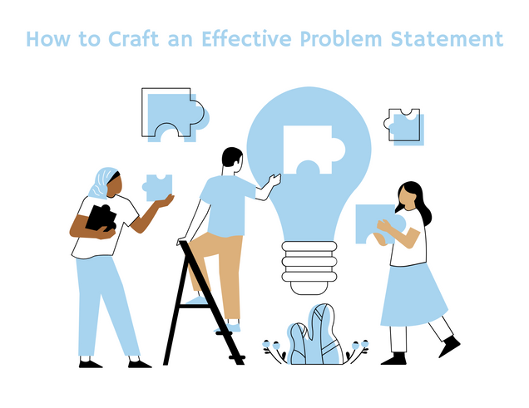
Problem Statement
Students and developers lack a transparent, minimal RDBMS implementation that demonstrates core query processing and transaction management, since production databases are too complex to inspect internally and ad-hoc storage solutions provide neither a query language nor transactional integrity.

Slide 7
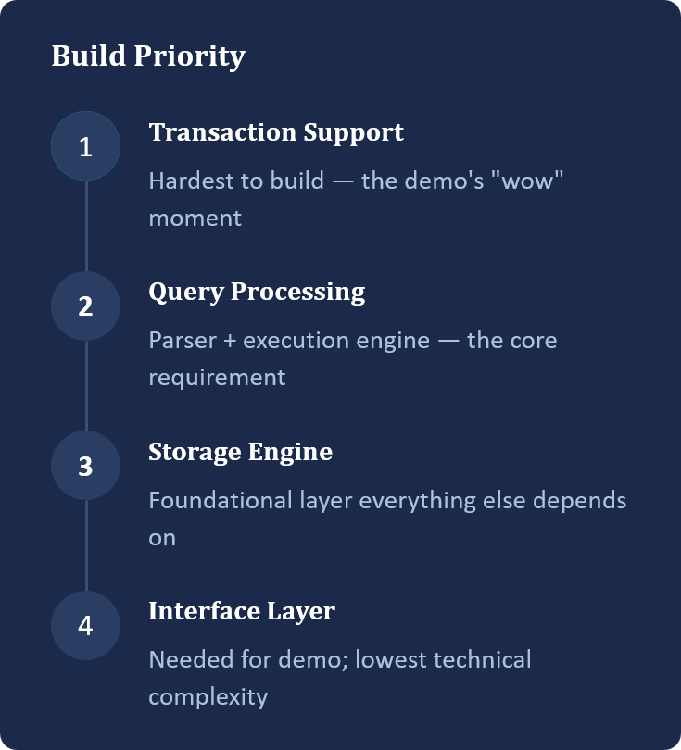
Underlying Needs and Priority
Build Priority
Underlying Needs
  A TRANSPARENT, BUILDABLE ENGINE TO LEARN DATABASE INTERNALS FROM
  A LIGHTWEIGHT QUERY PROCESSOR WITH REAL SQL-STYLE SYNTAX SUPPORT
  ACID-LIKE TRANSACTION GUARANTEES — ATOMICITY AND ROLLBACK
  A WORKING ARTIFACT THAT PROVES IMPLEMENTATION-LEVEL UNDERSTANDING

Slide 8

Project Objectives
Objectives
  Design a storage engine with typed columns & constraints (PK, NOT NULL)
  Implement a SQL-subset parser — CREATE, INSERT, SELECT (WHERE), UPDATE, DELETE
  Build an execution engine returning correct results against storage
  Implement BEGIN / COMMIT / ROLLBACK with atomicity guarantees
  Demonstrate a rollback scenario leaving zero partial changes
  Provide a CLI interface for queries and results/errors

Slide 9

REAL WORLD PROBLMES WE FACE
1- Difficult SQL error messages
Beginners may struggle to identify the exact cause of syntax or column errors.
SELECT nam FROM students;
Example: nam instead of name.
2. Accidental data modification
An UPDATE or DELETE without a proper WHERE condition can affect many rows.
DELETE FROM students;
Example: unintended deletion of all records.
3. Incomplete transactions
A failure between two related updates can leave data inconsistent.
UPDATE accounts SET balance = balance - 1000
WHERE id = 1;
Example: money deducted from A but not credited to B.

Slide 10

Proposed feasible features
Core SQL-like RDBMS Engine
Transaction Support and Recovery
Implement CREATE TABLE, INSERT, SELECT, UPDATE, DELETE, WHERE, and basic relational data storage.
BEGIN;
UPDATE accounts
SET balance = balance - 1000
WHERE id = 1;
UPDATE accounts
SET balance = balance + 1000
WHERE id = 2;
COMMIT;
Lightweight Query Execution Tracing
SELECT * FROM students
WHERE department = 'CS';
Execution Trace
1. Parse query ✓
2. Validate table ✓
3. Scan students ✓
4. Filter department = 'CS' ✓
5. Return 25 rows ✓
Execution time: 2 ms
Safe UPDATE / DELETE Preview
DELETE FROM students;
Your engine displays:
WARNING: This operation affects all rows.
Affected rows: 100
Confirm deletion? (yes/no)

Slide 11

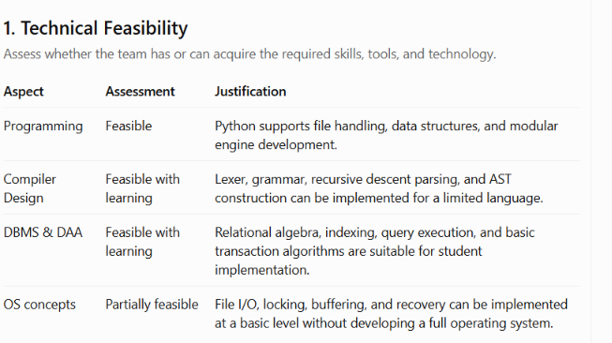



Feasibility Analysis
2.OPERATIONAL FEASIBILITY
Assess whether the proposed system will realistically work within the target environment/users.
The system will run as a local command-line database application. Users can create tables, insert records, execute supported queries, preview changes, and commit or roll back transactions. It will not require an internet connection or external database server. The system is suitable for demonstrations and small datasets, but not intended for production-critical workloads

Slide 12


What Could Go Wrong:
Project Risk Analysis
  Inconsistent state in data due to Transaction Rollback.
  Deadlock between two transactions with no detection/timeout
  Modules (parser, storage, transactions) built separately may not integrate smoothly.
  Disk I/O errors not handled (file locked, permission denied, disk full)
  Uneven team skill on modules
  Partial commits leaves half applied transaction.
Risk Mitigation
  Snapshot state before transaction rollback
  Add lock-acquisition timeout to auto-abort and return error.
  Freezing of modules before coding
  Wrap all file ops in try-catch with clear error messages
  Team discussions and brainstorming sessions for all the modules.
  Use write-ahead log and apply changes only on commit

