Slide 1
FAKE NEWS DETECTION
RNS INSTITUTE OF TECHNOLOGY
BENGALURU - 98
DEPARTMENT OF COMPUTER SCIENCE & ENGINEERING
Presentation on Internship

Slide 2
AGENDA
Abstract
About the Company
Introduction
Literature Survey
Requirements
System Design
Implementation
Results
Conclusion
References

Slide 3
ABSTRACT
The phenomenon of Fake news is experiencing a rapid and growing progress with the evolution of the means of communication and Social media.
Fake news detection is an emerging research area which is gaining big interest.
It faces however some challenges due to the limited resources such as datasets and processing and analyzing techniques.
In this work, we propose a system for Fake news detection that uses machine learning techniques.
We used term frequency inverse document frequency (TF-IDF) of bag of words and n-grams as feature extraction technique, and Support Vector Machine (SVM) as a classifier.
We propose also a dataset of fake and true news to train the proposed system.
Obtained results show the efficiency of the system.

Slide 4
ABOUT THE COMPANY
NASTECH – New Age Solutions & Technologies
NASTECH is formed with the purpose of bridging the gap between Academia and Industry.
NasTech is one of the leading Global Certification and Training service providers for technical and management programs for educational institutions.
They collaborate with educational institutes to understand their requirements and form a strategy in consultation with all stakeholders to fulfill those by skilling , reskilling and upskilling the students and faculties on new age skills and technologies.
Industry and project oriented student training programs.
Certification programs mapped to Global Certification Exams from Microsoft/EC- Council/Google/AWS/ Adobe).

Slide 5
INTRODUCTION
In the last decade, Fake News phenomenon has experienced a very significant spread, favored by social networks like Facebook ,Twitter etc..
This fake news can be broadcasted for different purposes.
Some are made only to increase the number of clicks and visitors on a site. Others, to influence public opinion on political decisions or on financial markets.
For example, by impacting the reputation of companies and institutions on the Web.
Fake news concerning health on social media represents a risk to global health. The WHO warned in February 2020 that the COVID-19 outbreak had been accompanied by a massive ‘infodemic’, or an overabundance of information—some of which was accurate and some of which was not—which made it difficult for people to find reliable sources and trustworthy information when they needed it.
It denotes a type of yellow journalism which intentionally presents misinformation or hoaxes spreading through both traditional print news media and recent online social media.

Slide 6
LITERATURE SURVEY
[1]Paper Name: - Evaluating Machine Learning algorithms for Fake News Detection.
Author: - Shloka Gilda
In this article, the author introduced the concept of the importance of NLP in stumbling across incorrect information. They have used time frequency-inverse document frequency (TF-IDF) of bigrams and probabilistic context-free grammar detection. Shloka Gilda introduced the concept of the importance of NLP in stumbling over incorrect information. They used Bi-Gram Count Vectorizer and Probabilistic Context-Free Grammar (PCFG) to detect deceptions. They examined the data set in more than one class of algorithms to find out a better model. The count vectorizer of bi-grams fed directly into a stochastic gradient descent model which identifies noncredible resources with an accuracy of 71.2%.
[2]Paper Name: - Fake News Detection on Social Media: A Data Mining Perspective.
Author: - Kai Shu, Amy Sliva , Suhang Wang, Jiliang Tang and Huan Liu.
In this paper to detect fake news on social media, a data mining perspective is presented that includes the characterization of fake news in psychology and social theories. This article looks at two main factors responsible for the widespread acceptance of fake messages by the user which are naive realism and confirmatory bias. It proposes a general two-phase data mining framework that includes 1) feature extraction and 2) modeling, analyzing data sets, and confusion matrix for detecting fake news

Slide 7
REQUIREMENTS
HARDWARE REQUIREMENTS
Processor : Any Processor above 500 MHz
RAM : 512Mb
Hard Disk : 4 GB
Input device : Standard Keyboard and Mouse
Output device : VGA and High Resolution Monitor
SOFTWARE REQUIREMENTS
Operating system : Windows 10
IDE : google colab
Tools/Technologies : Python3, Numpy library , Pandas library , sklearn , streamlit.

Slide 8
SYSTEM DESIGN
Data Set
Pre-processing
Data Split(Train,
Test)
Feature Extraction
User Input
Classification
Model
Training Classifier
Truth Probability
True|false

Slide 9
SYSTEM DESIGN
The system we propose uses a news dataset to build a decision model based on support vector machine method. The model is then used to classify novel news to fake or real.
The proposed system takes as input a dataset of comments and their related information, such as id, title, text and label(fake or real).
It then transforms them into a features dataset that can be used in the learning phase. This transformation is called preprocessing,
it performs a series of operations such as cleansing, filtering and encoding.
The preprocessed dataset is divided into two parts: the first for training and the second for testing.
The training module uses the training dataset and support vector machine algorithm to build a decision model that can be applied to the test dataset.
If the model is accepted (i.e., it is able to achieve an acceptable accuracy rate), it can be kept and used and then training ends. Otherwise, the parameters of the learning algorithm are revised in order to improve the accuracy rate.

Slide 10

SUPPORT VECTOR MACHINE (SVM)
Support Vector Machine or SVM is one of the most popular Supervised Learning algorithms, which is used for Classification as well as Regression problems. However, primarily, it is used for Classification problems in Machine Learning.
The goal of the SVM algorithm is to create the best line or decision boundary that can segregate n-dimensional space into classes so that we can easily put the new data point in the correct category in the future. This best decision boundary is called a hyperplane.
SVM chooses the extreme points/vectors that help in creating the hyperplane. These extreme cases are called as support vectors, and hence algorithm is termed as Support Vector Machine. Consider the diagram in which there are two different categories that are classified using a decision boundary or hyperplane:

Slide 11
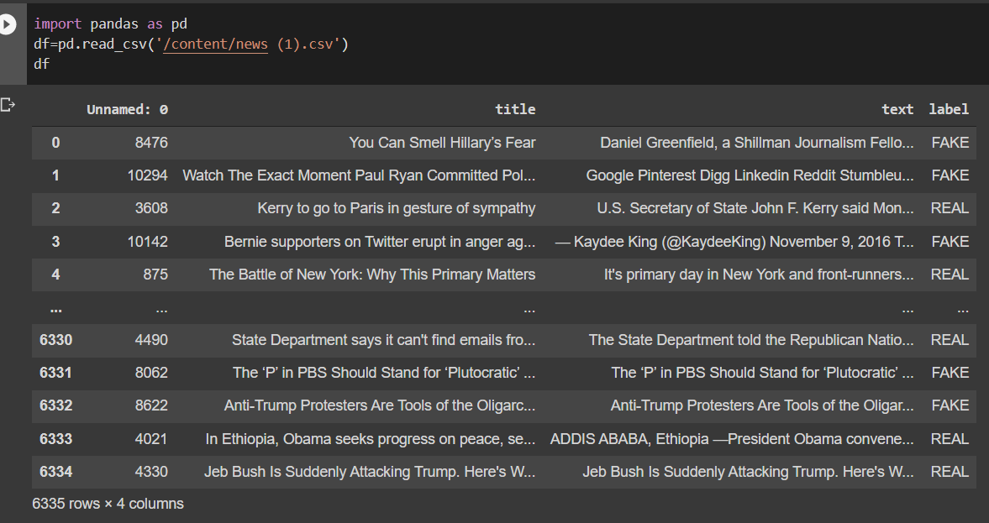
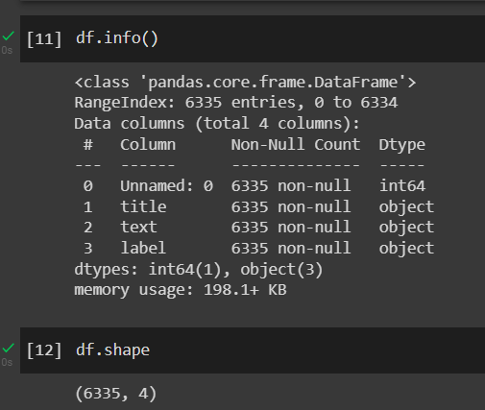
IMPLEMENTATION
Importing Dataset

Slide 12
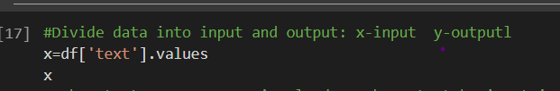
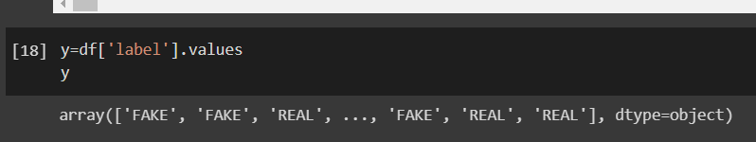
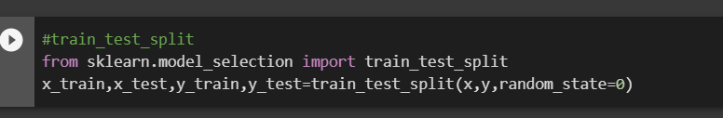
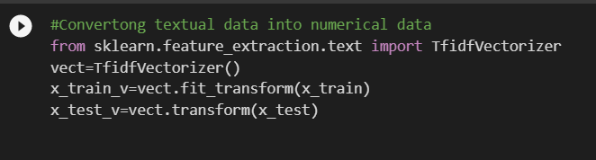
IMPLEMENTATION
Division of data into input and output
Spliting the dataset
Feature Extraction

Slide 13
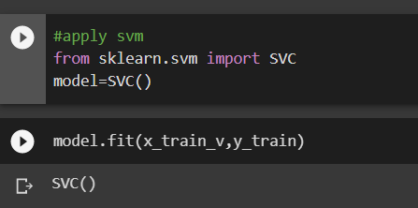
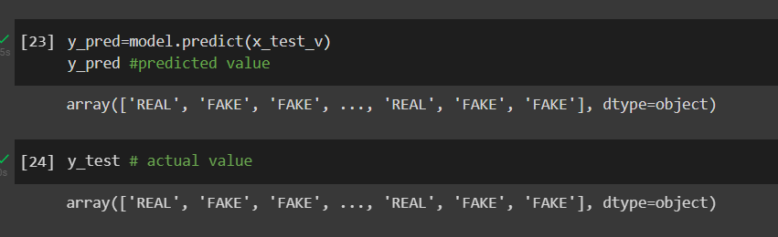
Choosing And Training The Model
Testing The Model

Slide 14
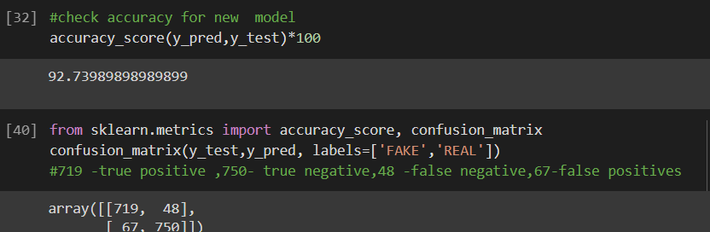
Accurcy : It can be calculated as the ratio of the number of correct predictions made by the classifier to all number of predictions made by the classifiers. The formula is given below:
Confusion Matrix : The confusion matrix is a matrix used to determine the performance of the classification models for a given set of test data.
True Negative: Model has given prediction No, and the real or actual value was also No.
True Positive: The model has predicted yes, and the actual value was also true.
False Negative: The model has predicted no, but the actual value was Yes, it is also called as Type-II error
False Positive: The model has predicted Yes, but the actual value was No. It is also called a Type-I error.

Slide 15
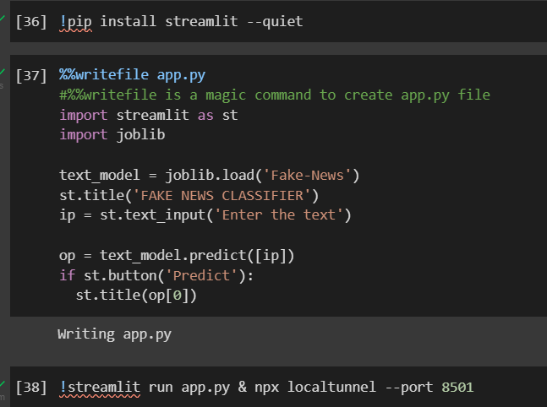
Deployment Using Streamlit

Slide 16
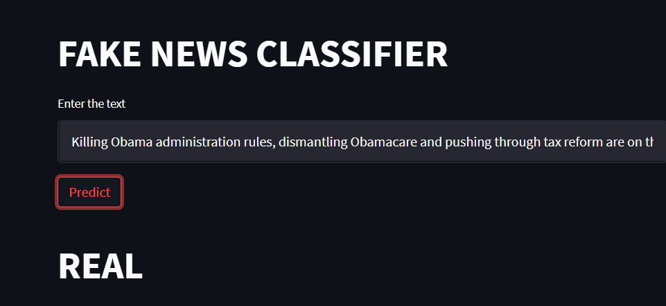
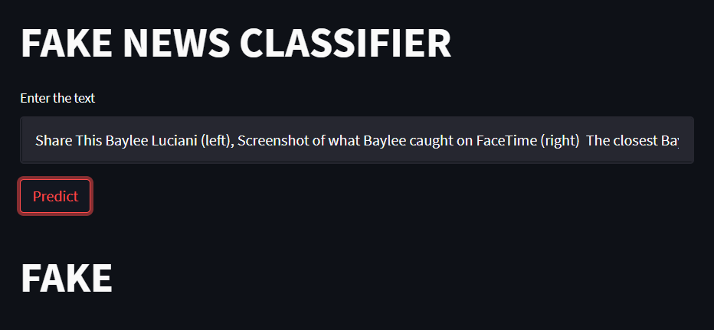
RESULTS

Slide 17
CONCLUSIONS
This paper presents a method of detecting fake news using support vector machine, trying to determine the best features and techniques to detect fake news. We started by studying the field of fake news, its impact and its detection methods.
We then designed and implemented a solution that uses a dataset of news preprocessed using cleaning techniques and TF-IDF to extract a set of features allowing to detect fake news.
We applied then Support Vector Machine algorithm on our features dataset to build a model allowing the classification of the new information.
The support vector machine seems the best algorithm to detect fake news, because it gave a better recognition rate, and allowed to give for each information a degree of confidence for its classification.
The work we have done could be completed and continued in different aspects. It would be relevant to extend this study with a larger dataset, and to evolve its supervised learning by another online for a continuous update and automatic integration of new fake news.

Slide 18
LIMITATIONS
The accuracy of detecting fake news will not be 100%.
Therefore some articles may be predicted as false.

Slide 19
REFERENCES
[1] S. Gilda, "Notice of Violation of IEEE Publication Principles: Evaluating machine learning algorithms for fake news detection," 2017 IEEE 15th Student Conference on Research and Development (SCOReD), 2017, pp. 110-115, DOI: 10.1109/SCORED.2017.8305411.
[2] M. Granik and V. Mesyura, "Fake news detection using naive Bayes classifier," 2017 IEEE First Ukraine Conference on Electrical and Computer Engineering (UKRCON), 2017, pp. 900-903, DOI: 10.1109/UKRCON.2017.8100379.

Slide 20
THANK YOU

