Slide 1
AmazeCare Hospital Management System
Trainer’s Name: Presented By:
Mr.Javeed Bhoomika D

Slide 2
Introduction
Healthcare systems require efficient management
Traditional methods are time-consuming and error-prone
Digital solutions improve accuracy and accessibility
AmazeCare provides a modern healthcare management platform

Slide 3
Scope
• Efficient Appointment Booking: Enable patients to schedule appointments online, reducing waiting times and improving overall patient experience.
• Comprehensive Medical Records: Store and manage patient medical records electronically for easy access by healthcare providers.
• Administrative Automation: Simplify administrative tasks such as handling medical records, staff records.

Slide 4
Definition
Design and develop AmazeCare, a full-stack healthcare application
Streamline patient management and healthcare services
Enable interaction between patients, doctors, and admin
Ensure efficient appointments, records, and communication

Slide 5
Modules
Patient Module
Doctor Module
Admin Module
Appointment Module
Security Module
Medical Records Module

Slide 6
Technologies Used
Frontend: React
Backend: Spring Boot
Database: MySQL
Authentication: JWT

Slide 7
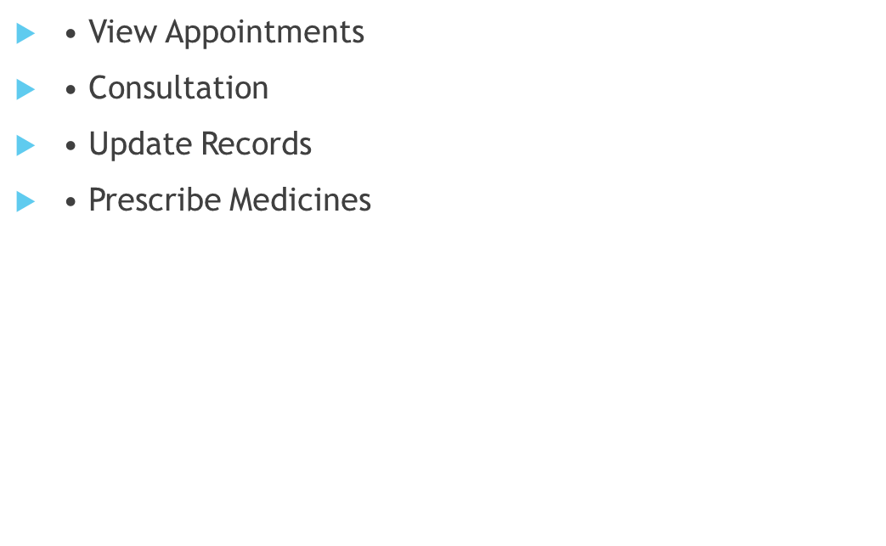
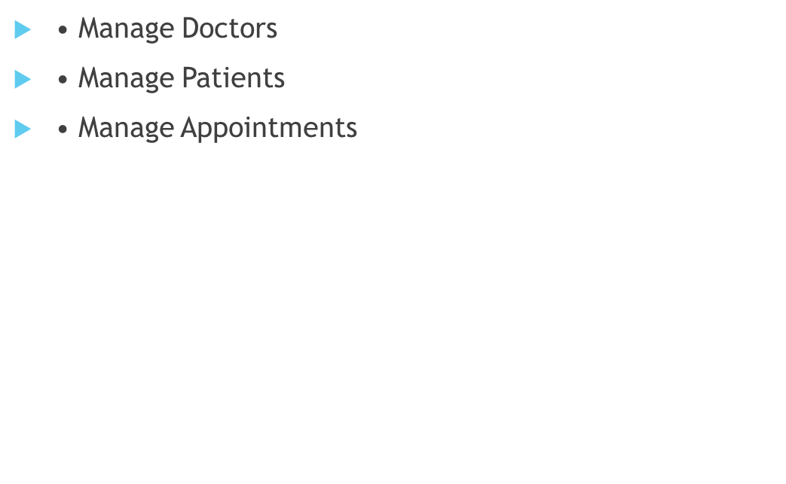
Patient Features Doctor Features
• Register/Login
• Book Appointment
• View Medical History
• Cancel/Reschedule Appointments
Admin Features

Slide 8
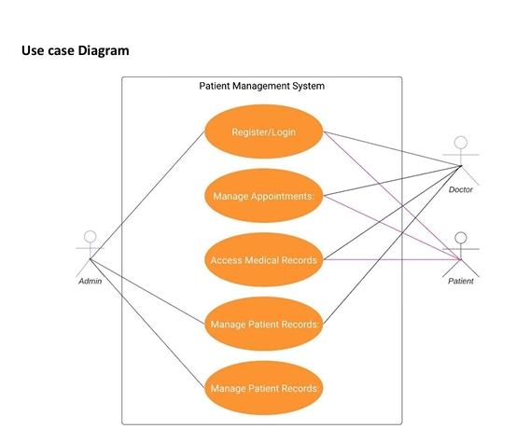

Slide 9
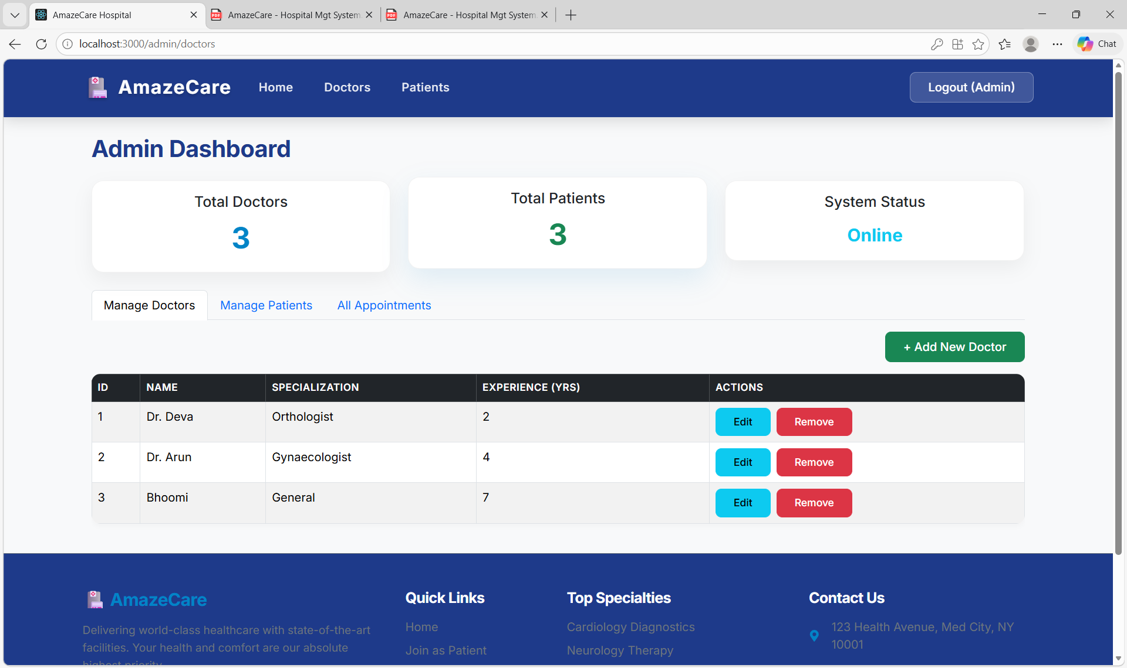
Screenshots

Slide 10
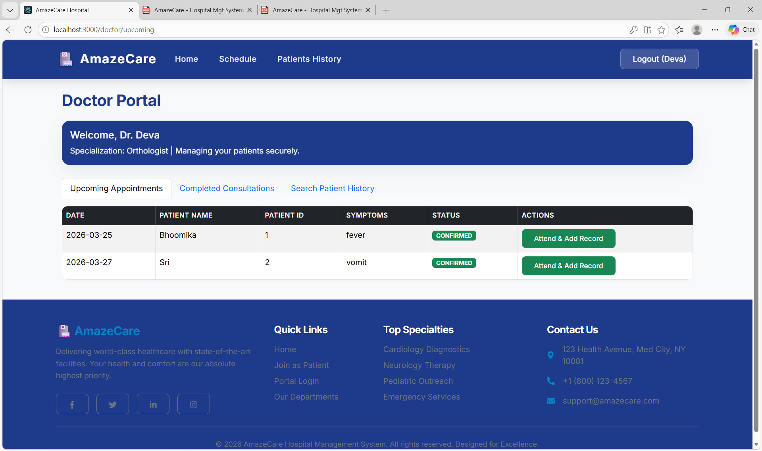

Slide 11
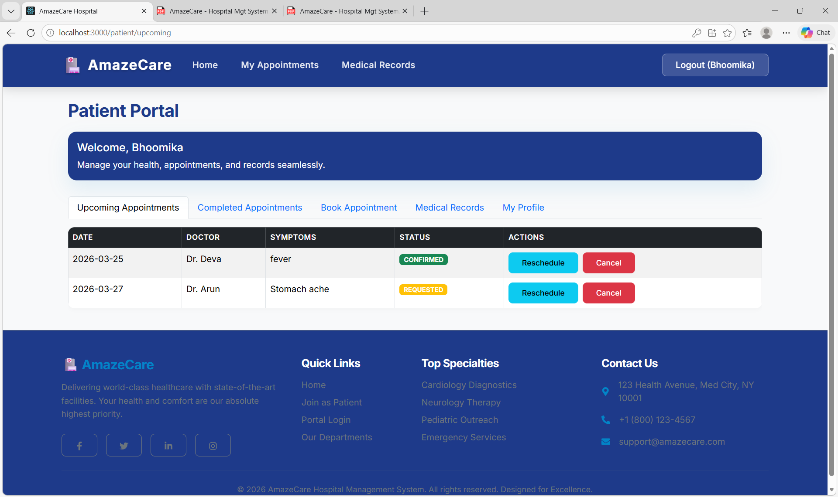

Slide 12
Conclusion
AmazeCare simplifies healthcare management
Improves efficiency and communication
Provides secure and scalable solution
Enhances overall patient care

