Slide 1

Energy-Efficient True Single Phase Clocked Flip Flop for High Performance Applications
Team
K.Sailatha (21NM1A0475)
K.Bhoomika (21NM1A0479)
K.Niharika (21NM1A0471)
M.Rupavathi (21NM1A0484)
Project Guide
Ms. S. Bindu Bhargavi
Assistant Professor
Department of Electronics and Communication Engineering
Vignan’s Institute of Engineering for Women(A)
Affiliated to JNTU-GV, Visakhapatnam,
Andhra Pradesh – 530049.
Department of Electronics and Communication Engineering
Vignan’s Institute of Engineering for Women, Visakhapatnam

Slide 2
Contents
Introduction
Literature Survey
Objectives
Method & Methodology
Implementation
Results
Communicated paper status
Conclusion and Future Scope
References
Department of Electronics and Communication Engineering
Vignan’s Institute of Engineering for Women, Visakhapatnam

Slide 3
Introduction
Flip-flops are basic building blocks of sequential circuits that store one bit of data (0 or 1) in digital circuits.
They work with a clock signal and change output only when the clock ticks.
D flip-flop is a type of flip-flop that gives the output same as the input (D) on every clock edge.
D flip-flops are easy to use and are found in memory, registers, and counters and help in storing and timing data in digital systems like computers and processors.
Department of Electronics and Communication Engineering
Vignan’s Institute of Engineering for Women, Visakhapatnam

Slide 4
Literature survey
S.no | Title | Journal and Year | Observations | Limitations
1 | Improved Metastability of True Single-Phase Clock D-Flipflops with applications in Vernier TDCs | IEEE Transactions on Circuits and Systems,2022 | Proposes a shunt capacitor technique to reduce setup/hold time | Dynamic DFFs are sensitive to leakage currents and disturbances, which can limit their realibility.
2 | Ultra-Low Power Flip-Flop Design for IoT Applications Using Adaptive Pre-charge | IEEE Transactions on VLSI Systems,2022 | Introduces an adaptive pre-charge scheme that minimizes redundant operations | Increases circuit complexity and incurs a slight layout overhead.
3 | A Robust Low-Voltage Flip-Flop with Self-Retentive Architecture for Subthreshold Operation | IEEE Journal of Solid-State Circuits,2023 | Improves robustness in subthreshold regimes with a self-retentive design and offers enhanced soft-error tolerance | Exhibits increased setup time and moderate area overhead compared to conventional designs.
Department of Electronics and Communication Engineering
Vignan’s Institute of Engineering for Women, Visakhapatnam

Slide 5
Objectives
To implement an energy-efficient TSPC flip-flop.
To reduce power consumption through an input-aware precharge scheme.
To optimize transistor-level design for better performance.
To resist radiation-induced bit flips.
Department of Electronics and Communication Engineering
Vignan’s Institute of Engineering for Women, Visakhapatnam

Slide 6
Method & Methodology
A Tanner EDA is a software tool used for designing , simulating and verifying wave forms of a circuit design.
Design of TGFF : contention-free FF which is suitable for near-threshold operation.
Design of TSPC : It is a sequential logic circuit offer high speed operation for advanced technologies with minimal delay.
Design of SEU : Designed to resist radiation-induced bit flip.
Simulation : Uses EDA tools to analyze power,speed.
Department of Electronics and Communication Engineering
Vignan’s Institute of Engineering for Women, Visakhapatnam

Slide 7
Transmission-gate flip-flop (TGFF)
The Transmission-Gate Flip-Flop (TGFF) is the most widely used FF in current digital systems.
The TGFF is a contention-free FF which is suitable for near-threshold operation.
The main drawback of TGFF is the large clock network.
The internal nodes CKN and CKI toggle no matter what the input data is, and the nodes CKN and CKI drive a larger number of transistors.
Thus, the power consumption of TGFF is still large even if the data activity remains low.
Department of Electronics and Communication Engineering
Vignan’s Institute of Engineering for Women, Visakhapatnam

Slide 8
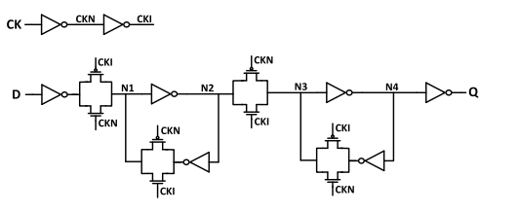
Fig 1: Schematic Design of the TGFF
Department of Electronics and Communication Engineering
Vignan’s Institute of Engineering for Women, Visakhapatnam

Slide 9
True Single-Phase Clock (TSPC) D-Flipflop
True Single-Phase Clock (TSPC) D-Flipflops are a class of sequential logic circuits designed to operate with a single clock signal.
Advantages of TSPC D-Flipflop is to Reduce clock skew and power consumption.
They also offer high-speed operation for advanced technologies.
It minimizes the power by employing an input-aware pre-charge scheme.
Department of Electronics and Communication Engineering
Vignan’s Institute of Engineering for Women, Visakhapatnam

Slide 10
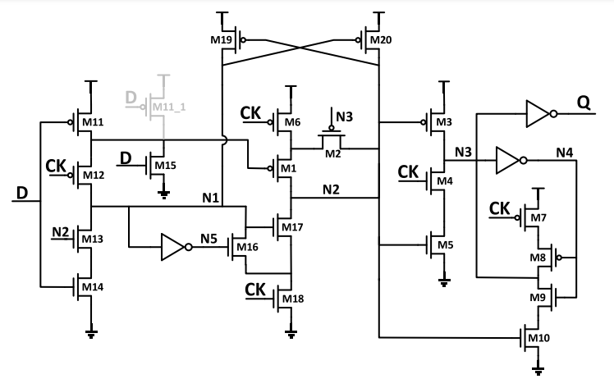
Fig 2: Schematic Design of the TSPC D-FF
Department of Electronics and Communication Engineering
Vignan’s Institute of Engineering for Women, Visakhapatnam

Slide 11
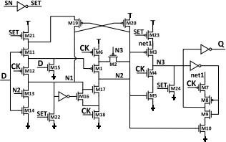
Fig 3: Schematic Design of the proposed TSPC FF with Set
Department of Electronics and Communication Engineering
Vignan’s Institute of Engineering for Women, Visakhapatnam

Slide 12
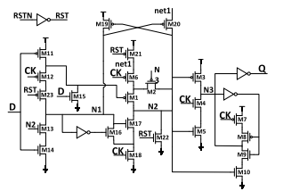
Fig 4: Schematic Design of the DFF with RESET
Department of Electronics and Communication Engineering
Vignan’s Institute of Engineering for Women, Visakhapatnam

Slide 13
Soft-Error Tolerant Optimization of the Proposed FF
SEU-tolerant flip-flops are designed to resist radiation-induced bit flips and ensure reliable data storage in critical applications.
They use redundancy, error correction, and feedback mechanisms to detect and recover from transient faults.
Design Techniques – Common approaches include Triple Modular Redundancy (TMR), Dual Interlocked Storage Cell (DICE), and error detection with correction circuits.
Applications – Widely used in aerospace, nuclear, medical, and safety-critical systems where data integrity is essential.
Department of Electronics and Communication Engineering
Vignan’s Institute of Engineering for Women, Visakhapatnam

Slide 14
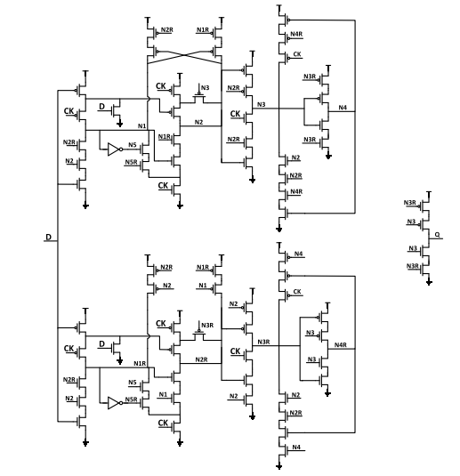
Fig 5: Schematic Design of the SEU-tolerant FF
Department of Electronics and Communication Engineering
Vignan’s Institute of Engineering for Women, Visakhapatnam

Slide 15
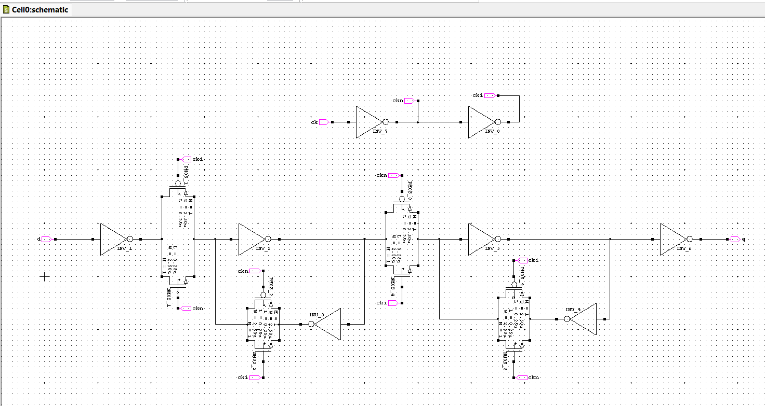
Implementation
Fig 6: Schematic Design of the TGFF
Department of Electronics and Communication Engineering
Vignan’s Institute of Engineering for Women, Visakhapatnam

Slide 16
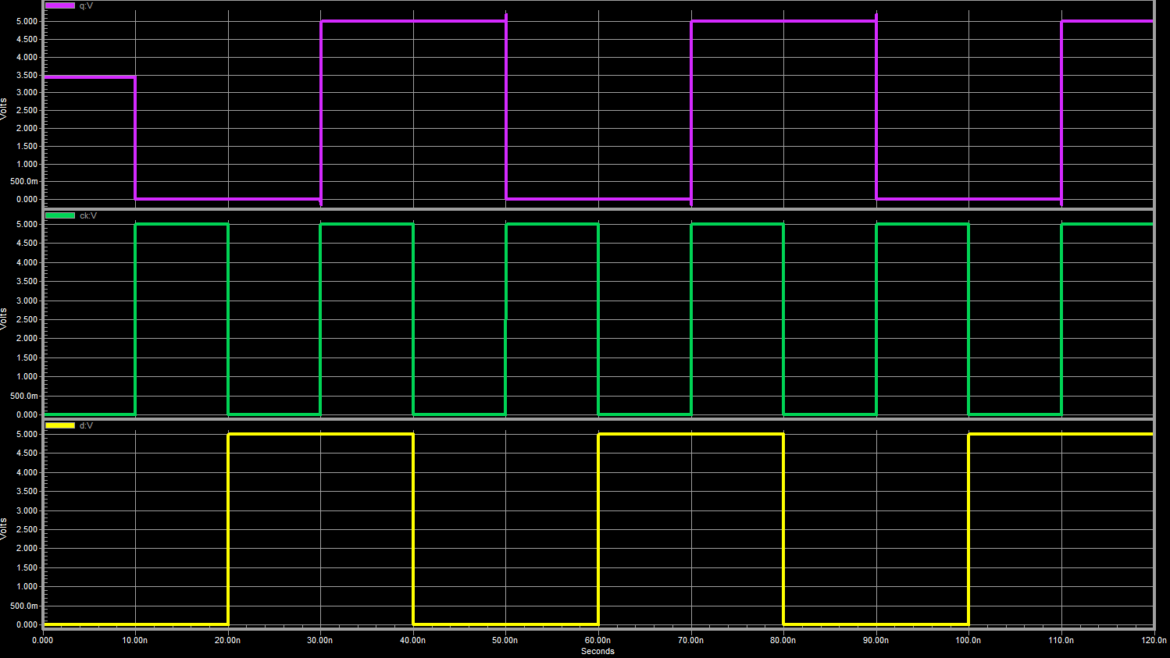
Fig 7: Transient Analysis of the TGFF
Department of Electronics and Communication Engineering
Vignan’s Institute of Engineering for Women, Visakhapatnam

Slide 17
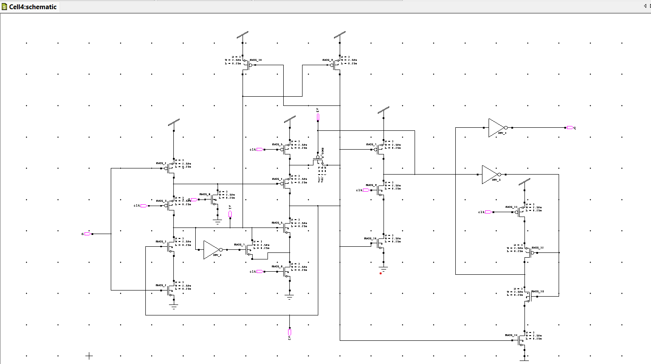
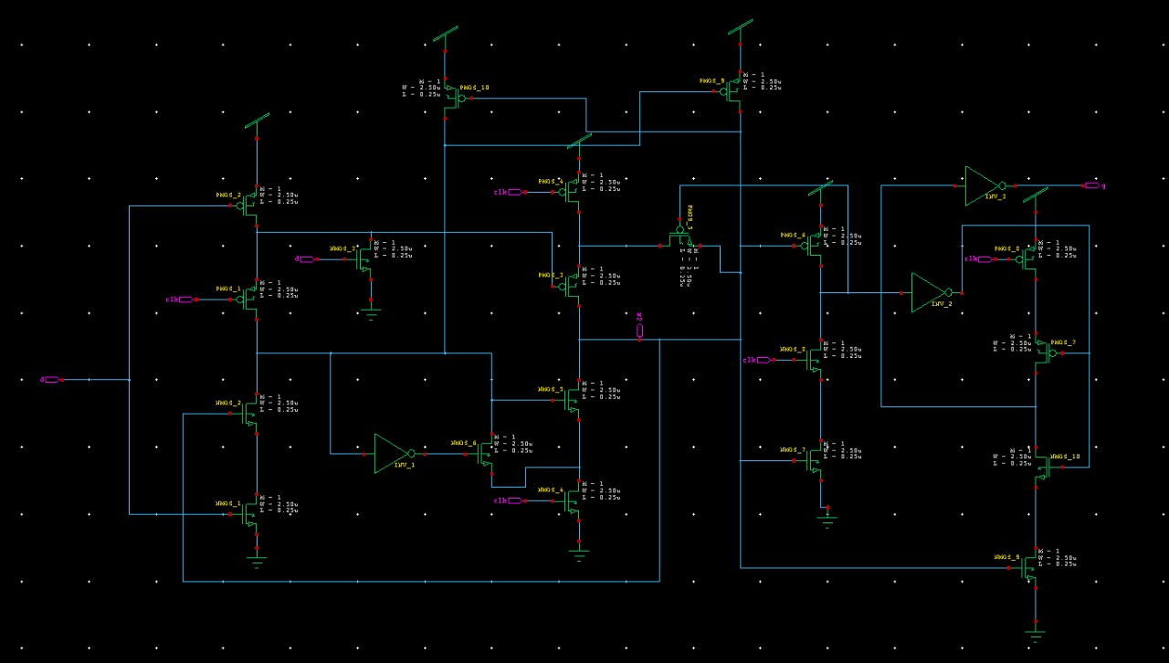
Fig 8: Schematic Design of the TSPC D-FF
Department of Electronics and Communication Engineering
Vignan’s Institute of Engineering for Women, Visakhapatnam

Slide 18
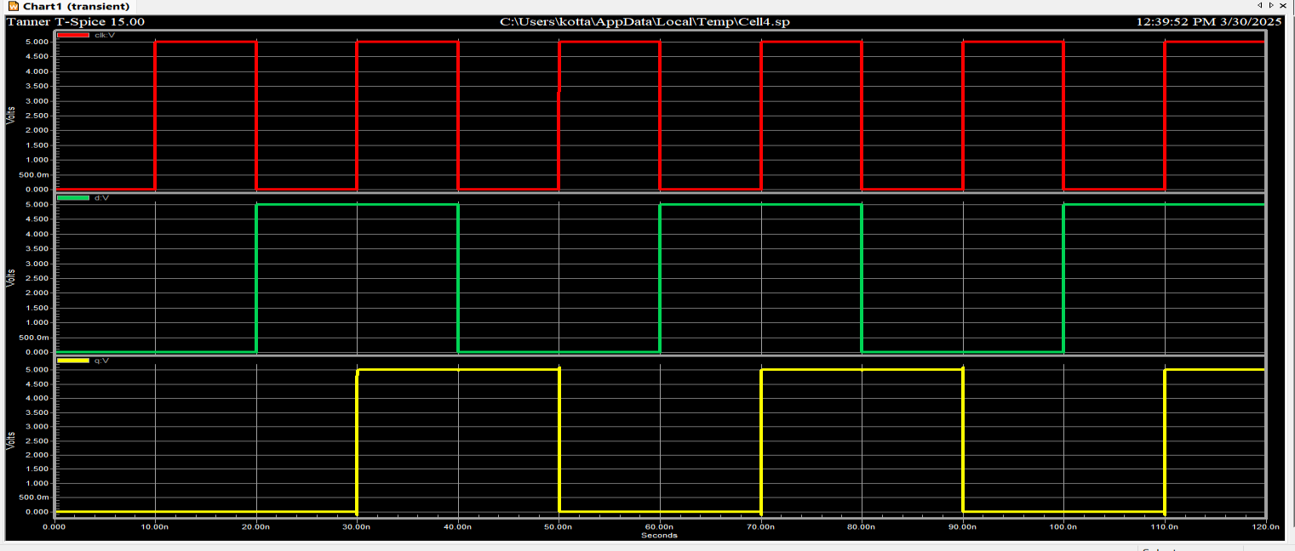
Fig 9: Transient Analysis of the TSPC DFF
Department of Electronics and Communication Engineering
Vignan’s Institute of Engineering for Women, Visakhapatnam

Slide 19
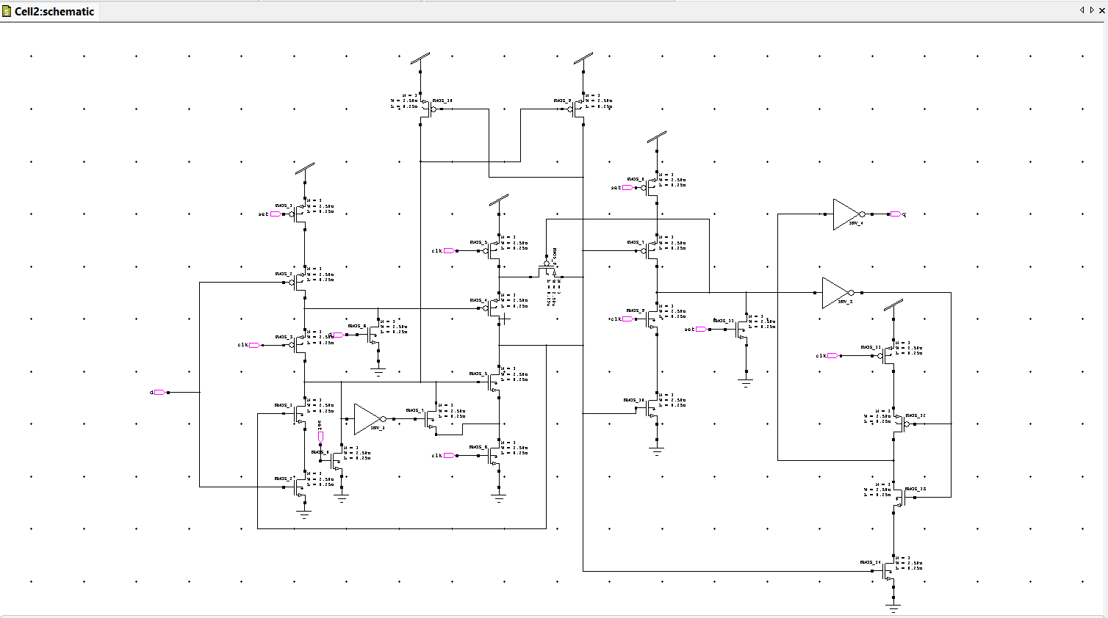
Fig 10: Schematic Design of the FF with SET
Department of Electronics and Communication Engineering
Vignan’s Institute of Engineering for Women, Visakhapatnam

Slide 20
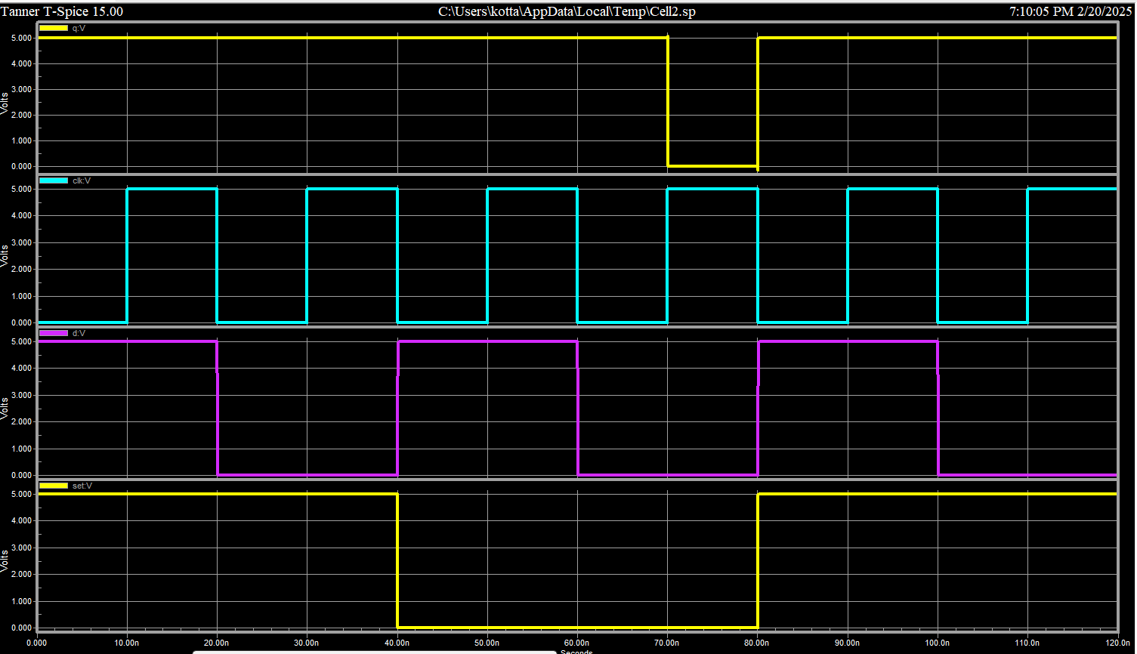
Fig 11: Transient Analysis of the FF with SET
Department of Electronics and Communication Engineering
Vignan’s Institute of Engineering for Women, Visakhapatnam

Slide 21
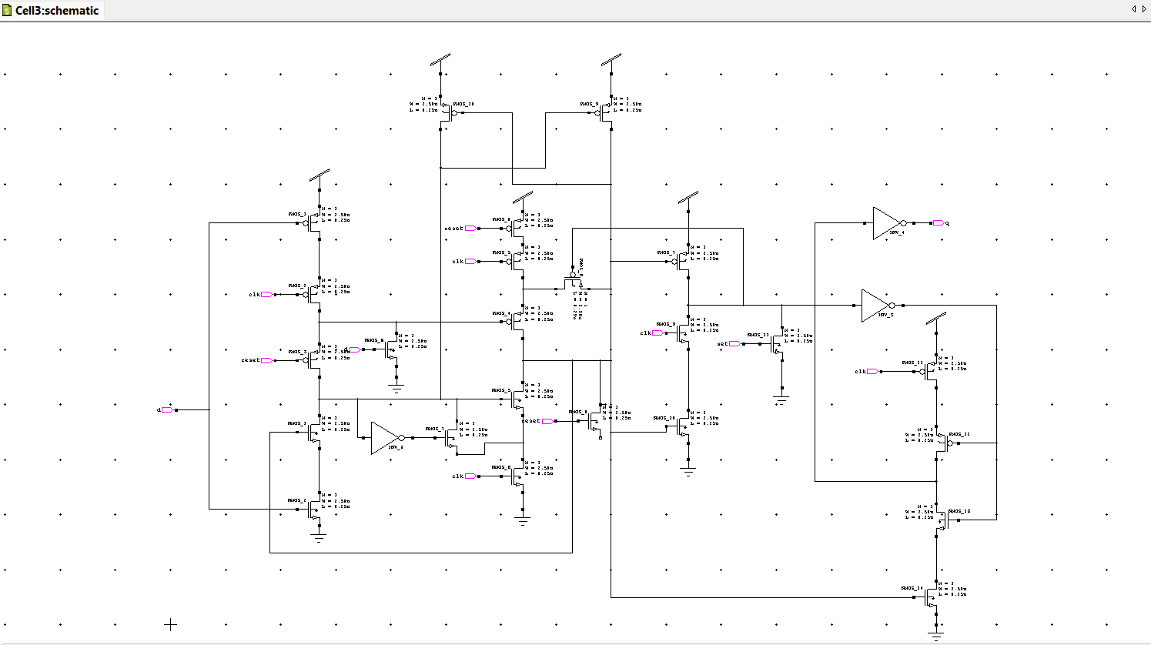
Fig 12: Schematic Design of the FF with RESET
Department of Electronics and Communication Engineering
Vignan’s Institute of Engineering for Women, Visakhapatnam

Slide 22
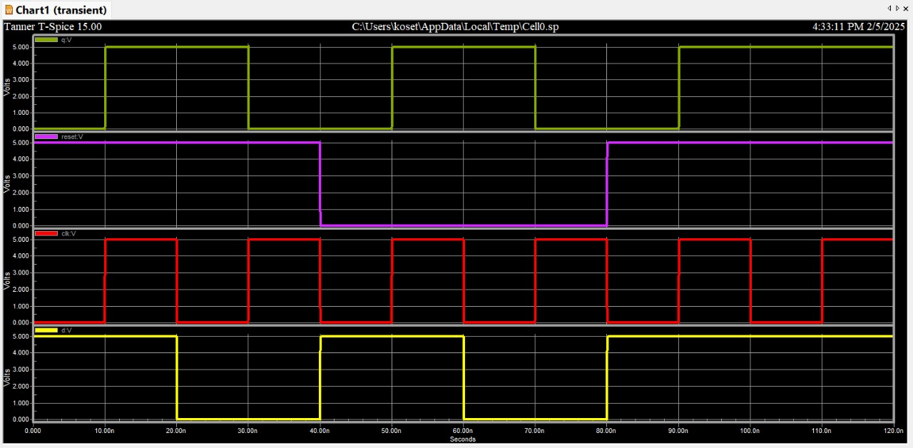
Fig 13: Transient Analysis of the FF with RESET
Department of Electronics and Communication Engineering
Vignan’s Institute of Engineering for Women, Visakhapatnam

Slide 23
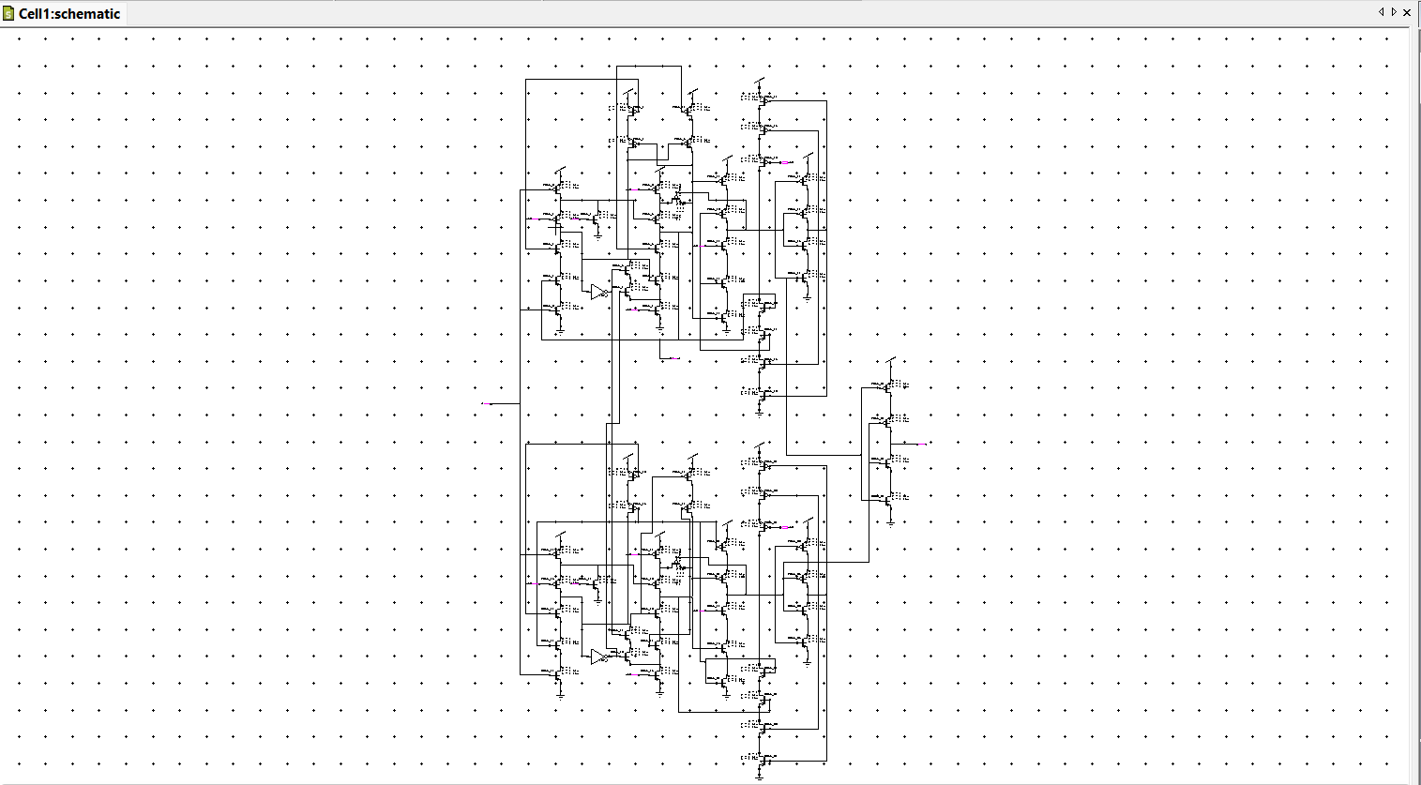
Fig 14: Schematic of the SEU-Tolerant FF (SEU-TFF)
Department of Electronics and Communication Engineering
Vignan’s Institute of Engineering for Women, Visakhapatnam

Slide 24
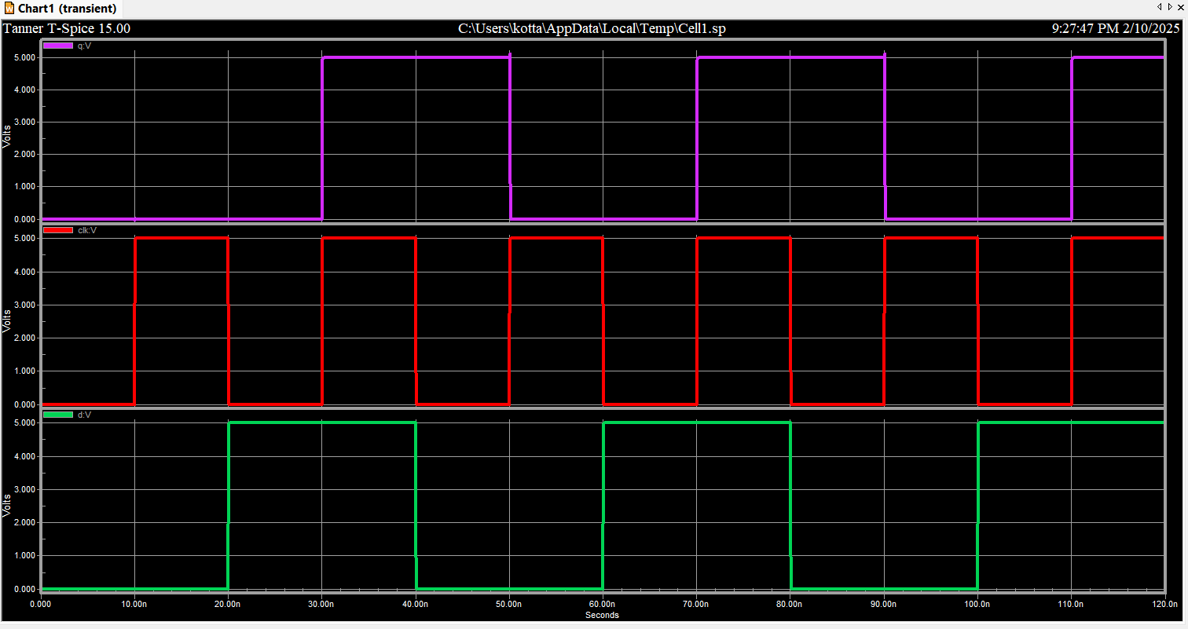
Fig 15: Transient Analysis of SEU-Tolerant FF (SEU-TFF)
Department of Electronics and Communication Engineering
Vignan’s Institute of Engineering for Women, Visakhapatnam

Slide 25
Results
parameters | TGFF | TSPC | TSPC with set | TSPC with reset | SEU
power | 3.69μW | 2.02μW | 4.5μW | 4.5μW | 2.9μW
delay | 20.0173sec | 17.5091sec | 40.0055sec | 40.9938sec | 17.5223sec
Table : Power and Delay Calculations
Department of Electronics and Communication Engineering
Vignan’s Institute of Engineering for Women, Visakhapatnam

Slide 26
Communicated paper status
Published in International Conference on Radio Frequency, Communication & Networks (SASTRA) - 2025
Paper Submitted: Before the deadline on April 5,2025.
Acceptance Notification: Awaiting decision
Department of Electronics and Communication Engineering
Vignan’s Institute of Engineering for Women, Visakhapatnam

Slide 27
Conclusion
The TSPC FF significantly reduces power consumption.
Eliminates redundant pre-charge and discharge operations.
Operates robustly at low voltages.
Hence,SEU-tolerant flip-flops are used to resist radiation-induced bit flips and to ensure reliable data storage in critical applications.
Department of Electronics and Communication Engineering
Vignan’s Institute of Engineering for Women, Visakhapatnam

Slide 28
Future Scope
Further Power Optimization – Exploring alternative circuit techniques to further minimize power consumption in flip-flop designs.
Technology Scaling – Analyzing how the proposed design performs in smaller technology nodes (e.g., 5nm, 3nm).
Application in IoT and AI Chips – Integrating the design in real-world applications like IoT devices or low-power AI accelerators.
Department of Electronics and Communication Engineering
Vignan’s Institute of Engineering for Women, Visakhapatnam

Slide 29
References
[1]Parth Parekh, Fei Yuan, and Yushi Zhou, "Improved Metastability of True Single-Phase Clock D-Flipflops With Applications in Vernier Time-to-Digital Converters," IEEE Transactions on Circuits and Systems—I: Regular Papers, vol. 69, no. 3, pp. 1102-1114, March 2022. DOI: 10.1109/TCSI.2021.3122340.
[2]Parekh, P.,F. Yuan, and Y. Zhou."Area/Power-Efficient True-Single Phase-Clock D-Flip-Flops with Improved Meta stability." Proceedings of the IEEE International Mid west Symposium on Circuits and Systems(MWSCAS), Aug. 2020, pp. 182-185
[3]T. Tekeste, H. Saleh, B. Mohammad, and M. Ismail, “Ultra-low power QRS detection and ECG compression architecture for IoT healthcare devices,” IEEE Trans. Circuits Syst. I, Reg. Papers, vol. 66, no. 2, pp. 669–679, Feb. 2019.
Department of Electronics and Communication Engineering
Vignan’s Institute of Engineering for Women, Visakhapatnam

Slide 30
[4] A. Andrei, P. Eles, O. Jovanovic, M. Schmitz, J. Ogniewski, and Z. Peng, “Quasi-static voltage scaling for energy minimization with time constraints,” IEEE Trans. Very Large Scale Integr. (VLSI) Syst., vol. 19, no. 1, pp. 10–23, Jan. 2011.
[5] A. Pullini, D. Rossi, I. Loi, G. Tagliavini, and L. Benini, “Mr. Wolf:An energy-precision scalable parallel ultra low power SoC for IoT edge processing,” IEEE J. Solid-State Circuits, vol. 54, no. 7, pp. 1970–1981,Jul. 2019.
[6] J. P. Cerqueira, T. J. Repetti, Y. Pu, S. Priyadarshi, M. A. Kim,and M. Seok, “Catena: A near-threshold, sub-0.4-mW, 16-core programmable spatial array accelerator for the ultralow-power mobile and embedded Internet of Things,” IEEE J. Solid-State Circuits, vol. 55,no. 8, pp. 2270–2284, Aug. 2020.
Department of Electronics and Communication Engineering
Vignan’s Institute of Engineering for Women, Visakhapatnam

Slide 31
THANK YOU!
Department of Electronics and Communication Engineering
Vignan’s Institute of Engineering for Women, Visakhapatnam

