Slide 1
PROJECT TITLE:-An AI agent designed to assist faculty with nba accreditation processes(RAG based)
CAPSTONE PROJECT
Presented By:
1. Bhoomika-University BDT college of Engineering,Davangere-E&I

Slide 2
OUTLINE
Problem Statement (Should not include solution)
Proposed System/Solution
System Development Approach (Technology Used)
Algorithm & Deployment
Result (Output Image)
Conclusion
Future Scope
References

Slide 3
Problem Statement
Preparing for NBA accreditation is a complex and document-intensive process that often overwhelms faculty and coordinators due to manual efforts in compiling SAR reports, CO-PO mappings, and compliance documentation. The lack of automated support tools leads to inefficiencies, errors, and delays.
This project aims to develop an AI-powered assistant using IBM Cloud and Granite LLM that helps faculty interpret NBA criteria, retrieve SAR templates, guide CO-PO mapping, and answer common accreditation queries in real time. The assistant will use Retrieval-Augmented Generation (RAG) to ensure accurate, context-based responses, reducing manual workload and improving the quality and speed of NBA SAR preparation.

Slide 4
Proposed Solution
To address the challenges faced by faculty members during NBA SAR preparation, we propose the development of an AI-powered Accreditation Assistant using IBM Cloud and Granite LLM.
This intelligent assistant will:
🧠 Understand and respond to natural language queries related to NBA accreditation (Criteria 1 to 10).
📁 Provide formatted templates for SAR documentation, including Vision/Mission statements, CO–PO matrices, attainment records, and more.
🔄 Assist in mapping and calculating Course Outcomes (CO), Program Outcomes (PO), and Program Specific Outcomes (PSO), using defined rubrics.
🔍 Use Retrieval-Augmented Generation (RAG) to ensure accurate, real-time answers grounded in institutional and NBA data.
☁️ Be deployed on IBM Cloud AgentLab, making it accessible through a simple chat interface for faculty, coordinators, and administrators.
To address the challenges faced by faculty members during NBA SAR preparation, we propose the development of an AI-powered Accreditation Assistant using IBM Cloud and Granite LLM.
This intelligent assistant will:
🧠 Understand and respond to natural language queries related to NBA accreditation (Criteria 1 to 10).
📁 Provide formatted templates for SAR documentation, including Vision/Mission statements, CO–PO matrices, attainment records, and more.
🔄 Assist in mapping and calculating Course Outcomes (CO), Program Outcomes (PO), and Program Specific Outcomes (PSO), using defined rubrics.
🔍 Use Retrieval-Augmented Generation (RAG) to ensure accurate, real-time answers grounded in institutional and NBA data.
☁️ Be deployed on IBM Cloud AgentLab, making it accessible through a simple chat interface for faculty, coordinators, and administrators.

Slide 5
System Approach
The system follows a modular architecture to assist in NBA SAR preparation using AI.
User Interface: A simple chat interface for faculty to ask NBA-related questions in natural language.
AI Engine (RAG): Combines IBM Granite LLM with document retrieval to provide accurate, fact-based answers.
Knowledge Base: Contains SAR documents, CO–PO mapping formats, criterion details, and FAQs in structured format.
Query Processor:
Extracts user intent and fetches relevant answers from the knowledge base using semantic search.
Deployment: Hosted on IBM Cloud AgentLab for real-time access, ensuring scalability and secure performance.

Slide 6
Algorithm & Deployment
🧠 Algorithm (RAG-Based Response Generation)
We use the Retrieval-Augmented Generation (RAG) approach with IBM Granite LLM to provide accurate and contextual responses.
Steps:
Input Query: User asks a question (e.g., "What is Criterion 3 in NBA?")
Preprocessing: Clean and tokenize the query using Natural Language Processing (NLP)
Document Retrieval: Retrieve top-matching documents from the knowledge base (SAR PDFs, Markdown)
Context Fusion: Combine the retrieved content with the user query
Response Generation: IBM Granite LLM generates a human-like answer, grounded in real data
Response Output: Displayed instantly on the chat interface with high accuracy

Slide 7
Algorithm & Deployment
☁️ Deployment (IBM Cloud Platform)
Tools Used:
✅ IBM Cloud Lite Account
✅ IBM Watson AgentLab
✅ IBM Granite LLM (2024 series)
✅ Markdown/PDF Knowledge Base
✅ RAG Framework for factual accuracy
Deployment Steps:
Create an Agent in IBM Watsonx AgentLab
Upload the NBA SAR documents and training data (Markdown, JSON, PDF)
Enable Granite LLM + RAG for grounded response generation
Customize user interface with prompts for faculty users
Test and deploy the assistant for 24x7 usage via web

Slide 8
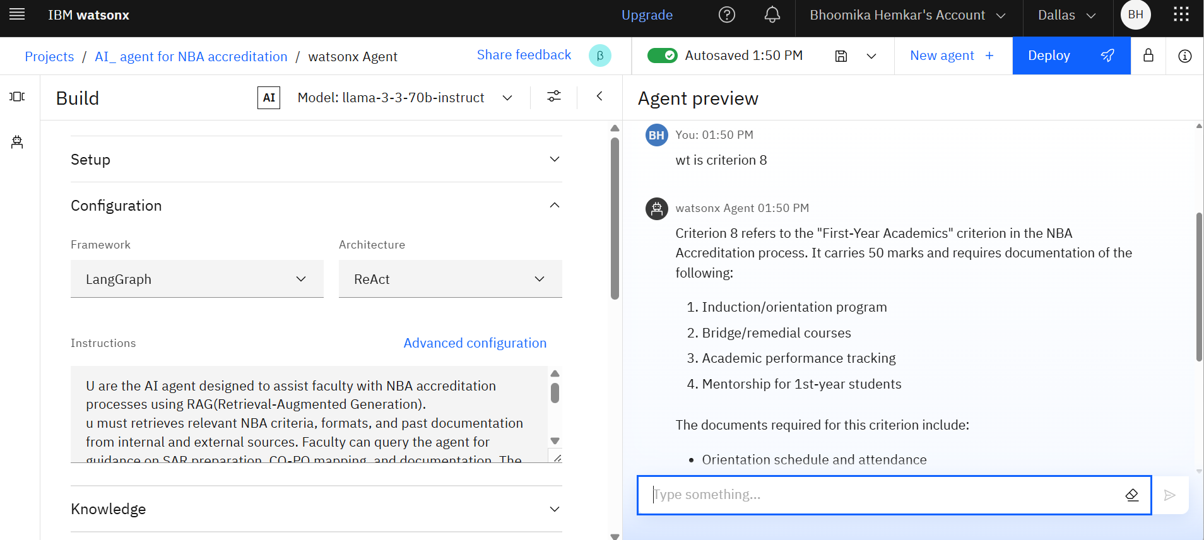
Result

Slide 9
Conclusion
The proposed AI-powered assistant for NBA Accreditation successfully addresses the challenges faced by faculty in preparing Self-Assessment Reports (SAR). By leveraging IBM Cloud, Granite LLM, and Retrieval-Augmented Generation (RAG), the system provides accurate, real-time responses grounded in institutional data.
This assistant simplifies:
Understanding of NBA criteria
Retrieval of SAR templates and documents
CO–PO–PSO mapping guidance
Overall faculty support during accreditation

Slide 10
Future scope
The AI Assistant for NBA Accreditation can be further enhanced and expanded in the following ways:
📄 Auto-Fill SAR Templates: Integrate editable SAR formats where the agent can auto-fill based on user input or uploaded data.
🌐 Multilingual Support: Enable the assistant to respond in regional languages like Kannada, Hindi, etc., to improve accessibility for all faculty.
📊 Dynamic CO–PO Attainment Calculator: Build a visual dashboard where faculty can upload marks and automatically compute attainment levels and gaps.
🏫 Support for Other Accreditations: Extend the assistant to support NAAC, ABET, and ISO 21001 frameworks using similar architecture.
🤖 Integration with ERP & LMS: Connect the assistant with college ERP systems and learning platforms like Moodle for real-time data analysis.
📱 Mobile and WhatsApp Interface: Create mobile apps or WhatsApp chatbots to make the assistant available anytime, anywhere.

Slide 11
References
National Board of Accreditation (NBA), India https://www.nbaind.org
NBA Self-Assessment Report (SAR) Guidelines – Tier I and Tier II National Board of Accreditation – Official Documentation, 2024 Edition
IBM Cloud Docs – Watsonx & AgentLab https://cloud.ibm.com/docs
IBM Granite LLM Technical Overview IBM Research, 2024 https://research.ibm.com/models/granite
Retrieval-Augmented Generation (RAG): Facebook AI Research Lewis et al., “Retrieval-Augmented Generation for Knowledge-Intensive NLP Tasks” – NeurIPS 2020
Outcome-Based Education: NBA Accreditation Booklet AICTE Publication Series, 2023
Course Outcome and Program Outcome Mapping: Manuals from NPTEL AICTE-FDP on OBE & NBA, 2023

Slide 12
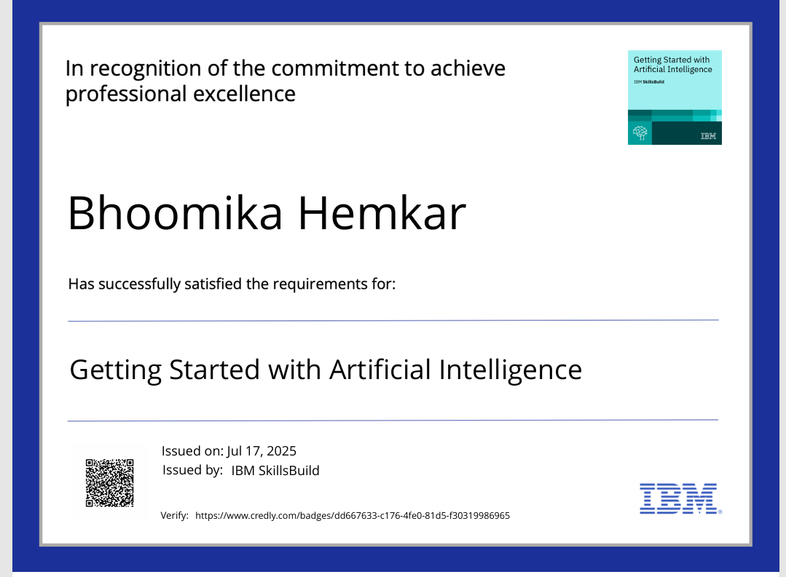
IBM Certifications

Slide 13
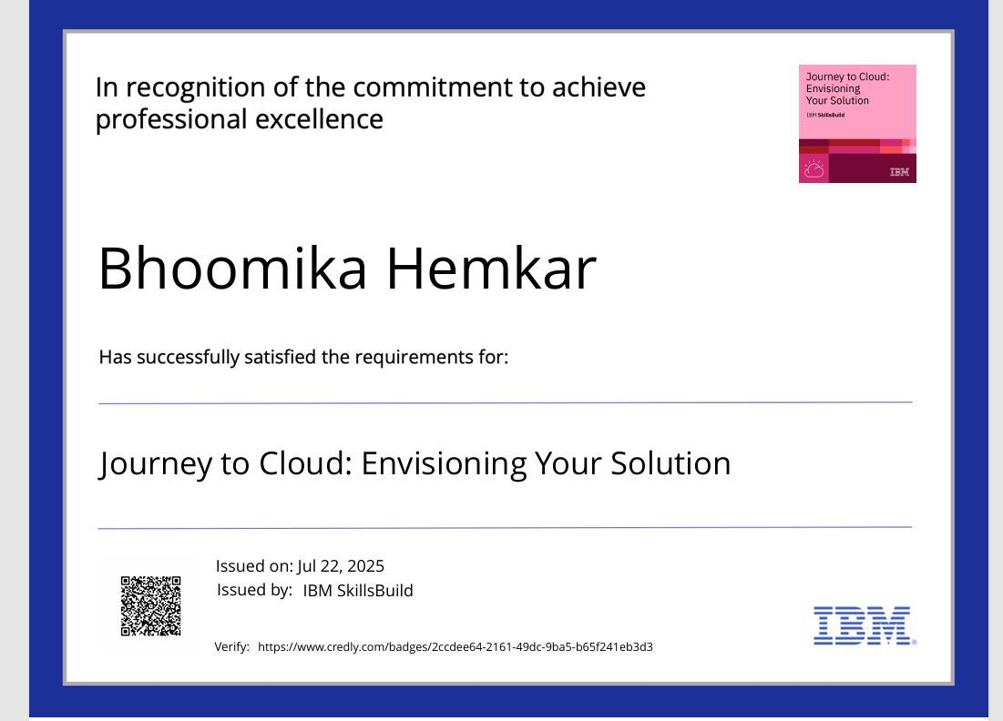
IBM Certifications

Slide 14
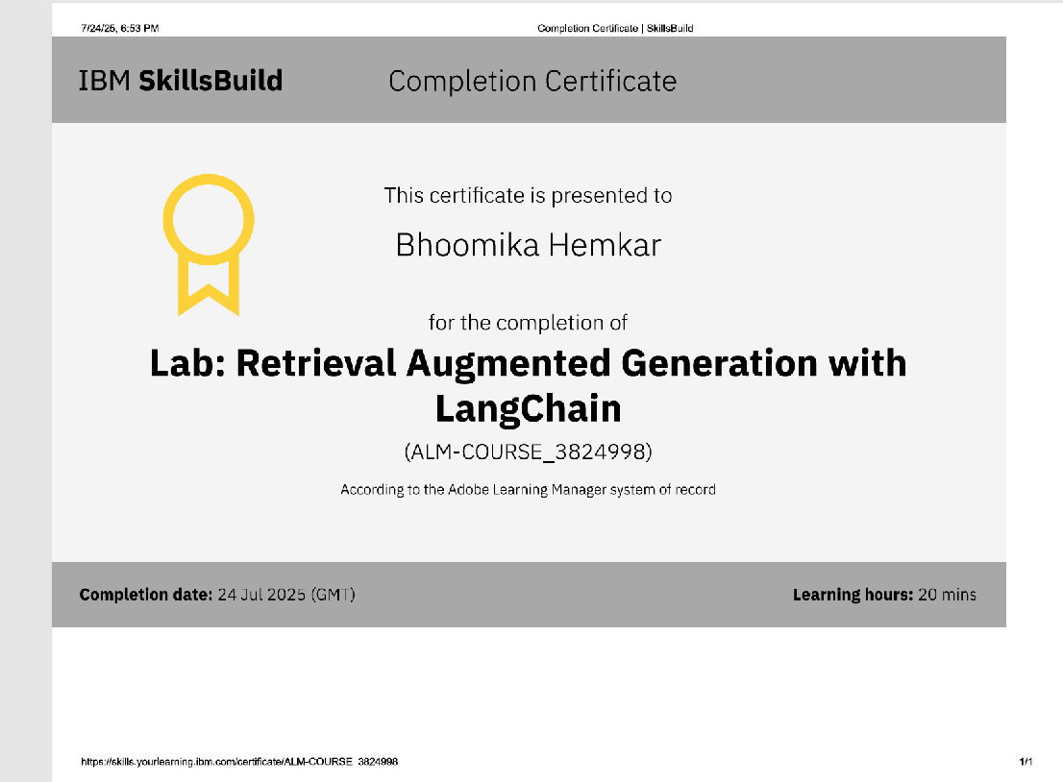
IBM Certifications

Slide 15
THANK YOU

