Slide 1

Mini Project
PERSONALITY PREDICTION VIA CV ANALYSIS
Presented By BATCH-02

Slide 2
TEAM MEMBERS
22331A4241 – N. Bhoomika Sai
22331A4212 – D. Harshita
23335A4203 – K. Chandra Sekhar
23335A4207 – V. Ramya Sree
SUPERVISED BY
Dr. P. Srinivasa Rao
Associate Professor
Dept. of Data Engineering
MVGR College of Engineering(A)

Slide 3


Problem Statement
Recruitment processes in organizations often rely on conventional methods, such as manually shortlisting resumes and conducting subjective evaluations. These methods are time-consuming, prone to biases, and may fail to comprehensively assess both the professional qualifications and personality traits of candidates. This creates inefficiencies and reduces the fairness and transparency of the recruitment process. There is a need for an automated system that integrates personality evaluation with professional eligibility screening to ensure objective, data-driven, and equitable recruitment decisions.

Slide 4
Abstract
This system streamlines recruitment through an online platform where candidates register and undergo personality assessments via Multiple-Choice Questions (MCQs). These quizzes analyze behavioral and psychological traits, while an AI-driven module evaluates CVs against a trained dataset. The system employs machine learning models such as Logistic Regression, Support Vector Machine, Decision Tree, and Random Forest for precise classification and decision-making.
By automating candidate screening, the platform enhances efficiency, transparency, and fairness. Candidates receive insights into their personality and job suitability, while recruiters access objective data for informed decision-making. This integrated approach modernizes recruitment by ensuring a perfect match between professional qualifications and personality traits, ultimately driving organizational success.

Slide 5
Literature Survey
Reference | Method/Algorithm Used | Key Contributions | Limitations
Xinyu Shui et al. | Physiological signals (HR data from a commercial bracelet) | Explored Big-Five personality assessment through physiological signals in real-life settings | Limited sample size (only 80 male students), controlled environment may not generalize to real-world scenarios
Nandani Agarwal et al. | Machine learning Algorithms | Developed an automated system for predicting personality traits from resumes | Accuracy depends on CV quality; lacks multimodal personality assessment
Amal Khalifa Al Aamer et al. | AI-powered recruitment system | Highlighted AI's role in improving HR processes with benefits such as increased productivity and accuracy | No specific implementation details; lacks empirical validation with real-world datasets
Anum Jaffar et al. | Multi-modal system (Facial expressions, body/head poses, BFI questionnaire, CNN with FER+ dataset) | Achieved high accuracy (95.14%) in personality prediction using non-verbal cues and expert analysis | Requires specialized hardware (cameras, sensors); privacy concerns in workplace applications
Darpan Jain, Rajesh Kumar et al. | Machine learning for CV-based personality prediction | Evaluated different ML models for enhancing recruitment efficiency | Focuses only on CV analysis, missing multimodal aspects like behavior and physiological data

Slide 6
Existing Models
Resume parsing, keyword-based screening, and chatbot-based assessments.
Resume parsing systems extract structured data from CVs but do not analyze personality traits or behavioral attributes.
Keyword-based screening matches resumes with job descriptions but lacks contextual understanding, often filtering candidates based on keyword presence rather than actual relevance.
Chatbot-based hiring assistants assist in initial screening; however, they rely on predefined responses and fail to provide deep personality insights.
Limitations
They neglecting soft skills and personality traits, which are essential for job compatibility.
Existing systems often suffer from bias in keyword matching, where qualified candidates may be overlooked simply because their resumes do not contain specific terms.
Lack advanced Natural Language Processing (NLP) capabilities to analyze text structure, sentiment, and behavioral patterns.
Limited Datasets with low accuracy algorithms.

Slide 7

Proposed System
USER MODULE
ADMIN MODULE
1.Login
2.Manage Questions assessments
3.View details
4.Add job Details
5.Shortlist Candidate
1.Registration and Login
2.Attend Tests
3.Upload CV
4.View Results

Slide 8
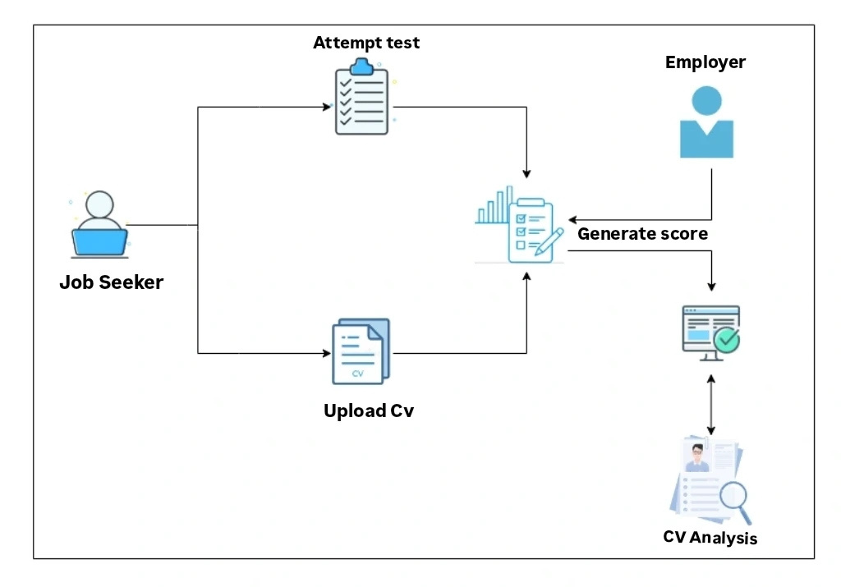
System Model

Slide 9
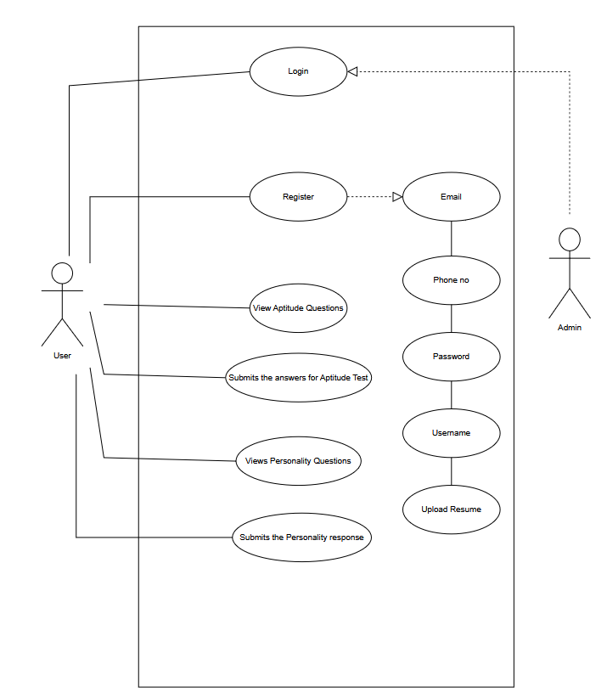
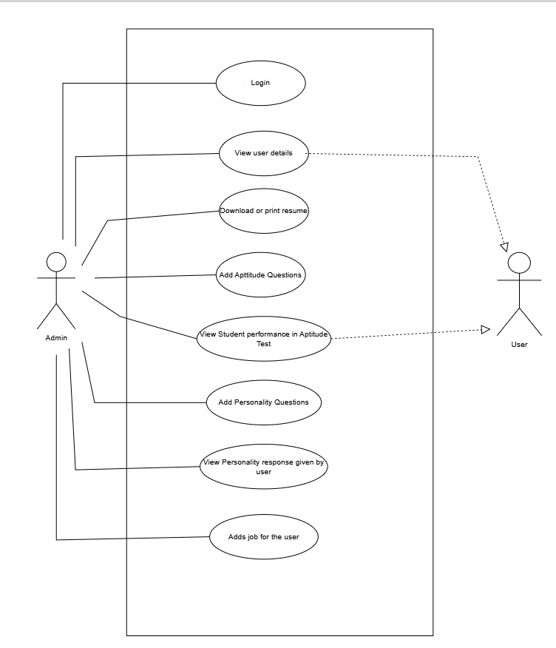
User module
Admin module

Slide 10
Methodology
.
The methodology includes data processing, developing a machine learning model and user interface design. The system is divided into two modules : Admin module and User module.
Admin Module
Admin has an authorized login.
Manage aptitude and personality questions.
Add job details and requirements.
View details of the user test results, CVs and the shortlisted candidate.
User Module
Register to the system.
Upload CV.
Attend the aptitude and personality tests.
View the test score.
CV Analysis
The CV data that job seekers submit is given to the system by admin.
Preprocess the data and use the training model to predict the personality, match the job requirements and shortlist the candidates.

Slide 11
Technologies Used
Frontend
Backend
HTML
CSS
JavaScript
Bootstrap
Flask
Tornado server
MongoDB
Database Layer
Machine Learning Algorithms
MongoDB
Logistic Regression
Random Forest
Support Vector Machine
Decision tree
Libraries and Packages
Sklearn
Imblearn
PyPDF2

Slide 12
End Users
Recruitment Teams (Admins)
Job Seekers (Candidates)
Organizations or Enterprises
HR professionals, recruitment managers, or employers responsible for hiring candidates.
Individuals looking to apply for jobs via the e-recruitment system.
Companies or institutions adopting the system for large-scale hiring.
Software Developers and
Researchers
Potential Industries
1.IT companies.
2.Educational institutions for student placements.
3.Government recruitment agencies.
4.Startups and SMEs seeking efficient hiring solutions.
Developers and AI researchers
enhancing or
studying e-recruitment processes.

Slide 13
Results
We experimented with various ML algorithms, including Logistic Regression, Random Forest, SVM, and Decision Tree. After training and testing, Logistic Regression and Random Forest showed the highest accuracy. Logistic Regression achieved 96.36%, with SVM performing closely. The class-wise performance metrics indicate that both models effectively capture personality traits from CV text, as evidenced by high precision, recall, and F1-scores.
Model | Accuracy | Precision | F1-score | Recall
Logistic Regression | 0.9636 | 0.97 | 0.96 | 0.96
Support Vector Machine | 0.9608 | 0.96 | 0.96 | 0.96

Slide 14
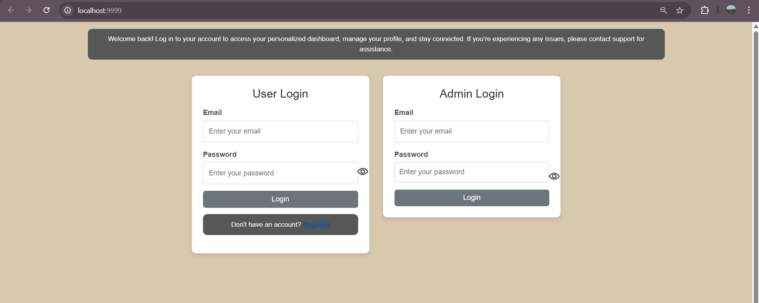
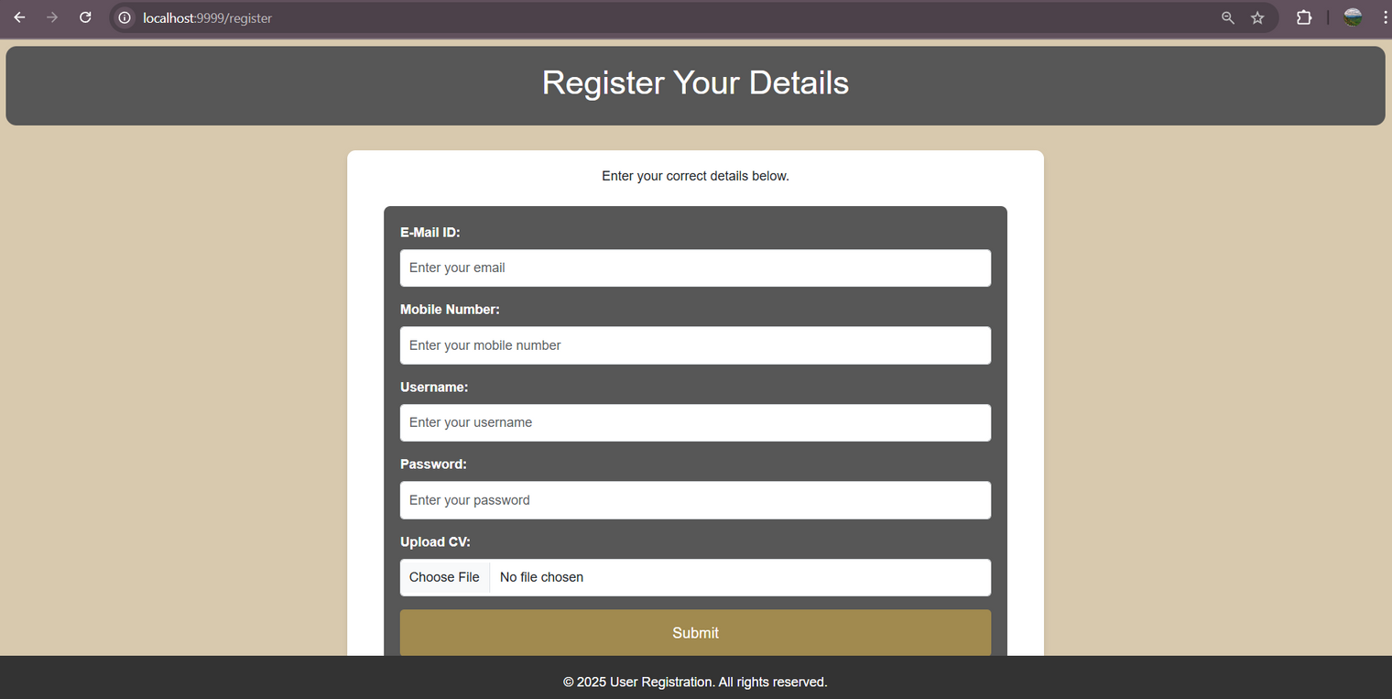

Slide 15
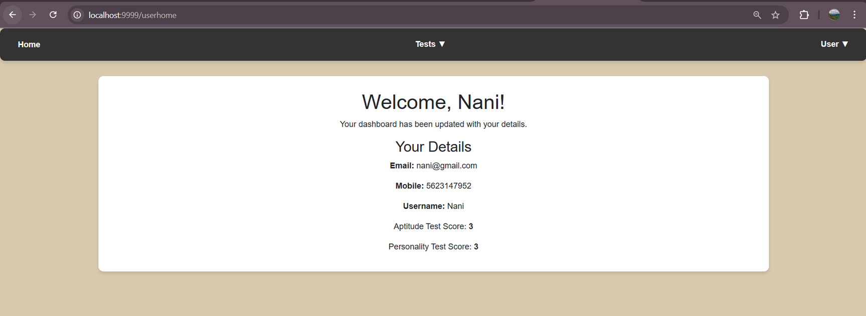
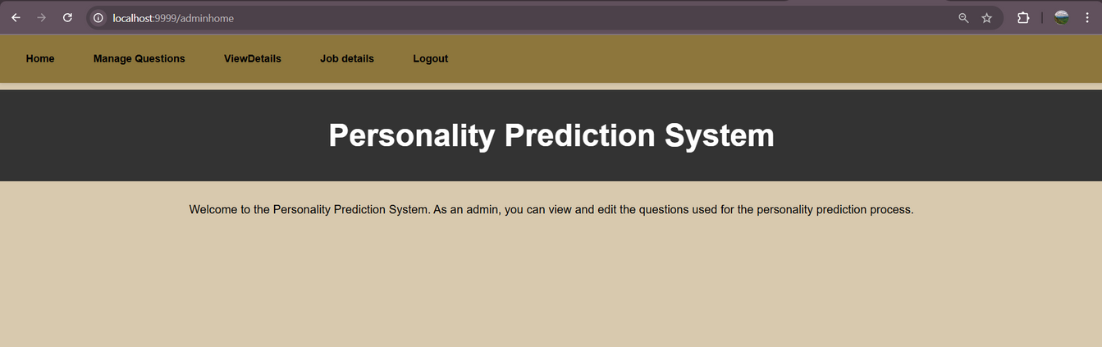

Slide 16
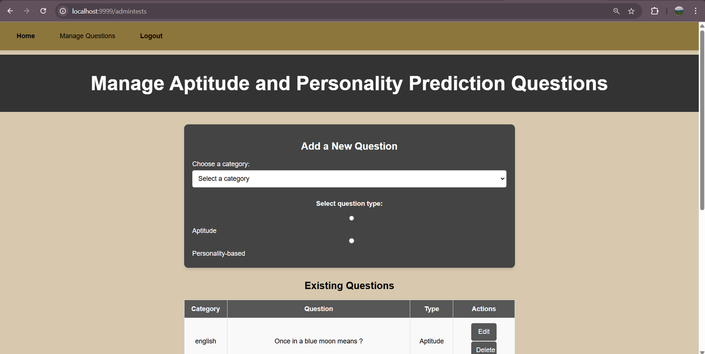
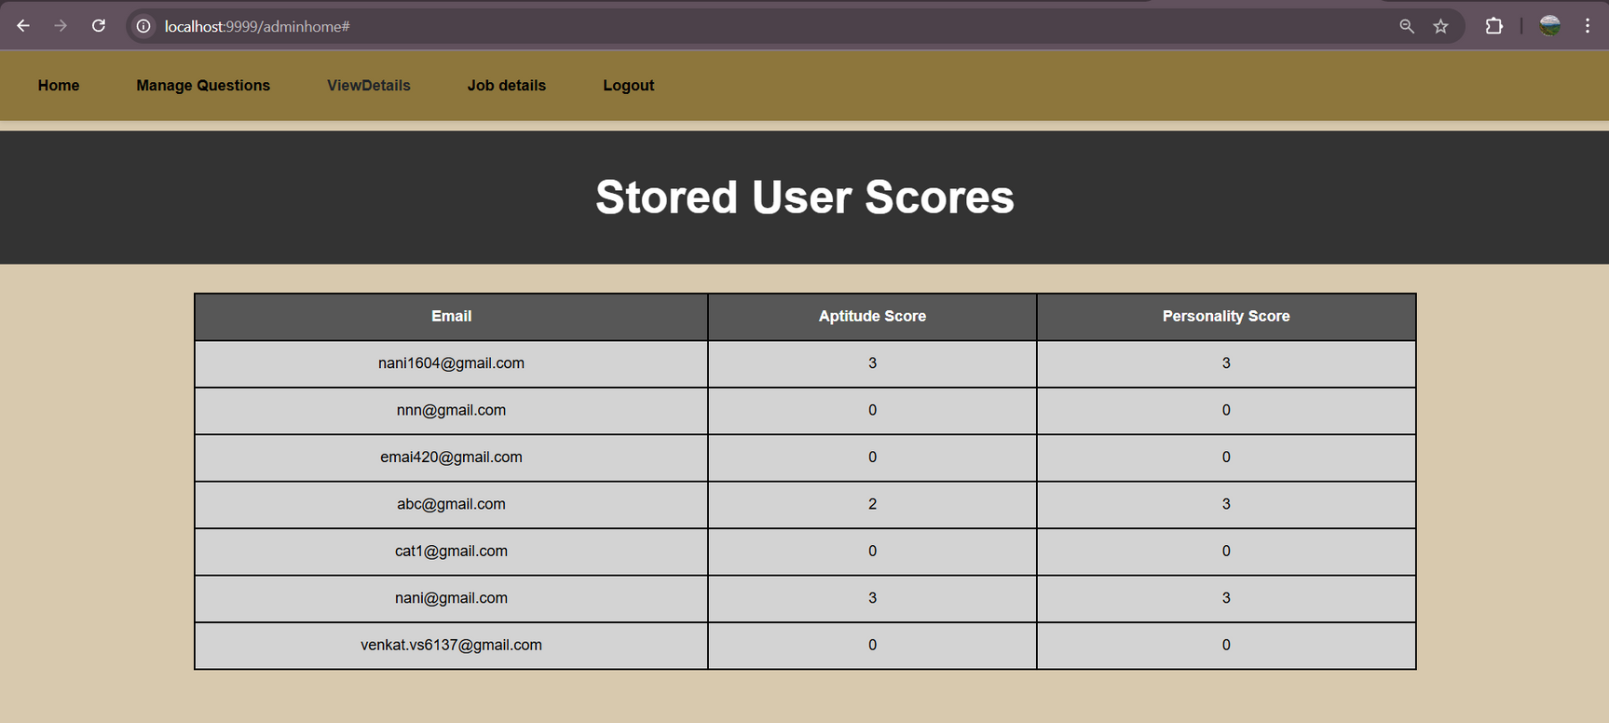

Slide 17
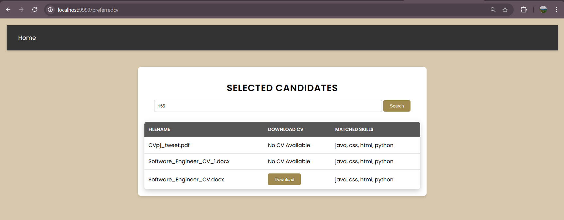
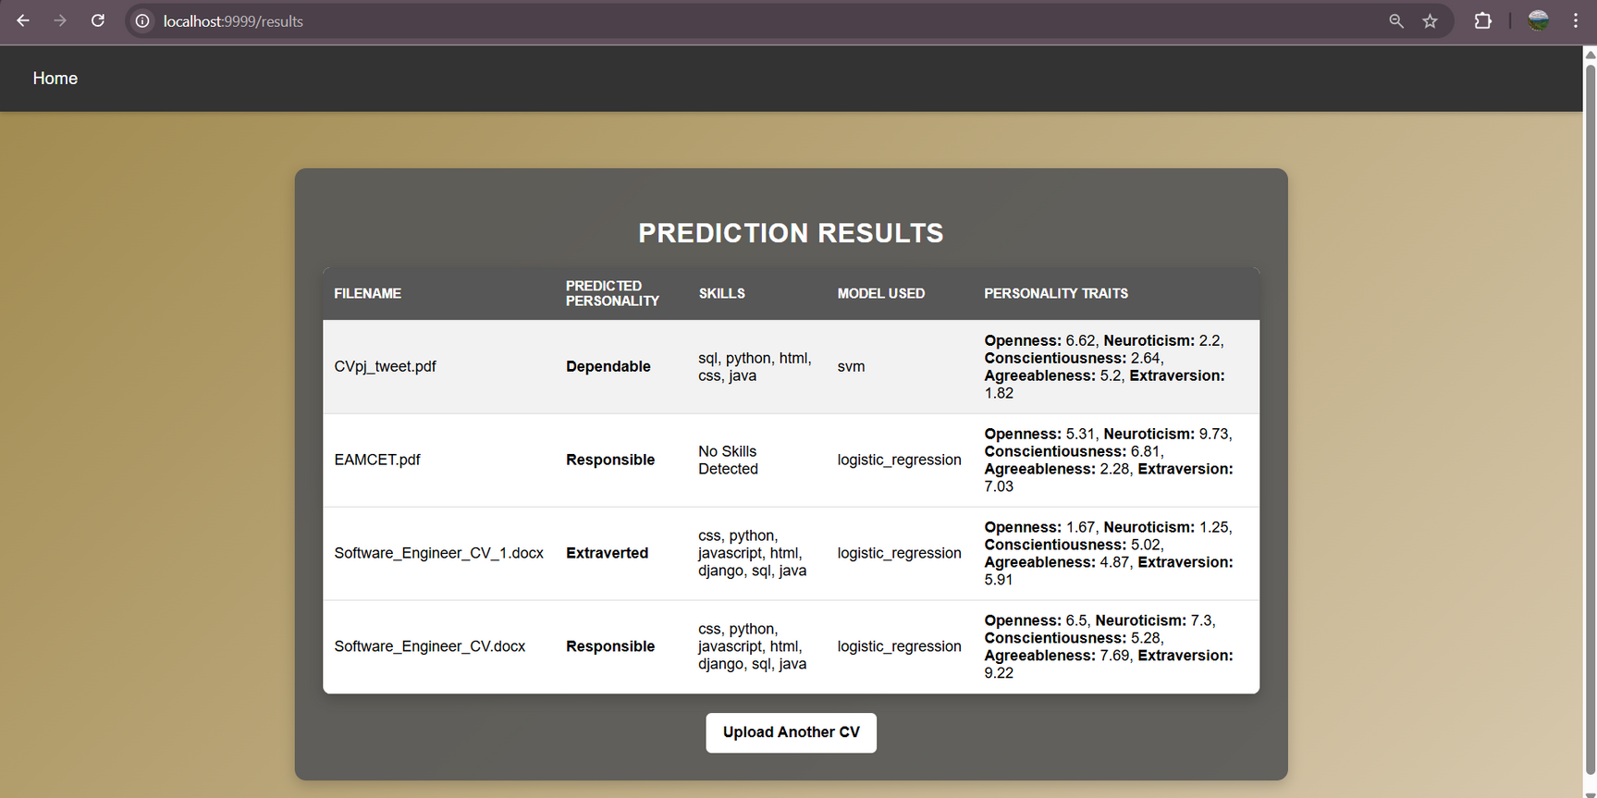

Slide 18
Conclusion
This project successfully demonstrated the working of an E-Recruitment System in helping the recruiters to shortlist the candidates required.
It has concluded that machine learning models can effectively predict personality traits from CV text data.These models can be useful in automated recruitment,candidate profiling and personality assessment,reducing bias and improving hiring efficiency.
It also requires shortspan of hiring process reducing the manual work.
Future Scope
Future work can also be done by enhanced modifications,broadening and partnerships for better solutions in today’s shifting recruitment world.
We can add additional personality traits than those used in this paper.Multi-model approach and the expanded dataset can be included in the future.
The advancement in this system can ensure privacy and ethical considerations and can also be deployed into real-world to automate personality analysis for hiring candidates.

Slide 19
References
[1]. Mrs. Vijayanirmala B .,Spoorthi D .,Varsha B H ., Madhialagi M., Meena G.,”PERSONALITY PREDICTION SYSTEM”.,IJARIIE-ISSN(O)-2395-4396.,Vol-10 Issue-2 2024.
[2]. Nuthalapati Leena., Normala Sandhya., Reddem Sai Archana Reddy., Shaik Kasim Saheb.,”PERSONALITY PREDICTION THROUGH CV ANALYSIS”.,International Research Journal of Modernization in Engineering Technology and Science., Volume:04.,Issue:07.,July-2022.
[3]. Riya Dagli.,Muskaan Shaikh.,Swapnil Bhadre.,Prof.Suchetadevi Gaikwad.,”Personality Prediction and CV Analysis System”.,International Research Journal of Engineering and Technology (IRJET).,Vol:09,Issue:03,March 2022.
[4]. Rishi Jain, Krishna Jaiswal, Pratham Jain, Tanay Jain, Jainivas Anandhan, Jainil Vaidya.,”THE SCIENCE OF HIRING : Predicting Personality through CV Parsing & Machine Learning”.,INTERNATIONAL JO
URNAL OF SCIENTIFIC RESEARCH IN ENGINEERING AND MANAGEMENT 07(11):1-11.,November 2023.
[5]. Rutuja Narwade, Srujami Palkar, Isha Zade Nidhi Sanghavi.,”Personality Prediction with CV Analysis”.,International Research Journal of Engineering and Technology (IRJET).,Volume: 09,Issue: 04, Apr 2022.

Slide 20
Thank
You

