Slide 1
Travel planner agent
IBM HACKATHON PROJECT
Presented By: Bhoomika Sai Neerasa
Student name: Neerasa Bhoomika Sai
College Name & Department : MVGR College of Engineering & CSM

Slide 2
OUTLINE
Problem Statement
Technology used
Wow factor
End users
Result
Conclusion
Git-hub Link
Future scope
IBM Certifications

Slide 3
Problem Statement
Planning a trip can be overwhelming and time-consuming, especially when considering multiple destinations, accommodations, transport options, weather conditions, and local attractions.
Proposed Solution: The Travel Planner Agent aims to eliminate the hassle of manual planning automatically by deeply understanding user preferences, budgets, and travel goals, the agent delivers customized plans that enhance convenience and satisfaction.

Slide 4
Technology used
IBM Cloud Lite Services – Cloud hosting and scalable backend deployment.
Foundation Models for Natural Language & Vision Understanding:
1. IBM Granite Foundation Models – For natural language understanding and decision-making.
2. LLaMA 3–3 Instruct (Meta AI) – Handles complex user instructions and planning queries.
3. LLaMA 3–2 Vision Instruct – Supports image input and visual data processing.
Third-Party Integrations:
1. Maps APIs (Google Map) – For routing, location search, and map visualizations.
2. Weather APIs (OpenWeather / IBM Weather) Real-time and forecast-based weather data.
3. Booking System APIs (e.g., Skyscanner, Booking.com) Integration for transport, stay, and activity reservations.

Slide 5
IBM cloud services used
Watsonx.ai Studio – For building and testing the Travel Planner Agent using no-code agentic workflows.
Watsonx.ai Runtime – Handles real-time execution of the deployed agent and APIs.
IBM Cloud Agent Lab – Used to design the agent’s logic and connect it with APIs and models.
IBM Granite Foundation Models – Powers the AI's natural language understanding and conversation.
Meta LLaMA 3 (Vision & Instruct) – Used for advanced reasoning, multimodal support (images + text), and intelligent responses based on user preferences.

Slide 6
Wow factors
Real-Time Itinerary Updates – Adapts instantly to changing travel plans or delays.
Personalized Trip Plans – Tailors destinations, activities, and stays based on user preferences, budget, and history.
Smart Integration – Connected with Maps, Weather, and Booking APIs for seamless travel guidance.
Auto-Booking & Optimization – Suggests and manages bookings while optimizing time and routes.
AI-Powered Responses – Powered by Granite & LLaMA 3 foundation models for intelligent travel advice.
Multimodal Support – Accepts text/image inputs for enriched interaction and context understanding.
All-in-One Platform – One-stop solution for planning, managing, and adjusting trips.

Slide 7
End users
Solo Travelers
Families
Business Professionals
Vacation Planners and Agencies
Backpackers and Frequent Flyers

Slide 8
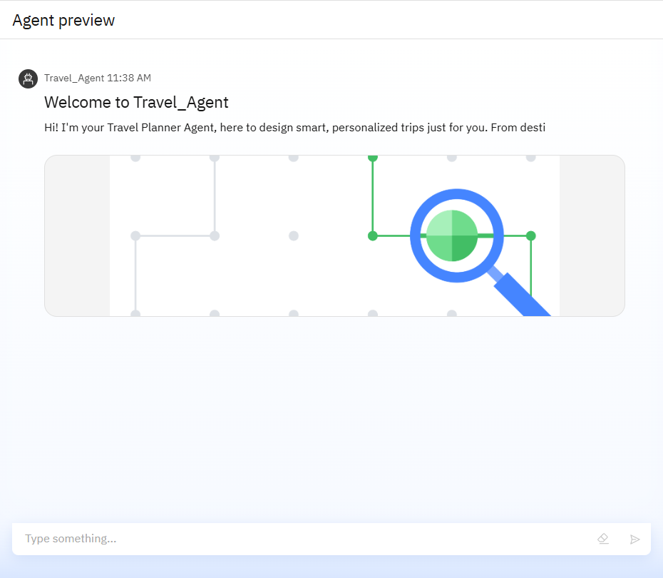
Results
The image shows the live Agent Preview of the Travel_Agent, where the assistant welcomes users and introduces its purpose. It showcases a clean interface with a friendly greeting:"Hi! I'm your Travel Planner Agent, here to design smart, personalized trips just for you.“ This preview reflects the agent’s readiness to interact, understand user needs, and offer tailored travel solutions — all powered by agentic AI and IBM foundation models.

Slide 9
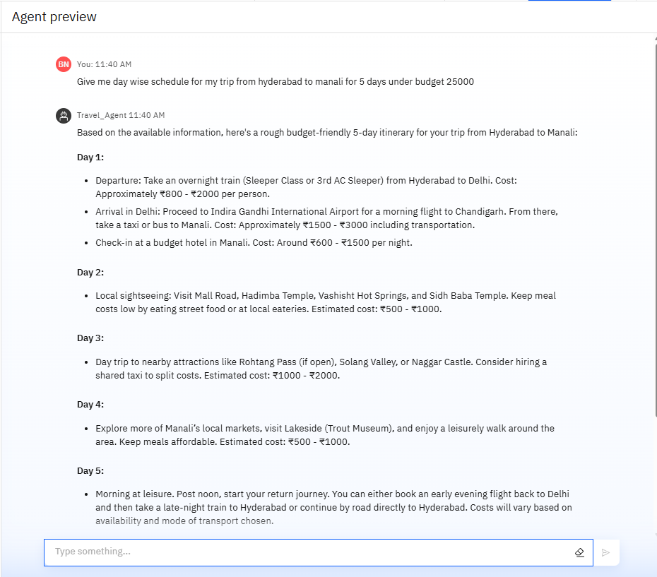
Results
This output demonstrates the agent's ability to generate a 5-day day-wise travel plan from Hyderabad to Manali under a specified budget of ₹25,000. It includes details like transportation modes, stay costs, sightseeing locations, food recommendations, and cost estimates per day. This highlights the agent’s strength in budget management, logistics optimization, and personalized itinerary planning based on user constraints.

Slide 10
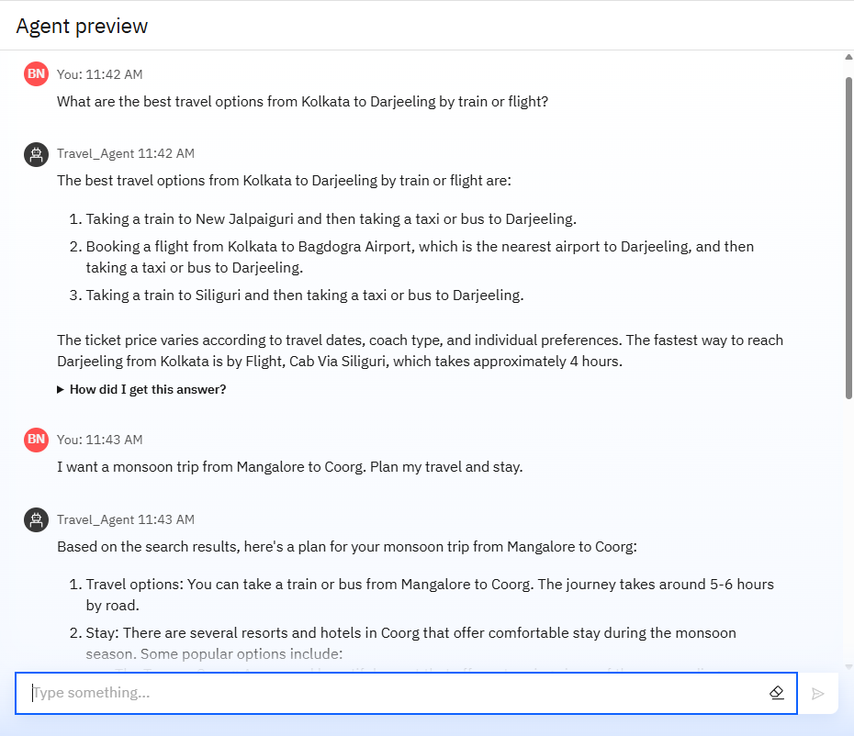
Results
This image displays a conversation between the user and the Travel Planner Agent, where the user inquires about travel options from Kolkata to Darjeeling. The agent provides multiple practical options using both train and flight, followed by a customized monsoon trip plan from Mangalore to Coorg. The response showcases the agent’s ability to handle multi-part queries, fetch real-time route information, and suggest accommodation—all tailored to seasonal preferences.

Slide 11
Conclusion
This AI-powered assistant transforms traditional travel planning into an intelligent, adaptive, and engaging experience. Built on IBM's cutting-edge AI infrastructure (Granite + Cloud Lite), the Travel Planner Agent bridges technology and convenience, redefining how individuals and families explore the world — smarter, faster, and with greater confidence.

Slide 12
GitHub Link
Link : https://github.com/BhoomikaNeerasa/Travel-Planner-Agent.git -

Slide 13
Future scope
Voice Assistant Integration (e.g., via Watson Assistant or Whisper)
Multilingual Support for global users
Multi-Currency Budgeting Tools
Behavioral Learning for long-term personalized suggestions
AR/VR Previews of destinations and hotel rooms
Partnership Integrations with travel brands and platforms for discounts & offers

Slide 14
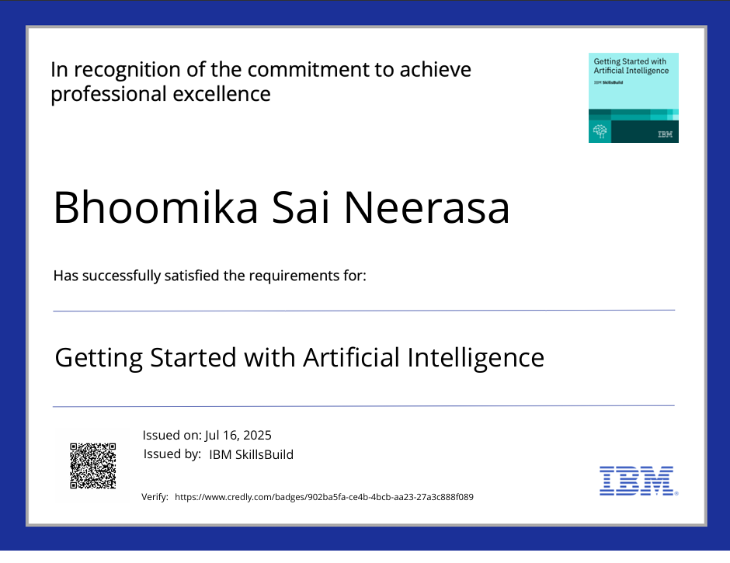
IBM Certifications
Getting Started with AI

Slide 15
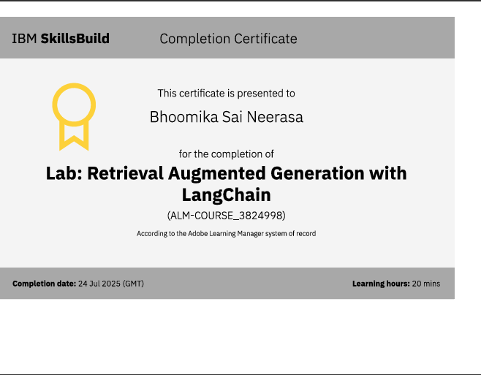
RAG LAB Certificate

Slide 16
THANK YOU

