Slide 1



Wind Power Generation Forecasting

Slide 2

Student Name : NEERASA BHOOMIKA SAI
Student ID : STU64f0d3e47f2ee1693504484
College Name : MVGR College Of Engineering

Slide 3

Learning Objectives
Understand the importance of forecasting in renewable energy systems, specifically wind power generation.
Analyze historical wind data and power output to identify patterns and influencing factors.
Apply machine learning algorithms (like Linear Regression, Decision Trees, or LSTM) to predict wind energy output.
Evaluate the performance of different forecasting models using metrics such as MAE, RMSE, or accuracy.
Develop a predictive system that helps optimize wind power usage and grid stability.
Enhance decision-making for energy management systems by providing accurate, data-driven wind power forecasts.
GOAL

Slide 4
Tools and Technology used:
Programming Language:
Python – widely used for data analysis, modeling, and machine learning.
Libraries & Frameworks:
NumPy / Pandas – for data manipulation and analysis
Matplotlib / Seaborn – for data visualization
Scikit-learn – for machine learning models
Machine Learning Algorithms:
Linear Regression
Random Forest
Decision Trees
LSTM
XGBoost
Data Sources:
Public wind power datasets
Weather data APIs (e.g., OpenWeatherMap, Meteostat)
Version Control:
Git & GitHub

Slide 5
Methodology
Data Collection
Gather historical wind data (wind speed, direction, temperature) and power output from trusted sources such as government datasets or weather APIs.
Kaggle Link: https://www.kaggle.com/datasets/mubashirrahim/wind-power-generation-data-forecasting
Data Preprocessing
Clean the dataset by handling missing values, removing noise, and normalizing the data for consistency.
Perform feature selection to identify the most influential variables affecting wind power output.
Exploratory Data Analysis (EDA)
Use visualization tools (matplotlib, seaborn) to discover patterns, trends, and correlations between features and output power.
Model Selection
Choose suitable machine learning models like Linear Regression, Random Forest, or LSTM for time-series forecasting.
Split the dataset into training and testing sets.
Model Training & Testing
Train the selected model(s) on historical data and test them using unseen data to evaluate performance using metrics like RMSE, MAE, and R² score.
Model Evaluation & Comparison
Compare the accuracy of different models and choose the best-performing one for final forecasting.
Forecasting & Visualization
Predict future wind power output and visualize the results using plots and graphs for better interpretation.

Slide 6
Problem Statement:
The increasing global demand for clean and renewable energy, wind power has become a major contributor to sustainable energy generation. However, its highly variable and unpredictable nature poses a significant challenge for grid management and energy planning. Inaccurate forecasting of wind power can lead to inefficient energy distribution, power shortages, or system overloads.

Slide 7
Solution:
The challenges of unpredictable wind power output, this project proposes a machine learning-based forecasting model that accurately predicts future wind energy generation using historical weather and power data.
The solution involves:
Collecting and preprocessing wind-related datasets (wind speed, temperature, etc.)
Applying advanced algorithms such as Linear Regression, Random Forest, or LSTM for time-series forecasting
Evaluating model performance using metrics like MAE, RMSE, and R² score
Visualizing the forecasted output to assist in efficient energy planning and grid stability
This system enables energy providers to make informed, data-driven decisions, reduce reliance on backup sources, and improve the integration of wind energy into the smart grid.

Slide 8
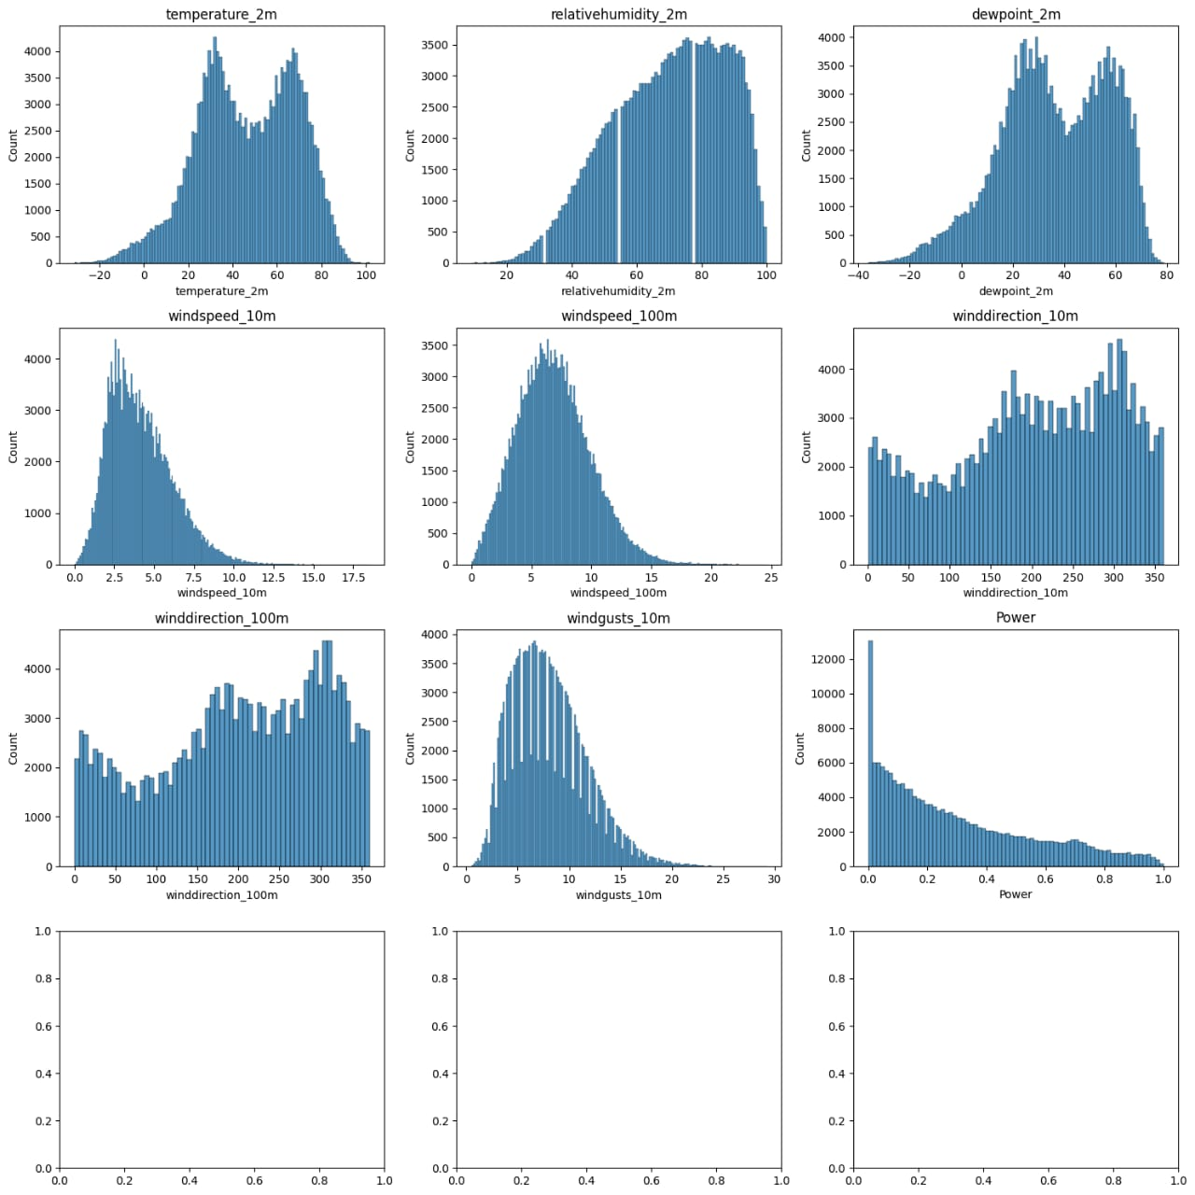
Screenshot of Output:

Slide 9
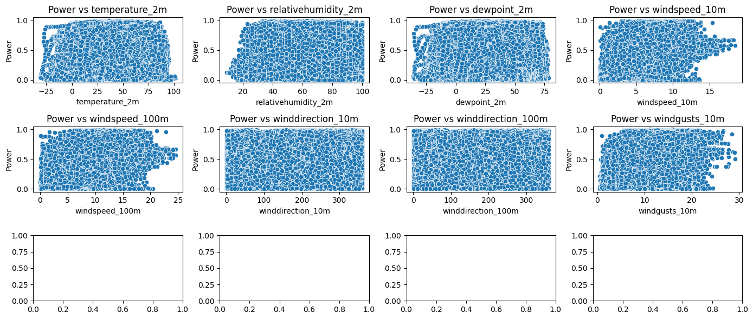



Screenshot of Output:

Slide 10
Conclusion:
The Wind Power Generation Forecasting project successfully demonstrates how machine learning techniques can be effectively used to predict wind energy output with improved accuracy. By analyzing historical weather and power data, the system enables better energy management, grid stability, and supports the broader adoption of renewable energy sources.
This approach not only enhances decision-making for power utilities but also contributes to the goal of building a more sustainable and efficient energy future. With further improvements, the model can be integrated into real-time systems for large-scale deployment.
Future Scope:
Integrate real-time weather data for live predictions
Deploy models on cloud platforms for scalability
Use hybrid ML/DL models for better accuracy
Extend forecasting to other renewable sources
Connect with smart grid systems for efficient energy use.
Github Repositories link: https://github.com/BhoomikaNeerasa/Wind-Power-Generation-Forecasting.git

