Slide 1
Project Approval
Project Title : Detecting Bots on Twitter
Project Guide : Dr. Nagegowda K S
Project Team : Bhoomika R Rao (01FB15ECS069)
Preetika (01FB15ECS214)

Slide 2
Problem Statement
How to detect bots on twitter?
What is a twitter bot?
This a program that produces automated posts, follow twitter users etc.
Bots behave like real users!
Prevent bad bots from polluting social media space

Slide 3
Literature Survey
Bots follow maximum people but have less friends
Non bots have lot of friends and followers
Dataset – Tweepy API

Slide 4
Proposed Solution
Understand psychology behind bot creation
Implement different machine learning algorithms
Hashing technique to quickly organize the user accounts in clusters of abnormally correlated accounts
Custom classification algorithm
Do not consider Attributes like id, status_count, default_profile, image etc. there should be no correlation between them
Consider attributes like followers,friends, verified account etc.
Other attributes like name, description, status for feature extraction.

Slide 5
Proposed Solution
What is custom classification algorithm?
It is building our own classifier based on the feature extraction and engineering which meets our requirements.
Here features which we use as our custom features are name, description, status etc. apart from considering things like friends and followers.

Slide 6
Why Your Solution is Better?
Existing solutions use naive bayes and decision trees
We are planning to implement our own custom algorithm based on few feature extraction
Aiming to get highest accuracy and differentiate between real twitter accounts and bots.

Slide 7
Tools Used
Numpy
Python3
Pandas
Matplotlib
sklearn

Slide 8
Algorithms To Be Implemented
Custom Classification Algorithm
Naive Bayes
Decision Trees
Random Forest
Multinomial Naive Bayes
And test for highest accuracy

Slide 9
Project Timelines & Plan
Week 1 : Idea Generation & Feasibility Study
Week 2 : Dataset and algorithm implementation
Week 3 :
Discussion on framework/technologies to be used
Test for small dataset
Add more feature engineering
High Level Design Documentation
Week 4 to Week 8 :
Testing of training datset
Improving bits of code to take up more accuracy and less time
Minor Optimizations
Test for testing datasets

Slide 10
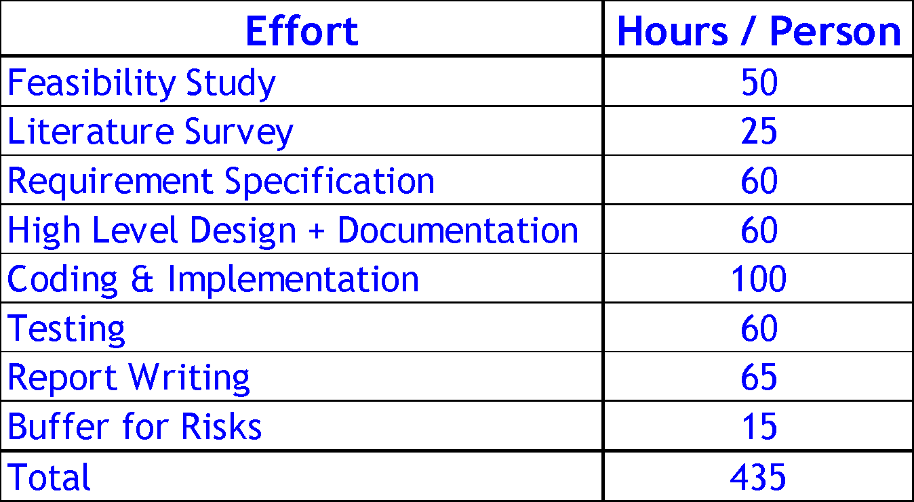
Project Effort Estimation

Slide 11
Thank You

