Slide 1
Project Progress Review #2
(Customer Requirement Specifications)
Project Title : Detecting Bots in Twitter
Project ID : PW19NKS01
Project Guide : Dr.Nagegowda K.S(AssistantProfessor)
Project Team : Bhoomika R Rao - 01FB15ECS069 Preetika - 01FB15ECS214

Slide 2
Project Abstract and Scope
Twitter bot is a program used to produce automated posts, follow Twitter users or serve as spam to entice clicks on the Twitter microblogging service. In this project, we will use Machine Learning techniques to predict weather an account on Twitter is a Bot or a real user performing significant amount of feature engineering, along with feature extraction considering around 20 features like name of the twitter account, description, profile image, inactivity, twitter posts etc. We are implementing our own custom algorithm in order to achive high accuracy.

Slide 3
Further Literature Survey
Twitter is an online news and social networking service where users post and interact with messages, “tweets” restricted to 140 characters
There are 310M monthly active twitter users and a total of 1.3 billion accounts have been created and 500M tweets per day
Since it’s such an influential platform people have developed Twitter bots
These bots are used to increase number of followers, retweeting, spamming etc. and there are about 48M bots today.
Tweepy a REST API is a python dataset to extract data from twitter accounts.(CSV file)
This dataset has 1056 bots and 1176 users
According to study released by University Of California 24% of tweets are done by Bots.

Slide 4
Further Literature Survey
Types Of Attributes
1)Integers:ID,Friends,Followers,Favourites,Statuses,listed count(tagging people)
2) String: Name,Location,Description,URL,Language
3)Boolean: Verified Acoount,Default Profile
4)Date: CreatedAt
5)JSON:Status(all tweets by the user in a json format)
Other Derived attributes like age, account has name bot in it

Slide 5
User Characteristics
Automatic accounts sharing random bits of information across Twitter may not seem like such a bad thing, but bots are a potentially serious threat to your online security. Many even encourage businesses to make poor investments.

Slide 6
Dependencies / Assumptions / Risks
Assumptions
Neglecting cases like
A real user who has no image, and no friends and has some link in his description.

Slide 7
Dependencies / Assumptions / Risks
Risks
No classification between good and bad bots
It just classifies bots and real users

Slide 8
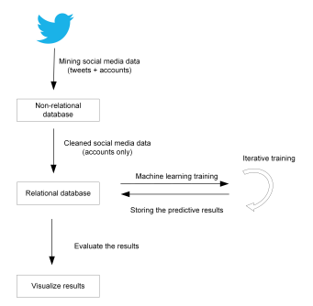
System Architecture

Slide 9
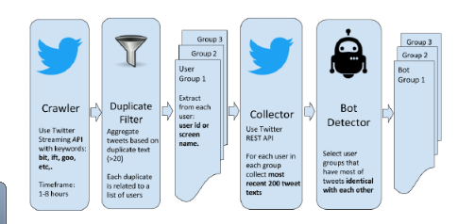
UI/ Use Case

Slide 10
Algorithms
Custom Classification Algorithm
Naïve Bayes
Decision trees
Random Forest
And test for highest accuracy

Slide 11
Tools Used
Numpy
Pandas
Python 3
Matplotlib
sklearn

Slide 12
Thank You

