Slide 1
Project Work :
UE15CS490(Major)/UE15CS492(Minor)
Final ISA(Review 5) / ESA 2019
Project Title : Detecting Bots in Twitter
Project ID : PW19NKS01
Project Guide : Dr.Nagegowda K.S(AssistantProfessor)
Project Team : Bhoomika R Rao - 01FB15ECS069 Preetika - 01FB15ECS214

Slide 2
Problem Statement
Twitter bot is used to produce automated posts, follow Twitter users or serve as spam to entice clicks on the Twitter micro blogging service.
Project aims to detect whether an account in twitter is a bot or a real human.
Twitter is an online news and social networking service where users post and interact with messages, “tweets” restricted to 140 characters. There are 310M monthly active twitter users and a total of 1.3 billion accounts have been created and 500M tweets per day. Since it’s such an influential platform people have
developed Twitter bots. These bots are used to increase number of followers, retweeting,spamming etc. and there are about 48M bots today

Slide 3
User Profile
This problem is mostly faced by common users. These include directing more visitors to certain websites which can be considered as
spam, influence a community on a specific topic, spread misinformation, recruit people to illegal organizations, manipulating people for stock market actions, and blackmailing people to spread their private information by the power of these accounts.
Consequently, social bot detection is of great importance to keep people safe from these harmful effects.

Slide 4
Literature Survey
● Eiman Alothali, Nazar Zaki, Elfadil A. Mohamed, Hany Alashwal, "Detecting Social
Bots on Twitter: A Literature Review", Innovations in Information Technology (IIT)
2018 International Conference on , pp. 175-180, 2018.
● Ryutaro Ushigome, Mio Suzuki, Tao Ban, Takeshi Takahashi, Daisuke Inoue, Takeshi
Matsuda, Michio Sonoda, "Establishing Trusted and Timely Information Source using
Social Media Services", Consumer Communications & Networking Conference (CCNC)
2019 16th IEEE Annual , pp. 1-2, 2019.
● https://ieeexplore.ieee.org/document/8093483

Slide 5
● layton Allen Davis, Onur Varol, Emilio Ferrara, Alessandro Flammini, and Filippo
Menczer. 2016. Botornot: A system to evaluate social bots. In Proceedings of the 25th
International Conference Companion on World Wide Web. International World Wide
Web Conferences Steering Committee, 273–274.
● Juan Echeverría and Shi Zhou. 2017. The ‘Star Wars’ botnet with >350k Twitter bots.
arXiv preprint arXiv:1701.02405 (2017).
Dept

Slide 6
Proposed Solution
Understand psychology behind bot creation
Implement different machine learning algorithms
Hashing technique to quickly organize the user accounts in clusters of abnormally correlated accounts
Custom classification algorithm
Do not consider Attributes like id, status_count, default_profile, image etc. there should be no correlation between them
Consider attributes like followers,friends, verified account etc.
Other attributes like name, description, status for feature extraction.

Slide 7
Why Your Solution is Better?
Existing solutions use naive bayes and decision trees
We are planning to implement our own custom algorithm based on few feature extraction
Aiming to get highest accuracy and differentiate between real twitter accounts and bots.

Slide 8
Technologies / Methodologies
Numpy
Python3
Pandas
Matplotlib
sklearn

Slide 9
Dependencies and Risks
Dependencies:
● Works well with Linux and Windows.
● Install Python, pandas,numpy, sklearnlibraries.
● Laptop specifications: 8GB RAM, Windows 10, Intel core i5, at least 3GB HDD free.
Server specifications: Ubuntu 18.04, 32 GB RAM, at least 3GB HDD free.

Slide 10
Risks
• No classification between good and bad bots
• It just classifies bots and real users
• A user having no profile image, more followers than friends, description with a link is more likely to be classified as a Bot. Detecting such specific cases becomes a risk.

Slide 11
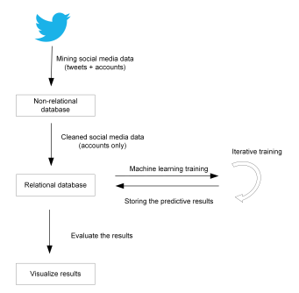
System Architecture

Slide 12
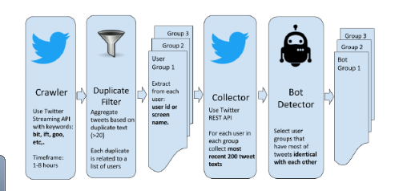
UI/ Use Case

Slide 13
Modules
Aims to detect whether an account in twitter is a bot or a real human.
Future implementations will be to detect if bot is a good or bad bot.

Slide 14
Design Approach
Crawler – Crawler stage extracts data from the twitter API called Tweepy.
Duplicate Filter – Involves cleaning of data and removes duplicate account because that affects
the accuracy rate.
Extraction – Extraction of attributes that we require in order to perform the analysis.
Collector – Analysis of the textual data like tweets using an algorithms like sentiment analysis.
Bot Detector – This stage finalizes an account to be a bot or a real user.

Slide 15
Design Constraints, Assumptions & Dependencies
Dependencies:
● Works well with Linux and Windows.
● Install Python, pandas,numpy, sklearnlibraries.
● Laptop specifications: 8GB RAM, Windows 10, Intel core i5, at least 3GB HDD free.
Server specifications: Ubuntu 18.04, 32 GB RAM, at least 3GB HDD free.

Slide 16
Design Description
UI

Slide 18
Test Strategy
The Test strategy may be for the following types of tests: -
· Stress Testing: It is a subset of Performance testing. We check the amount of load the
system can bear. Greater the file size, more the time it takes to process. If the file size is very huge, it could crash the system. Stress testing was performed by using exceptional scenarios where the server was exposed to unusual/incorrect data and we checked how it was handled.
· Unit Testing: In unit testing, the interface, local modules,independent paths and algorithms
are checked. Most of the system is comprised of modules with dedicated algorithms. They are checked for efficiency. For unit testing, we use individual frames generated. A video generates ‘n’ frames out of which we pick one. The chosen frame is used for text localization. The localized frame is inpainted. The output frame is obtained.
.

Slide 19
· User Friendliness: It is a measure of how easy the usage of interface is. All the options should be clearly visible and usable. The webpage is very simple. It consists of two options -
Upload and download. The buttons are easily locatable to the user. Navigation across the web pages is made user friendly.
· Error recovery: This includes an important case of missing frame or interruption in the execution of the code. Error recovery is done by restarting the session and the code.
· Error Handling: If the code gets interrupted while execution, the buffer output has to be cleared and it has to be restarted.
· Batch Testing: Our mobile application is very user driven, there is not much scope for creating scripts that automate the testing process by running a batch of commands sequentially.
Uploading and downloading of the video and subtitle file is to be done manually

Slide 20
Implementation Details
After data analysis we implemented 4 algorithms
1. Decision Trees
2. Random Forest
3. Multinomial Naive Bayes
4. Custom Classification Algorithm

Slide 21
Step 1: Consider the attributes which determine a twitter account to be a bot or non bot and start classifying based on that.
Step 2: Go to twitter developer section and create an app based on machine learning
requirement.
Step 3: After the classification plot is drawn as shown below indicating the friends:followers ratio.

Slide 22
Step 4:Create a bot identification criteria based on attributes and classify the dataset randomly into train and test dataset.
Final Step: Test using the decision tree classifier .
It gave an accuracy of 91%.

Slide 23
Project Completion
Project Report Status – Ready
Project Demo – Fully done

Slide 24
Project Results
The result of the 4 models is as given below for the training and test dataset .
Accuracy Score Training Test Test Set
Decision Tree 0.8824 0.8785
Multinomial NB 0.5421 0.5631
Random Forest 0.8252 0.7916
Custom Classification 0.9646 0.9385
Algorithm

Slide 25
In the future, we plan to make our system open source, and to implement a Web service (for example, an API) to allow the research community to perform tweet-level bot detection using
it.

Slide 26
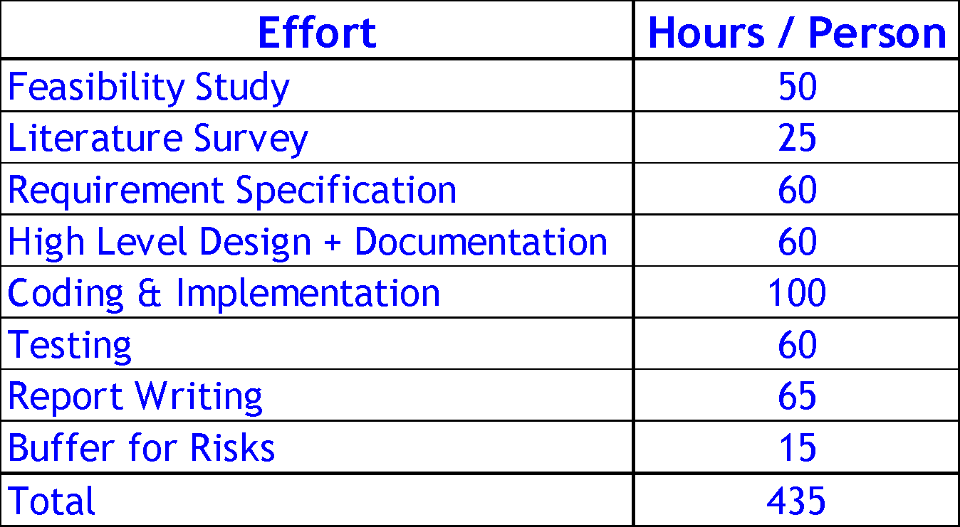
Planned Effort Vs Actual Effort

Slide 27
Lessons Learnt
Custom classification algorithm which was basically our own algorithm.
It is building our own classifier based on the feature extraction and engineering which meets our requirements

Slide 28
Thank You

