Slide 1
NREGA (National Rural Employment Guarantee Act)
By:
Bhoomika

Slide 2
What we are discuss :-
Overview
Problem Summary
Dataset
Data Cleaning
EDA
Conclusion

Slide 3
Overview:
This project delves into the analysis of data related to the National Rural Employment Guarantee Act (NREGA), a transformative government scheme aimed at providing rural households with guaranteed wage employment opportunities. The dataset used for this analysis encompasses a wide range of parameters, including the number of job cards issued, the workforce engaged, budget allocation, work completion statistics, and much more. Through the application of data analytics techniques, we aim to gain valuable insights into the implementation and impact of NREGA across different states and districts in India.

Slide 4
Problem Statement:
NREGA is a vital initiative to alleviate rural unemployment and poverty. This project seeks to address several key questions and challenges associated with NREGA:
● How effective is NREGA in providing employment opportunities to rural households?
● Are there regional disparities in the implementation and outcomes of the scheme?
● What is the utilization of the allocated budget, and how does it correlate with
employment generation?
● What are the key factors contributing to the completion of NREGA works, and are there
any roadblocks to its success?
● Can data-driven insights guide policymakers and administrators in optimizing the
scheme's impact?

Slide 5
Dataset
state_name: Name of the Indian state.
district_name: Name of the district within the state.
Total No. of JobCards issued: The total number of job cards issued to rural households.
Total No. of Workers: The total number of workers registered under NREGA.
Total No. of Active Job Cards: The number of active job cards at a given point in time.
Total No. of Active Workers: The number of workers currently engaged in NREGA works.
SC workers against active workers: The count of Scheduled Caste workers among active workers.
ST workers against active workers: The count of Scheduled Tribe workers among active workers.
Approved Labour Budget: The budget allocated for labor under NREGA.

Slide 6
Dataset
Persondays of Central Liability so far: The total persondays of employment provided, considering central liability.
SC persondays: Persondays of employment provided to Scheduled Caste workers.
ST persondays: Persondays of employment provided to Scheduled Tribe workers.
Women Persondays: Persondays of employment provided to women.
Average days of employment provided per Household: The average number of days of employment provided per rural household.
Average Wage rate per day per person(Rs.): The average daily wage rate per NREGA workerin Indian Rupees.
Total No of HHs completed 100 Days of Wage Employment: The number of households completing 100 days of wage employment.
Total Households Worked: The total number of households involved in NREGA works.

Slide 7
Dataset
Total Individuals Worked: The total number of individuals engaged in NREGA works.
Differently abled persons worked: The count of differently abled persons who participated in NREGA works.
Number of GPs with NIL exp: The number of Gram Panchayats with zero expenditure.
Total No. of Works Takenup (New+Spill Over): The total number of works initiated, including new projects and spill-over from previous periods.
Number of Ongoing Works: The count of works that are currently in progress.
Number of Completed Works: The count of works that have been successfully completed.
% of NRM Expenditure(Public + Individual): The percentage of expenditure on Natural
Resource Management (NRM) projects, including both public and individual contributions.
% of Category B Works: The percentage of expenditure on Category B works.

Slide 8
Dataset
% of Category B Works: The percentage of expenditure on Category B works.
% of Expenditure on Agriculture & Agriculture Allied Works: The percentage of expenditure on agriculture and allied activities.
Total Exp(Rs. in Lakhs.): Total expenditure in Indian Rupees (in lakhs).
Wages(Rs. In Lakhs): Expenditure on wages in Indian Rupees (in lakhs).
Material and skilled Wages(Rs. In Lakhs): Expenditure on materials and skilled wages in Indian Rupees (in lakhs).
Total Adm Expenditure (Rs. in Lakhs): Total administrative expenditure in Indian Rupees (in lakhs).

Slide 9
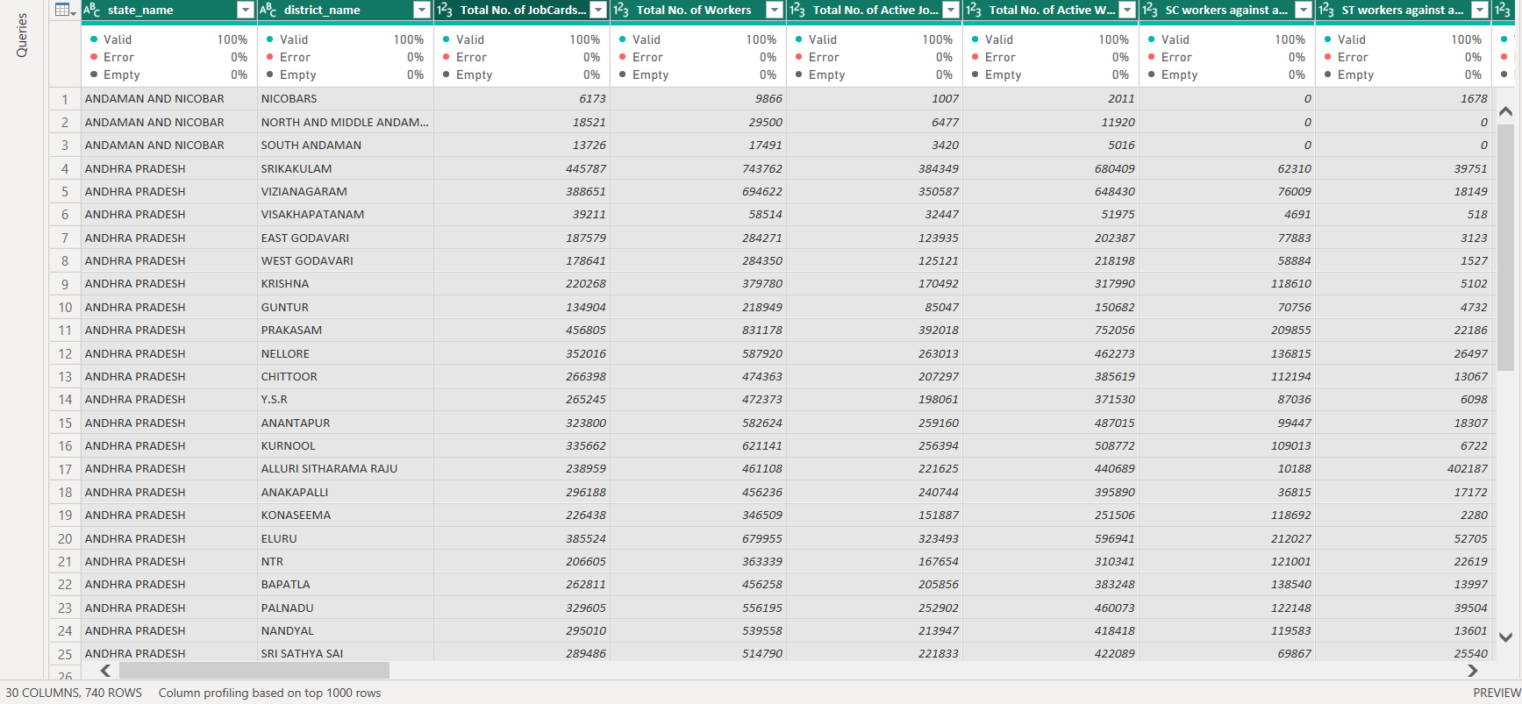
Cleaning: Importing a excel CSV file and cleaning the data for the same

Slide 10
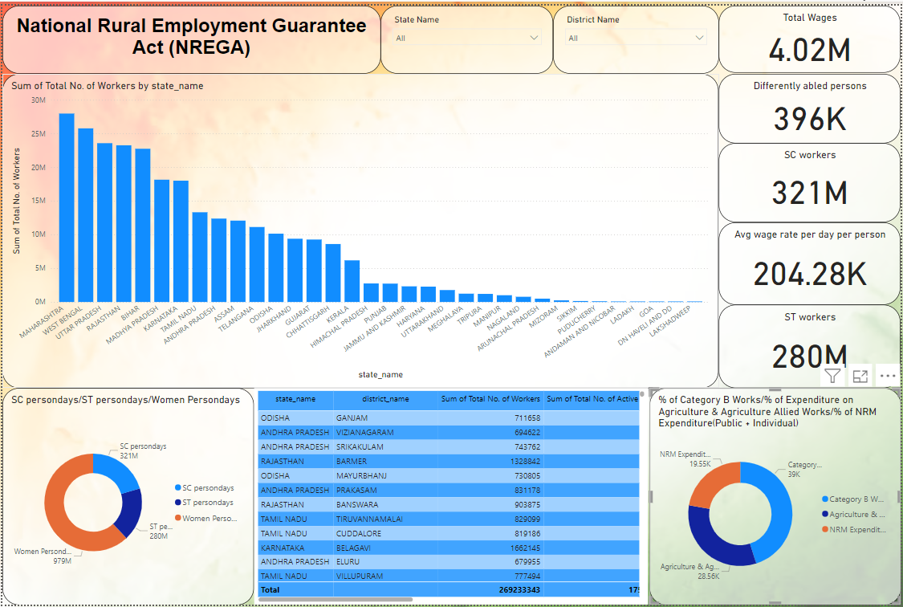
EDA

Slide 11
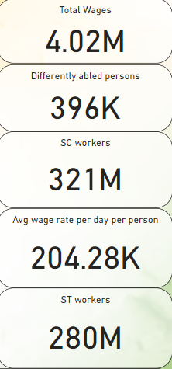
EDA
Total Wages Paid : ₹4.02 million
Total Number of Workers : 300 million
Differently Abled Persons : 396 thousand
SC Workers (Scheduled Caste Workers) : 321 million
ST Workers (Scheduled Tribe Workers) : 280 million
Women Workers : 979 million

Slide 12
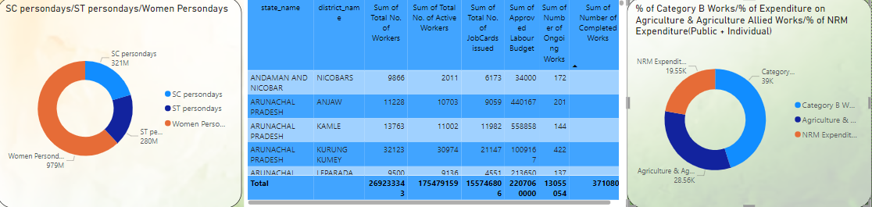
EDA
Pie chart shows that how many SC, ST and Women are working in nrega project which is 321M, 280M and 979M
In another pie chart expenditure on agriculture, NRM AND B Works which is 19.55k, 39k and 28.56k.
Table shows state name, district, total no of workers, total number of job card issue, sum approved labour budget and ongoing works

Slide 13
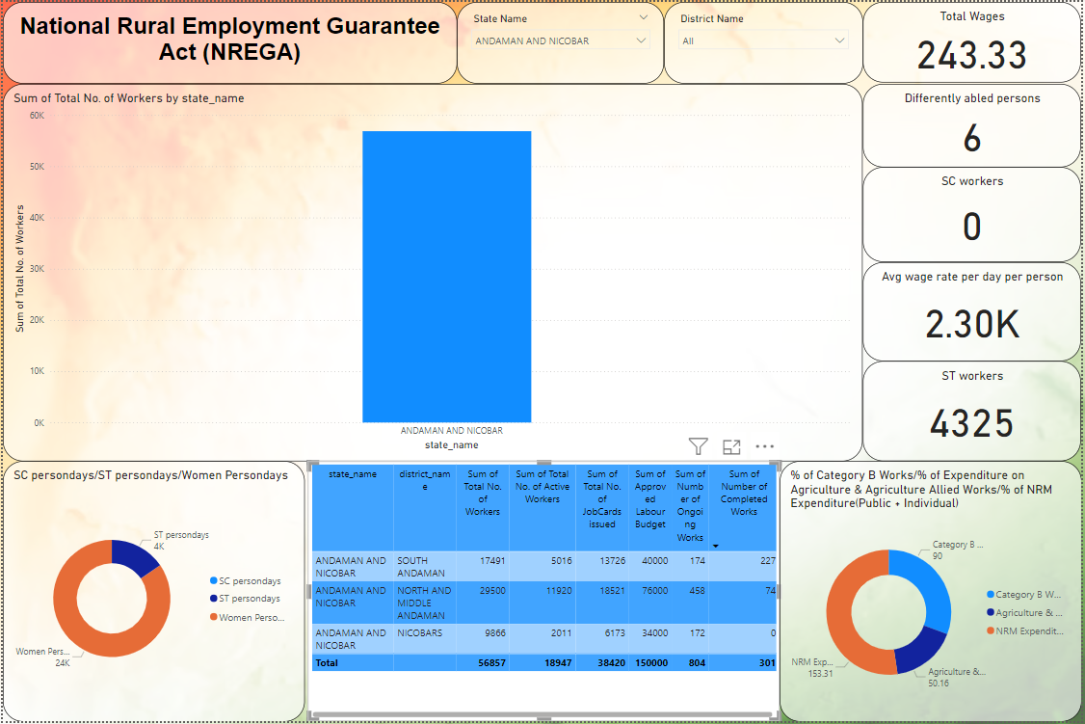
EDA

Slide 14
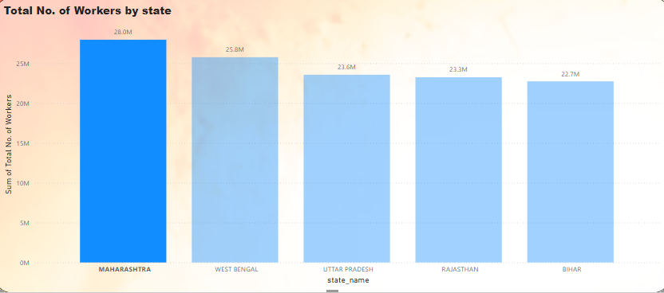
Top 5 state in number of workers
Top 5 state is Maharashtra, West Bengal, UP, Rajasthan and Bihar.
Maharashtra - 28 m
West Bengal - 25.8 m
UP - 23.6 m
Rajasthan 23.3 m
Bihar - 22.7m

Slide 15
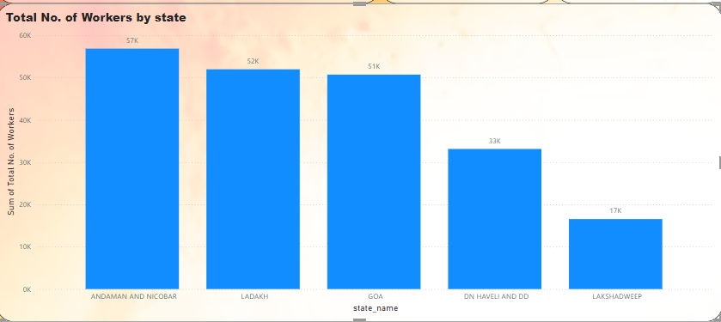
Low 5 state in number of workers
Bottom 5 state is Anderman and Nicobar, Ladakh, goa, DN haveli and Lakshadweep
Anderman and Nicobar - 57k
Ladakh - 52 k
goa - 51 k
DN haveli - 33k
Lakshadweep - 17k

Slide 16
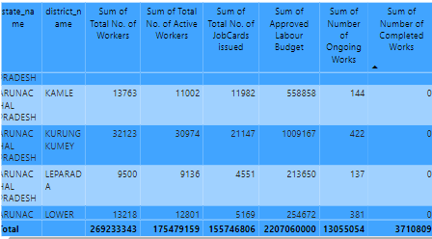
Job card/ongoing works/completed works
Total number of labour - 269M
TOTAL LABOUR BUDGET – 2BN
ONGOING PROJECT – 13055054
COMPLETED PROJECT - 3710809

Slide 17
Conclusion
Despite some challenges, the program effectively provides employment to rural workers and households. With substantial expenditure and wages disbursed, it contributes positively to livelihoods.
Top 5 state is Maharashtra, West Bengal, UP, Rajasthan and Bihar.
Bottom 5 state is Anderman and Nicobar, Ladakh, goa, DN haveli and Lakshadweep
Most expenditure done on category B project.
Women involvement is more then on SC and ST.

Slide 18


