Slide 1
Working Of Java Program
Topics
What is JVM,JRE and JDK
Architecture of JVM

Slide 2

How Java Program Works ?

Slide 3

Java Internal Working Process
Source Code
(.java file)
Java Compiler
Byte Code
(.class file)
Java Interpreter
Native Code/
(Machine Code
Out Put
Java Compiler will check the syntax error.
Java interpreter will convert the bytecode into native code .
After converting it to native code , we can see the out put on console.

Slide 4
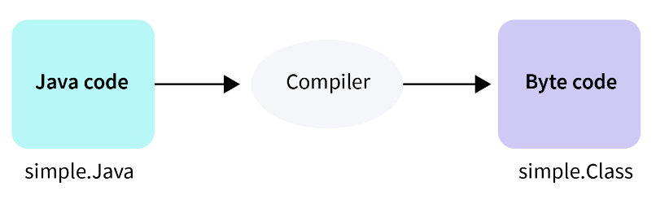
Java Compiler
The Process of converting entire source code into byte code with the help of JVM is known as java compiler.
It is the program that contains set of instructions which is implemented in C/C++ programming language.
Purpose : It will check the syntax error or grammatical mistakes.

Slide 5
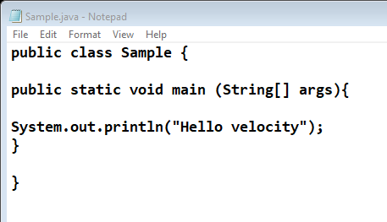
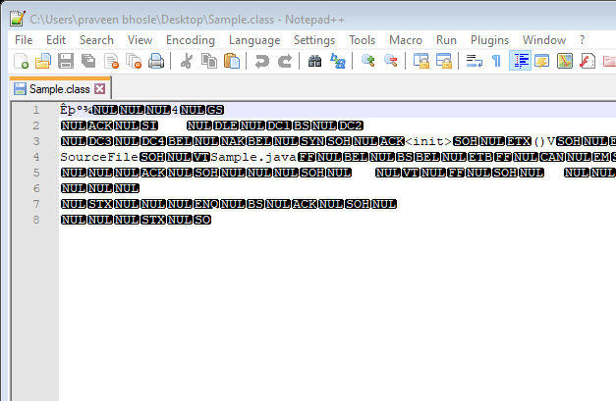
Java Compiler
Java Compiler
Source Code
Sample.Java
ByteCode
Sample.class

Slide 6
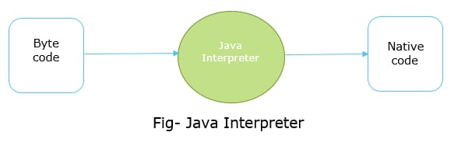
Java Interpreter
The process of converting entire byte code into native code is called as java interpreter.
It is nothing but .exe file which is implemented in C/C++ language.
Purpose :It converts the high-level program into machine language

Slide 7
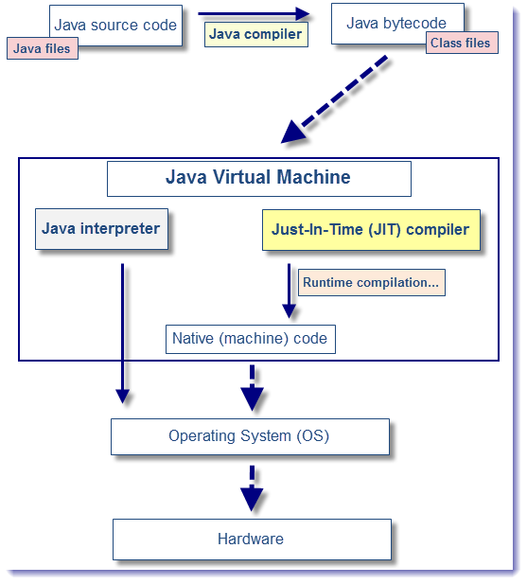
JIT (Just in time ) Compiler
The process of converting byte code into machine code only once is known as JIT compiler
JIT is a component of java runtime environment that improves the performance of java application at runtime .
It has more information like which class has been loaded , which code is executed frequently.

Slide 8
JVM, JRE and JDK

Slide 9
JVM
JVM : Java Virtual Machine
It is a runtime environment in which application(Bytecode) is executed.
JVM is specifically responsible for converting bytecode to machine-specific code
JVM is platform dependent.
JVM is virtually present. It does not exist physically.

Slide 10
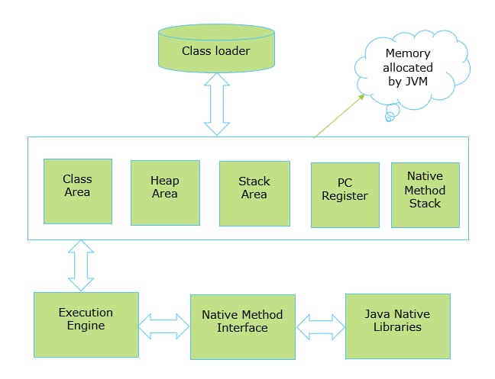
Internal Working of JVM

Slide 12

Internal Working of JVM
1.Class loader : When ever we run a program it is first loaded by class loader into memory. It is used to load the class files.
-The first class to be loaded into memory is usually the class that contains the main() method.
2.Class area : It is also called as method area.
-It stores all class level information like class name ,methods and variables information including static variables.
3.Heap area : It is a runtime area.
-It stores all the objects and their corresponding instance/global variables
4.Stack area : All local variables of a method are stored here.
5.PC register: It includes address of java virtual machine (JVM) instructions to be currently executed.
6.Native method stack : It contains all the native methods used in the application. These methods are written in a language other than the Java, such as C and C++.

Slide 13
Internal Working of JVM
7.Execution Engine : It contains Interpreter , JIT compiler and garbage collector
-Interpreter: It interprets the bytecode line by line and then executes.
-Just-In-Time Compiler(JIT) : It is used to increase the efficiency of an interpreter. It compiles the entire bytecode and changes it to native code
-Garbage Collector: It destroys un-referenced objects.
8.Native method interface: It is an interface that interacts with the Native Method Libraries and provides the native libraries(C, C++) required for the execution
9.Java Native libraires : Native Method Libraries are libraries that are written in other programming languages, such as C, C++, and assembly. These native libraries can be loaded through JNI (Native method interface).

Slide 14
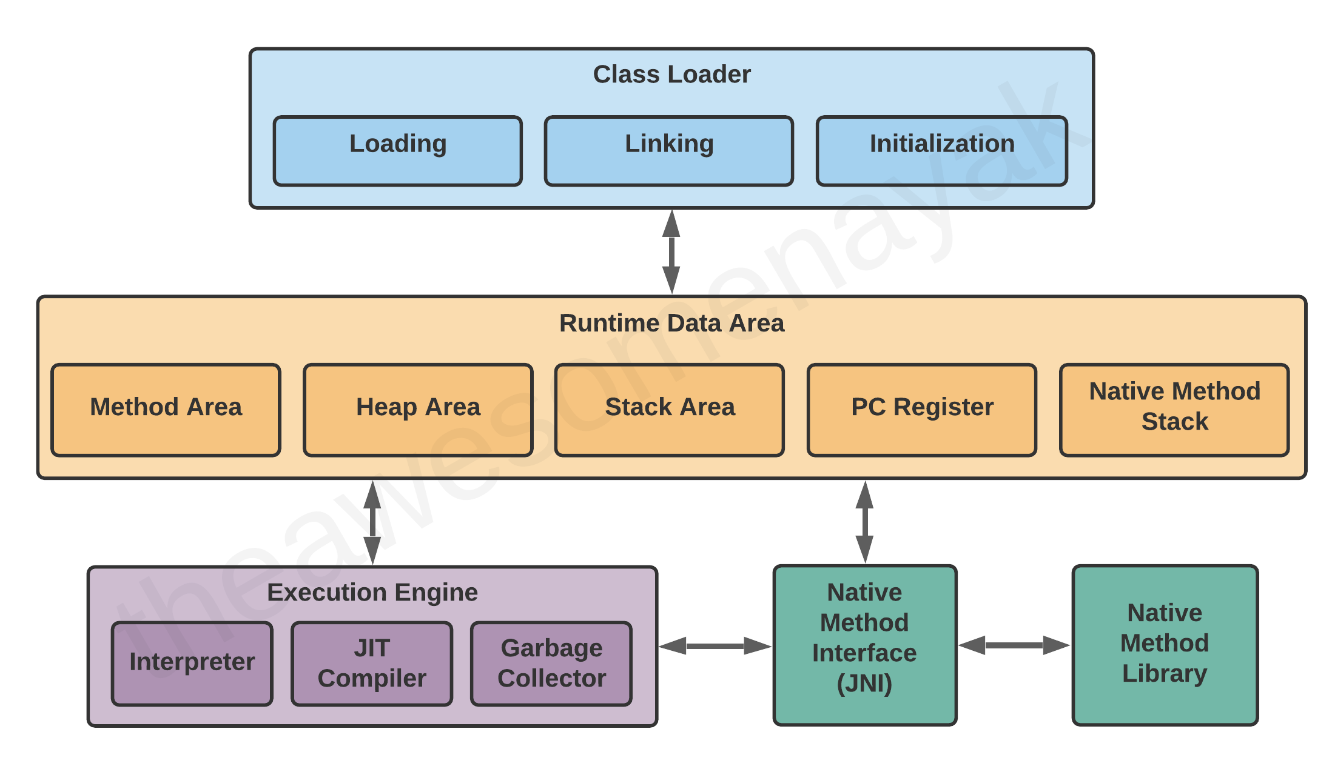
Internal Working of JVM

Slide 15
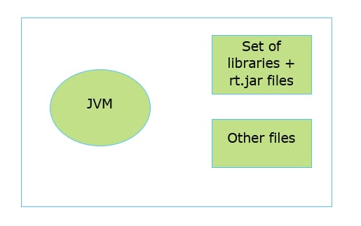
JRE
JRE : Java Runtime Environment
It includes set of libraries ,other files and rt.jar files that JVM requires at run time.
If you want to only run a program, then JRE is sufficient.
It is Platform Dependent.
It is Physically present.

Slide 16
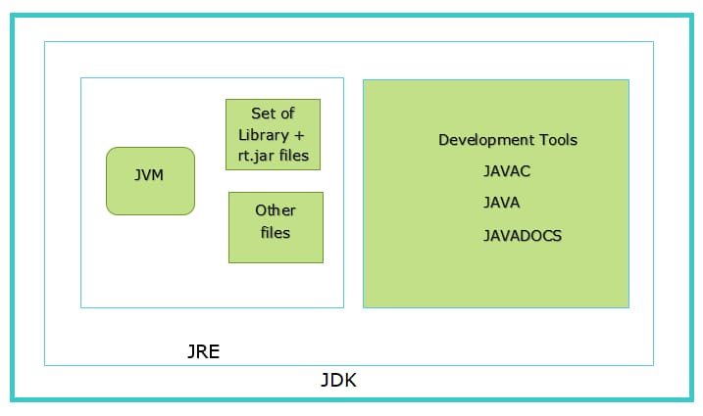
JDK
JDK : Java Development Kit
It is a software development environment which is used to develop java applications
JDK contains all the tools required to compile, debug and run a program.
It includes JRE + Development tools such as javac , Java, Javadoc …etc.
If you want to create and run the program, then JDK is required.
It is platform dependent
It is physically present

Slide 17
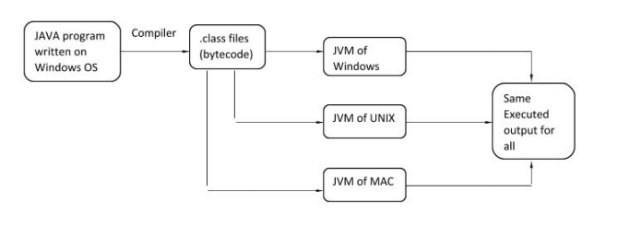
Why Java is called as platform independent
Java is platform independent because the bytecode which is generated from source code can run on any platform (machine) directedly. It means that bytecode is platform independent which eventually makes the JAVA as platform independent

Slide 19

Any Questions

