Slide 1
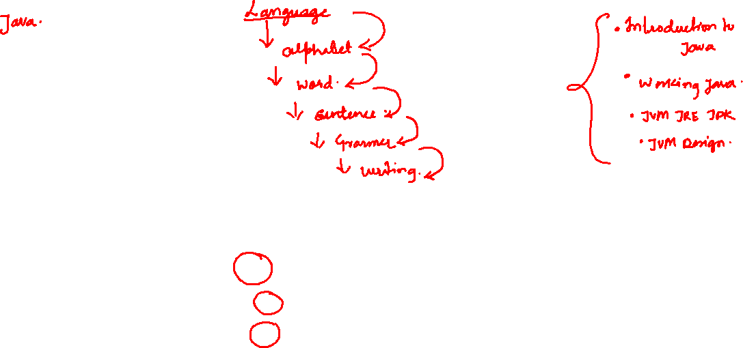
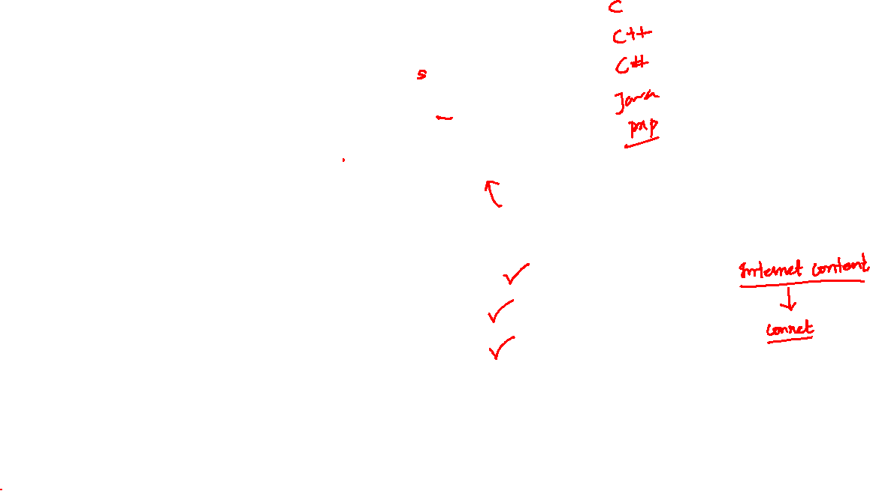

Topic
Character Set
Keywords
Data Type

Slide 2
Character Set In java
It includes alphabets, digits and special symbols that are used to represent information are called character set.
Alphabets : Both lowercase (a, b, c, d, e, etc.) and uppercase (A, B, C, D, E, etc.) letters.
Digits : 0,1,2,3,4,5,6,7,8,9.
Special Symbols : !@#$%&*(){}
Comma (,) Dot (.) Colon (:) Semi-colon (;) Single quote (‘)
Double quote (“), Back slash (\).
White space: Space, Tab, New line.

Slide 3
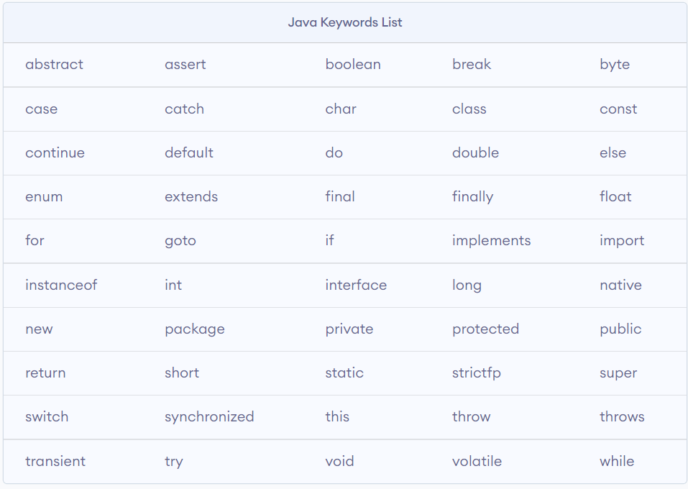
Keywords In java
Keywords are the reserved names , whose meaning is already defined in computer memory.

Slide 4

Data Type in java
They are used to represent type of data or information which will be stored into variable.
It defines the operations that can be done on the data and what type of values can be stored.

Slide 5
Data type classification
Primitive Data Types: A primitive data type is pre-defined by the programming language. The size and type of variable values are specified, and it has no additional methods.
Non-Primitive Data Types: These data types are not actually defined by the programming language but are created by the programmer. They are also called “reference variables” or “object references” since they refer a memory location which stores the data.

Slide 6
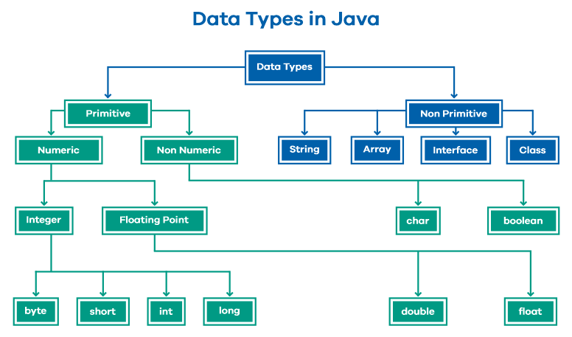

Slide 7
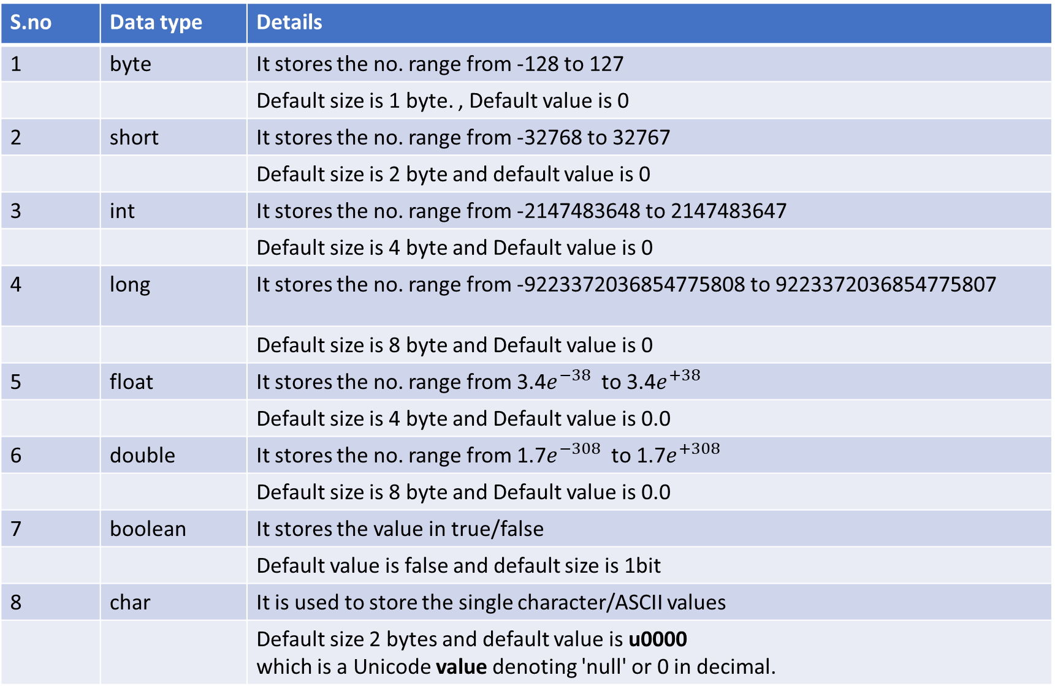
S.no | Data type | Details
1 | byte | It stores the no. range from -128 to 127
 |  | Default size is 1 byte. , Default value is 0
2 | short | It stores the no. range from -32768 to 32767
 |  | Default size is 2 byte and default value is 0
3 | int | It stores the no. range from -2147483648 to 2147483647
 |  | Default size is 4 byte and Default value is 0
4 | long | It stores the no. range from -9223372036854775808 to 9223372036854775807
 |  | Default size is 8 byte and Default value is 0
5 | float | It stores the no. range from 3.4$e^{−38}$ to 3.4$e^{+38}$
 |  | Default size is 4 byte and Default value is 0.0
6 | double | It stores the no. range from 1.7$e^{−308}$ to 1.7$e^{+308}$
 |  | Default size is 8 byte and Default value is 0.0
7 | boolean | It stores the value in true/false
 |  | Default value is false and default size is 1bit
8 | char | It is used to store the single character/ASCII values
 |  | Default size 2 bytes and default value is u0000 which is a Unicode value denoting 'null' or 0 in decimal.

