Slide 1

Q&A using Human Brain theory
-Bhrugvish Vakil

Slide 2

Motivation
We are surrounded by massive amounts of information in full-text documents i.e. web. Usually, we are interested in knowing the answer to our question rather than looking at the document. QA systems are useful in retrieving useful information from the web and providing insights. The QA process can be broken into two parts:
Information Retrieval: Finding the document containing the answer to the question
Reading Comprehension: Given the document find the answer to the question

Slide 3
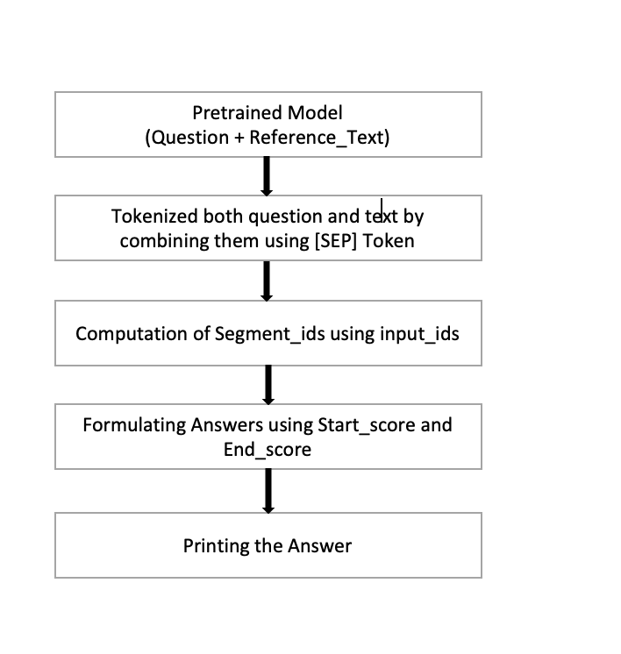
Implementation Flow:

Slide 4


Dataset:
SQuAD (Stanford Question Answering Dataset)
Answers to questions can be found in referenced text provided.
Every Training and test sample consists of questions and text from passage.

Slide 5

Which model we have used?
How is it different from other voice assistant ?

Slide 6
Model :-
Hugging face transformer Library
BRET Model :
BertForQuestionAnswering
“bert-large-uncased-whole-word-masking-finetuned-squad”
Bert Tokenizer

Slide 7
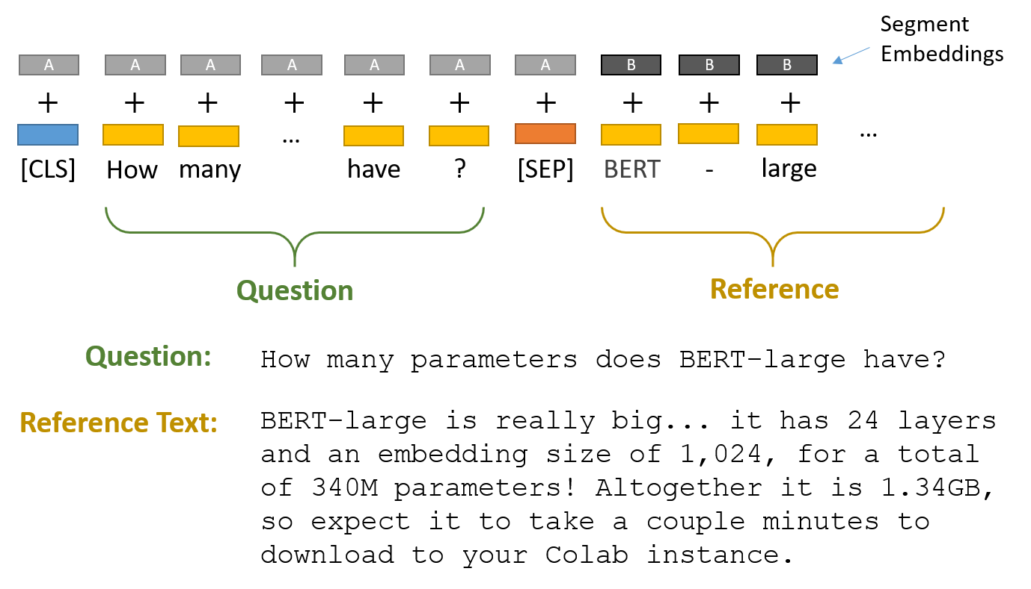
Bert Tokenizer:
Tokenization against both question and reference text.

Slide 8
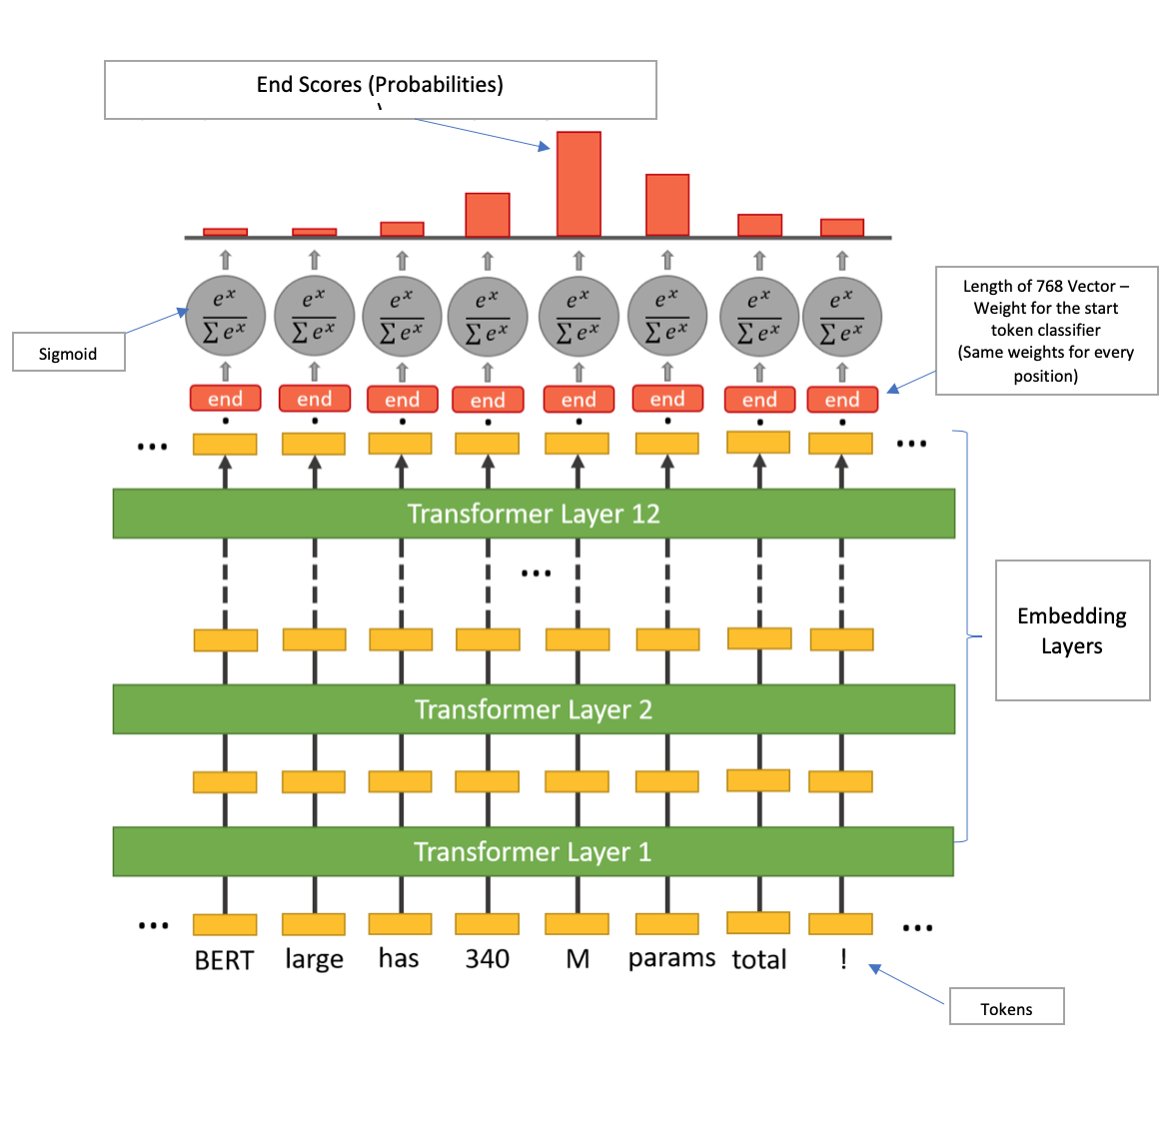
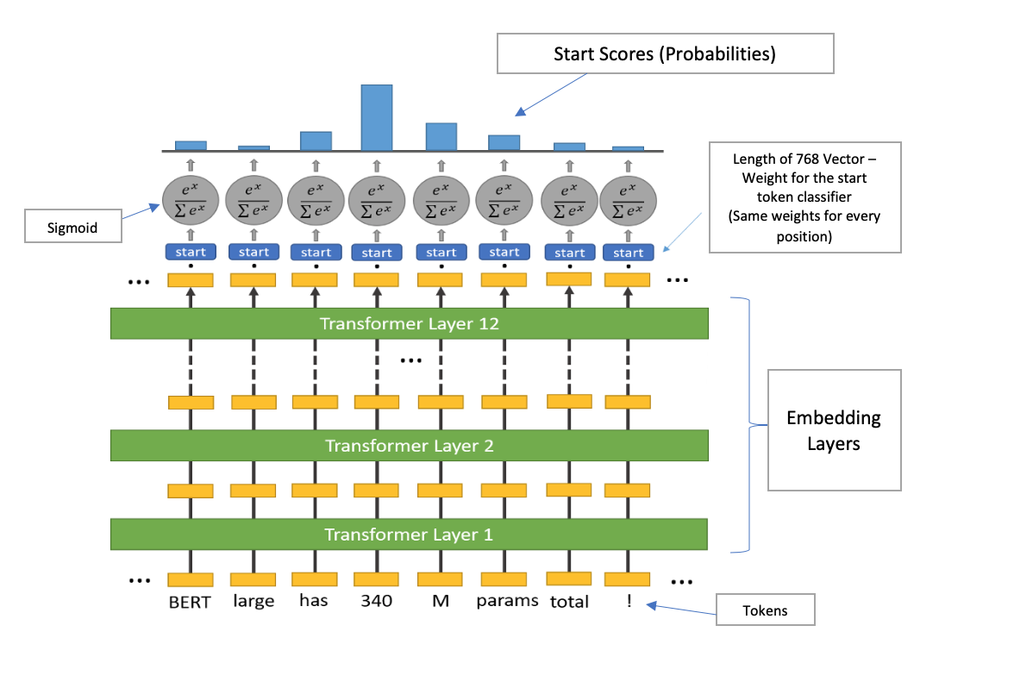
Start & End Token Classifiers:
Softmax
Softmax

Slide 9
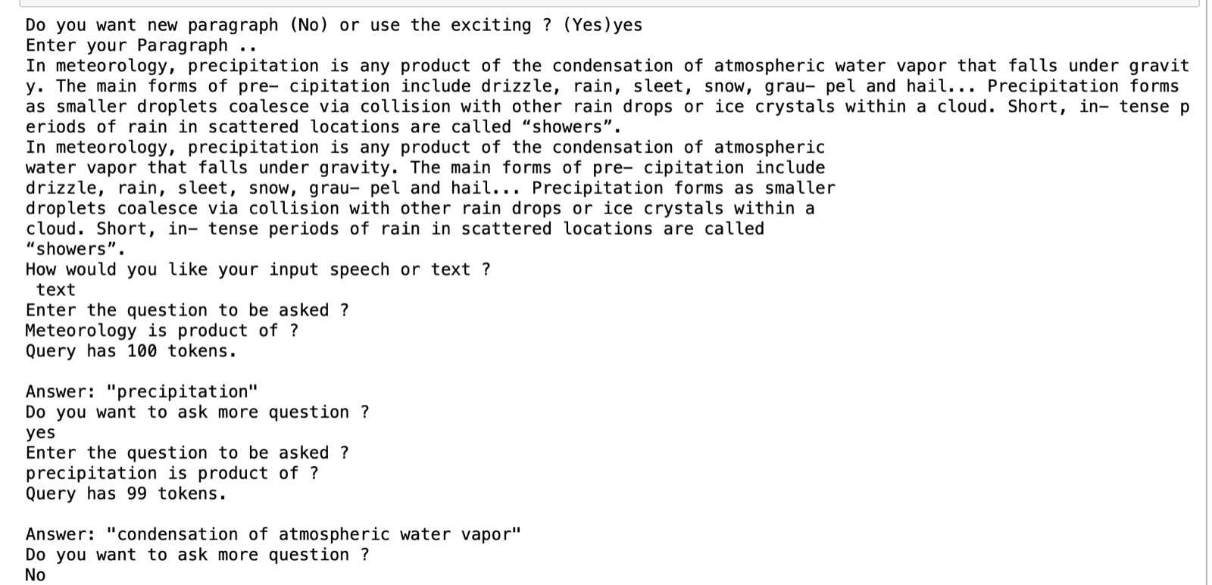

Results:

Slide 10
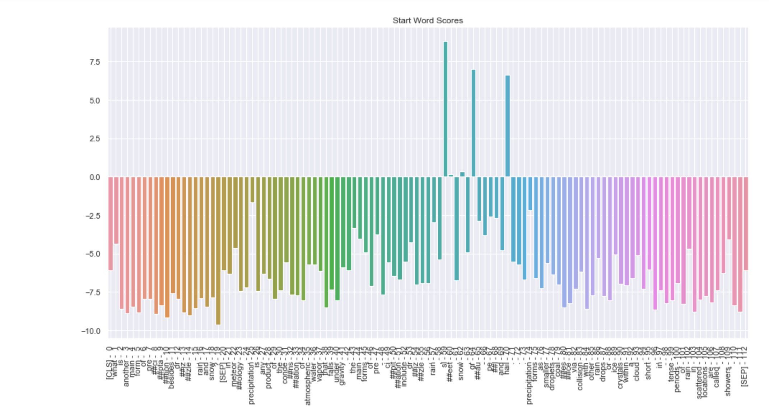
Results:
Visualizing Scores
Start scores:

Slide 11
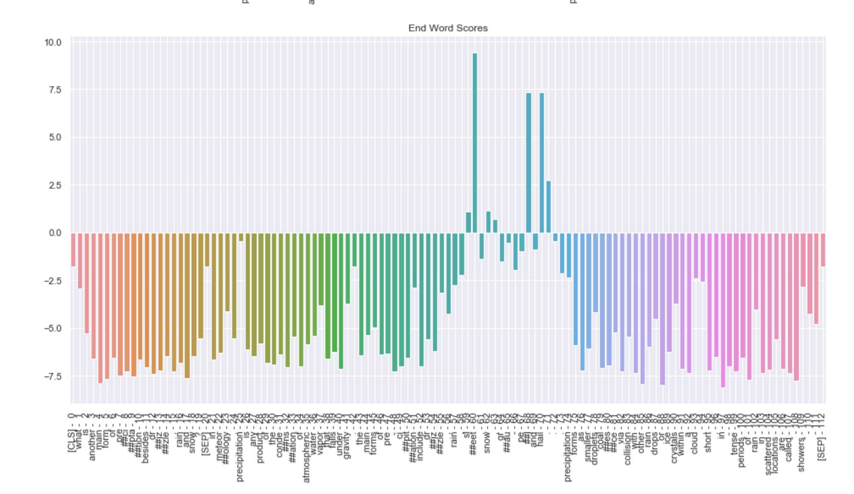
Results:
Visualizing Scores
End scores:

Slide 12
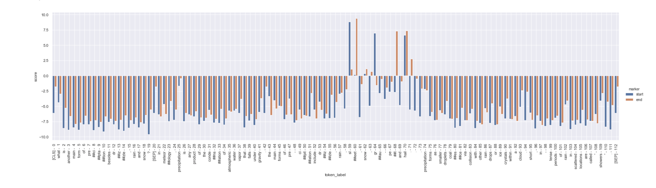
Results:
visualizing both the start and end scores on a single bar plot:

Slide 13

Future Work:
Formulation of nice response
Answer questions where it has to combine from multiple sentence in order to answer it.
Using lighter version of Bert. Like (ALBERT)

Slide 14

References:
Multiple Attention Networks with Temporal Convolution for Machine Reading Comprehension
End to End Memory Network.
SQuAD: 100,000+ Questions for Machine Comprehension of Text
Fusionnet: Fusing via Fully-Aware Attention with Application to Machine Comprehension
Bert:https://mccormickml.com/2020/03/10/question-answering-with-a-fine-tuned-BERT/

Slide 15

Any Questions?

