Slide 1
EXPLORING RAINFALL TRENDS AND PATTERNS With PYTHON
By:
BHUSHAN PATIL
234161015

Slide 2
Motivation
1: Agricultural Impact
"The monsoon season, vital for Indian agriculture, influences crop growth significantly. Timely rainfall is crucial for food production, and any deviation from expected patterns can have profound implications."
2: Economic Dependency on Agriculture
"India's economy relies heavily on agriculture, where rainfall plays a pivotal role. The impact of monsoons on farming isn't just meteorological; it's a critical factor determining the economic well-being of the nation.“
3)Predicting Floods:
By studying rainfall patterns, we gain insights into flood risks, enabling us to identify vulnerable areas and implement protective measures for communities.

Slide 3
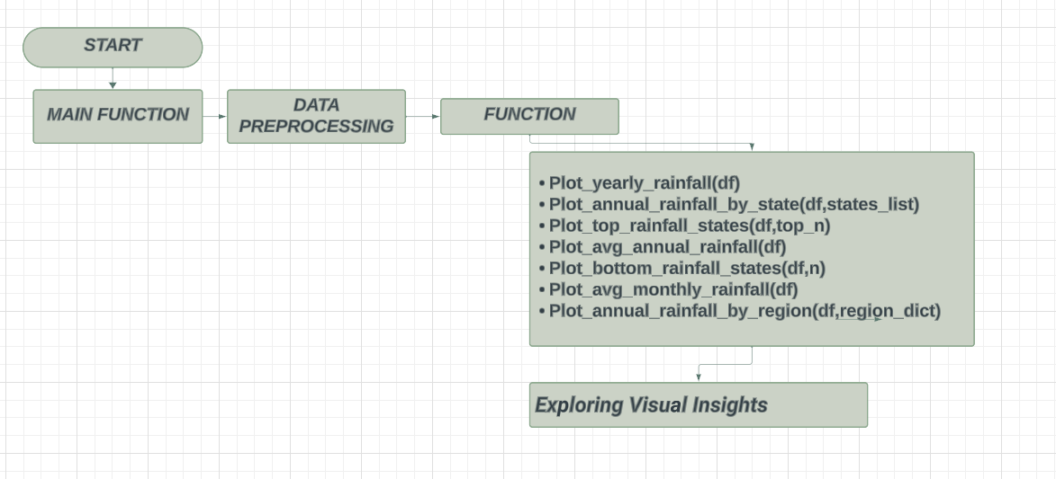
BLOCK DIAGRAM
Datasets Used:
Rainfall Distribution (Yearly)
Rainfall Distribution (District wise)

Slide 4
PSEUDOCODE
# Main function
function main():
# Function to plot top rainfall states
function plot_top_rainfall_states(dataframe, top_n=5):
# Plotting logic using matplotlib
# Read and preprocess yearly and district-wise rainfall data
df_1 = read_csv("Yearly Rainfall Data")
df_1 = rename_columns(df_1)
# Function to plot average annual rainfall
function plot_avg_annual_rainfall(dataframe):
# Plotting logic using seaborn
df_1_grouped = group_by_year_state(df_1)
# Read and preprocess district-wise rainfall data
df_2 = read_csv("District-wise Rainfall Data")
df_2 = rename_columns(df_2)
# Function to plot bottom rainfall states
function plot_bottom_rainfall_states(dataframe, n=8):
# Plotting logic using matplotlib
df_2_mapped = map_states_to_region(df_2)
# Perform rainfall analysis
plot_yearly_rainfall(df_1_grouped)
plot_annual_rainfall_by_state(df_1_grouped, selected_states)
plot_top_rainfall_states(df_1_grouped)
plot_avg_annual_rainfall(df_2_mapped)
plot_bottom_rainfall_states(df_1_grouped)
plot_avg_monthly_rainfall(df_2_mapped)
plot_annual_rainfall_by_region(df_2_mapped, region_mapping)
# Function to plot average monthly rainfall
function plot_avg_monthly_rainfall(dataframe):
# Plotting logic using seaborn
# Function to read CSV file
function read_csv(file_path):
return pandas.read_csv(file_path)
# Function to plot annual rainfall by region
function plot_annual_rainfall_by_region(dataframe, region_dict):
# Plotting logic using seaborn
# Function to rename columns for consistency
function rename_columns(dataframe):
# Function to plot annual rainfall by state
function plot_annual_rainfall_by_state(dataframe, states_list):
# Plotting logic using matplotlib
return dataframe.rename(columns={'original_column_name': 'new_column_name'})
# Function to group data by year and state
function group_by_year_state(dataframe):
return dataframe.groupby(["Year", "State"])
# Function to plot yearly rainfall
function plot_yearly_rainfall(dataframe):
# Plotting logic using matplotlib
function map_states_to_region(dataframe):
dataframe["Region"] = dataframe["State"].map(region_mapping)
return dataframe

Slide 5


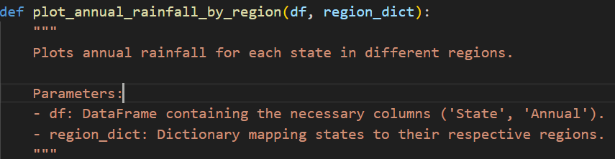
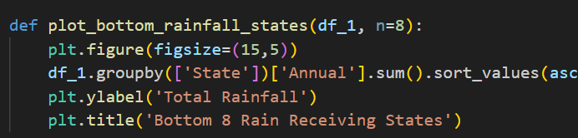
Pythonic Features
PANDAS for DATA Processing and Manipulation
MATPLOTLIB For Dynamic Plotting
Python Docstring
Python Function

Slide 6
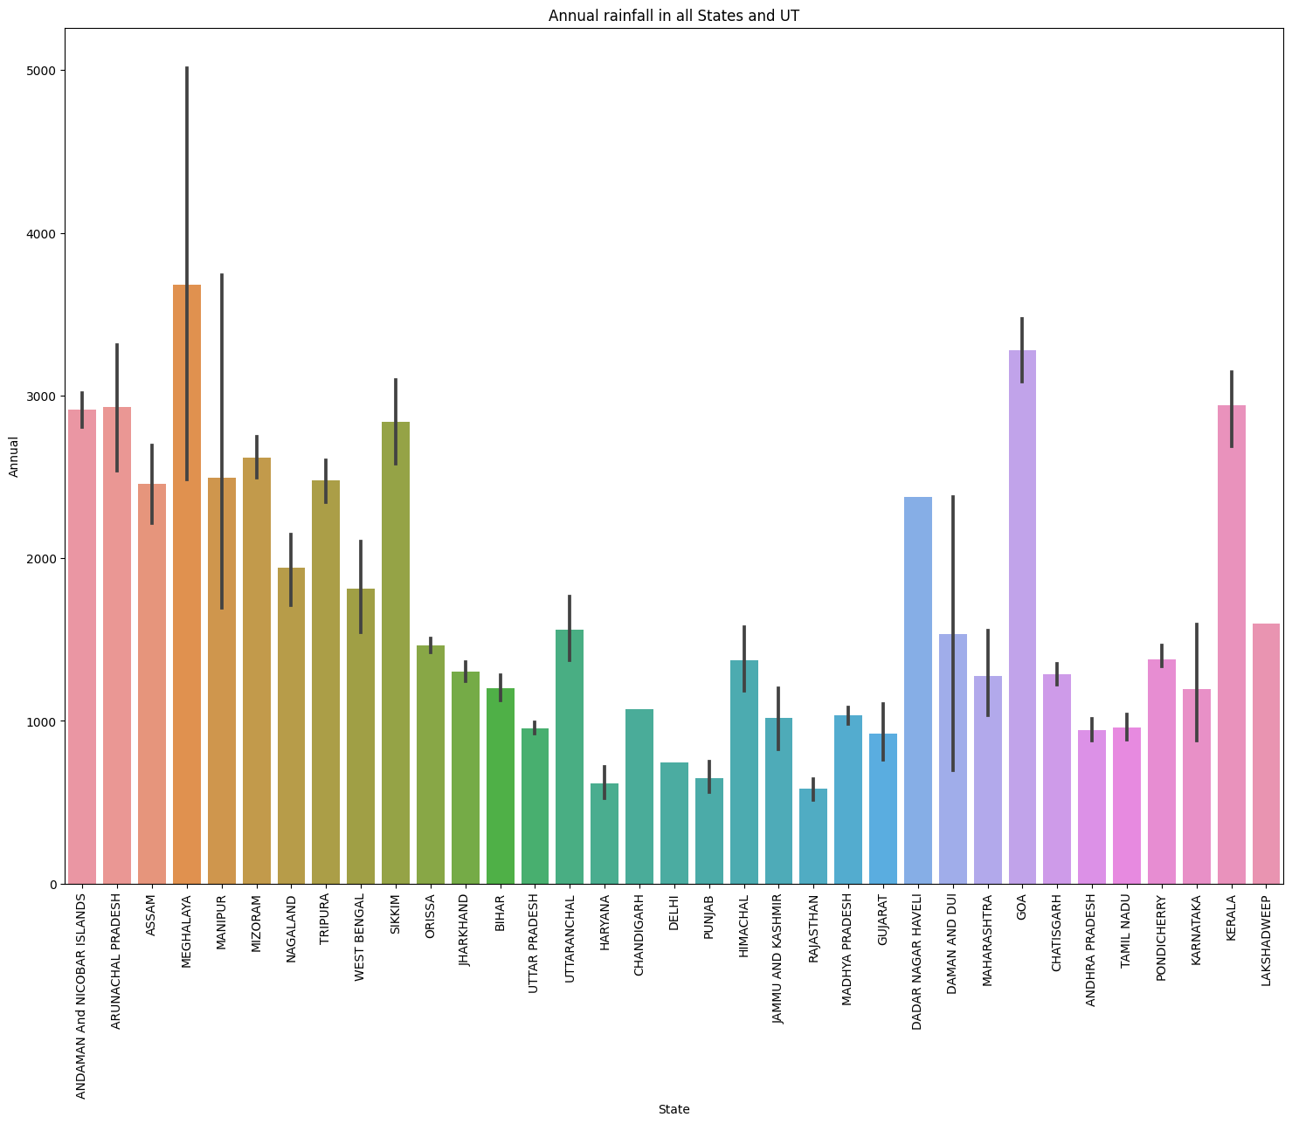
Rainfall Distribution

Slide 7
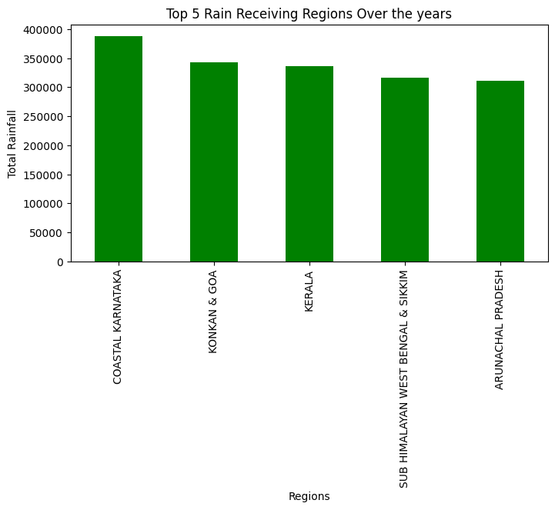
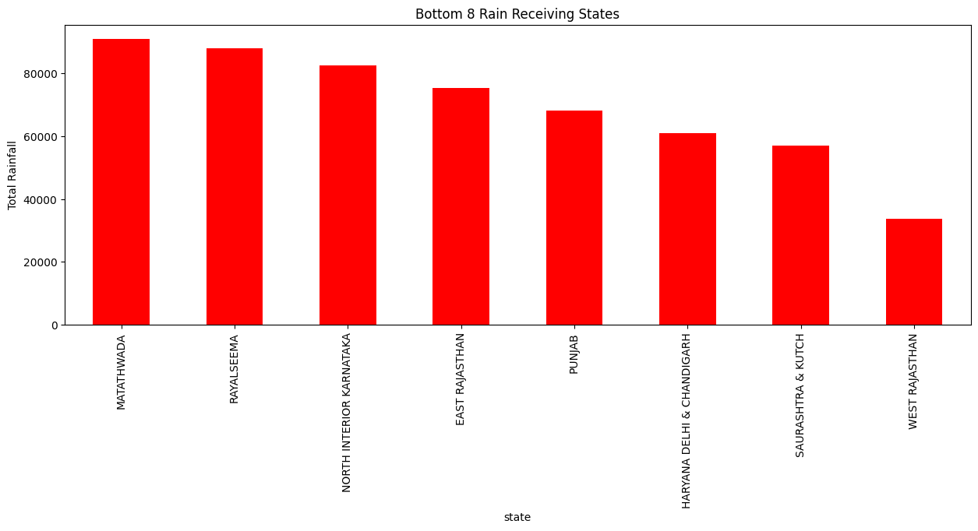
Cumulative Rainfall Data

Slide 8
Using the above plots, we get the insights on distribution of rainfall across the country. Using this we can draw out the plans for Water Management for Low rainfall receiving states and Flood Management in areas with heavier rainfall.
We can also see variation in the Vegetation, Soil Patterns, Agriculture Practices in different regions with varying rainfall.
Although this data is helpful in visualizing the current scenario of Rainfall and Monsoon in different regions of the country.

Slide 9
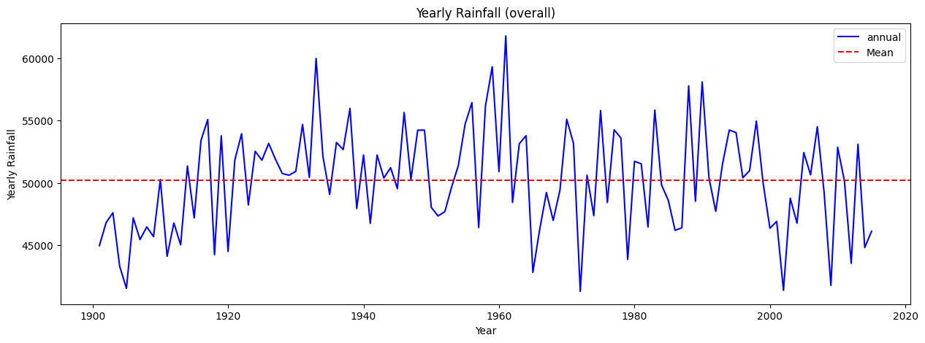
The above plot shows the Annual Rainfall variation over the years, we can draw some insights from this regarding the changes in rainfall in recent years. As we can see from the slides that Quantity of the rainfall has been decreasing recently which is a cause of concern.
Although we promised to relate it to climate change, but our exploration lead to the discovery that Climate Change although is an important factor but it is not the only factor and there are dozens of other factors including wind conditions, ocean currents etc which affect the rainfall in India. But because we couldn’t explore those other factors we cannot really say we know the reason for the effect on rainfall.

Slide 10
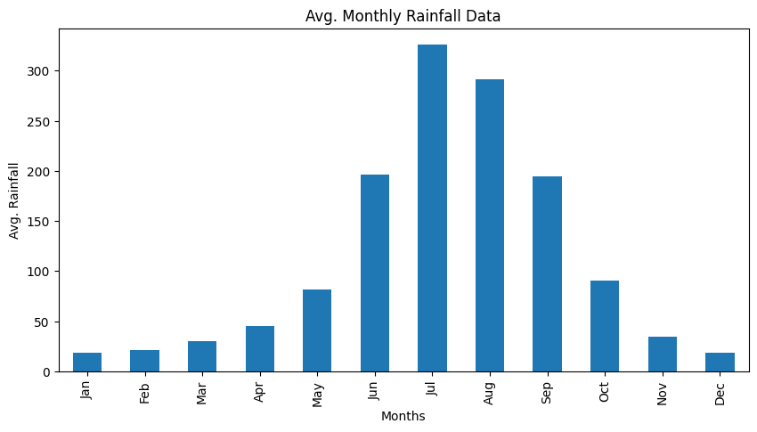
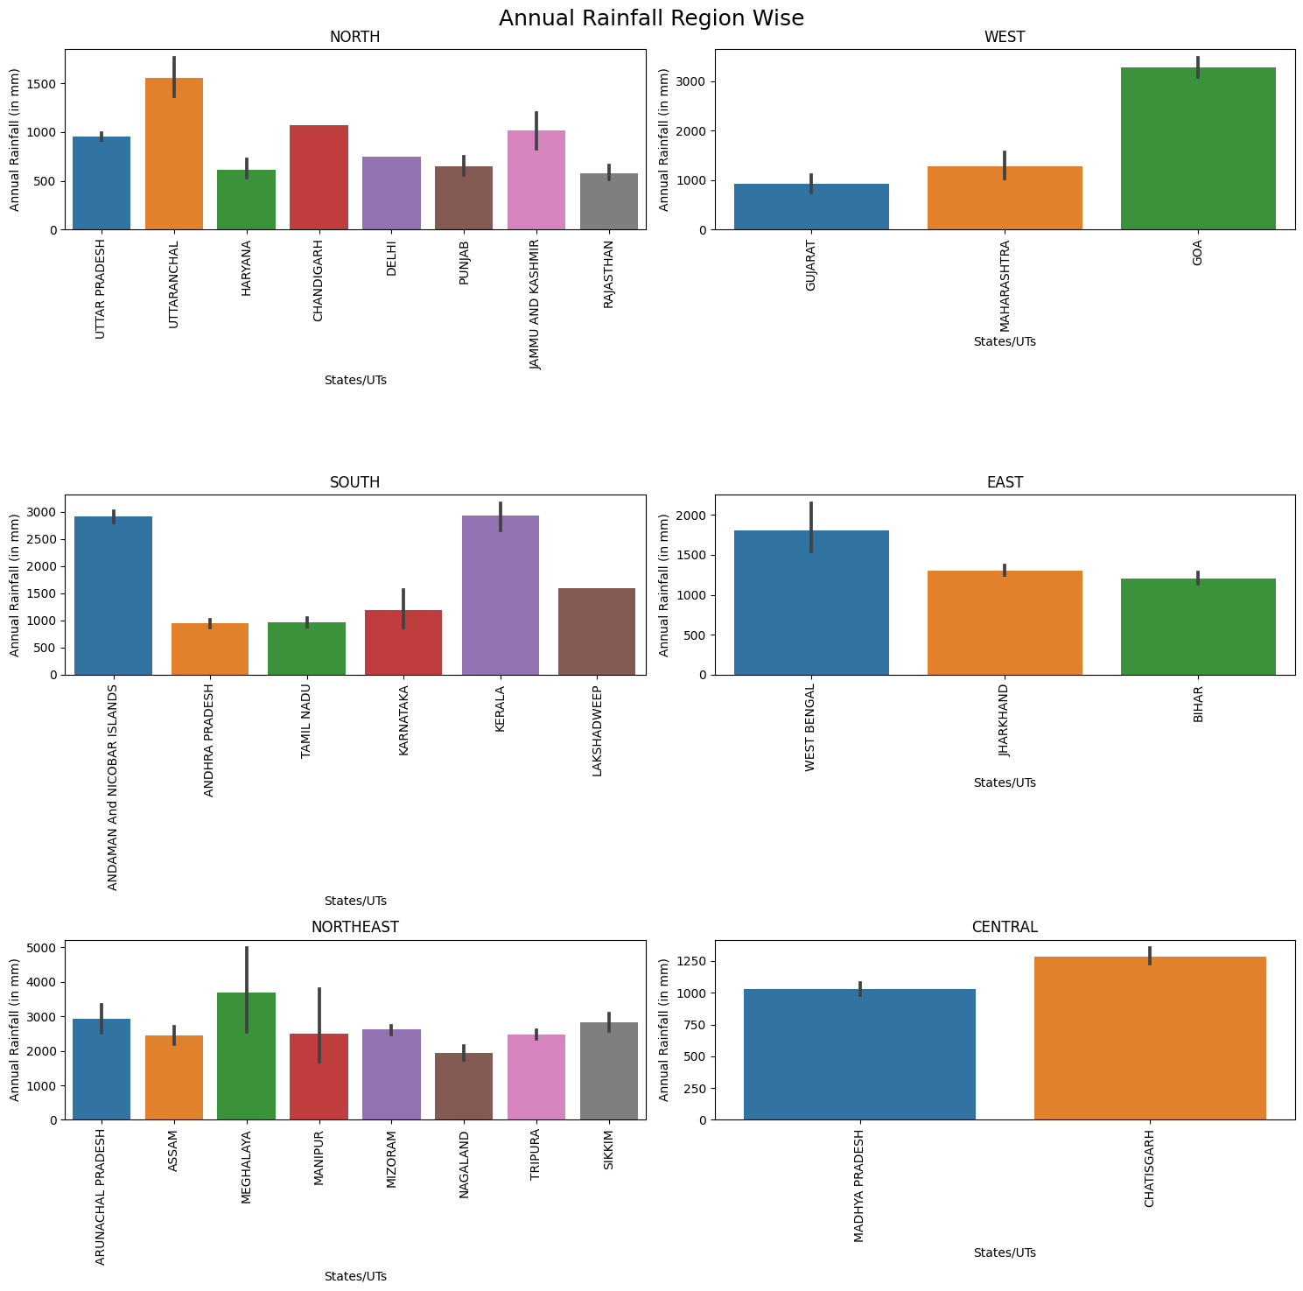
The monthly distribution of the rainfall and Rainfall distribution region wise can be related with Agricultural Practices in different regions in the country.

Slide 11
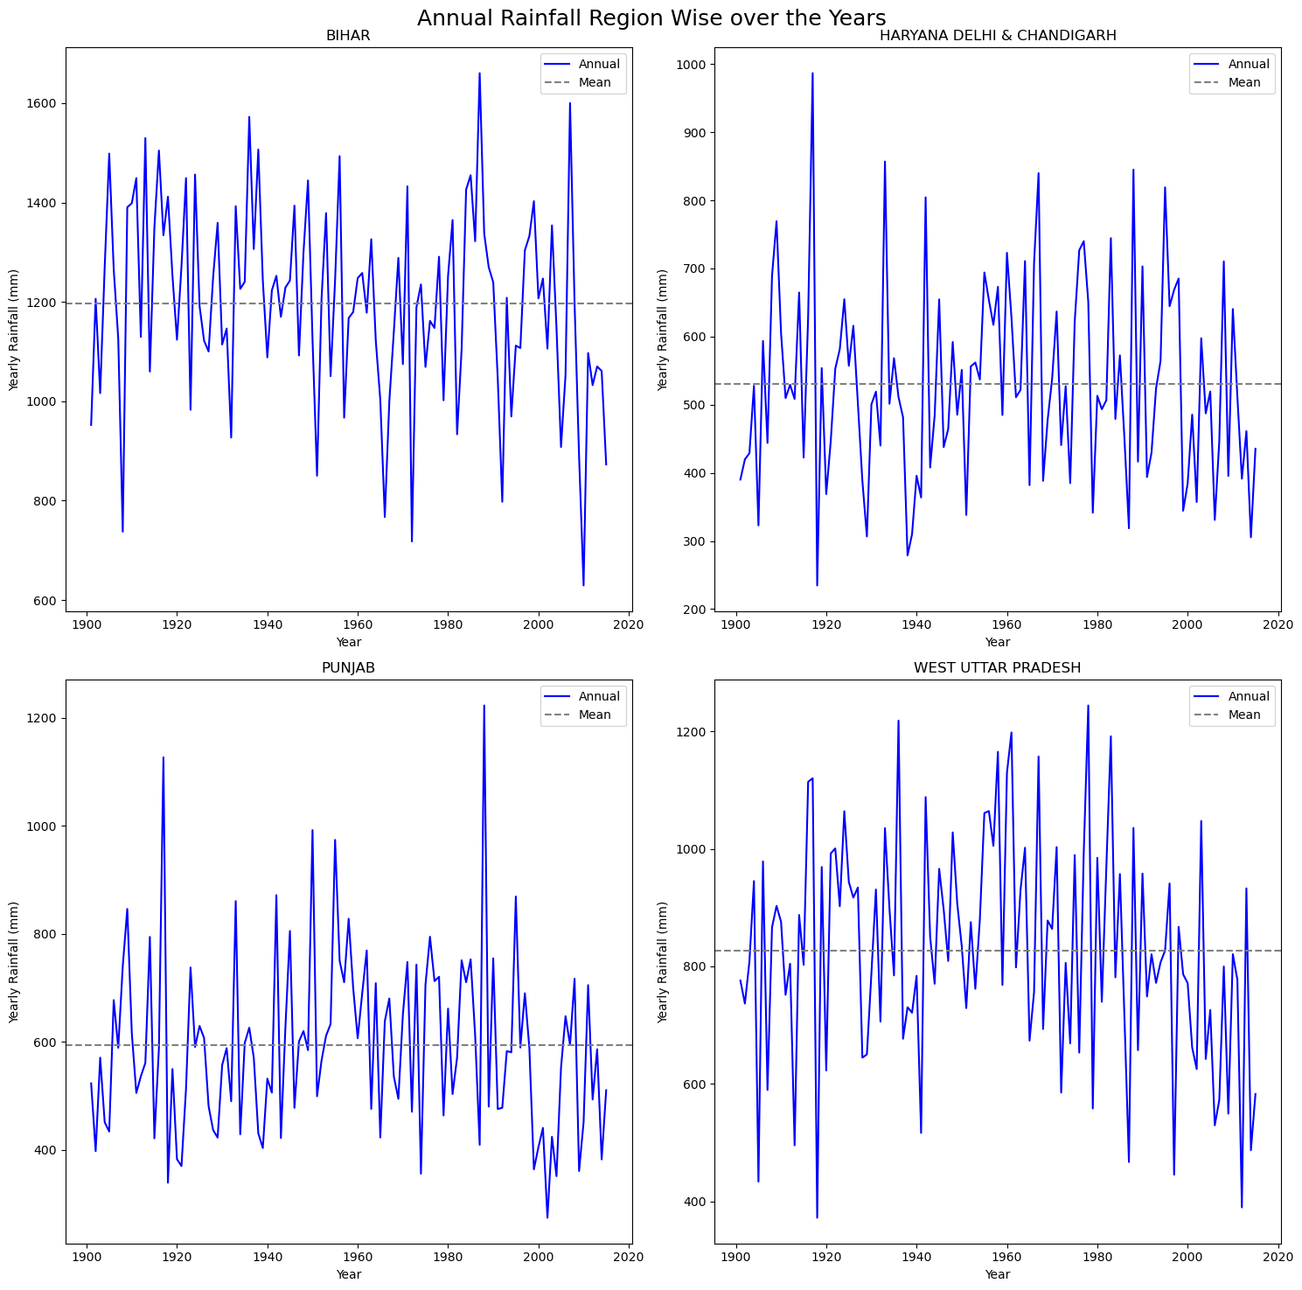
Annual Rainfall Region Wise Over The Years

Slide 12
Conclusion
We tried to come up with some interesting facts and insights based on the data.
But in recent years there has been a decrease in overall rainfall received and this has affected different regions in different ways.
Further Exploration is possible in this project, as this is a very dynamic field and there can be different perspective to see the problem, I tried to do that in our simplistic way.

Slide 13
Thank You

