Slide 1

Univariate Binary Logistic Regression Analysis of Metabolic Outcome Predictors
Bhuiyan Sadhin
MSc Student of Irkutsk National Research Technical University

Slide 2

Study Purpose & Data Overview
Objective
Identify significant predictors of a binary outcome using univariate logistic regression across 31 variables spanning demographics, hormones, lipids, and antioxidants.
Dataset Overview
Parameter
Value
Sample Size
1,148
Total Variables
31
Outcome = 0
987 (86%)
Outcome = 1
160 (14%)
DEMOGRAPHICS
HORMONES
LIPIDS
ANTIOXIDANTS

Slide 3
Methodology
Method: Univariate Binary Logistic Regression
Key Metrics: Odds Ratio (OR), 95% CI, p-value
Significance Level: p < 0.05
Software: R Statistical Software
.
Statistical
Approach
Risk Interpretation
OR > 1 → Risk Factor (increases odds)
OR < 1 → Protective Factor (decreases odds)
OR = 1 → No Effect
Formula
Significance Guide
log(p/(1−p))=β0​+β1​X
Where:
p = probability of outcome = 1
X = predictor variable
β₀ = intercept
β₁ = coefficient
p < 0.05 → Statistically Significant
p ≥ 0.05 → Not Significant
CI not crossing 1 → Statistically Significant
CI crossing 1 → Not Significant

Slide 4
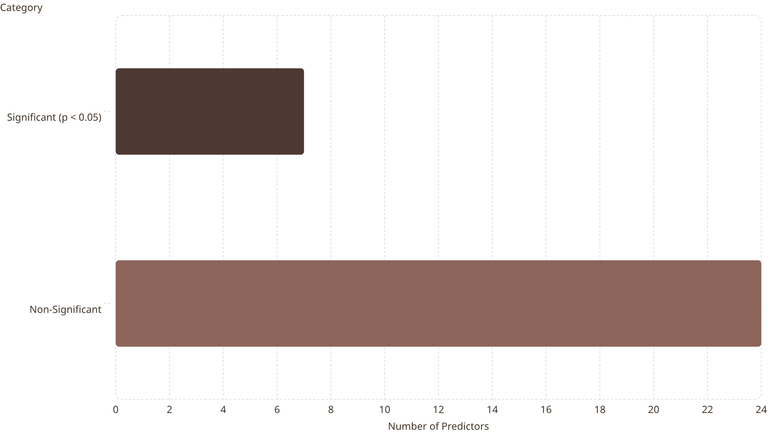
Significant Predictors
7 out of 31 predictors were significant — representing 22.6% of all tested variables. The bar chart below illustrates the proportion of significant versus non-significant predictors across the full variable set.
Significant predictors spanned all four categories — lipids, hormones, and antioxidants — with the strongest signals emerging from lipid and
antioxidant variables.

Slide 5
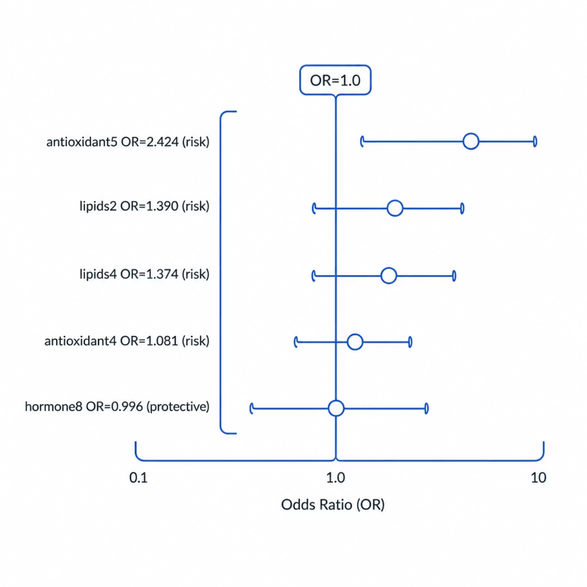


Odds Ratios — Forest Plot
The forest plot below displays univariate odds ratios with 95% confidence intervals for all significant predictors. Values above 1.0 indicate risk factors; values below 1.0 indicate protective factors. The vertical line at OR = 1.0 represents no effect.
Risk Factors (OR > 1): antioxidant5 (OR = 2.424, p = 0.0009), lipids2 (OR = 1.390, p = 0.0001), lipids4 (OR = 1.374, p = 0.0004)
Protective Factor (OR < 1): hormone8 (OR = 0.996, p = 0.0003)

Slide 6
Results Table
Univariate logistic regression results for all significant predictors (p < 0.05). Odds ratios, 95% confidence intervals, and p-values are presented below.
Variable
OR
95% CI
p-value
antioxidant5
2.424
1.426–4.069
0.0009
lipids2
1.390
1.172–1.648
0.0001
lipids4
1.374
1.150–1.637
0.0004
antioxidant4
1.081
1.028–1.136
0.0021
hormone8
0.996
0.993–0.998
0.0003

Slide 7

Final Model
Final Equation
Final Model Results
Variable
OR
95% CI
log(p/(1-p)) = −3.636
+ 0.283(lipids2)
− 0.004(hormone8)
+ 0.056(lipids4)
+ 0.705(antioxidant5)
+ 0.052(antioxidant4)
p-value
hormone8
0.996
0.994 – 0.999
0.003
antioxidant5
2.024
1.158 – 3.538
0.013
antioxidant4
1.054
1.000 – 1.110
0.050
lipids2
1.327
0.860 – 2.048
0.199
lipids4
1.058
0.677 – 1.654
0.804

Slide 8

Conclusions
Key findings from the final multivariable-adjusted model highlight three variables of note. antioxidant5 emerged as the strongest risk factor (OR = 2.024), hormone8 demonstrated a protective effect (OR = 0.996), and antioxidant4 showed borderline significance (p = 0.050). Notably, lipid variables were significant in univariate analysis but lost significance after multivariable adjustment.
⬆ Strongest Risk
⬇ Protective
antioxidant5
OR = 2.024
hormone8
OR = 0.996
⚠ Borderline
antioxidant4
p = 0.050

Slide 9
References
Hosmer, D. W., Lemeshow, S., & Sturdivant, R. X. (2013). Applied Logistic Regression (3rd ed.). Wiley.
Field, A., Miles, J., & Field, Z. (2012). Discovering Statistics Using R. Sage Publications.
Harrell, F. E. (2015). Regression Modeling Strategies: With Applications to Linear Models, Logistic and Ordinal Regression, and Survival Analysis (2nd ed.). Springer.
R Core Team. (2024). R: A Language and Environment for Statistical Computing. R Foundation for Statistical Computing.
Cohen, J., Cohen, P., West, S. G., & Aiken, L. S. (2003). Applied Multiple Regression/Correlation Analysis for the Behavioral Sciences (3rd ed.). Lawrence Erlbaum Associates.

Slide 10
Thank You

