Slide 1

Data Ingestion and Quality Control System
A comprehensive ETL solution for data validation and database integration

Slide 2

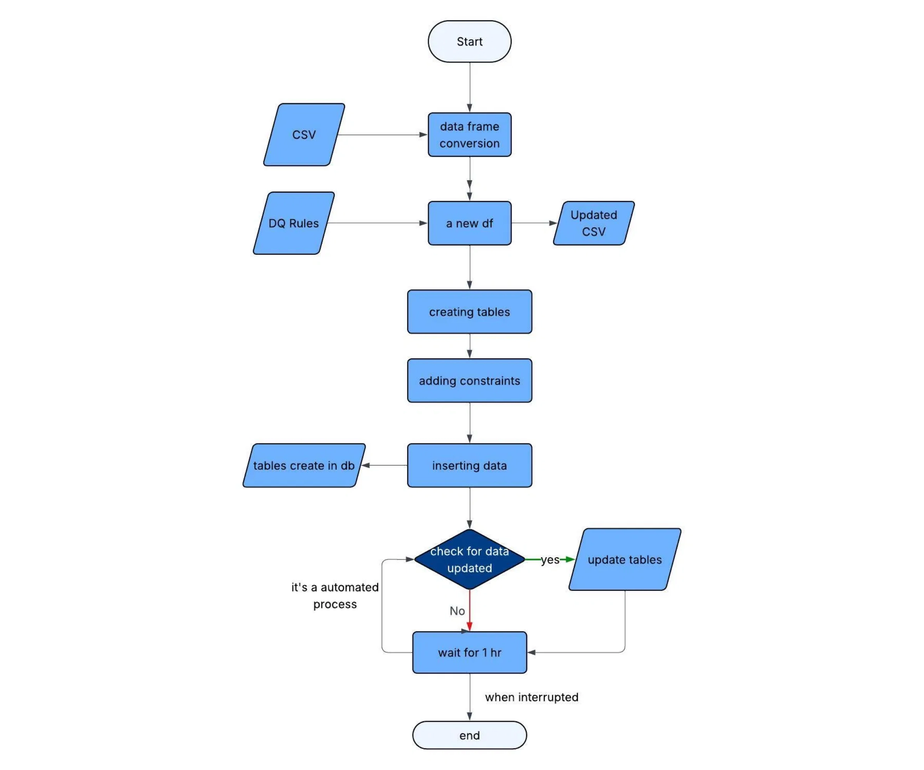

Project Overview
Purpose
This project automates the Extract, Transform, Load (ETL) process for data from CSV files into a MySQL database with robust data quality controls.
Key Objectives
Ensure data integrity through validation
Automate data cleaning and transformation
Maintain consistent database structure
Provide transparent error logging
Support automated periodic updates

Slide 3

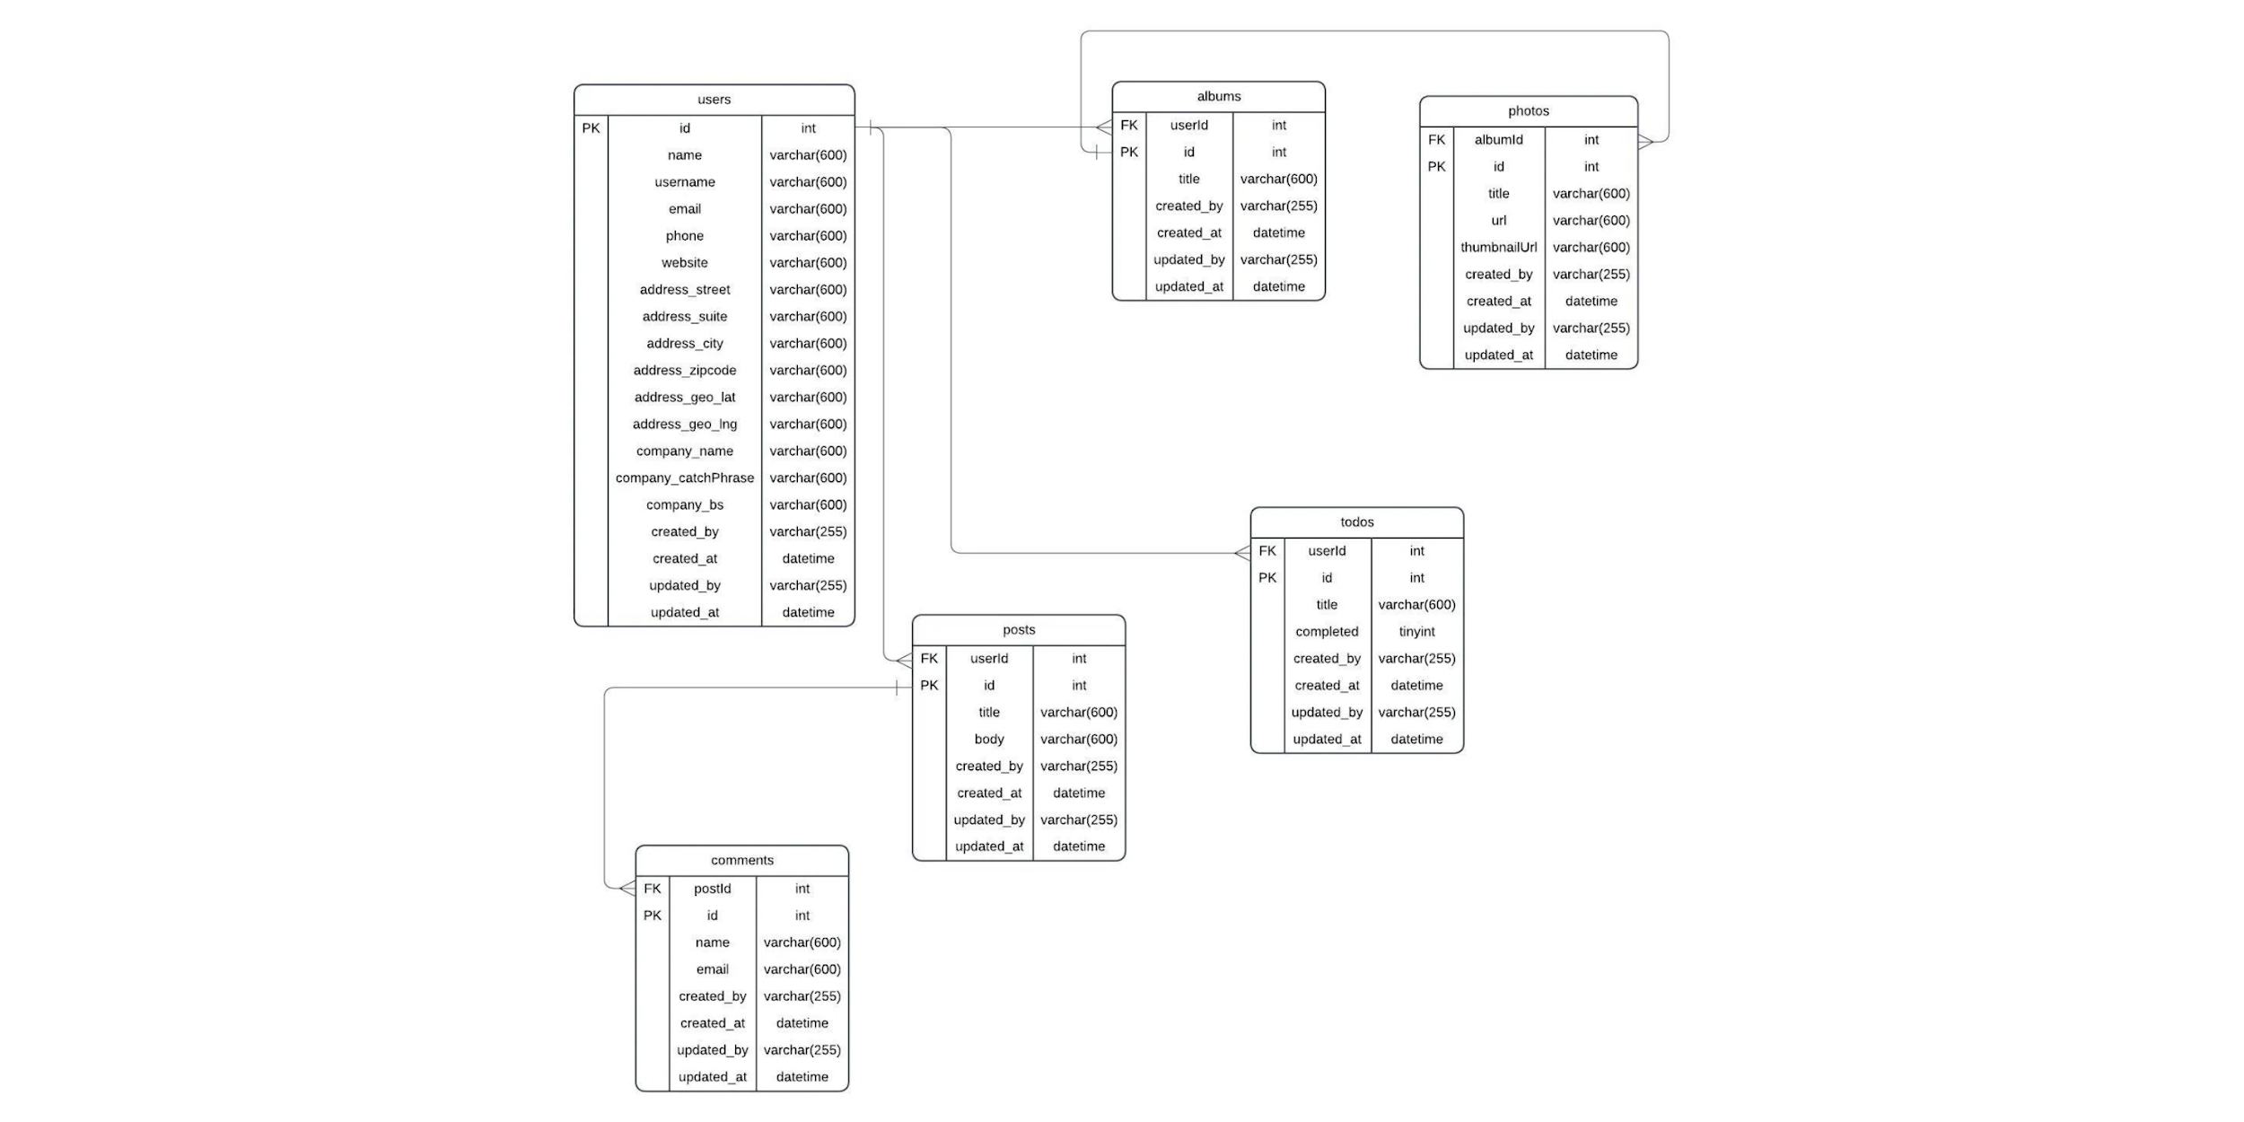
System Architecture
The system follows a modular architecture with clear separation of concerns between components. Each module handles a specific part of the ETL process, making the system maintainable and extensible.
Orchestrates the entire ETL pipeline
Implements data quality validation functions
Centralizes configuration parameters
Manages database connections and schema
app.py
dq.py
config.json
tables.py

Slide 4





Core Components
app.py
dq.py
Central orchestrator that manages the entire ETL pipeline from data extraction to database insertion.
Library of data quality functions that validate and transform data according to predefined rules.
Reads configuration from config.json
Primary key validation
Applies data quality checks from dq.py
Foreign key checks
Saves cleaned data to CSV files
Data format validation (email, URL, etc.)
Triggers database insertion via tables.py
Null handling and default value assignment
config.json
tables.py
Configuration file that centralizes all parameters for database connection and file paths.
Handles database connections, schema creation, and data insertion operations.
Database credentials
Database connection management
Source CSV file paths
Table creation with proper schema
Destination paths for cleaned data
Bulk data insertion from CSV files
Table name mappings
Error handling and logging

Slide 5

app.py - Application Orchestration
Core Functionality
The app.py script serves as the central orchestrator for the entire ETL pipeline, coordinating all data processing steps.
Workflow
1
Loads configuration from config.json
,
2
Creates database tables via tables.py
3
Reads raw CSV data into pandas DataFrames
4
Applies data quality checks from dq.py
5
Saves cleaned data to dist/ directory
6
Inserts cleaned data into MySQL database

Slide 6

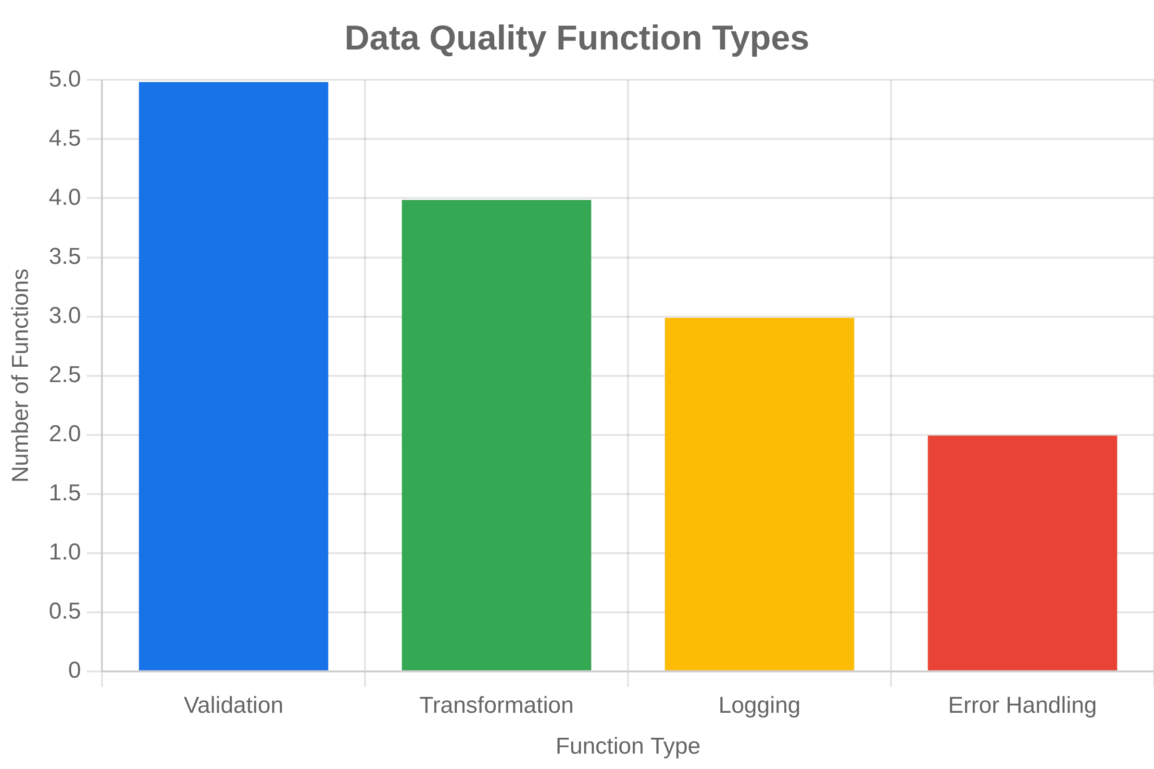
dq.py - Data Quality Functions
The
dq.py
module contains specialized functions that
validate and transform data according to predefined
quality rules. Each function focuses on a specific
validation task.
primary_key_check_num()
Validates numeric primary keys for uniqueness and non-null values
fk_id_check()
Ensures foreign keys are valid and non-null
title_check_to_untitled()
Replaces null titles with 'untitled'
email_check_blank()
Validates email format using regex patterns
url_check_null()
Replaces invalid URLs with a default URL

Slide 7





config.json - Configuration Management
Role in the System
The config.json file centralizes all configurable parameters, enhancing flexibility and maintainability without code changes.
Key Configuration Sections
database:
Connection credentials for MySQL
srcpath:
Source CSV file locations
tables:
Mapping of logical to actual table names
distpath:
Destination paths for cleaned data
names & paths:
Processing sequence for data insertion

Slide 8

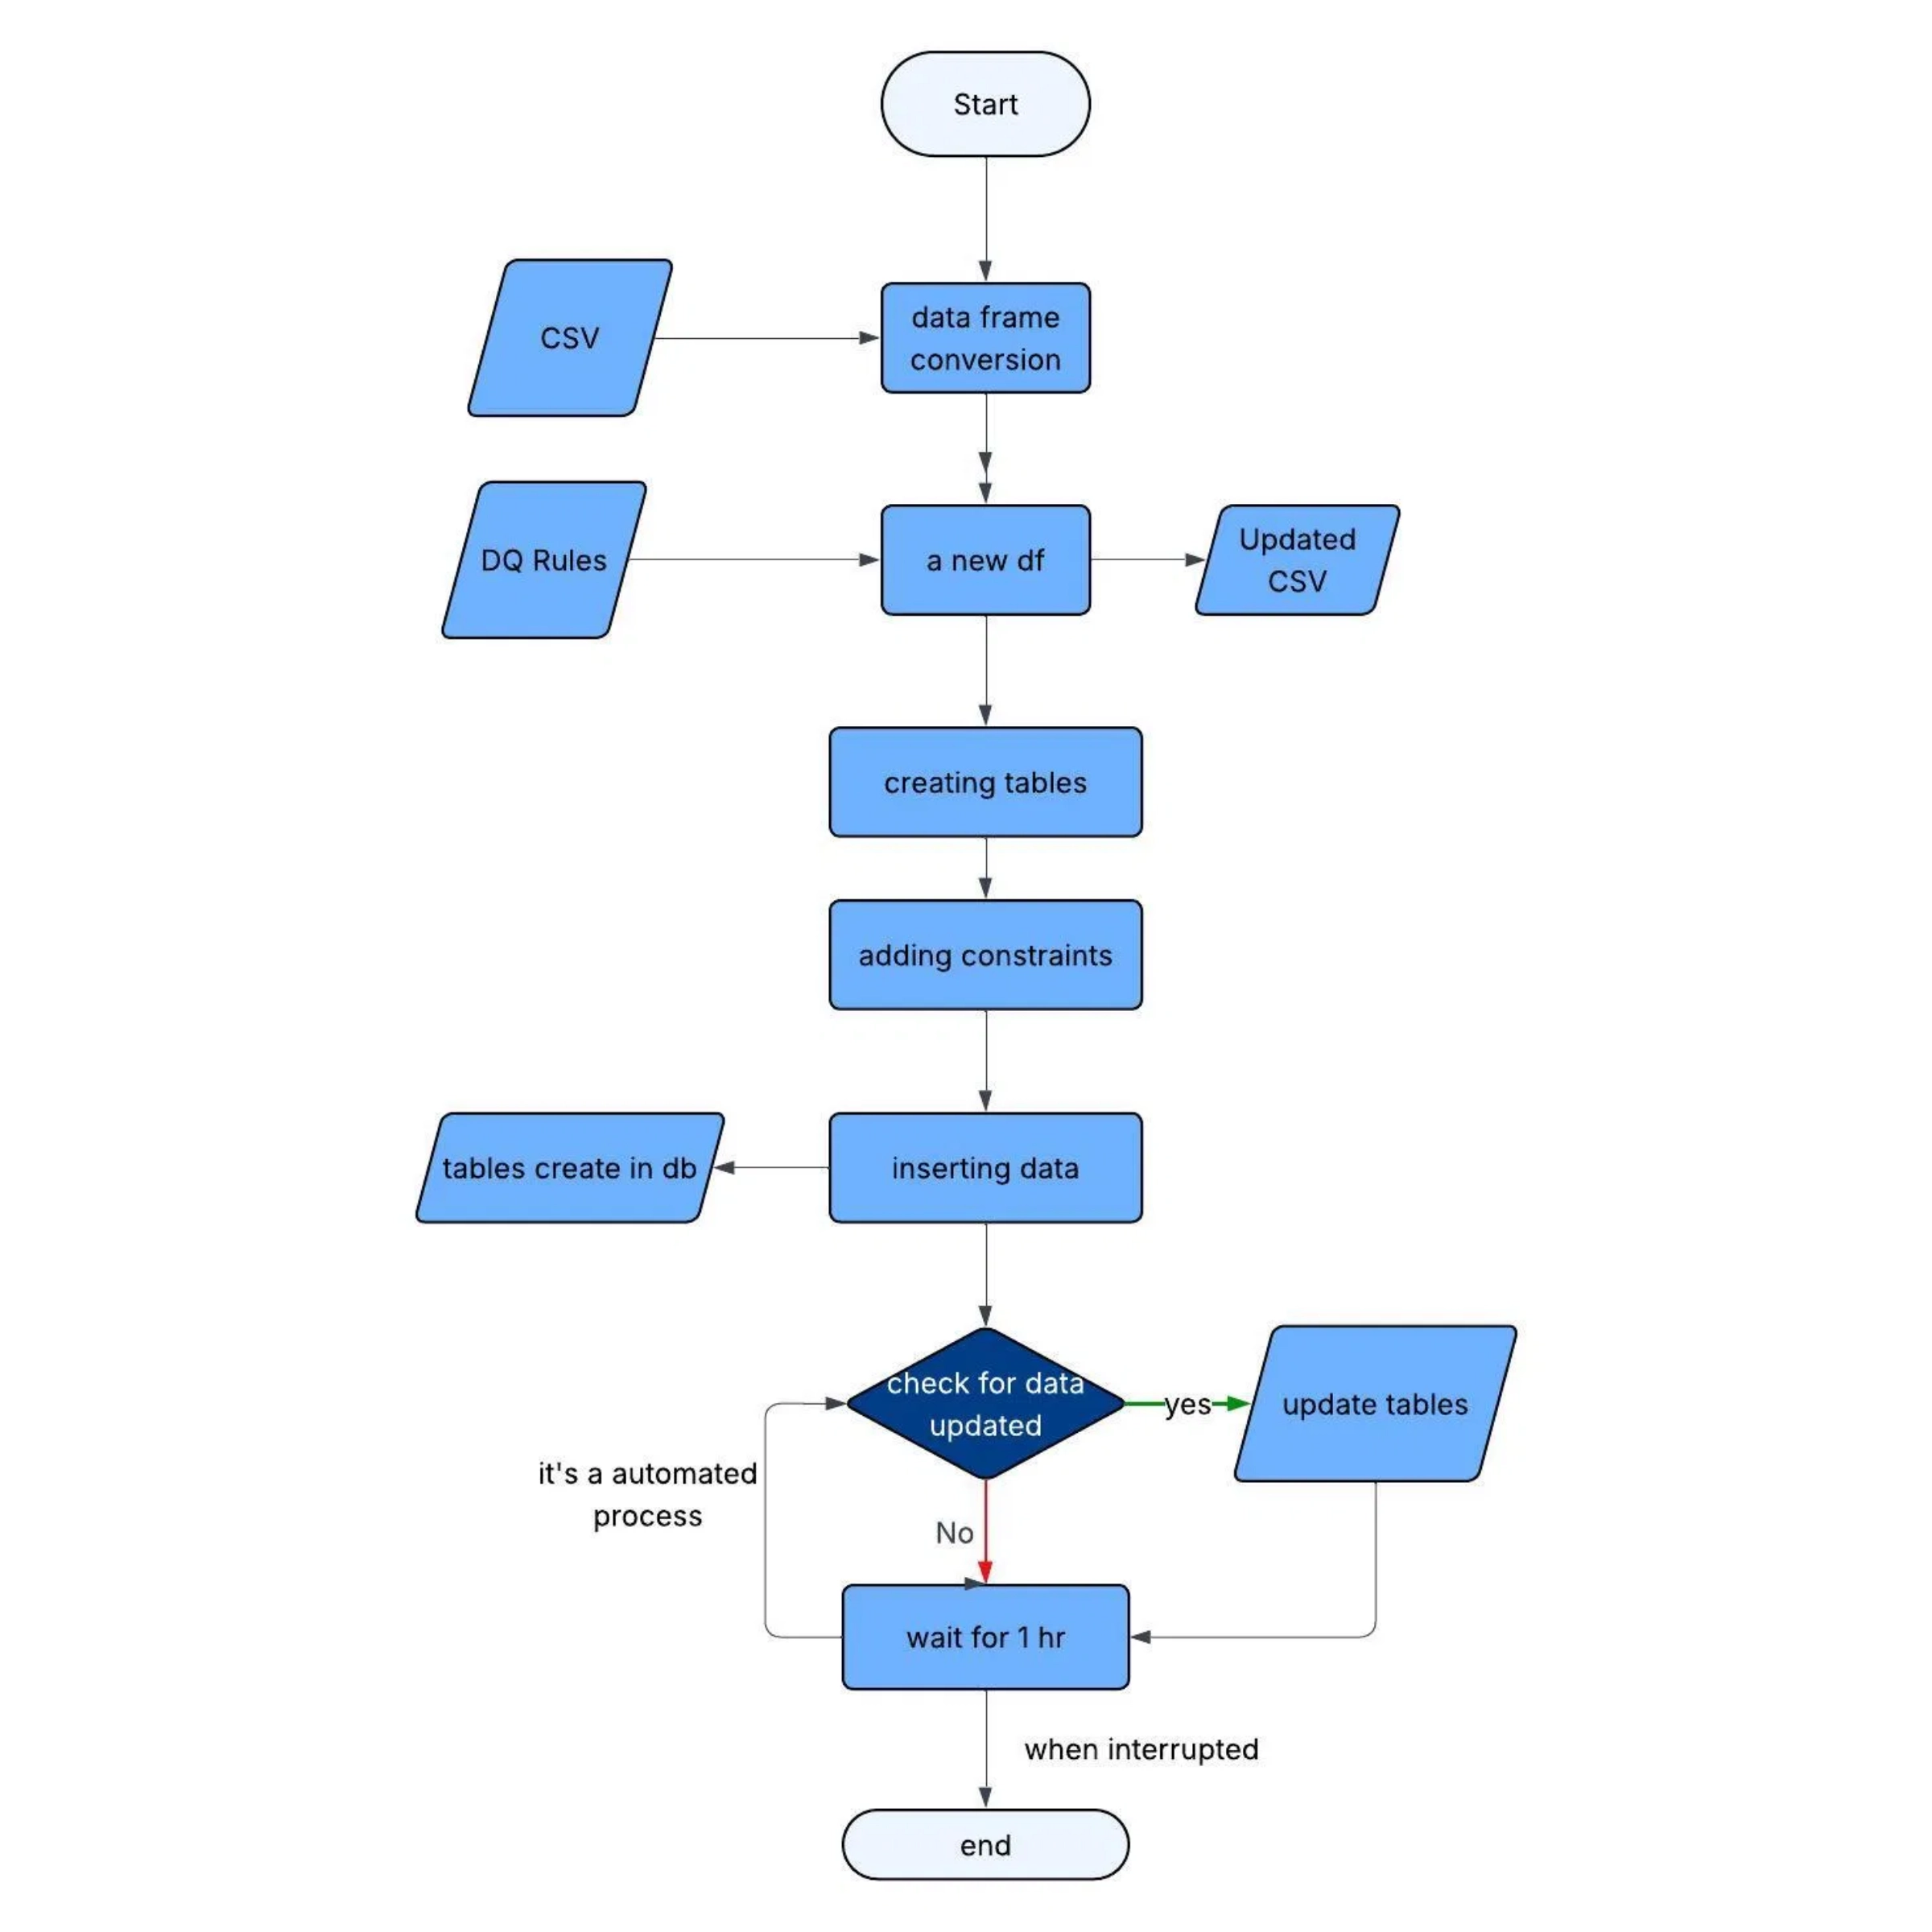
Data Flow Process
1
CSV Data Ingestion
Raw data is read from CSV files into pandas DataFrames using paths defined in config.json.
2
Data Quality Validation
Multiple data quality functions from dq.py are applied to validate and transform the data according to predefined rules.
3
Cleaned Data Storage
Validated and cleaned data is saved to new CSV files in the dist/ directory for review or further processing.
4
Database Table Creation
Database tables with appropriate schema and constraints are created if they don't already exist.
5
Data Insertion
Cleaned data is inserted into the corresponding MySQL database tables using INSERT IGNORE to handle duplicates.
6
Automated Monitoring
The system periodically checks for data updates and repeats the process as needed.

Slide 9





Key Features
Robust Data Validation
Comprehensive validation rules ensure data integrity through primary key checks, foreign key validation, and format verification for emails, URLs, and more.
Automated Data Cleaning
Intelligent data transformation with default value assignment, null handling, and format standardization to ensure consistent data quality.
Transparent Error Logging
Detailed logging of all data quality issues and transformations for complete audit trail and troubleshooting capabilities.
Periodic Data Updates
Automated monitoring and processing of data updates with configurable intervals for continuous data freshness.

Slide 10






Setup & Installation
Prerequisites
Quick Start Commands
Ensure you have Python 3.x and MySQL installed on your system. Install required Python packages using pip.
# Install required packages
git clone https://github.com/BhukyaKishore/Demo-ETL-v2.0.git
Configuration
# Create directory structure
Create a config.json file with your database credentials and file paths. Ensure the source CSV files are placed in the specified src/ directory.
cd DEMo-ETL-v2.0
# Place CSV files in src/ directory
pip install pandas mysql-connector-python
Directory Structure
# Configure database settings
Create the necessary directories for source data (src/) and processed data (dist/). The system will automatically create these if they don't exist.
nano
config.json
# Run the ETL process
python
app.py
Execution
Run the app.py script to start the ETL process. The system will create tables, process data, and insert it into the database.
Monitoring
Check the error.txt file for any data quality issues or errors encountered during processing. Review the cleaned CSV files in the dist/ directory.
Thank You

