Slide 1
Airline Passenger Satisfaction Analysis
ALY6140 Analytics System Technology
Bhumika Mohan
Bo Wang
Hao Liu
Instructor: Jialun He

Slide 2
Project outline
Data description
Data cleanup
Data visualization
Machine learning model

Slide 3
Part 1
Data description

Slide 4
Introduction
Passengers of multiple U.S airlines provided feedback on their experience in a survey
Original source of dataset is unknown.
Dataset retrieved from kaggle.
Goal: Find model that predicts customer satisfaction.

Slide 5
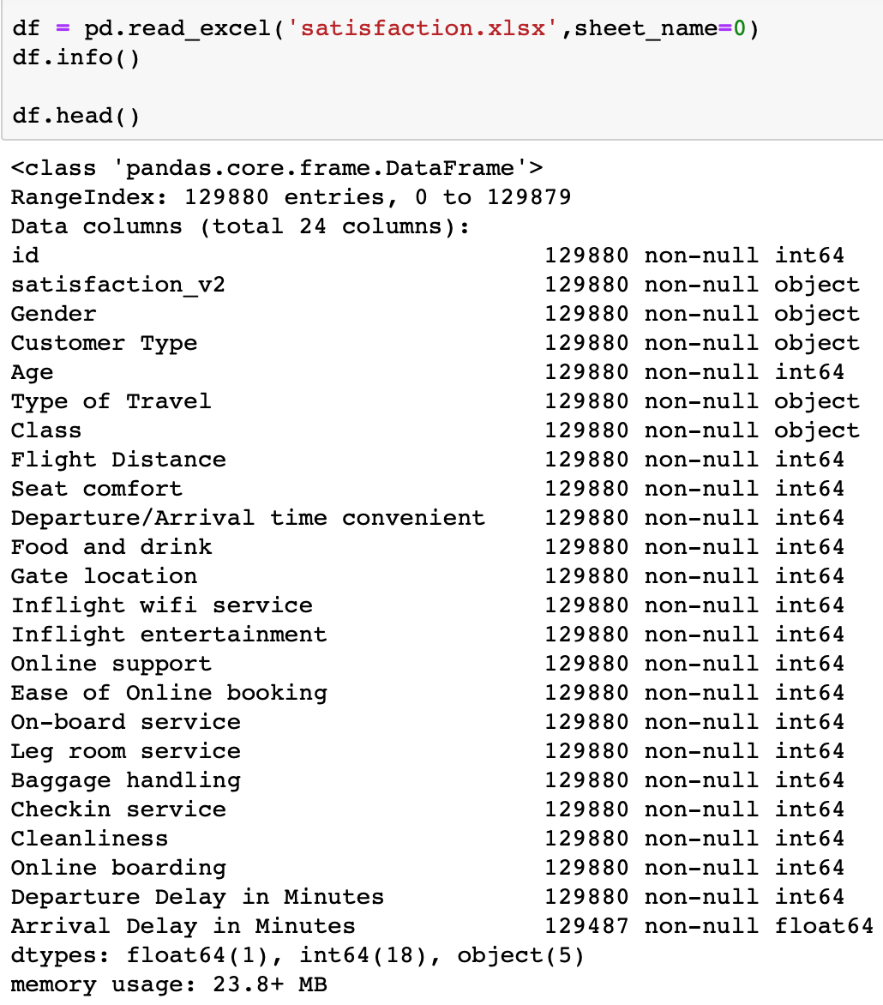
Data description
Airline Passenger satisfaction dataset
Contains 24 columns.
Includes a variety of variables including: Food & drink services, Arrival/departure flight delay, Inflight services, seat comfort etc
Based on data we are to find a model that helps predict customer satisfaction.

Slide 6
Part 2
Data cleanup

Slide 7
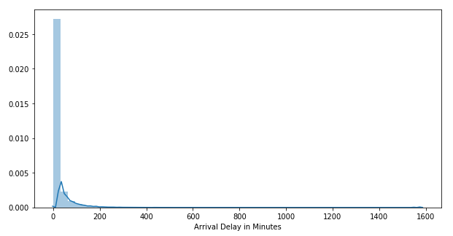
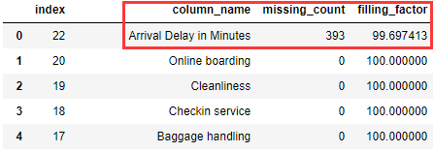
Data cleanup
Two ways dealing with missing values:
Delete incomplete instances.
Fill them up with other values.
Improper data:
Missing data
Incorrect data
Outliers
Etc.
1. Checking missing data:
Extremely biased distribution.
Median > Mean → Replace

Slide 8
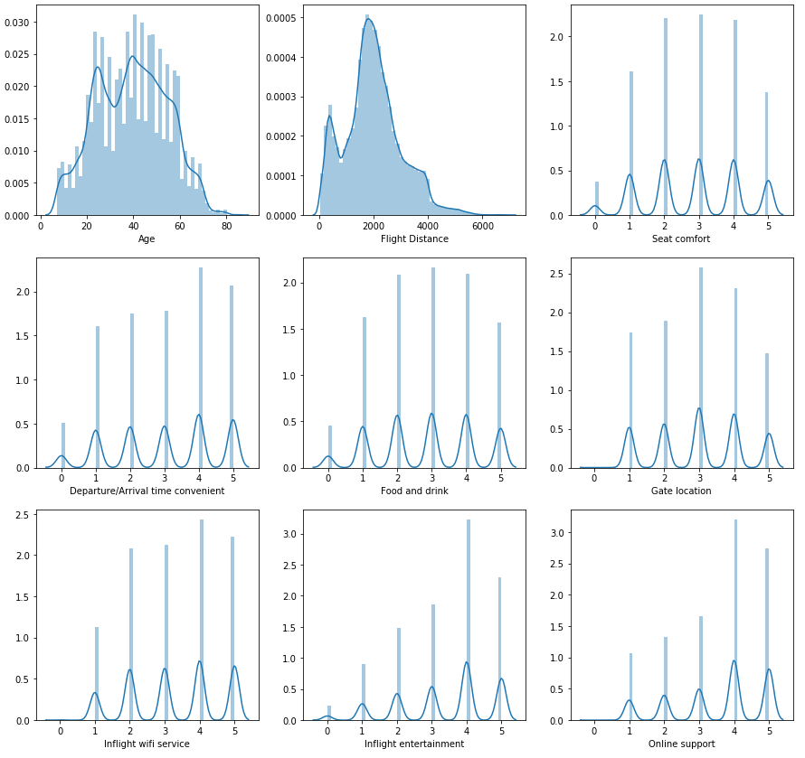
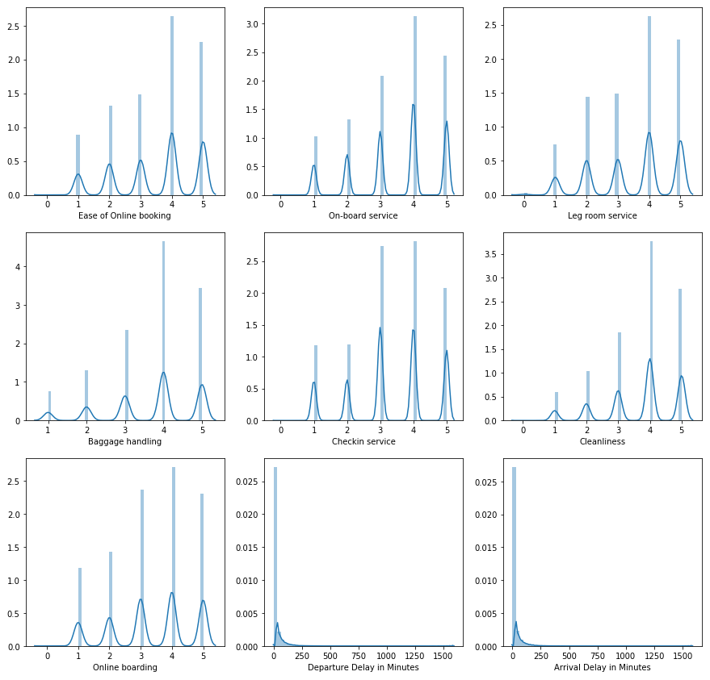
Data cleanup
2. Remove useless column: ‘id’
3. Checking outliers: No outliers observed.

Slide 9
Part 3
Data visualization

Slide 10
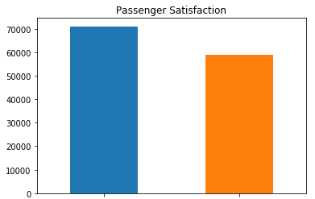
Data visualization
Variable: satisfaction
Most important feature
Satisfied more than neutral or dissatisfied
satisfied
neutral or dissatisfied

Slide 11
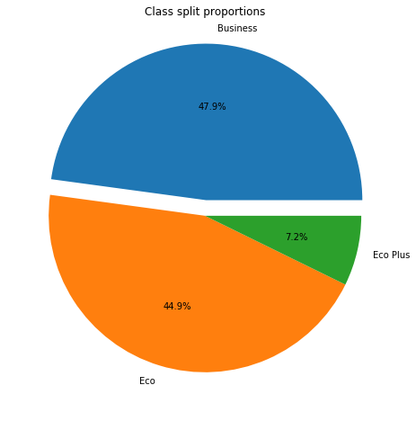
Data visualization
Variable: class
Three class of seating
Half of passengers – Business class
45% passengers – Economy class
Small percentage – Economy Plus

Slide 12
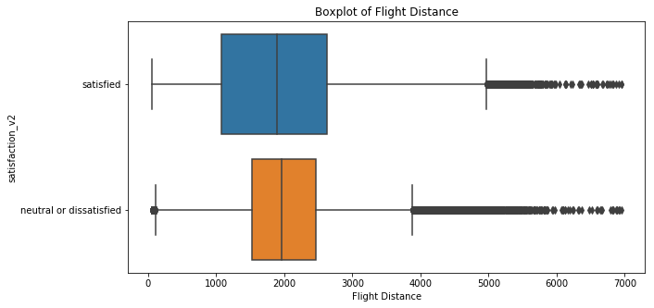
Data visualization
Variable:
Flight Distance
Compare the interquartile range (IQR) and median
Shorter distance, more satisfied

Slide 13
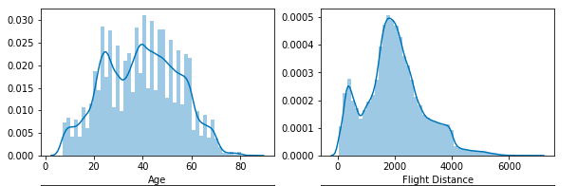
Data visualization
Variable: Age & Flight Distance
Age – mostly ranged from 20 to 60
Most travels -- 2000 units of distance, some passengers have short-distance trips

Slide 14
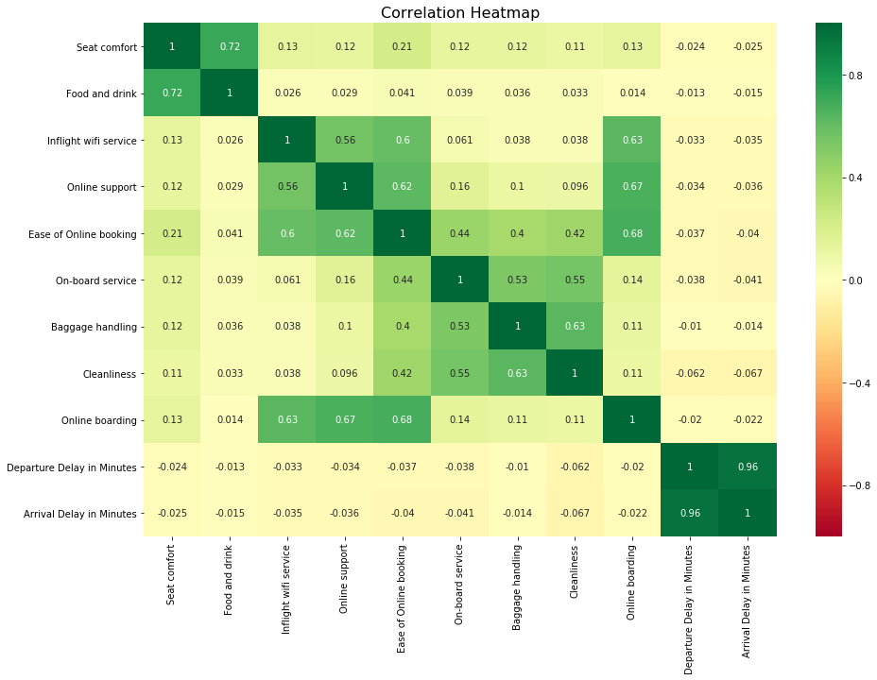
Data visualization
Correlation Heatmap
Highest correlation: 0.96
departure delay & arrival delay
Second highest: 0.72
seat comfort & food and drink
Online boarding highly related:
online booking
online support
inflight wifi service

Slide 15
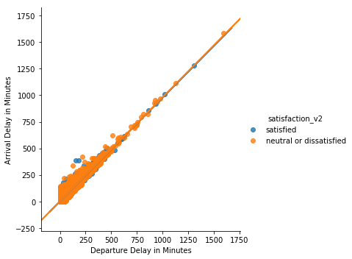
Data visualization
Linear regression plot
Very strong correlation between : departure delay & arrival delay
Correlation close to 1
Time of departure delay increase, the time of arrival delay will increase as well
Make sense in real case

Slide 16
Part 4
Machine learning model

Slide 17
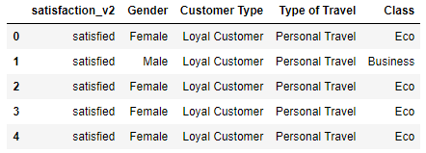
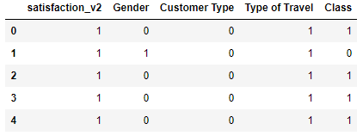
Prepare for prediction
1. Encoding categorical values
Gender |  | Customer Type
Business travel | 0 | Loyal Customer | 0
Personal Travel | 1 | Disloyal Customer | 1
Type of Travel |  | Class
Female | 0 | Business | 0
Male | 1 | Eco | 1
 |  | Eco Plus | 2
Satisfaction
Neutral or Dissatisfied | 0 | Satisfied | 1
2. Splitting datasets
Ratio: 75% training, 25% testing

Slide 18
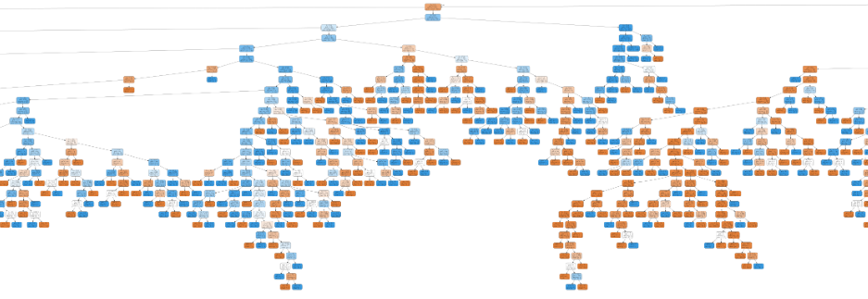
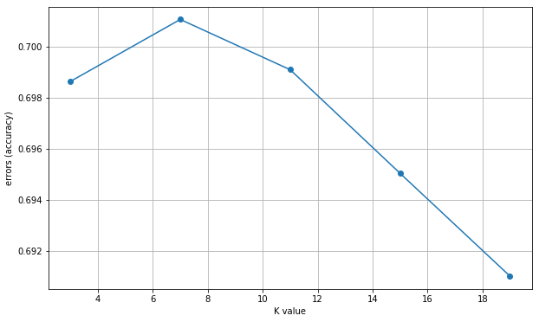
Prediction
1. Decision tree: 0.938 score
↓ Decision tree
2. Naive Bayes: 0.813 score
3. KNN: 0.701 score
↑ Decision tree (partial)

Slide 19
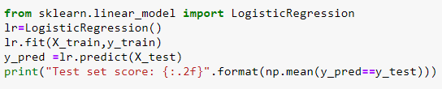
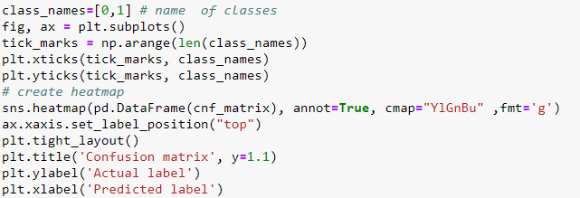
Prediction
4. Logistic Regression:
Test score: 0.83
Visualizing Confusion Matrix using Heatmap

Slide 20

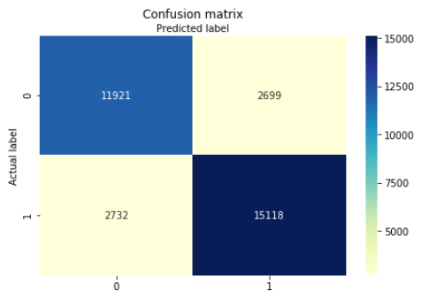
Prediction
Confusion Matrix Heatmap
Classification rate: 83%
Precision: 84%, means when the model makes a prediction, how often it is correct
Recall: The logistic regression model identify rate

Slide 21
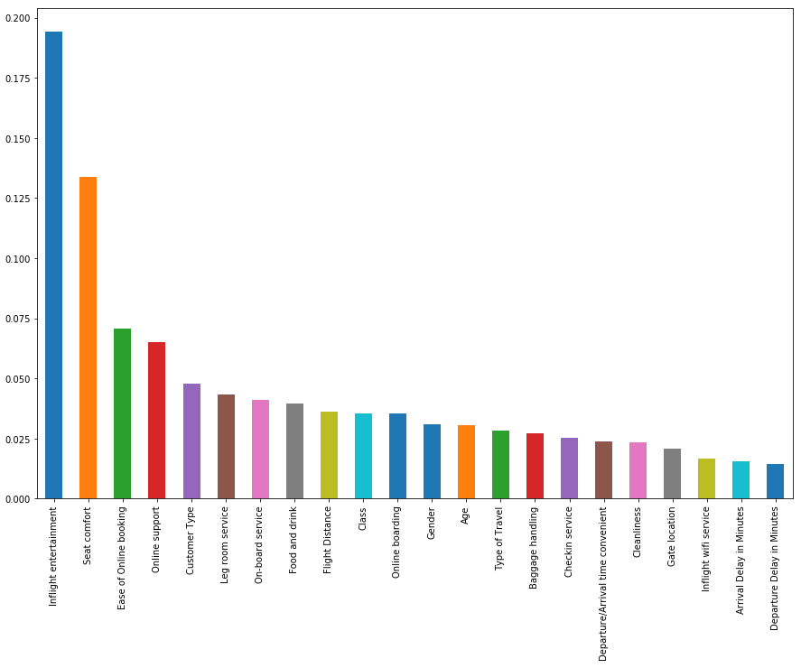
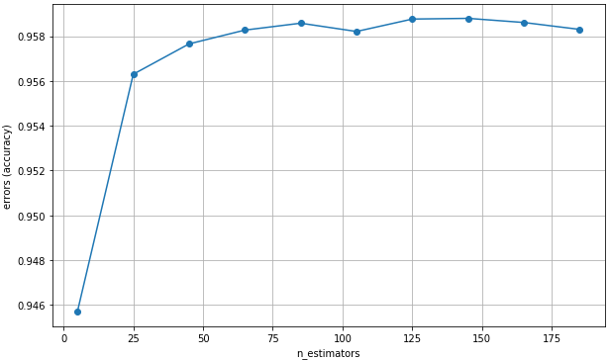
Model optimization
1. Ensemble model: Random Forest
Feature importance:
Test score: 0.959 (0.021↑)
Parameter selection:

Slide 22

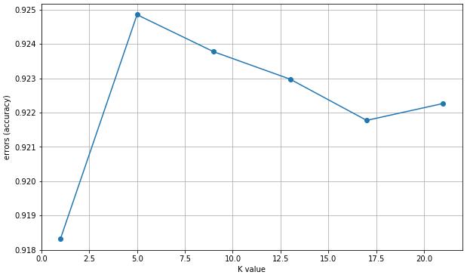
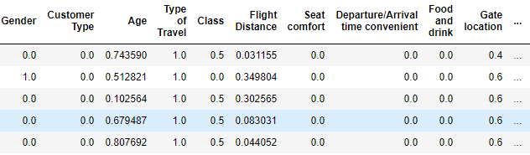
Model optimization
2. Normalization
KNN on normalized data:
Test score: 0.925 (0.224↑)
Parameter selection:
Normalized data:

Slide 23
Reference
D.John(2018). Passenger Satisfaction dataset. Retrieved from https://www.kaggle.com/johndddddd/customer-satisfaction#satisfaction.xlsx

Slide 24
Thank you!

