Slide 1
Git Version control
Introduction

Slide 2
Initial Assessment

Slide 3
User Interface

Slide 4

What is UI?
Visual Part of computer application or operating system through which a user interacts with a computer or software.
This can include display screens, keyboard, a mouse and the appearance of a desktop.
It is also the way of through which a user interacts with an application or website

Slide 5

Types of Interface
There are three types of Interface
Command Line Interface(CLI): the user must know the machine or program specific instructions or code.
Menu: user chooses the command from lists displayed menu’s on screen.
Graphical User Interface(GUI): User gives commands by selecting and clicking on icon displayed on screen.

Slide 6
Command Line Interface(CLI)
Applications:
System Administration
Scientific Application
Engineering Application

Slide 7
Advantages and Disadvantages of CLI
Advantages:
Good for expert users, who can access command.
A CLI requires less memory to use in comparison to other interface.
A CLI don’t require window and a low-resolution monitor can be used.
Disadvantages:
Command have to be type precisely. If there is spelling error, the command will fail.
Not very good for a novice user(beginner, engineer, new in this)

Slide 8

Menu Driven Interface
You are the presented with a menu, you can make a choice and then the next menu appears on the screen. You make another choice and so on.
Application:
iPod and Mobile
Cash Withdrawal Machines
Video Recorder and household device

Slide 9

Advantages and Disadvantages of Menu Driven Interface
Advantages:
No need to learn complex command language.
Easier for a novice to learn/use.
Ideal when there a limited number of options.
Disadvantages:
It can be irritated if there are too many menu screens to work through-user get annoyed or bored if it takes too long.

Slide 10

Graphical User Interface(GUI)
GUI allows user to interact with electronic devices through graphical icons and visual indicators such as secondary notation, instead of text-based user interface typed command labels or text navigation.
Applications:
GUI used by most commercially popular computer operating systems and software programs today.
It allows to user that manipulate elements on the screen using a mouse, or even a finger.

Slide 11

Advantages and Disadvantages of GUI
Advantages:
Less expert knowledge is required to use it.
Easier to navigate.
Disadvantages:
Typically decreased options.
Less customisable

Slide 12
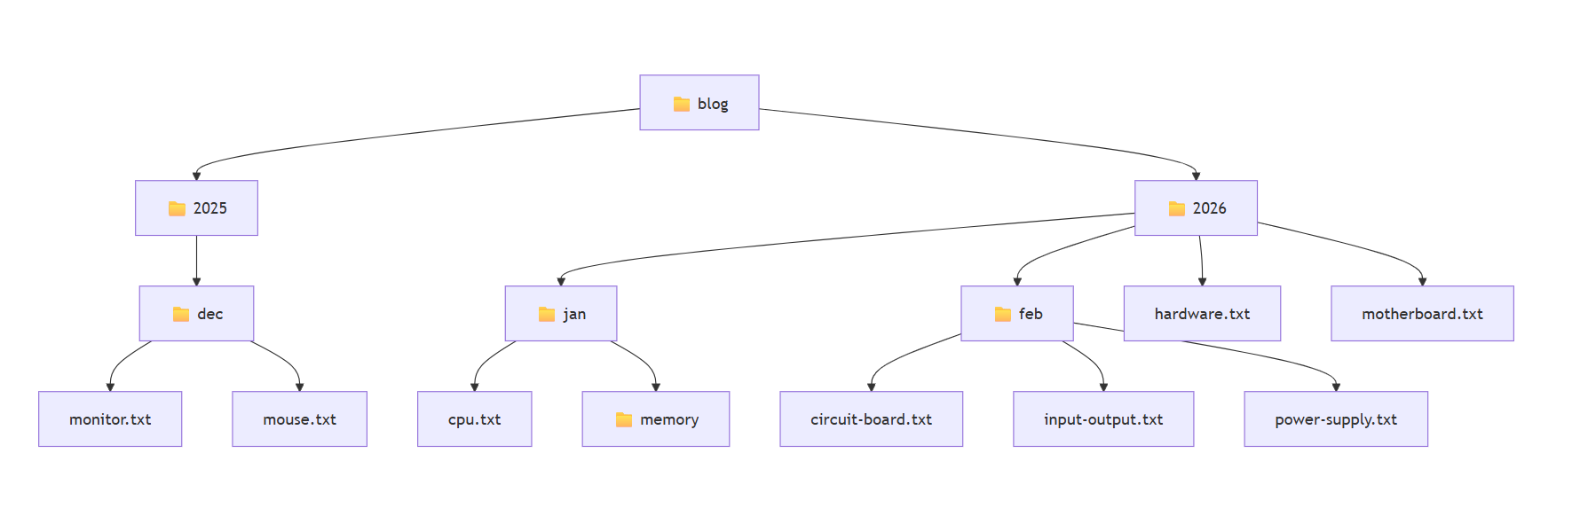
File System

Slide 13
Basic commands for Windows Command Prompt
dir lists all files and directories in the working directory.
cd switches you into the directory you specify.
mkdir creates a new directory in the working directory.
notepad creates a new file inside the working directory

Slide 14
Assessment
Activity time

Slide 15
Basic commands for Linux
pwd outputs the name of the current working directory.
ls lists all files and directories in the working directory.
cd switches you into the directory you specify.
mkdir creates a new directory in the working directory.
touch creates a new file inside the working directory

Slide 16
What is Git?
Git is a version control system.
It helps you:
Track changes in your code
Go back to older versions
Work with other people without breaking things
Think of Git as “undo + history + teamwork” for code.

Slide 17
Why Do We Need Git?
Without Git:
You might overwrite files
You lose old versions
Teamwork becomes messy
With Git:
Every change is saved
Mistakes are reversible
Multiple people can work together smoothly

Slide 18
Git vs GitHub (Very Important!)
Git
A tool
Runs on your computer
Tracks changes
GitHub
A website
Stores Git projects online
Helps people collaborate
Git = engine GitHub = parking + sharing place

Slide 19
Basic Git Concepts
Repository (Repo) A project folder tracked by Git
Commit A saved checkpoint of your work
Branch A separate version of your code
Main / Master The main branch of the project
Download: https://git-scm.com/install/windows

Slide 20
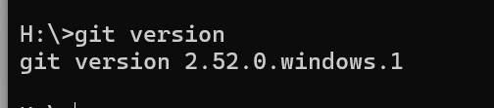
git version
git version

Slide 21
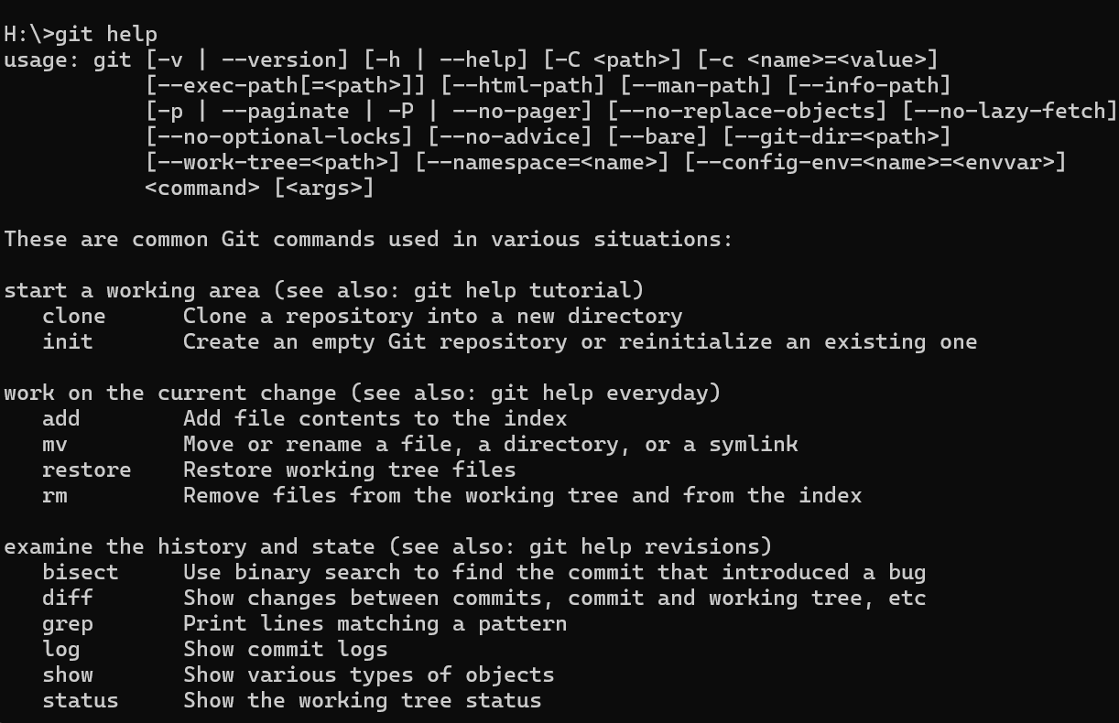
git help

Slide 22
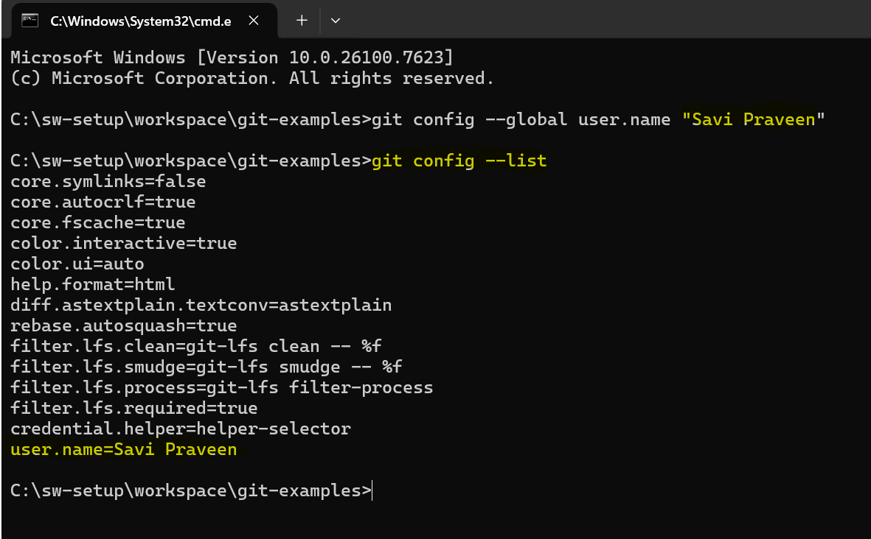
Git Setup
Open the command prompt and execute the following git commands to setup you’re user profile

Slide 23
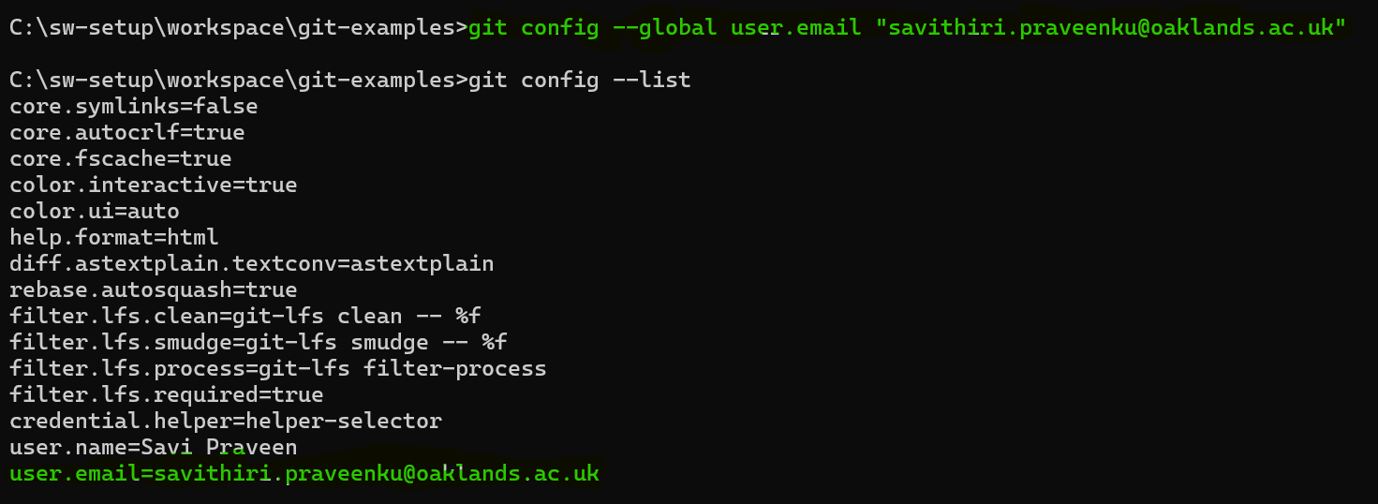
Email id

Slide 24
Setup a project in your workstation
Create a new git project in your workstation
Open command prompt and navigate to the respective folder location in your workstation

Slide 25
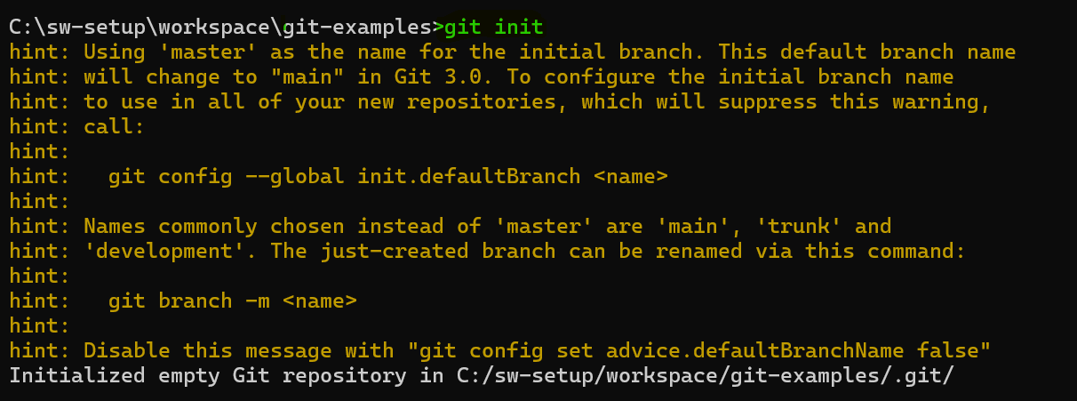
Git init
The word init means initialize . The command sets up all the tools Git needs to begin tracking
changes made to the project

Slide 26
Git Workflow
A Git project can be thought of as having three parts:
1. A Working Directory : where you’ll be doing all the work: creating, editing, deleting and organizing files
2. A Staging Area : where you’ll list changes you make to the working directory
3. A Repository : where Git permanently stores those changes as different versions of the project
The Git workflow consists of editing files in the working directory, adding files to the staging area, and saving changes to a Git repository.

Slide 27
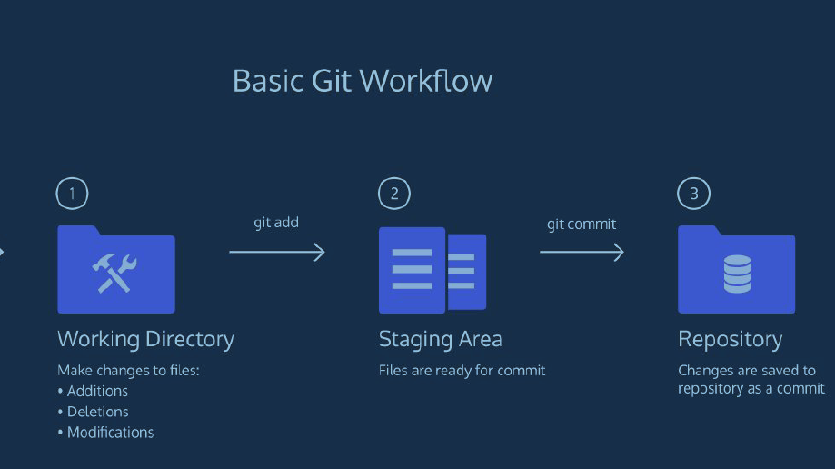

Slide 28
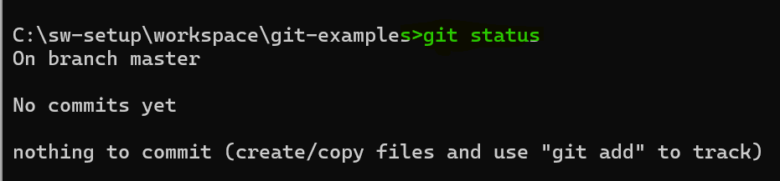
Git status
show modified files in working directory, staged for your next commit

Slide 29
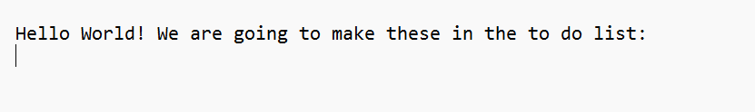
Create a new file in your working directory

Slide 30
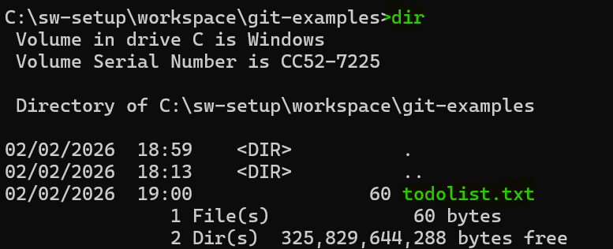
Verify the newly created file by using
“dir” command:

Slide 31
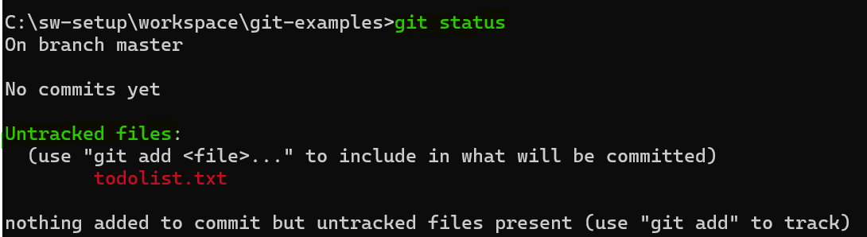
Git status: check newly created file

Slide 32

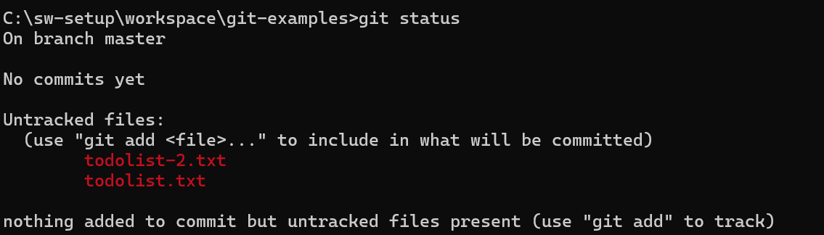
Second file

Slide 33
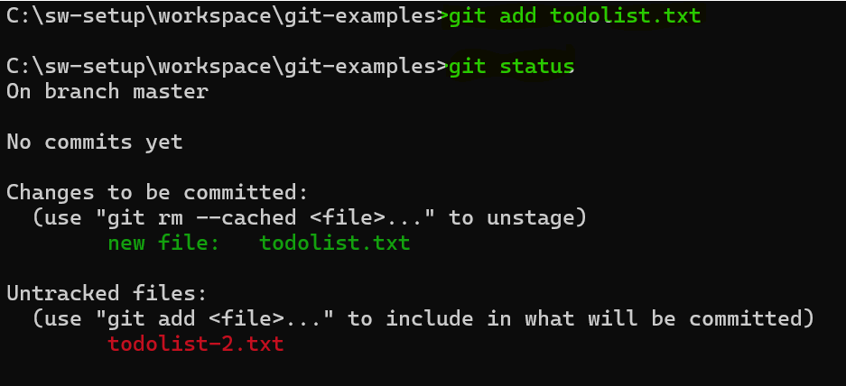
Git add
git add [file]
add a file as it looks now to your next commit (stage)

Slide 34
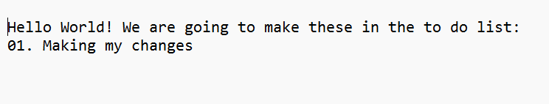
Open notepad and make some changes
Step 1: Open the file Step 2: Edit and save the file Step 3: verify the status of the file (cont..)

Slide 35
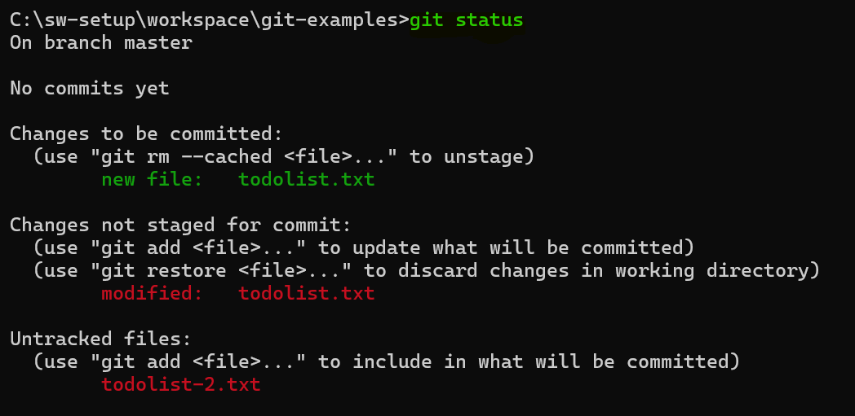
Step 3: verify the status of the file(cont..)

Slide 36
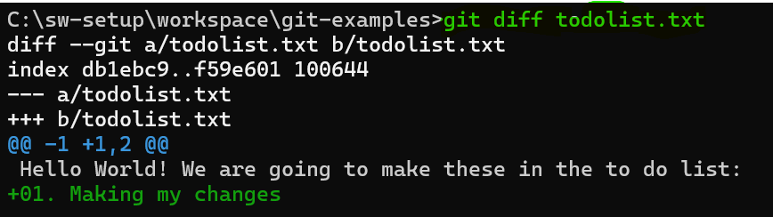
git diff
git diff
diff of what is changed but not staged

Slide 37
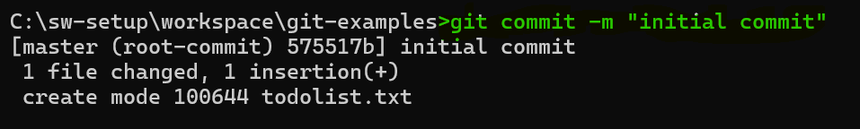
git commit
A commit is the last step in our Git workflow. A commit permanently stores changes from the staging area inside the repository. git commit -m “[descriptive message]”
Standard Conventions for Commit Messages:
Must be in quotation marks
Written in the present tense
Should be brief (50 characters or less) when using -m

Slide 38
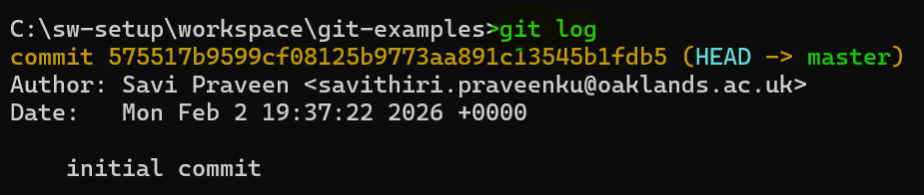
Git log
you’ll need to refer back to an earlier version of a project. Commits are stored chronologically in the repository and can be viewed with:
Notes:
Often with Git, you’ll need to refer back to an earlier version of a project. Commits are stored
chronologically in the repository and can be viewed with:
$ git log
In the output, notice:
● A 40-character code, called a SHA , that uniquely identifies the commit. This
appears in orange text.
● The commit author (you!)
● The date and time of the commit
● The commit message

Slide 39
Revisit
You have now been introduced to the fundamental Git workflow. You learned a lot! Let’s take a moment to generalize:
Git is the industry-standard version control system for web developers
Use Git commands to help keep track of changes made to a project:
init creates a new Git repository
git status inspects the contents of the working directory and staging area
git add adds files from the working directory to the staging area
git diff shows the difference between the working directory and the staging
area
git commit permanently stores file changes from the staging area in the
repository
git log shows a list of all previous commits

Slide 40
HOW TO BACKTRACK
When working on a Git project, sometimes we make changes that we want to get rid of. Git offers a few eraser-like features that allow us to undo mistakes during project creation. In this lesson, we’ll learn some of these features.
To start out, let’s review the basic Git workflow.
$ mkdir hamlet-prince-of-denmark
$ cd hamlet-prince-of-denmark
$ notepad scene1.txt
Ghost:
My hour is almost come,
When I to sulphurous and tormenting flames
Must render up myself.
$ git add scene-1.txt
$ git commit -m “my hour”

Slide 41

Learning Check

Slide 42
Github – Online demo
https://github.com/

Slide 43
What is a Branch?
A branch lets you:
Try new features
Fix bugs safely
Not break the main code
Example:
Main branch = working website
New branch = experiment zone

Slide 44
Merging Branches
Merge = combining branches
Example:
Feature branch is finished
Merge it into main
Now main has the new feature

Slide 45
Working with GitHub
Typical teamwork flow:
Push code to GitHub
Others pull the code
Everyone works together
Changes are merged
This is how real companies work

Slide 46
Benefits of Using Git
Tracks history Easy collaboration Backup of code Industry standard Saves time & stress

Slide 47
Who Uses Git?
Software developers
Data scientists
Web designers
Big companies (Google, Microsoft, Netflix)
If you code → you’ll use Git.

Slide 48
Final Thoughts
Git is not scary
Everyone learns it step by step
Practice is the key
Start small. Commit often.

Slide 49
Advanced Learning:
Undoing Changes: git restore, git reset
Branching: Create & switch branches
Merging: Fast-forward & recursive merges
Merge Conflicts: How to resolve conflicts
Rebasing: Replay commits for linear history

Slide 50
Git and GitHub Tutorial – Version Control for Beginners
https://www.freecodecamp.org/news/git-and-github-for-beginners/

