Slide 1
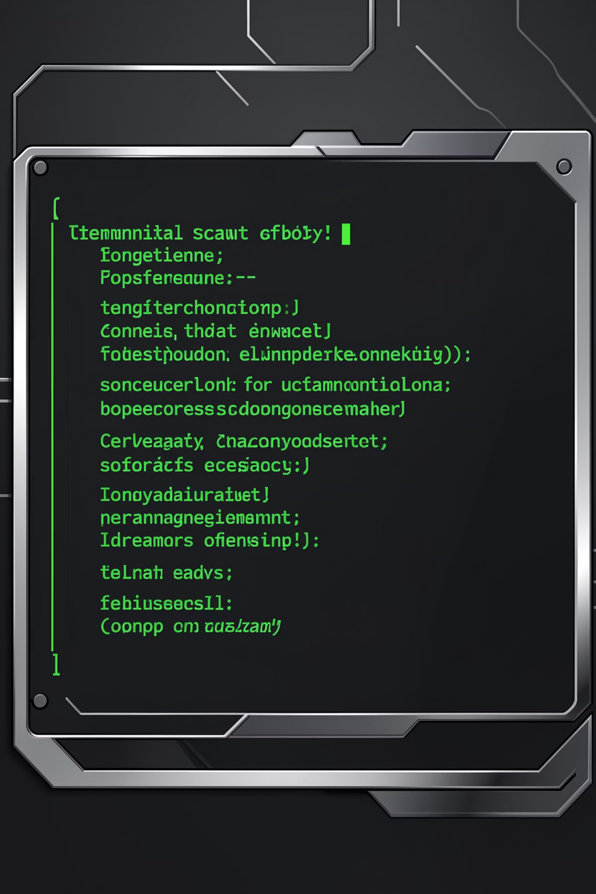
boost-cli
A project health toolkit for Node.js developers. Install globally, run as boost — and get a full audit of your project in seconds.
NPM CLI
NODE.JS >= 18
ESM

Slide 2
What Does boost Do?
One command. Five dimensions of project health — scanned, scored, and surfaced right in your terminal.
Scan
Clean
Deps
Unused files, large assets, duplicate code, stray console.logs
Removes temp files and empty folders automatically
Spots unused, heavy packages and suggests lighter alternatives
Score
Security
Aggregates all checks into a health score out of 100
Detects committed .env files, hardcoded API keys, and audit issues

Slide 3
Commands at a Glance
boost
boost scan
Runs everything — scan + deps + score + security in one pass
Unused files, large files, duplicate code, unused assets, stray console.logs
boost clean
boost deps
Deletes temp files, cache artifacts, and empty directories
Flags unused packages, heavy dependencies, and recommends lighter swaps
boost score
boost security
Displays a health score out of 100 with checkmarks and warnings
Checks for committed .env, hardcoded API keys, and npm audit vulnerabilities

Slide 4
Tech Stack
Runtime & Module System
Node.js >= 18, ESM-only (import/export), "type": "module" in package.json
Key Libraries
CLI parsing
commander
Terminal UI
chalk, ora
File traversal
glob, fs-extra, ignore
Duplicates
jscpd
Dep analysis
depcheck
Testing
vitest

Slide 5

Folder Structure
boost-cli/
├── bin/
│ └── boost.js # Entry point + commander setup
├── src/
│ ├── index.js
│ ├── commands/ # Orchestrators
│ │ ├── scan.js
│ │ ├── clean.js
│ │ ├── deps.js
│ │ ├── score.js
│ │ └── security.js
│ ├── scanners/ # Individual scan checks
│ ├── cleaners/ # File system operations
│ ├── deps/ # Dependency analysis
│ ├── security/ # Security checks
│ ├── scorer/
│ │ └── healthScore.js
│ └── utils/
│ ├── fileWalker.js
│ ├── config.js
│ ├── logger.js
│ └── spinner.js
├── boost.config.js
└── package.json
Each layer has one job. Commands orchestrate, workers execute, utils are shared. No file does more than one thing.
Layer Responsibilities
1
bin/
CLI entry — registers commands, runs all if none specified
2
commands/
Thin orchestrators — import workers, collect results, display output
3
utils/
Shared across all modules — traversal, config, logging, spinners

Slide 6
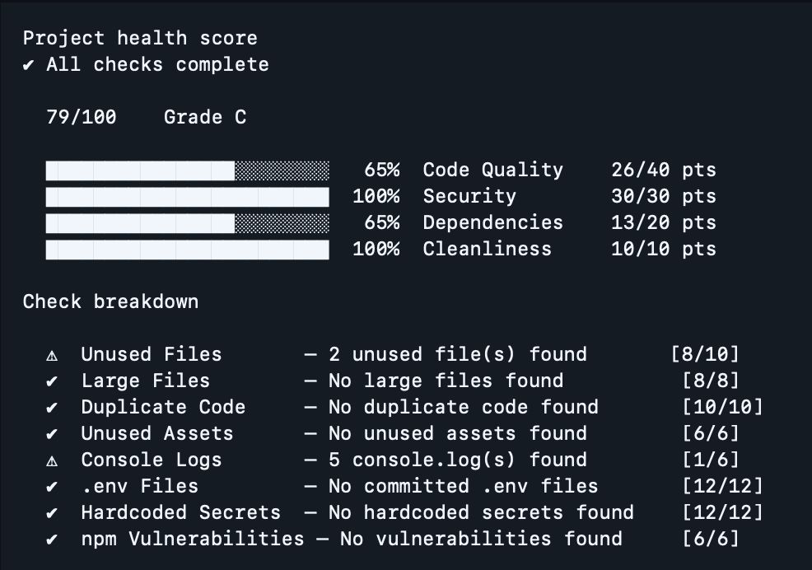



Result Object Convention
Every worker module returns the same shape — predictable, composable, easy to aggregate into the health score.
status: 'ok' — no issues found, check passed cleanly
status: 'warn' — issues exist but non-critical, worth reviewing
status: 'error' — critical issue, impacts health score significantly

Slide 7
boost.config.js
Drop a boost.config.js in your project root to override any default. Config is loaded by utils/config.js and consumed by all commands — nothing is hardcoded.
export default {
scan: {
largeFileThreshold: '500kb',
ignore: ['dist/', 'node_modules/', '.git/', 'coverage/'],
extensions: ['.js', '.ts', '.jsx', '.tsx', '.vue'],
},
clean: {
tempPatterns: ['**/*.tmp', '**/*.cache', '**/.DS_Store', '**/Thumbs.db'],
},
deps: {
checkBundleSize: true,
},
security: {
scanPatterns: ['**/*.js', '**/*.ts', '**/*.jsx', '**/*.tsx', '**/*.env*'],
},
}

Slide 8

Implementation Rules
Always ESM
Use import/export everywhere. Never require().
Building a command? Follow the pattern
Create the workers in scanners/ (or cleaners/ etc.), then wire the orchestrator in commands/. Use logger.js, spinner.js, and config.js.
No hardcoded paths or thresholds
All values come from config.js. Every worker gracefully handles errors with try/catch.
One responsibility per file
Workers return results. Commands display them. Utils are shared. Keep it that way.

