Slide 1



Team Avengers HackOut’26
SamriddhiAI
An Intelligent, Conversational, and Empathetic Financial Assistant for Everyday India
Presented By:
Vrinda Teli
Devanshi Vora
Bhumi Halatwala
Khushboo Dharmani

Slide 2
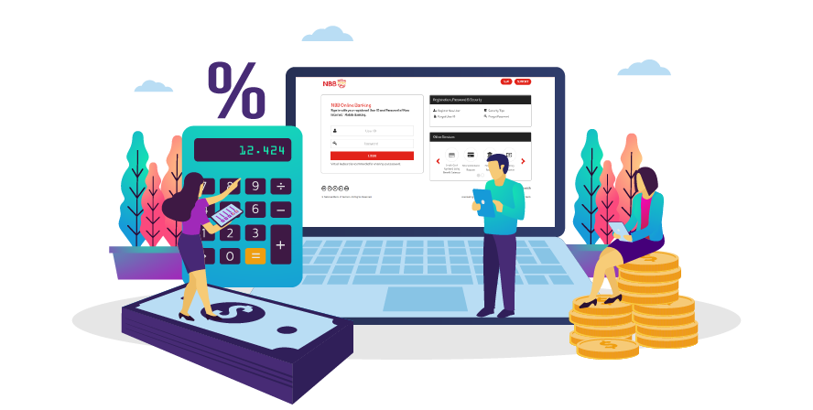
Team Avengers HackOut’26
Advanced Banking, Everyday Confusion
Digital Barriers
Indian banks have advanced rapidly in digital banking, but many customers in Tier 2/3/4 towns and rural areas still struggle with apps that feel complex, generic, and disconnected from their real financial needs.

Slide 3

Team Avengers HackOut’26
Empathetic & Conversational Mobile Banking
  Dialogue in Vernacular Languages: Swap complex formats for step-wise and textual dialogue in local Indian languages.
  Context-based Prompts: Kill generic spam with explainable financial recommendations that match your spending behavior.
  Safety Net Empathy: Predict cash flow distress proactively to provide flexibility in EMI dates before penalty hits.

Slide 4
Team Avengers HackOut’26
AI / ML Modular Architecture
Behavioral Pattern Recognition
Aggregates that roll transaction-based indicators to capture actual customer needs without requiring intrusive demographic information gathering
Dual-Action Monitoring
Contextual, Need-Based Guidance
While unsupervised anomaly detection models quickly detect any suspicious transactions for fraud prevention purposes, trend analysis detects slow financial distress to offer support.
Analyzes spending and saving patterns to surface genuinely useful actions — a recurring savings option, or education budget planning — each with a plain-language 'why'.

Slide 5


Team Avengers HackOut’26
Data Layer: Ingests transactions, user behavior, profiles, and labels.
System Intelligence
Feature Pipeline: Extracts 178 features/customer (profile, 7-mo transactions, stress score).
AI Engine:
  Narration Classifier: LightGBM model.
  Recommender: Propensity & product scoring.
  Anomaly Detector: Isolation Forest + custom rules.
  Chatbot: Text & voice across 5 languages.
Guardrail Layer: Suppresses loans for stressed users; handles bias audits & risk flags.
Delivery Endpoints: Powers Bank Admin Panel (risk/alerts) and Customer App

Slide 6


Team Avengers HackOut’26
Prototype Roadmap
  Stage 1 (The Vernacular Assistant): Interface for multilingual onboarding and questions.
  Stage 2 (The Recommendation Engine): Signal-driven, explainable finance nudges instead of blanket advertisements.
  Stage 3 (Guardrail Layer): Supress loans for stressed users, empathy over flags.

Slide 7
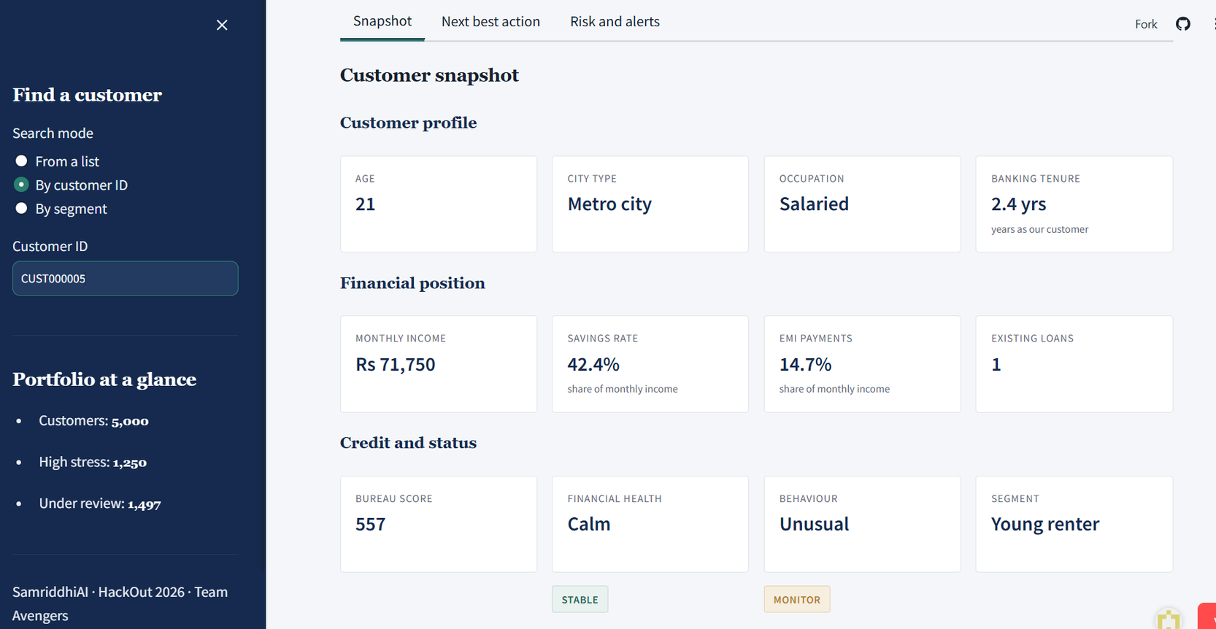
Team Avengers HackOut’26
Healthy User Profile

Slide 8
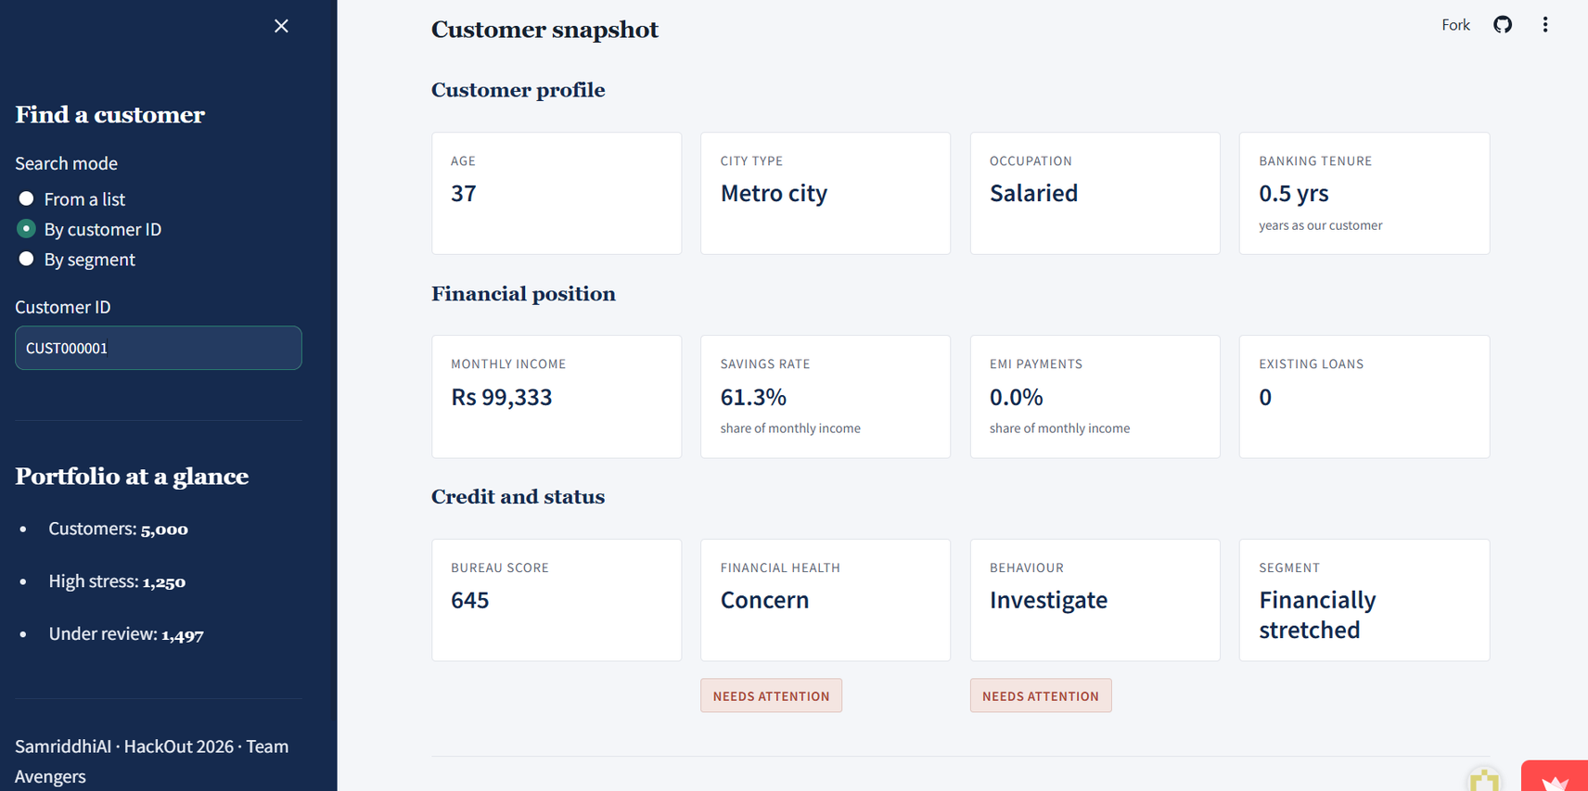
Team Avengers HackOut’26
Stressed User Profile

Slide 9
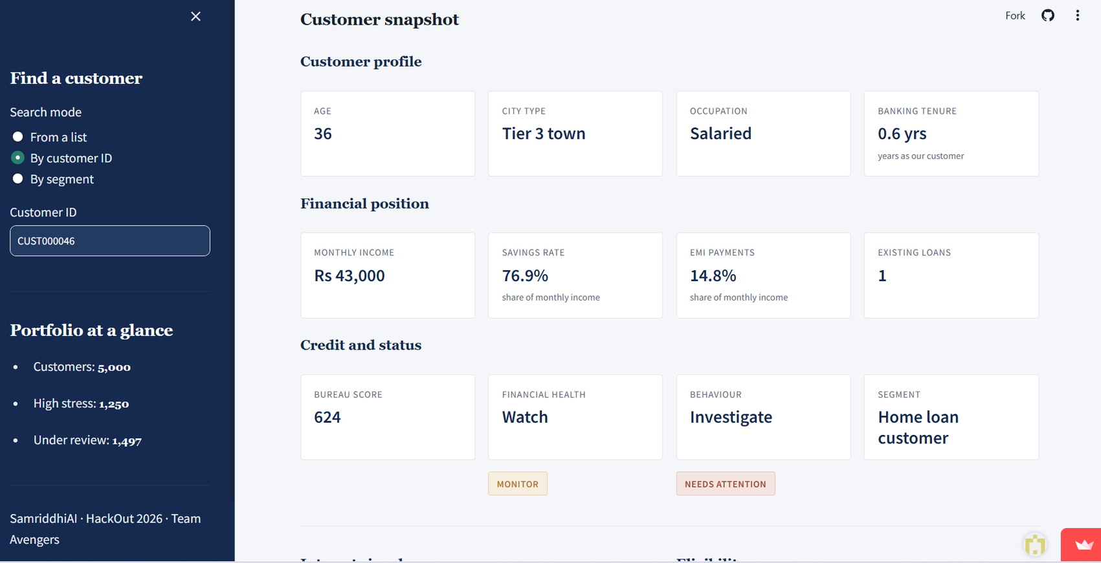
Team Avengers HackOut’26
Possible Fraud User Profile

Slide 10

Team Avengers HackOut’26
Validation & Performance
  0.84 F1 Score: Performance of narration classification model.
  26.4x Lift: Anomaly Detection (with 0.76 recall).
  12 Languages: English, Hindi, Tamil, Marathi, etc.
  178 Features: Profile, transactional, behavioral, and stress features.
  Technology Stack: Python, streamlit

Slide 11


Team Avengers HackOut’26
24/7 Access
  Data Strategy: Synthetic Dataset(5K profiles, 1M+ transactions, 489K logs)
  DPDP Act: Enforces data minimization & explanation rights.
  No PII: Uses customer_id only—no personal details logged.
  Bias Audit: Equal performance across city tiers, occupations, and age bands.

Slide 12
Team Avengers Hackout’26
Thank you so much

