Slide 1
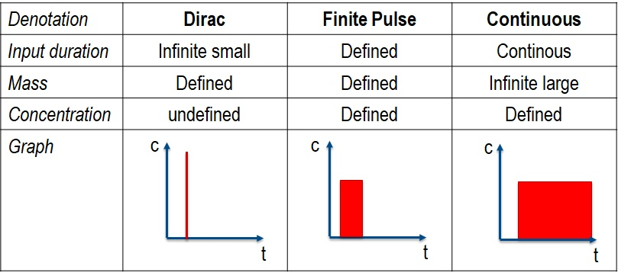

SOURCE TYPE
Mass Pulse
Volume Pulse
Continuous
Input duration
Infinitely Small
Defined
Continuous
Mass
Defined
Defined
Infinitely Large
Concentration
Undefined
Defined
Defined
Graphic of
source
duration
$$∞$$
t
t
t

Slide 2
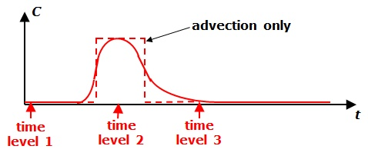
Concentration
Time

Slide 3

One-Dimensional Groundwater Flow
steady hydraulic gradient
homogeneous hydraulic conductivity, effective porosity, and dispersivity
Mass Pulse
Contaminant
Sources
at
Time = 0
Finite Volume Pulse
Continuous Injection
0 x

Slide 4
One-Dimensional Groundwater Flow
steady hydraulic gradient
homogeneous hydraulic conductivity, effective porosity, and dispersivity
Mass Pulse
Contaminants
at
Later
Time
Finite Volume Pulse
Continuous Injection
0 x

