Slide 1

DATA ANALYSIS & VISUALIZATION PROJECT
SMART BASKET ANALYSIS
Decoding Pricing, Discounts & Value Across India's E-Grocery Platforms
STUDENT
BATCH NAME
Bhumi Paliwal
TEC DS-01
REGISTRATION NUMBER
DATE
CL20260703011712020
30 Aug 2026
39,426 Listings • 4 Platforms • 28 Categories
Notes:
Welcome the panel. Introduce the project title SmartBasket Analysis, a Data Analysis and Visualization project comparing four major Indian e-grocery platforms. State your name, department and guide, and mention the scale of the dataset: over 39,000 product listings.

Slide 2



SLIDE 02
Project Overview
Purpose
Business Need
Expected Outcome
Combine and clean multi-platform grocery data to uncover pricing, discount and rating patterns that matter to everyday shoppers.
Indian consumers juggle BigBasket, Blinkit, JioMart and Zepto with no single view of who is genuinely cheaper or more reliable.
A data-backed comparison of price positioning, discount behaviour and satisfaction that guides smarter household spending.
SmartBasket Analysis
01
Notes:
This project blends purpose, business need and expected outcome: we want to give shoppers a clear, evidence-based picture of how BigBasket, Blinkit, JioMart and Zepto really compare on price and value.

Slide 3

SLIDE 03
Problem Statement
Grocery shoppers across BigBasket, Blinkit, JioMart and Zepto face fragmented pricing, inconsistent discounting, and no unified way to judge real value — leading to overspending and platform mistrust.
1
Raw multi-platform data (39,426 rows) is noisy — duplicates, missing values and encoding errors obscure true patterns.
2
MRP, sale price, discount % and ratings are scattered signals with no combined view of platform-level value.
3
Without structured analysis, consumers and analysts cannot reliably answer: which platform, category or brand offers the best deal?
SmartBasket Analysis
02
Notes:
The core problem: pricing and discount data across grocery apps is fragmented and noisy, so shoppers and analysts alike lack a trustworthy, unified way to compare real value across platforms.

Slide 4



SLIDE 04
Objectives
Clean & Unify Data
Analyze Pricing Patterns
Resolve duplicates, missing values and encoding issues across 39,000+ listings.
Study MRP, sale price and discount behaviour across categories and platforms.
Compare Platforms
Surface Business Insights
Benchmark BigBasket, Blinkit, JioMart and Zepto on price, discount and rating.
Translate statistical findings into actionable, consumer-facing recommendations.
SmartBasket Analysis
03
Notes:
Four objectives anchor the work: clean and unify a messy multi-platform dataset, analyze pricing patterns, benchmark the four platforms against each other, and turn the findings into clear business insights.

Slide 5
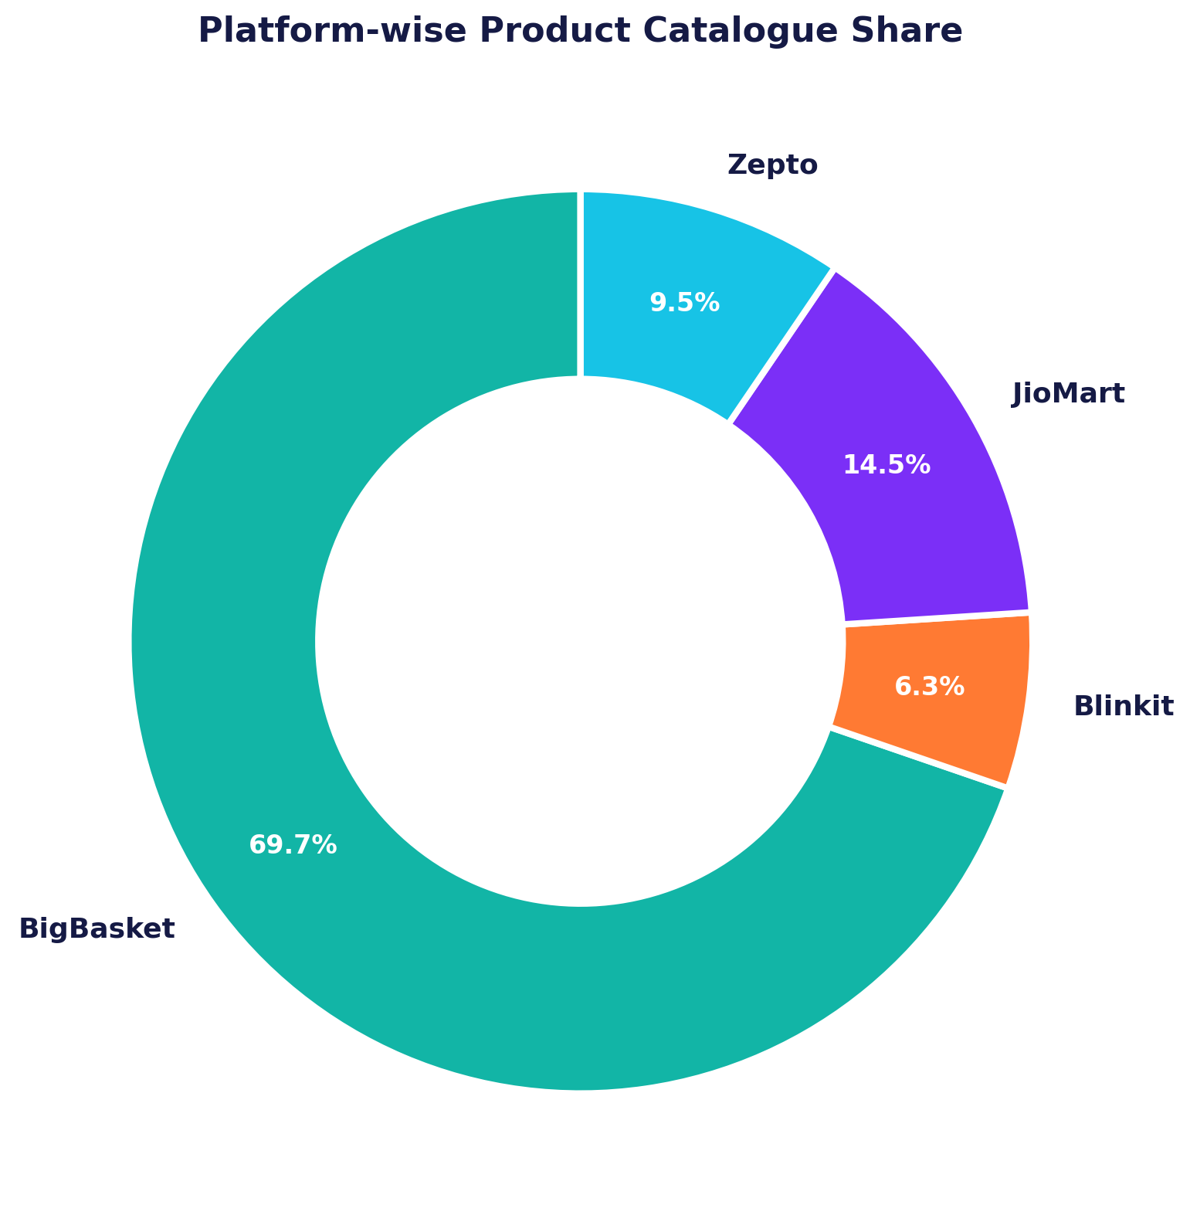
SLIDE 05
Dataset Overview
39,426
9
4
28
Total Records
Columns
Platforms
Categories
Platform Catalogue Share
Sourced from Kaggle-style e-grocery scrapes covering BigBasket, Blinkit, JioMart and Zepto listings, spanning 28 categories and 135 sub-categories across 3,183 brands.
BigBasket
27,342 listings
69.7%
JioMart
5,672 listings
14.5%
Zepto
3,730 listings
9.5%
Blinkit
2,467 listings
6.3%
SmartBasket Analysis
04
Notes:
The combined dataset spans 39,426 rows and nine columns. BigBasket dominates the catalogue with nearly 70% of listings, while Blinkit contributes the smallest but often higher-value share.

Slide 6








SLIDE 06
Dataset Features
product_name
platform
category
Text
Text
Text
Identifies the item, brand & packaging variant
The e-grocery app fulfilling the order
High-level department grouping
sub_category
brand
mrp
Text
Text
Numeric (₹)
Specific product sub-type
Manufacturer or store house-brand
Official Maximum Retail Price
sale_price
rating
discount_pct
Numeric (₹)
Numeric (1–5)
Numeric (%)
Final discounted selling price
Average customer satisfaction score
Markdown: (MRP − Sale)/MRP × 100
SmartBasket Analysis
05
Notes:
Nine columns describe each listing: five text fields for identity and classification, and four numeric fields — MRP, sale price, rating and discount percentage — that drive the entire pricing analysis.

Slide 7






SLIDE 07
Technology Stack
Python
Pandas
NumPy
Matplotlib
Seaborn
Jupyter
CSV Data
SmartBasket Analysis
06
Notes:
The full analysis was built in Python using Pandas and NumPy for data wrangling, Matplotlib and Seaborn for visualization, inside a Jupyter notebook, working directly off CSV exports.

Slide 8



SLIDE 08
Project Workflow
STEP 1
STEP 2
STEP 3
STEP 4
STEP 5
STEP 6
Data Collection
Cleaning
EDA
Visualization
Insights
Conclusion
Every stage — from raw CSV ingestion through cleaning, exploration, visualization and insight generation — was executed sequentially in a single reproducible Jupyter notebook.
SmartBasket Analysis
07
Notes:
The workflow moves left to right: collect the raw data, clean it thoroughly, explore it through EDA, visualize the patterns, extract insights, and close with actionable conclusions.

Slide 9


SLIDE 09
Data Cleaning Process
BEFORE CLEANING
AFTER CLEANING
1 missing product_name
product_name filled from brand + price match
6,199 missing sub_category
sub_category mapped via category dictionary
309 missing / zero MRP values
MRP reconstructed from sale price ÷ (1 − discount)
1 missing sale_price
sale_price filled using MRP (0% discount rows)
214 exact duplicate rows
Duplicates dropped with drop_duplicates()
Encoding artifacts ( ï»¿ ) in text fields
Encoding artifacts & quotes stripped from text
Corrupted category value ( " )
Category corrected to 'Personal Care'
SmartBasket Analysis
08
Notes:
Cleaning tackled seven issues: missing names, sub-categories, MRP and sale price were logically reconstructed rather than dropped, 214 duplicates were removed, and text encoding artifacts and a corrupted category label were fixed — resulting in a fully null-free dataset.

Slide 10
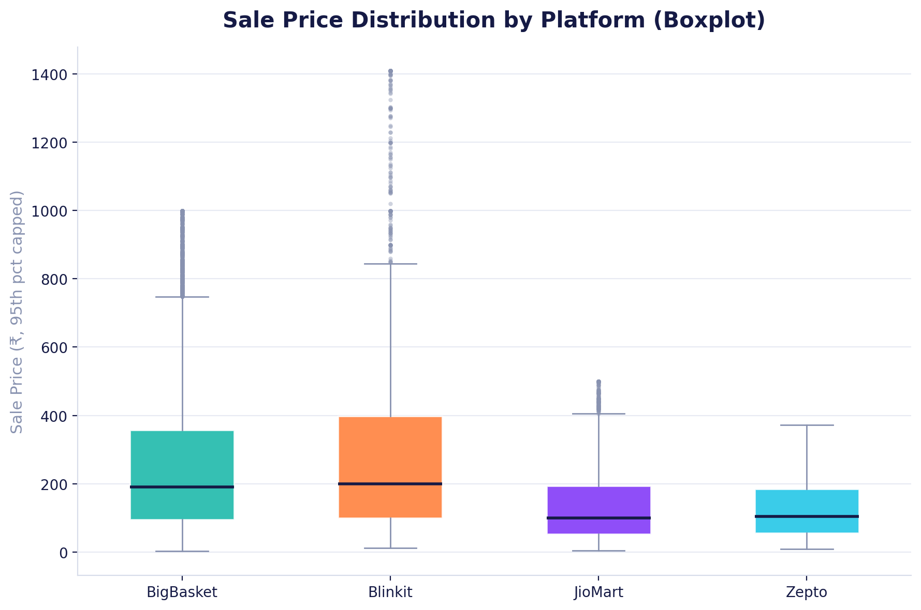

SLIDE 10
Outlier Detection
The IQR Method
For mrp, sale_price and discount_pct, we computed Q1 and Q3, then flagged any value beyond Q1 − 1.5×IQR or Q3 + 1.5×IQR as a statistical outlier.
mrp
3,117 outliers
sale_price
3,237 outliers
discount_pct
615 outliers
Outliers were kept — they represent genuine premium products (e.g. ₹39,900 air purifier), not data errors.
SmartBasket Analysis
09
Notes:
Using the IQR method, we found roughly three thousand outliers each in MRP and sale price. Rather than deleting them, we retained them since they reflect real premium products like appliances, not data-entry errors — the boxplot shows this spread clearly by platform.

Slide 11
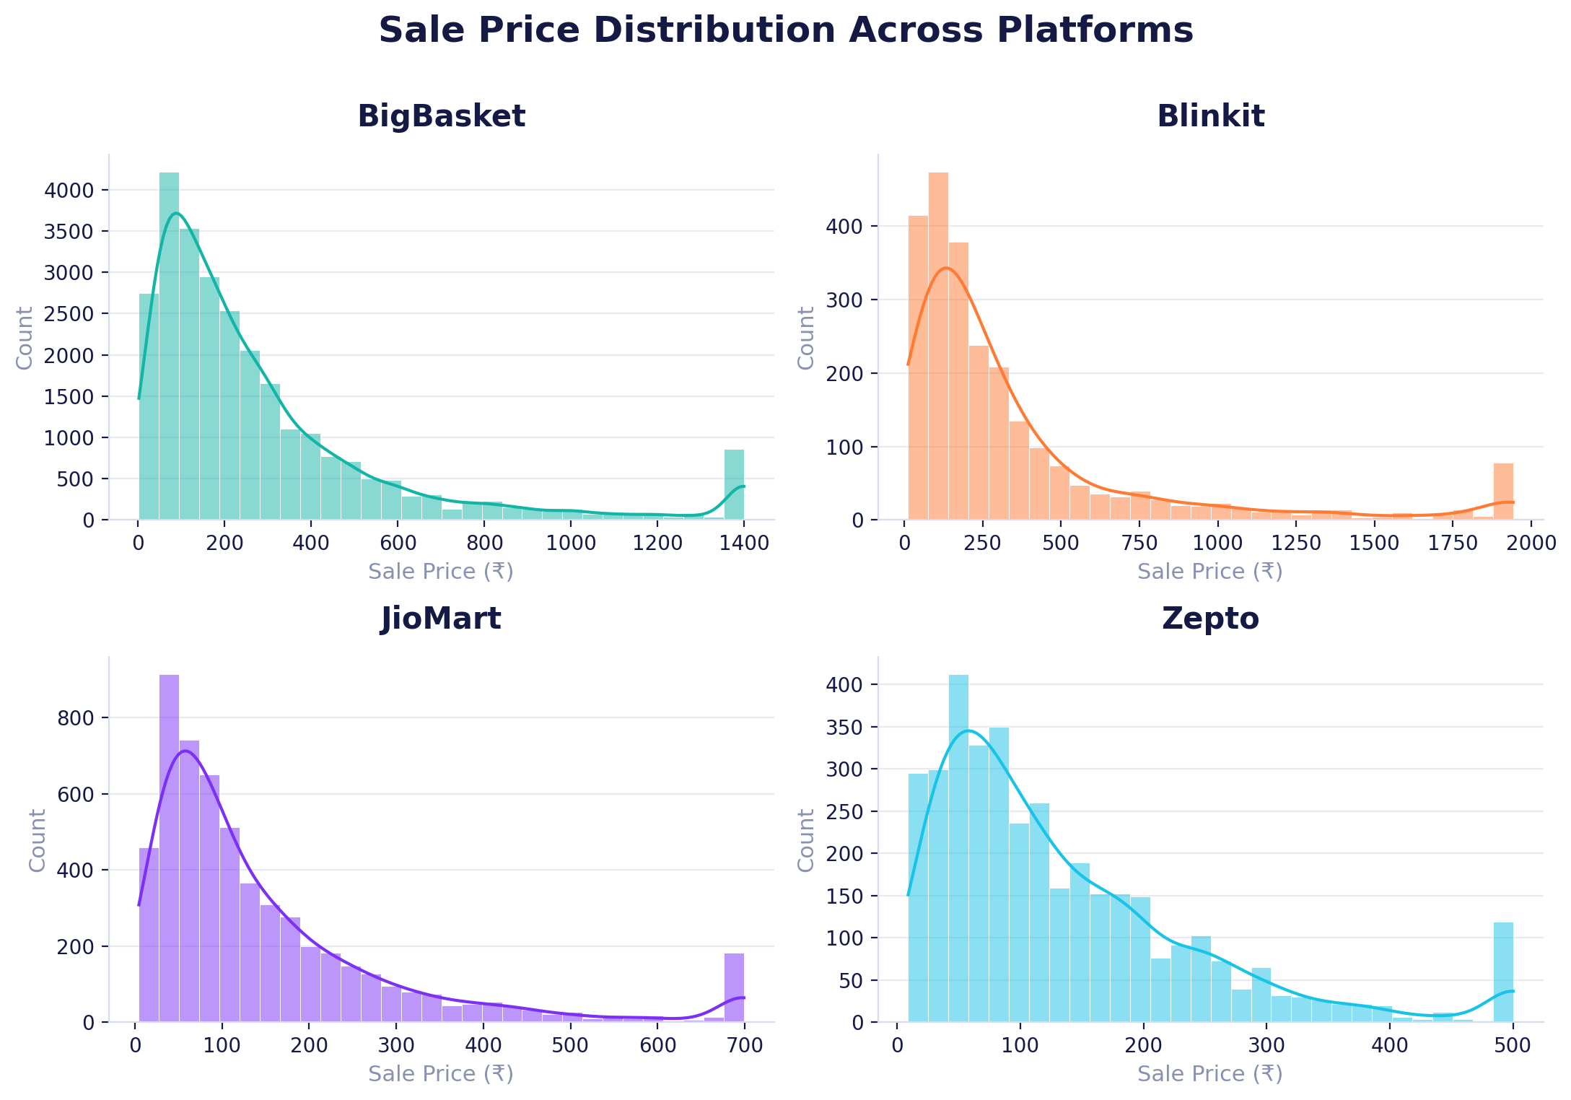
SLIDE 11
Exploratory Data Analysis — Q1 to Q5
Q1 BigBasket spans the widest price range; Zepto & Blinkit skew low-to-medium.
Q2 Beauty & Hygiene drives the highest total sales value, followed by Kitchen, Garden & Pets.
Q3 Sale prices are heavily right-skewed (skew = 13.2) — most products are budget-priced.
Q4 BigBasket shows the widest price variation (σ = ₹487); Zepto is the most consistent.
Q5 Zepto leads average rating (4.30), followed by Blinkit (4.20); JioMart trails (3.90).
SmartBasket Analysis
10
Notes:
These first five questions establish the baseline: how price and rating vary by platform. BigBasket carries the broadest catalogue and price range, while Zepto is both the cheapest on average and the most consistently well-rated.

Slide 12
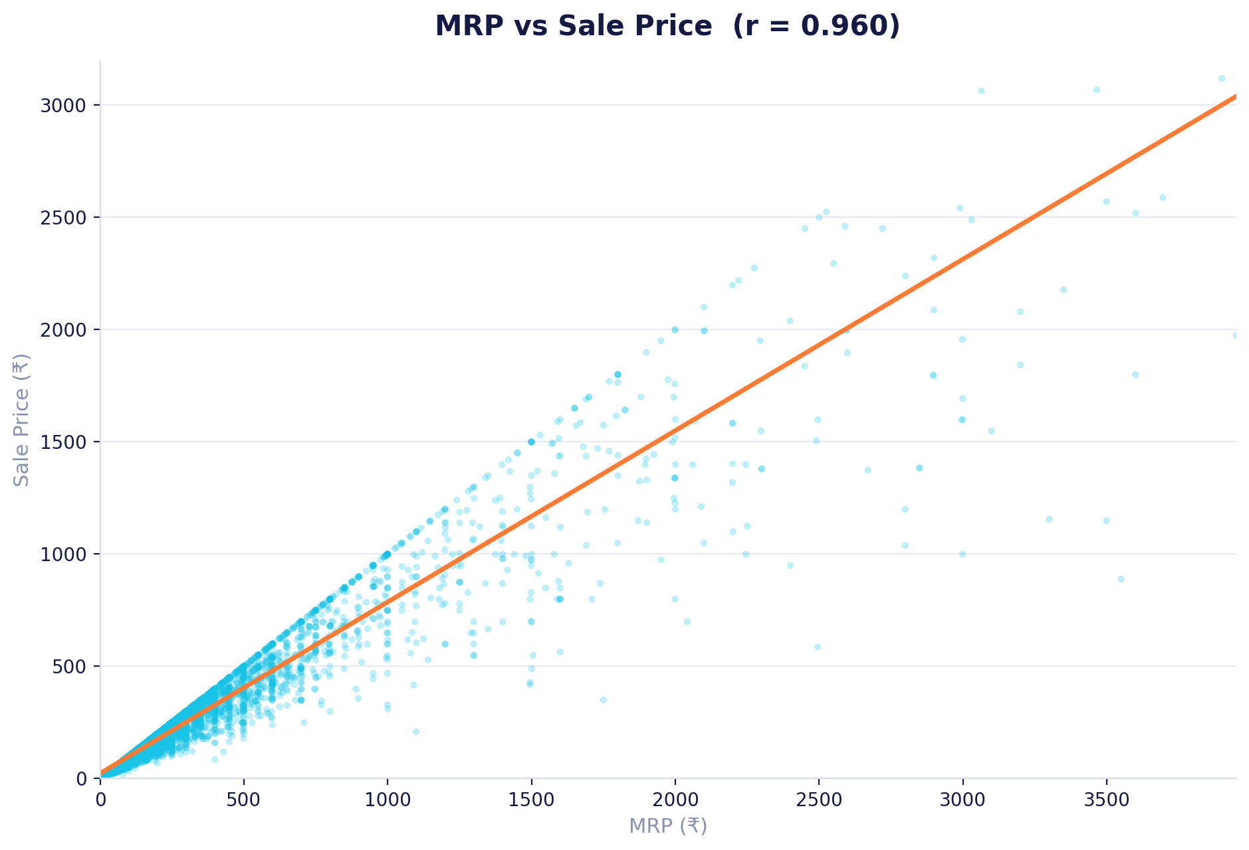
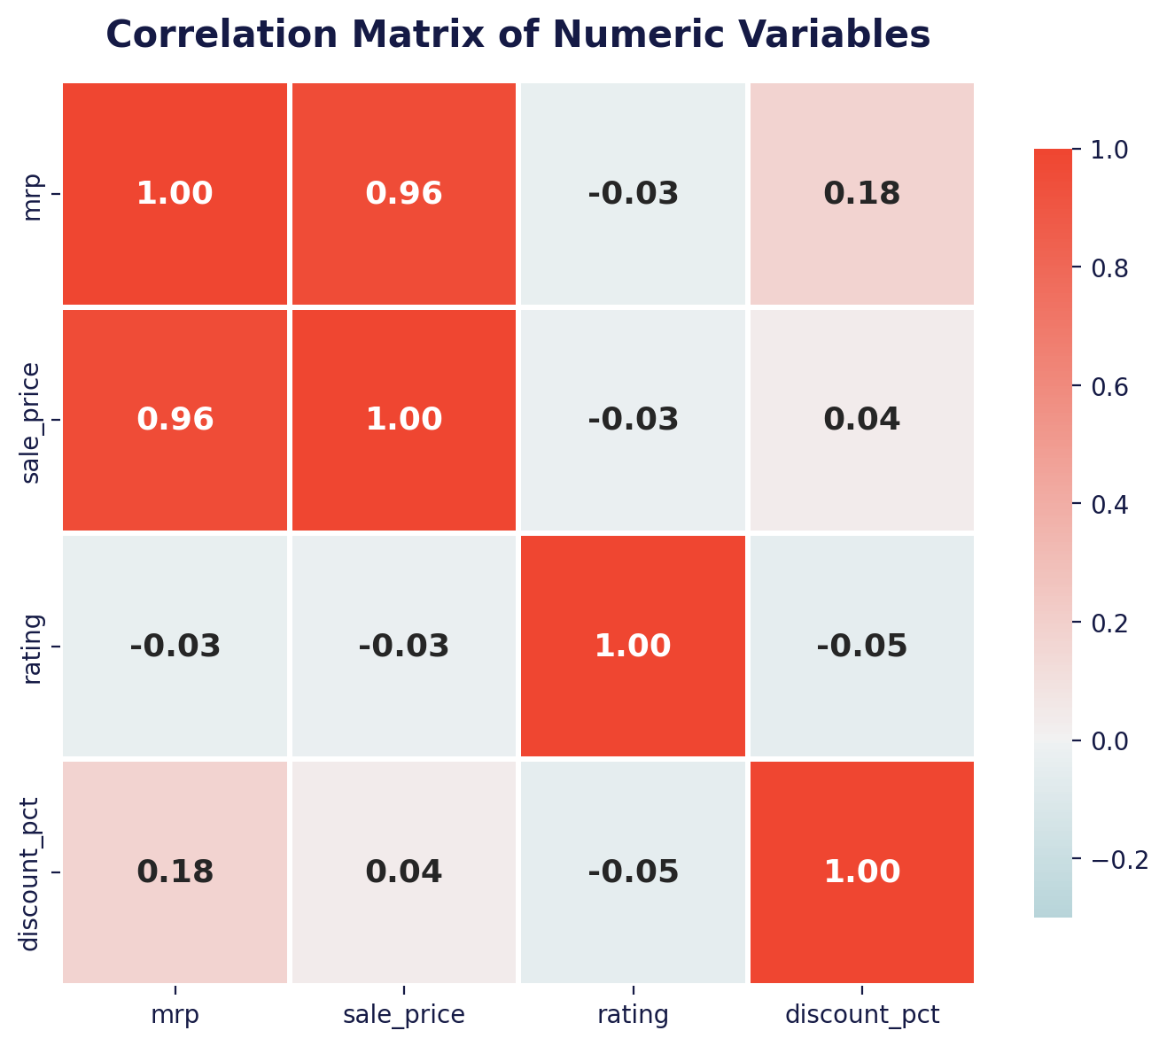
SLIDE 12
Exploratory Data Analysis — Q6 to Q10
Q6 MRP and Sale Price correlate strongly (r = 0.96) — pricing is consistent across the funnel. | Q7 Discount % barely tracks Sale Price (r = 0.036); premium items get large discounts too. | Q8–9 Rating is essentially independent of price and discount — quality perception isn't price-driven. | Q10 Ratings stay high across price bands — premium items don't earn better reviews.
SmartBasket Analysis
11
Notes:
Correlation analysis reveals MRP and sale price move almost in lockstep, while discount percentage and customer rating are largely disconnected from price — deeper discounts don't necessarily mean cheaper products, and higher prices don't buy better ratings.

Slide 13
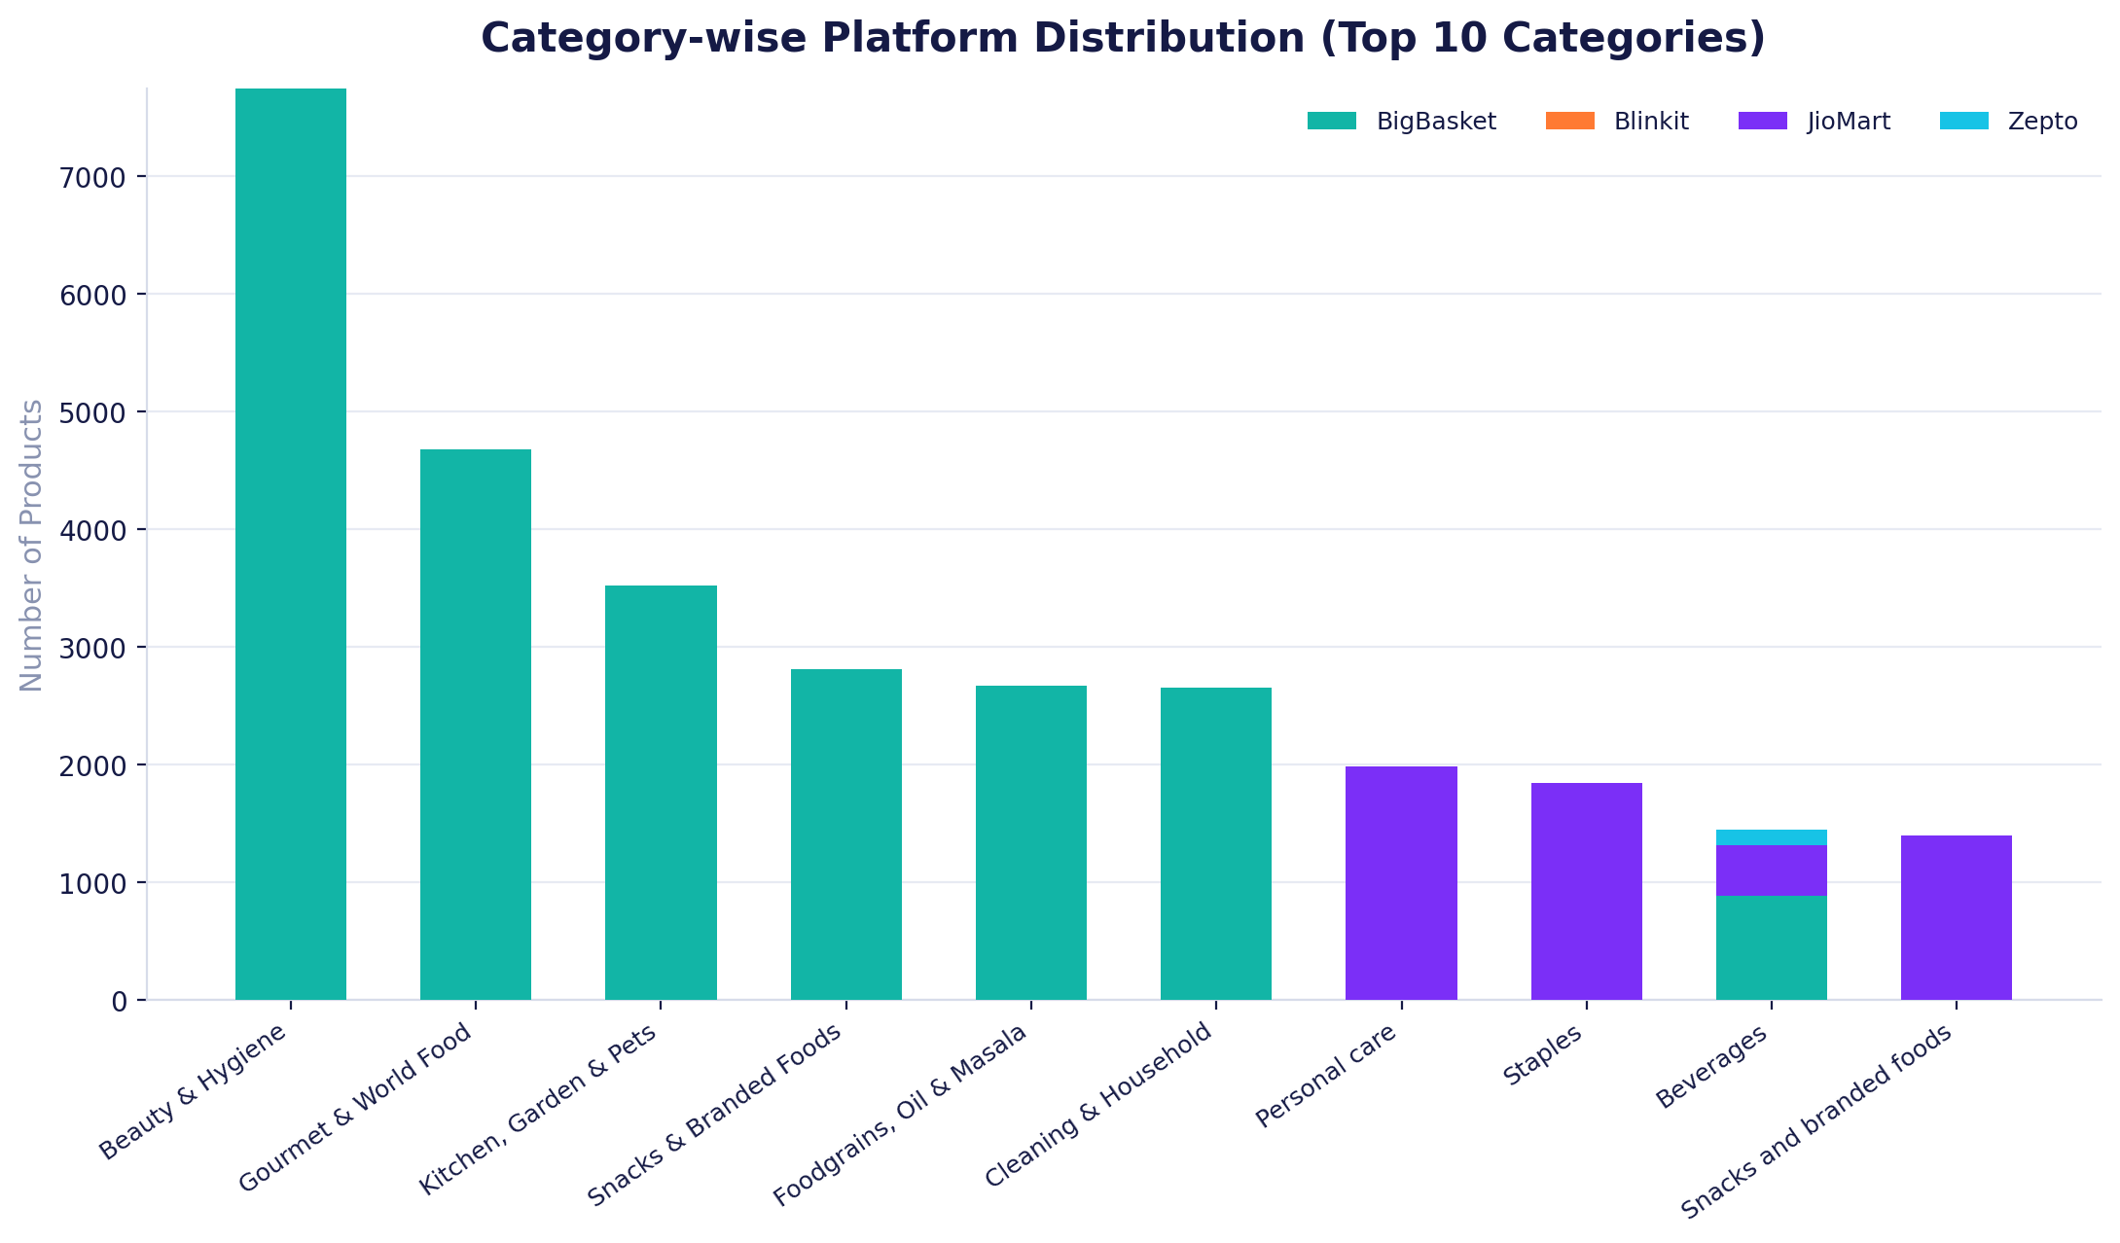
SLIDE 13
Exploratory Data Analysis — Q11 to Q15
Q11 BigBasket contributes 69.7% of the entire product catalogue.
Q12 General Grocery & Kitchen/Garden/Pets show the widest price variability.
Q13 Most categories are dominated by a single platform, not evenly spread.
Q14 Brands like Amul & Ching's pair strong ratings with modest discounting.
Q15 Ratings are left-skewed (skew = −2.07) — concentrated between 4.0 and 5.0.
SmartBasket Analysis
12
Notes:
The final EDA block shows category-platform dominance patterns, identifies which categories have the widest pricing spread, and confirms that customer ratings across the dataset skew strongly positive.

Slide 14
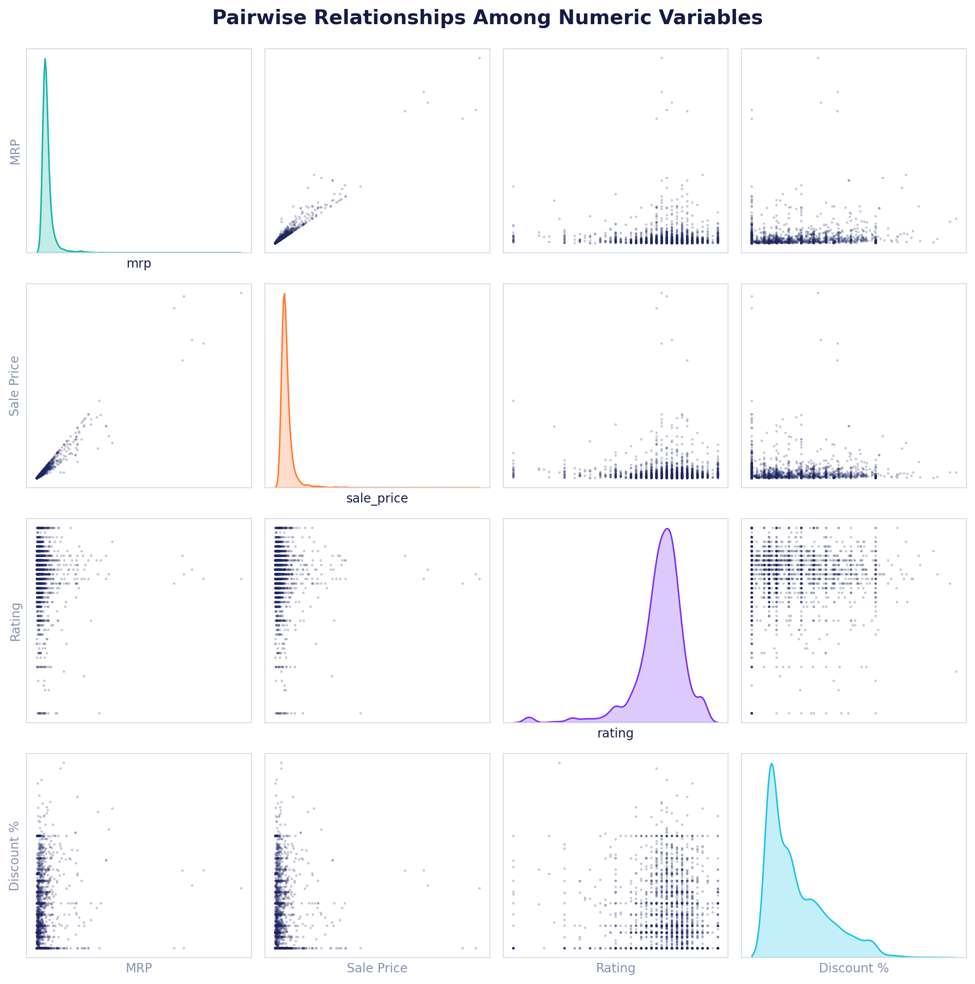
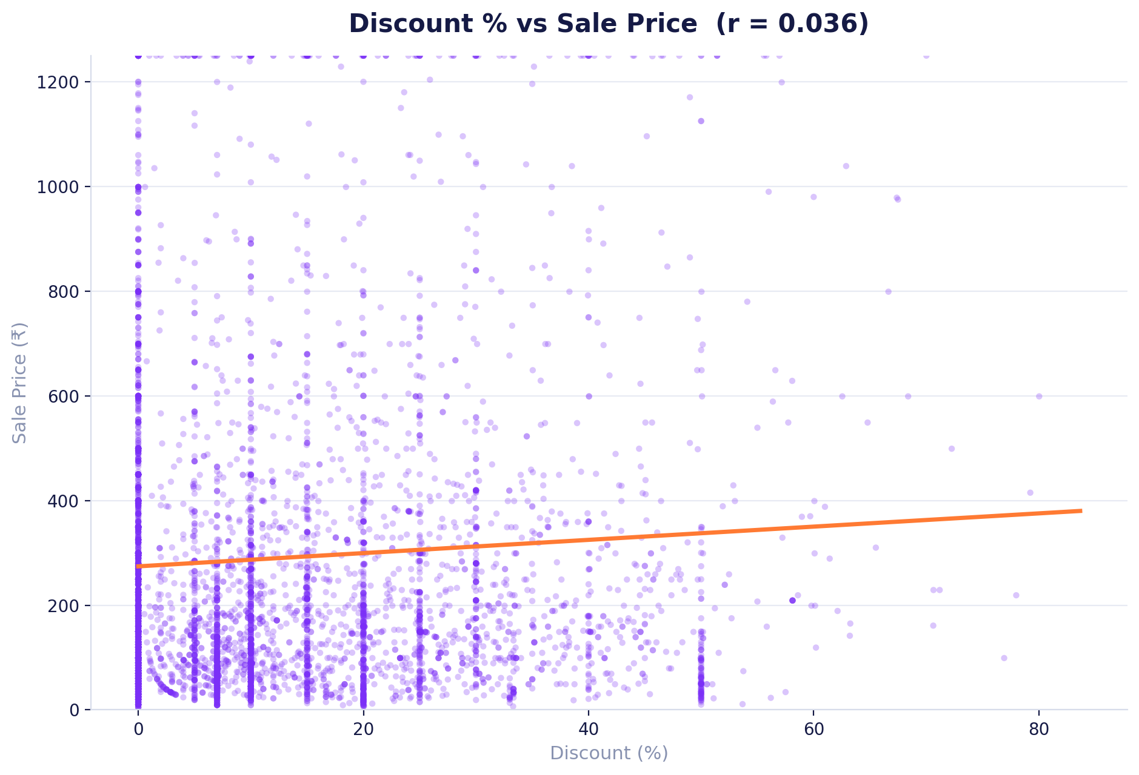
SLIDE 14
Correlation Analysis
MRP ↔ Sale Price: r = 0.96 (very strong) Discount ↔ Sale Price: r = 0.04 (negligible) Rating is nearly uncorrelated with every pricing variable.
SmartBasket Analysis
13
Notes:
Zooming into relationships: the pairwise grid on the left confirms MRP and sale price move together tightly, while discount and rating scatter loosely against every other variable — reinforcing that pricing, discounting and satisfaction are driven by largely independent forces.

Slide 15




SLIDE 15
Platform Comparison
BigBasket
Blinkit
JioMart
Zepto
AVG. PRICE
AVG. PRICE
AVG. PRICE
AVG. PRICE
₹322
₹425
₹174
₹142
AVG. DISCOUNT
AVG. DISCOUNT
AVG. DISCOUNT
AVG. DISCOUNT
11.8%
21.0%
14.8%
7.9%
AVG. RATING
AVG. RATING
AVG. RATING
AVG. RATING
3.99 ★
4.20 ★
3.90 ★
4.30 ★
CATALOGUE SIZE
CATALOGUE SIZE
CATALOGUE SIZE
CATALOGUE SIZE
27,342
2,467
5,672
3,730
SmartBasket Analysis
14
Notes:
Side by side: BigBasket wins on scale and mid-range pricing, Blinkit sits at a premium with the deepest average discounts, JioMart is budget-friendly but lowest-rated, and Zepto combines the lowest average price with the highest customer satisfaction.

Slide 16



SLIDE 16
Key Business Insights
Zepto = Best Value
Discount ≠ Cheap
Lowest average price with the highest customer rating — the strongest value proposition in the dataset.
High discount % is common on premium items too (r = 0.04) — a big markdown badge doesn't guarantee the lowest price.
Rating Is Price-Blind
Beauty & Hygiene Leads
Customer satisfaction barely shifts with price — budget and premium products earn similarly strong reviews.
This single category generates the highest total sales value (₹32.5L+), ahead of Kitchen & Gourmet segments.
SmartBasket Analysis
15
Notes:
Four insights matter most for the business: Zepto delivers the best overall value, discount percentage is a poor proxy for cheapness, ratings don't move with price, and Beauty & Hygiene is the single biggest revenue driver.

Slide 17

SLIDE 17
Key Findings
BigBasket carries 69.7% of the catalogue — the default choice for range and availability.
MRP and Sale Price move almost in lockstep (r = 0.96) across every platform.
Zepto posts the highest average rating (4.30) despite the lowest average price.
Blinkit's average discount (21.0%) is the deepest of all four platforms.
Sale prices are heavily right-skewed — most products sit well under ₹200.
Ratings cluster tightly between 4.0–5.0, with very few poor reviews recorded.
General Grocery & Kitchen/Garden/Pets show the widest intra-category price spread.
Discount percentage shows almost no relationship with either price or rating.
SmartBasket Analysis
16
Notes:
Eight findings summarize the analysis — from BigBasket's catalogue dominance and the tight MRP-to-sale-price relationship, to Zepto's rating advantage and Blinkit's aggressive discounting.

Slide 18




SLIDE 18
Business Recommendations
Expand High-Margin Categories
Rethink Discount Messaging
Double down on Beauty & Hygiene and Gourmet & World Food, the top sales-value contributors.
Since discount % barely predicts final price, promote absolute savings (₹) alongside % off for clarity.
Benchmark Against Zepto
Platform-Specific Pricing
Use Zepto's price-to-rating ratio as the internal benchmark for competitive positioning.
Tailor pricing tiers per platform — BigBasket for range, Blinkit/Zepto for speed-driven premiums.
SmartBasket Analysis
17
Notes:
Four recommendations follow directly from the data: invest in the highest-value categories, be more transparent about discount messaging, benchmark against Zepto's efficiency, and adopt platform-specific pricing strategies.

Slide 19





SLIDE 19
Future Scope
AI Recommendation Engine
Price Prediction Models
Customer Personalization
Real-Time Dashboard
Demand Forecasting
These extensions would turn a descriptive analysis into a predictive, personalized shopping-intelligence platform.
SmartBasket Analysis
18
Notes:
Looking ahead, this analysis could evolve into an AI-driven recommendation engine, price prediction models, personalization layers, a live dashboard, and demand forecasting — moving from descriptive to predictive intelligence.

Slide 20



CONCLUSION
From Raw Data to Real Value
SmartBasket Analysis cleaned and explored 39,000+ grocery listings to reveal that sales concentrate in a few high-performing categories, MRP and sale price track tightly across platforms, and customer satisfaction stays strong regardless of price — insights that can guide smarter inventory, pricing and marketing decisions.
Thank You
Questions?
SmartBasket Analysis
19
Notes:
To conclude: cleaning and exploring this multi-platform dataset shows that sales concentrate in a handful of categories, pricing is internally consistent, and customer satisfaction holds up regardless of price point. Thank the panel and invite questions.

