Slide 1
SHRI SHANAKARCHARYA TECHANICAL CAMPUS
“Exploring the Power of Agentic AI with IBM Granite and IBM Bob”

Slide 2
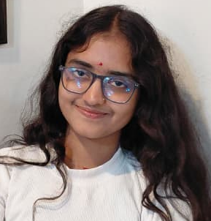
Project Tile – [ Agentic AI & Advanced Social Analytics ]
Domain of Project – [ Social Media Agent ]
Student Name | Recent Passport Photo | Email ID | Mobile number [WhatsApp]
Bhumika Chandrakar
bhumikachandrakar0110@gmail.com
9098582046

Slide 3
Problem Statement -
Problem Statement : Social Media Agent
The Challenge
Brands, influencers, and organizations struggle to keep up with the fast-paced and fragmented world of social media. Content trends evolve hourly, audience sentiment shifts rapidly, and competitor strategies are difficult to track. Managing multiple platforms often leads to scattered insights, missed engagement opportunities, and ineffective campaigns. The challenge is not only to collect social media data but also to analyze, predict, and recommend actions in real time.
The Objective
Build an agentic AI application that acts as an intelligent social media companion. The solution should:
Fuse Multichannel Data :- Collect and synthesize content, comments, hashtags, and competitor posts from platforms like X, LinkedIn, Instagram, and Facebook into unified insights.
Enable Multimodal Interaction :- Accept user inputs (text, images, or voice prompts) and generate creative post drafts, captions, or campaign ideas aligned with brand tone.
Create a Predictive & Agentic Layer :- Forecast trending hashtags, audience sentiment shifts, and competitor engagement patterns while suggesting the best posting schedules.
Visualize Social Media Pulse :- Provide a dashboard with real-time analytics—engagement trends, influencer mapping, sentiment tracking, and campaign performance forecasts.
Tech Stack (Mandatory)
IBM BOB + IBM Models + LLMs

Slide 4
Proposed Solution -
Proposed Solution: AI-Powered Social Media Agent The proposed solution is a multi-agent AI-powered Social Media Agent built using IBM Langflow, IBM watsonx.ai, and Granite Models to provide personalized, real-time marketing guidance. The system addresses challenges in multichannel data fusion, digital asset generation, and predictive trend tracking through an intelligent, modular architecture. At its core, the solution uses a Retrieval-Augmented Generation (RAG) and Orchestration pipeline to fetch accurate performance metrics, historical metrics, and trending topics from trusted sources such as X, LinkedIn, Instagram, and Facebook API streams. This data is embedded and stored in a vector database, enabling the system to retrieve and summarize channel activity and sentiment details using Granite models.
The system consists of four key agents: Multichannel Data Fusion Agent retrieves and summarizes brand engagement metrics and across-the-board text updates using RAG. AI Content Recommendation Agent generates personalized post drafts and creative strategies based on user inputs such as target audience demographics, historical brand tone, and campaign goals. Predictive Trend Advisory Agent provides foresight suggestions, including platform-specific scheduling updates (e.g., best times to post or high-impact hashtag recommendations). Multimodal Log & Feedback Agent allows users to input ideas via text, voice, or images and delivers instant performance analysis and copy-optimization options with actionable feedback.
The solution includes a user-friendly dashboard (built with Tailwind CSS and React) that visualizes daily and weekly engagement trends, highlights competitor activities, and tracks progress toward brand outreach targets. IBM Langflow / IBM Orchestrate is used to coordinate agent workflows, while watsonx.ai ensures scalable model deployment, embeddings, and AI governance. Granite models power advanced reasoning, automated caption summarization, and creative personalization. Overall, this solution delivers an end-to-end intelligent marketing assistant that promotes agile brand growth through data-driven insight frameworks, real-time creative feedback, and predictive optimization strategies.

Slide 5
Technology Used
IBM Langflow / IBM Orchestrate – For designing and orchestrating multi-agent marketing workflows visually
IBM Granite model – (e.g., ibm-granite-3-2-8b) – For natural language understanding, creative copywriting, reasoning, and campaign personalization
IBM Cloud – It provides the infrastructure to build, deploy, and scale the Social Media Agent efficiently. IBM Cloud enables a reliable, secure, and scalable environment for deploying the Social Media Agent.
RAG – RAG to fetch real-time cross-channel platform data first, then generate intelligent answers and trend reports, making the Social Media Agent more trustworthy and effective.
IBM Watsonx.ai – For model deployment, embeddings, and AI governance
Vector Database (FAISS/Chroma) – For RAG-based historical performance and trending hashtag retrieval

Slide 6
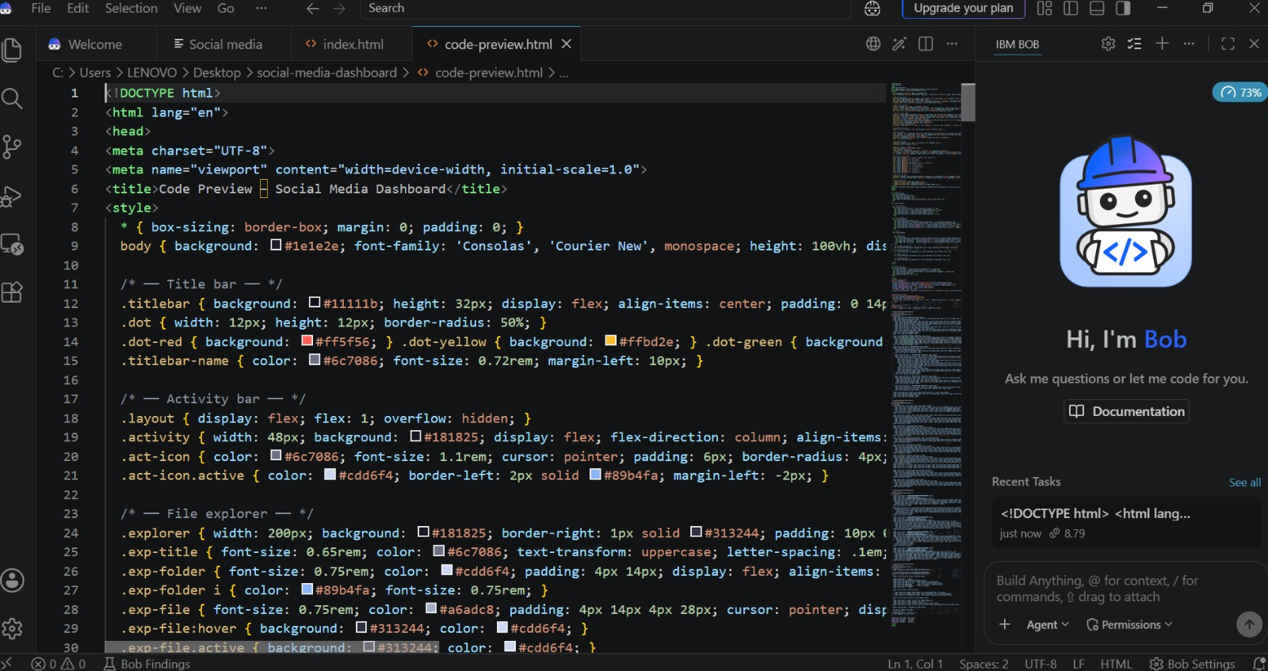
Required Files created using IBM bob -
App.py
Requirements.txt
Style.css
.env
Index.html

Slide 7
IBM Bob Screenshots:

Slide 8
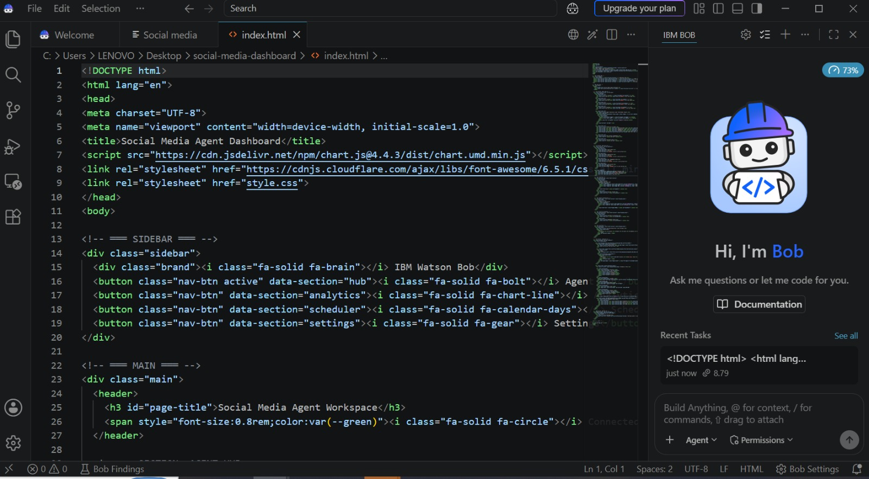

Slide 9
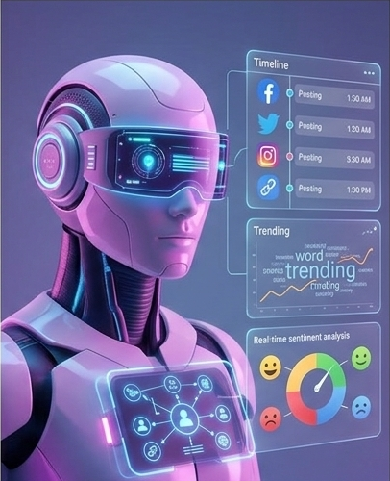
Role of Agentic AI in the solution
Role of Agentic AI in Social Media Agent Agentic AI enables the Social Media Agent to function as an intelligent, autonomous system rather than a simple chatbot. Using IBM watsonx.ai and IBM Granite models, it coordinates multiple specialized agents to deliver personalized social media guidance. Each agent performs a specific role—such as retrieving multichannel data, generating creative post drafts, tracking competitor strategies, and analyzing audience sentiment—while working collaboratively. This multi-agent approach ensures efficient task execution and accurate results.
Agentic AI also brings context awareness, understanding brand identity like tone of voice, campaign guidelines, and target demographics to generate tailored recommendations. It supports real-time adaptation, continuously updating posting schedules and hashtag strategies based on trending user signals. Additionally, agents communicate with each other, enabling better decision-making and improved campaign outcomes.
Overall, Agentic AI makes the system proactive, personalized, and goal-driven, acting like a smart digital companion that helps brands maintain a powerful online presence.

Slide 10
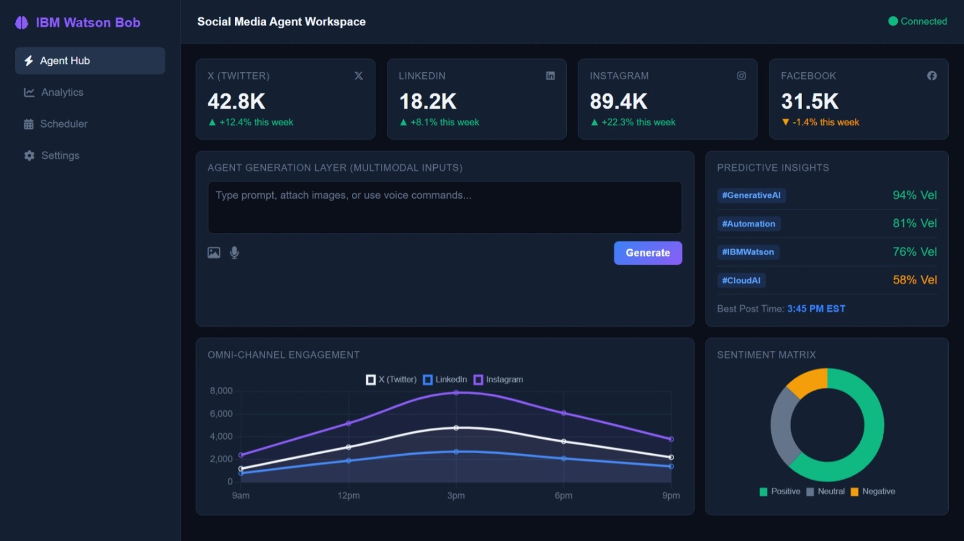
Project Output Screenshot
·
·
·

Slide 11
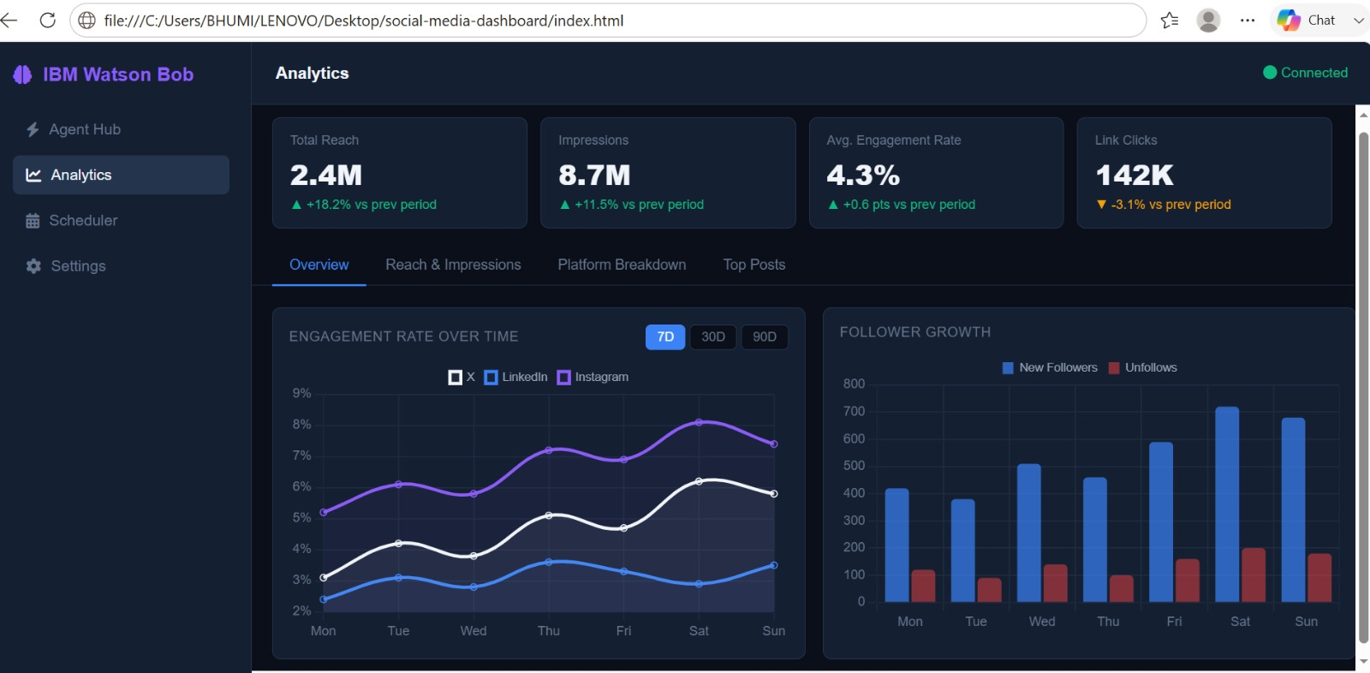
Project Output Screenshot
·
·
·

Slide 12
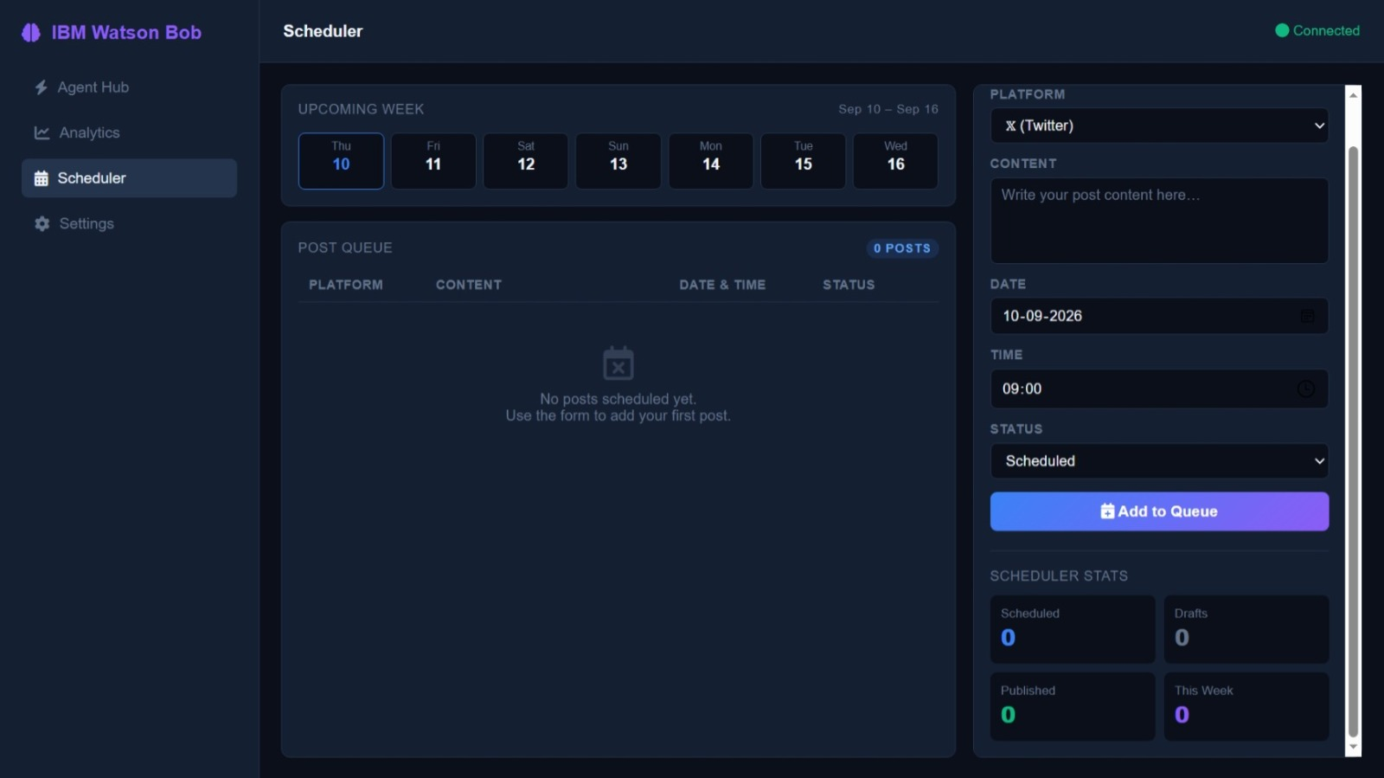
Project Output Screenshot
·
·
·

Slide 13
Novelty and Uniqueness
Novelty and Uniqueness
The proposed Social Media Agent stands out by combining Agentic AI, RAG, and personalization into a single intelligent system.
Multi-Agent Intelligence – Instead of a simple chatbot, multiple specialized agents collaborate to deliver accurate and context-aware marketing guidance.
RAG-Based Accuracy – Integrates real-time live web and platform data retrieval with AI generation, reducing misinformation and ensuring trustworthy trends and metrics.
Hyper-Personalization – Tailors content, campaign ideas, and recommendations based on specific brand guidelines, target demographics, and industry niches.
Real-Time Feedback Loop – Continuously adapts posting schedules and hashtag strategies based on daily audience behavior and active engagement metrics.
Multi-Modal Input – Supports text, voice, and image-based prompt tracking for faster creation workflows and content analysis.
Predictive & Strategic Focus – Goes beyond standard metric tracking to forecast viral trends, sentiment changes, and upcoming competitor behavior.
Scalable & Enterprise-Ready – Built on IBM watsonx.ai with IBM Granite models, ensuring reliability and strict data governance.
This makes the solution a smart, adaptive, and proactive digital companion, not just a static social media analytics tool.

Slide 14
Git Hub Link
· Please create public github repository (Enable Add README button while creating repository) with format –
Please test and Paste the working Github URL –
Make sure you have Uploaded following three files into your github repository 1) All Agent relevant files of IBM Cloud , 2) yourproblemstatement.pdf file 3) your projectpresntation.pptx file 4)any other files
·
·
·

Slide 15
Future Scope
1. Integration with CRM & Enterprise Marketing Hubs –
The system can be integrated with enterprise CRMs and marketing automation platforms to collect real-time data such as customer conversions, sales pipelines, and active lead metrics. This will enable the Social Media Agent to provide more accurate and dynamic content recommendations based on actual revenue performance and business impact metrics.
2. AI-Powered Autonomous Video Generation & Multi-Platform Publishing –
Enhancing the system with automated video rendering agents and direct API publishing across multiple social media networks will improve operational scale. Users can generate complete multimedia visual assets naturally from text prompts, making the solution an end-to-end, hands-free campaign management system for global enterprise teams.
·
·
·

Slide 16
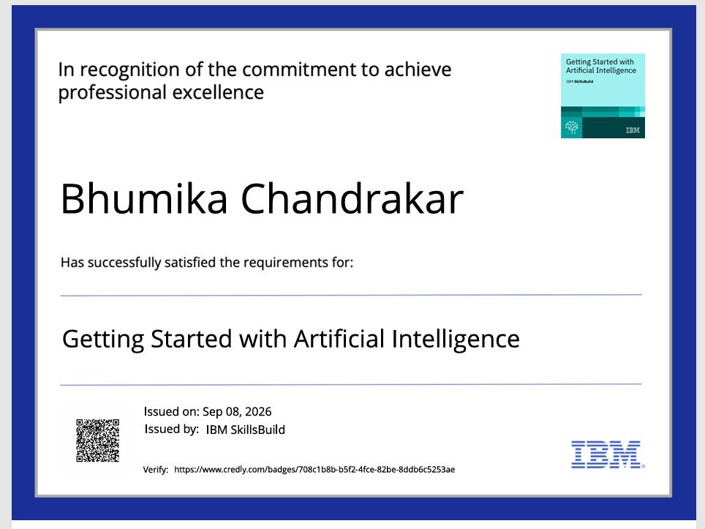
Certificates Earned:
Credly certificate

Slide 17
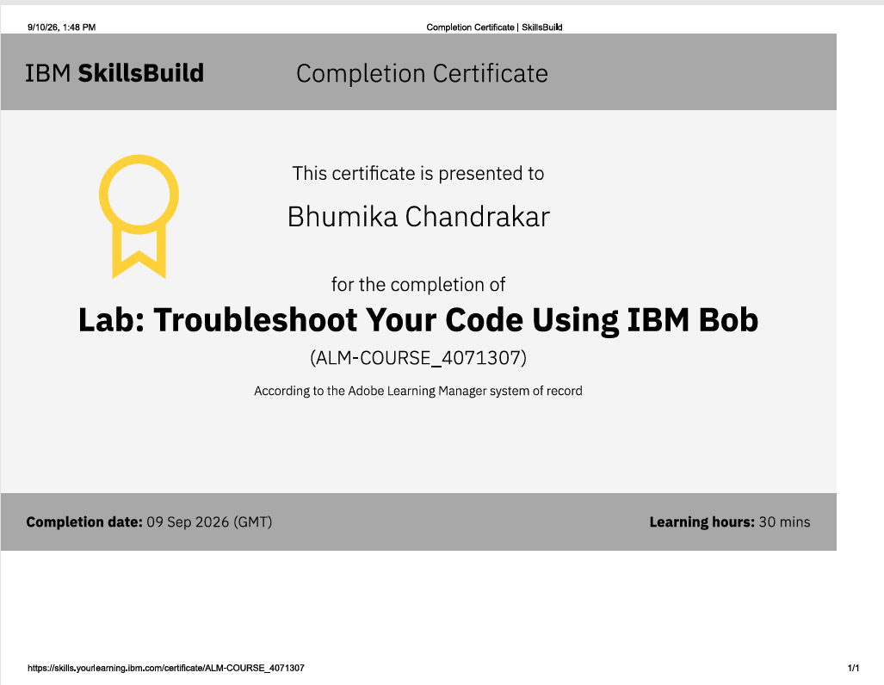
Certificates Earned:​
IBM BOB Certificate

Slide 18
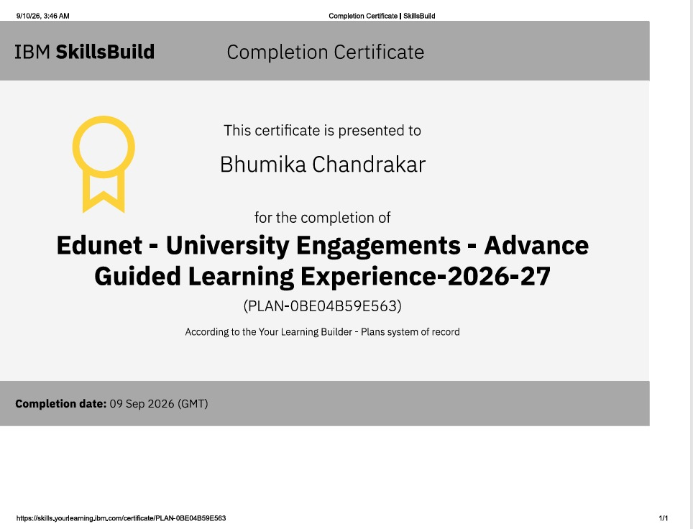
Certificates Earned :

Slide 19


