Slide 1
Tourism in india
rajasthan tourism

Slide 2
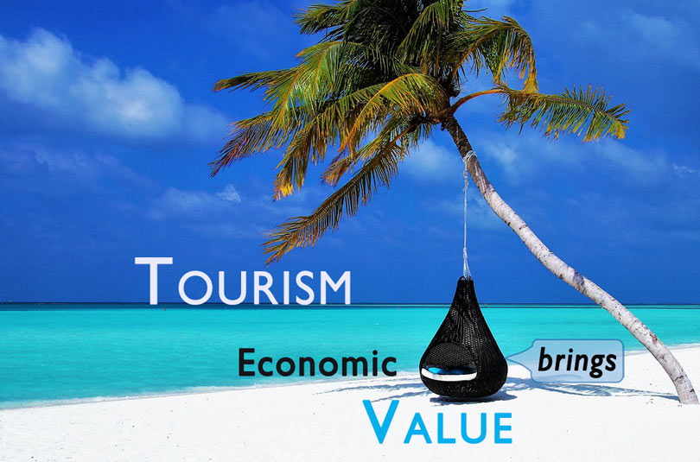
Importance of tourism
Tourism is widely regarded as a significant source of economic growth, particularly in developing countries. Poverty alleviation in rural and remote areas through tourism presents a unique opportunity.

Slide 3
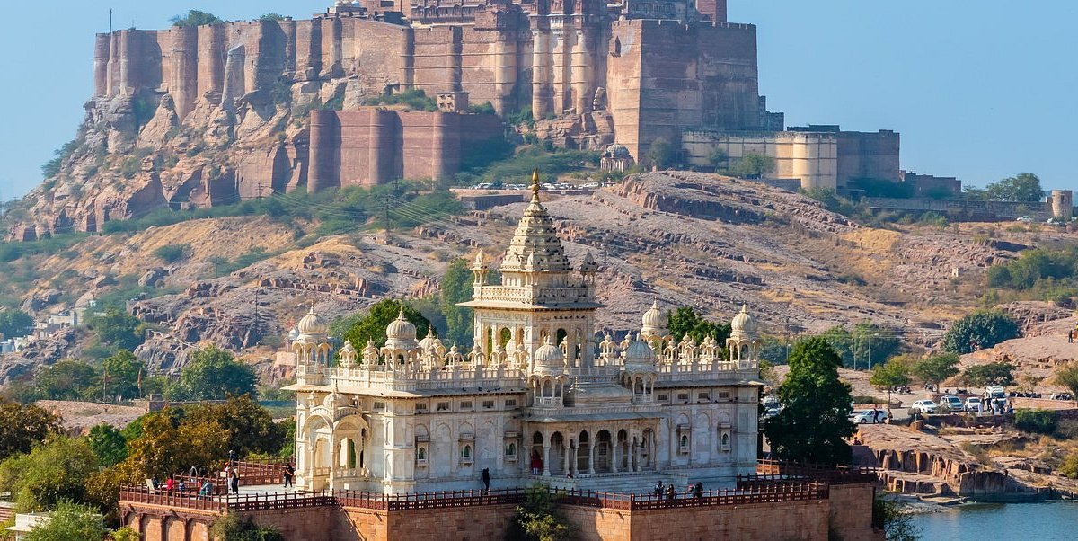
Rajasthan tourism
Rajasthan one of the most popular tourist destinations in India, for both domestic and international tourists. Rajasthan attracts tourists for its historical forts, palaces, art and culture with its slogan "Padharo Mhare Desh (Welcome to my land.)"^{[1]} The capital city, Jaipur, also known as Pink City, is a very popular tourist destination and is a part of the Golden Triangle.

Slide 4
Places to visit in rajasthan
Jaipur
Udaipur
Jodhpur
Jaisalmer
Mehrangarh fort

Slide 5
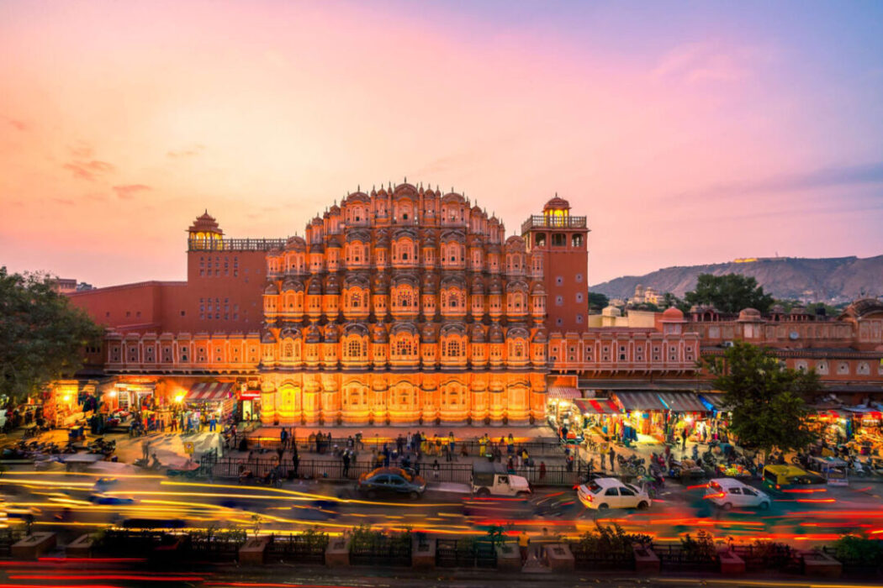
Jaipur
Jaipur is the capital of India’s Rajasthan state. It evokes the royal family that once ruled the region and that, in 1727, founded what is now called the Old City, or “Pink City” for its trademark building color.
Jaipur is the capital of India’s Rajasthan state. It evokes the royal family that once ruled the region and that, in 1727, founded what is now called the Old City, or “Pink City” for its trademark building color. At the center of its stately street grid (notable in India) stands the opulent, colonnaded City Palace complex. With gardens, courtyards and museums, part of it is still a royal residence.

Slide 6
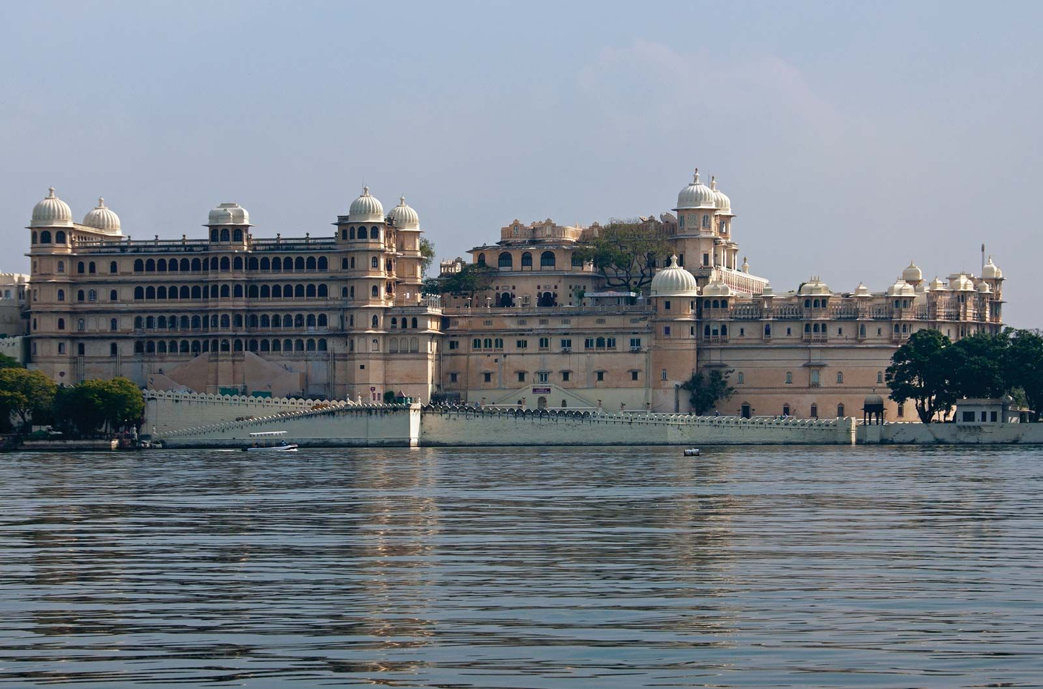
Udaipur
Udaipur, formerly the capital of the Mewar Kingdom, is a city in the western Indian state of Rajasthan. Founded by Maharana Udai Singh II in 1559, it’s set around a series of artificial lakes and is known for its lavish royal residences.

Slide 7
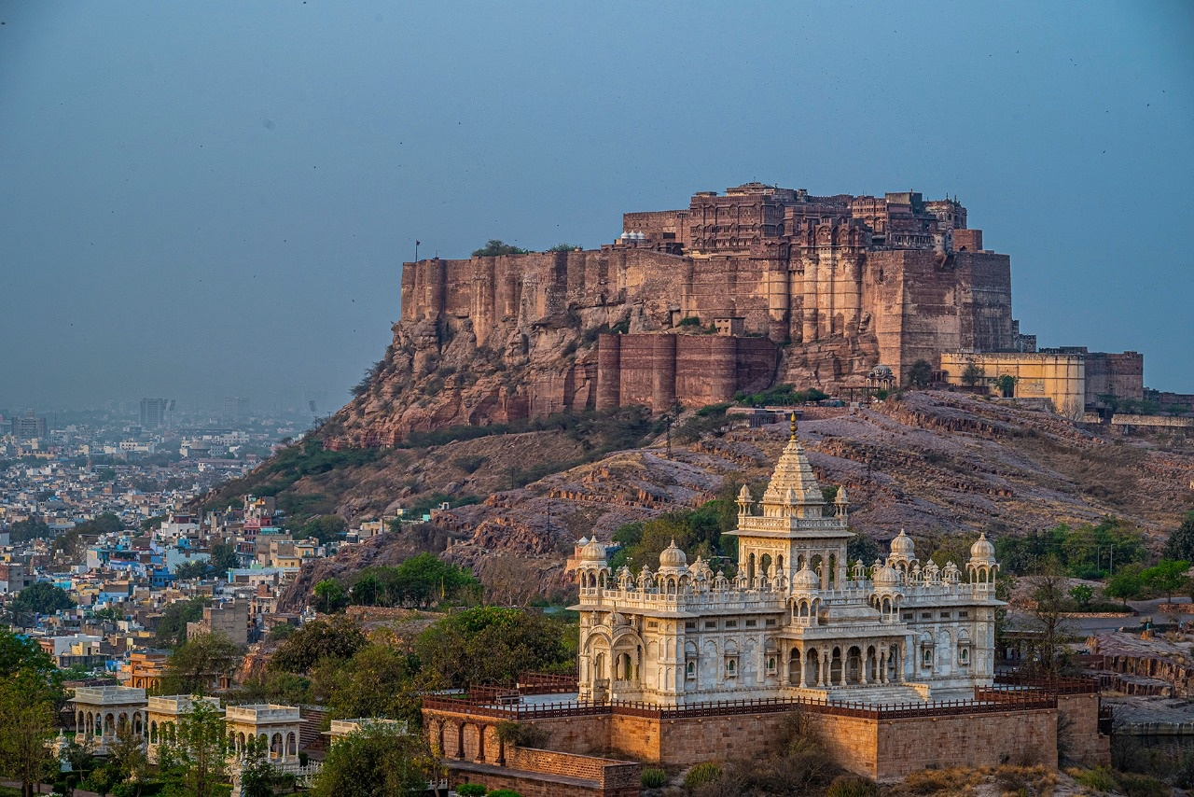
jodhpur
Jodhpur is a city in the Thar Desert of the northwest Indian state of Rajasthan. Its 15th-century Mehrangarh Fort is a former palace that’s now a museum, displaying weapons, paintings and elaborate royal palanquins (sedan chairs).

Slide 8
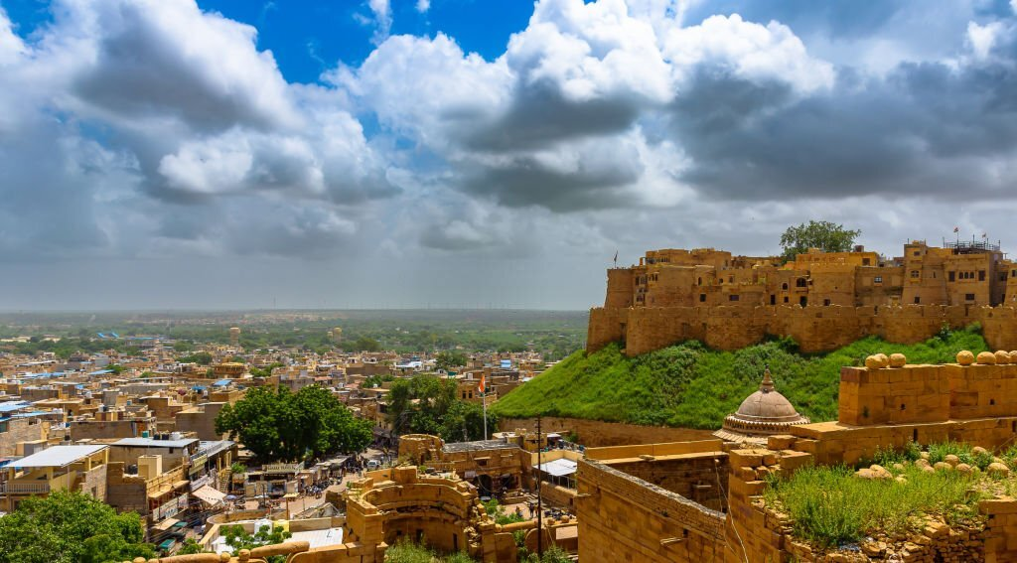
jaisalmer
Jaisalmer is a former medieval trading center and a princely state in the western Indian state of Rajasthan, in the heart of the Thar Desert. Known as the "Golden City," it's distinguished by its yellow sandstone architecture. Dominating the skyline is Jaisalmer Fort

Slide 9
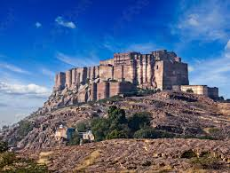
Mehrangarh fort
Mehrangarh is an historic fort located in Jodhpur, Rajasthan, India. It stands on a hilltop, rising about 122 m above the surrounding plains, and the complex spans 1,200 acres.

Slide 10
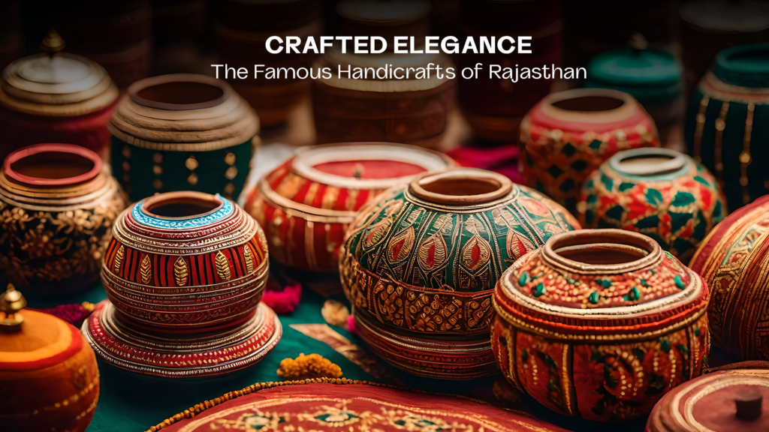

Slide 11
Arts and cafts of rajasthan
Popularly known as the “Jewel of India,” Rajasthan has been a captivating destination for travelers, and has been mesmerizing people from all over the world for decades! A deserted land with golden sand dunes, where the streets are bustling with enchantment and liveliness. With its magnificent forts and palaces, traditional arts and crafts, exuberant festivals, and rich folklore, the state of Rajasthan offers a glimpse into the grandeur and opulence of its royal past.

Slide 12
Thank you

