Slide 1
PaasPaasPASS
A way for student groups to sit and study together
Students | Faculty Mentor
1.Bhumika Chopra 2.Aditi Rai 3.Priyanshi Gupta | Subrat Kar Professor, Electrical Engg 1088; subrat@ee.iitd.ac.in

Slide 2
The need our project is trying to address
Why can’t like-minded people sit together if they want to ?
A good environment for sitting together and discussing /studying with friends - CSC cannot ensure this.
Overcoming the fragmentation of seats which occur in CSC .

Slide 3
Innovation Component
Many times it happens that some of the PCs are not working, PaasPaasPass will ensure that these systems are not allocated to the incoming students.
Extension : we will allow multiple simultaneous requests to be considered and implemented over a wireless (bluetooth) network. This will allow PaasPaasPass to be extended to a large scale in a generic way (for instance, (a) seating students of the same graduating batch or parents of students of the same department together in convocation ceremony even if they enter from different doors of Dogra Hall)

Slide 4
Prior Ground work
Google form – survey of requirements from users (students and other stakeholders)
Effective pre-planning and alogorithm design to avoid fragmentation of seats by working on the basis of our algorithm
Implementation on a stand-alone system (not a PC)

Slide 5
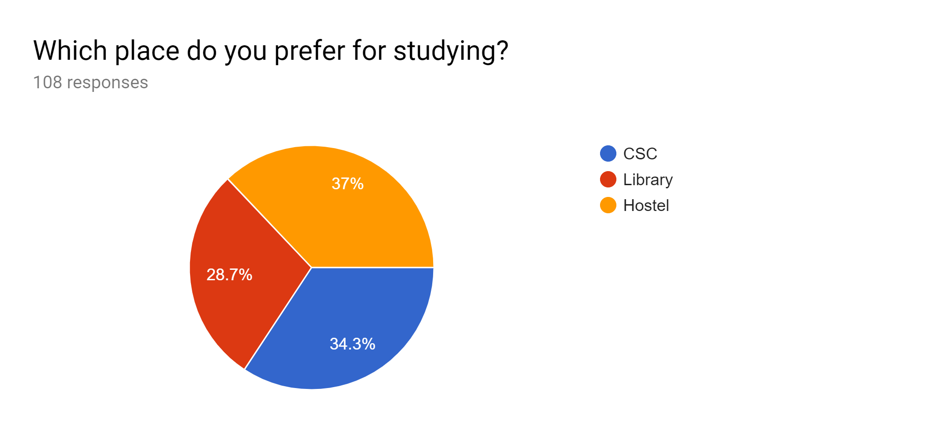
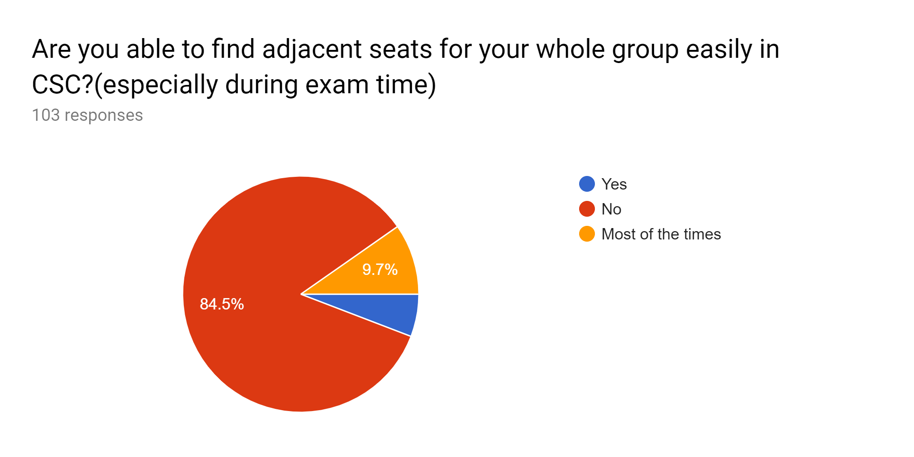
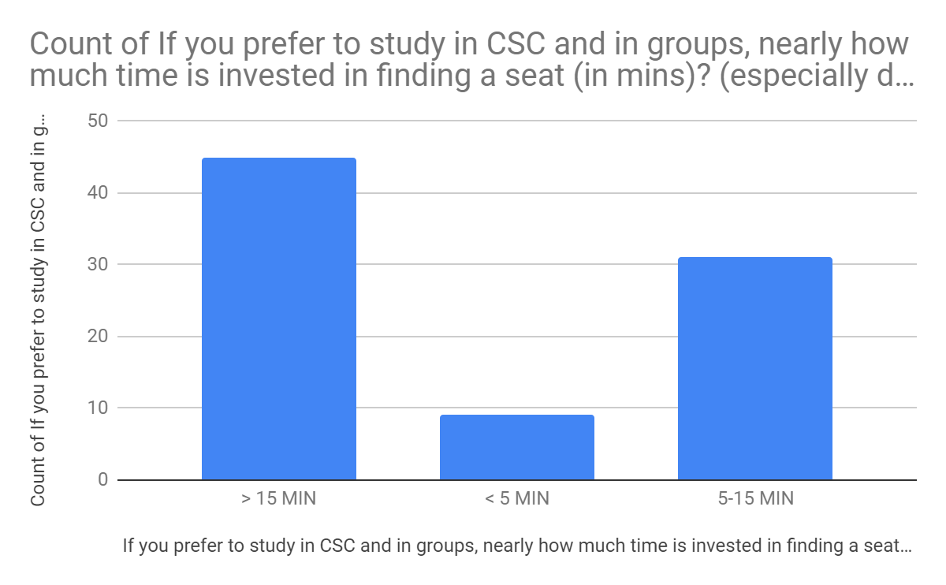
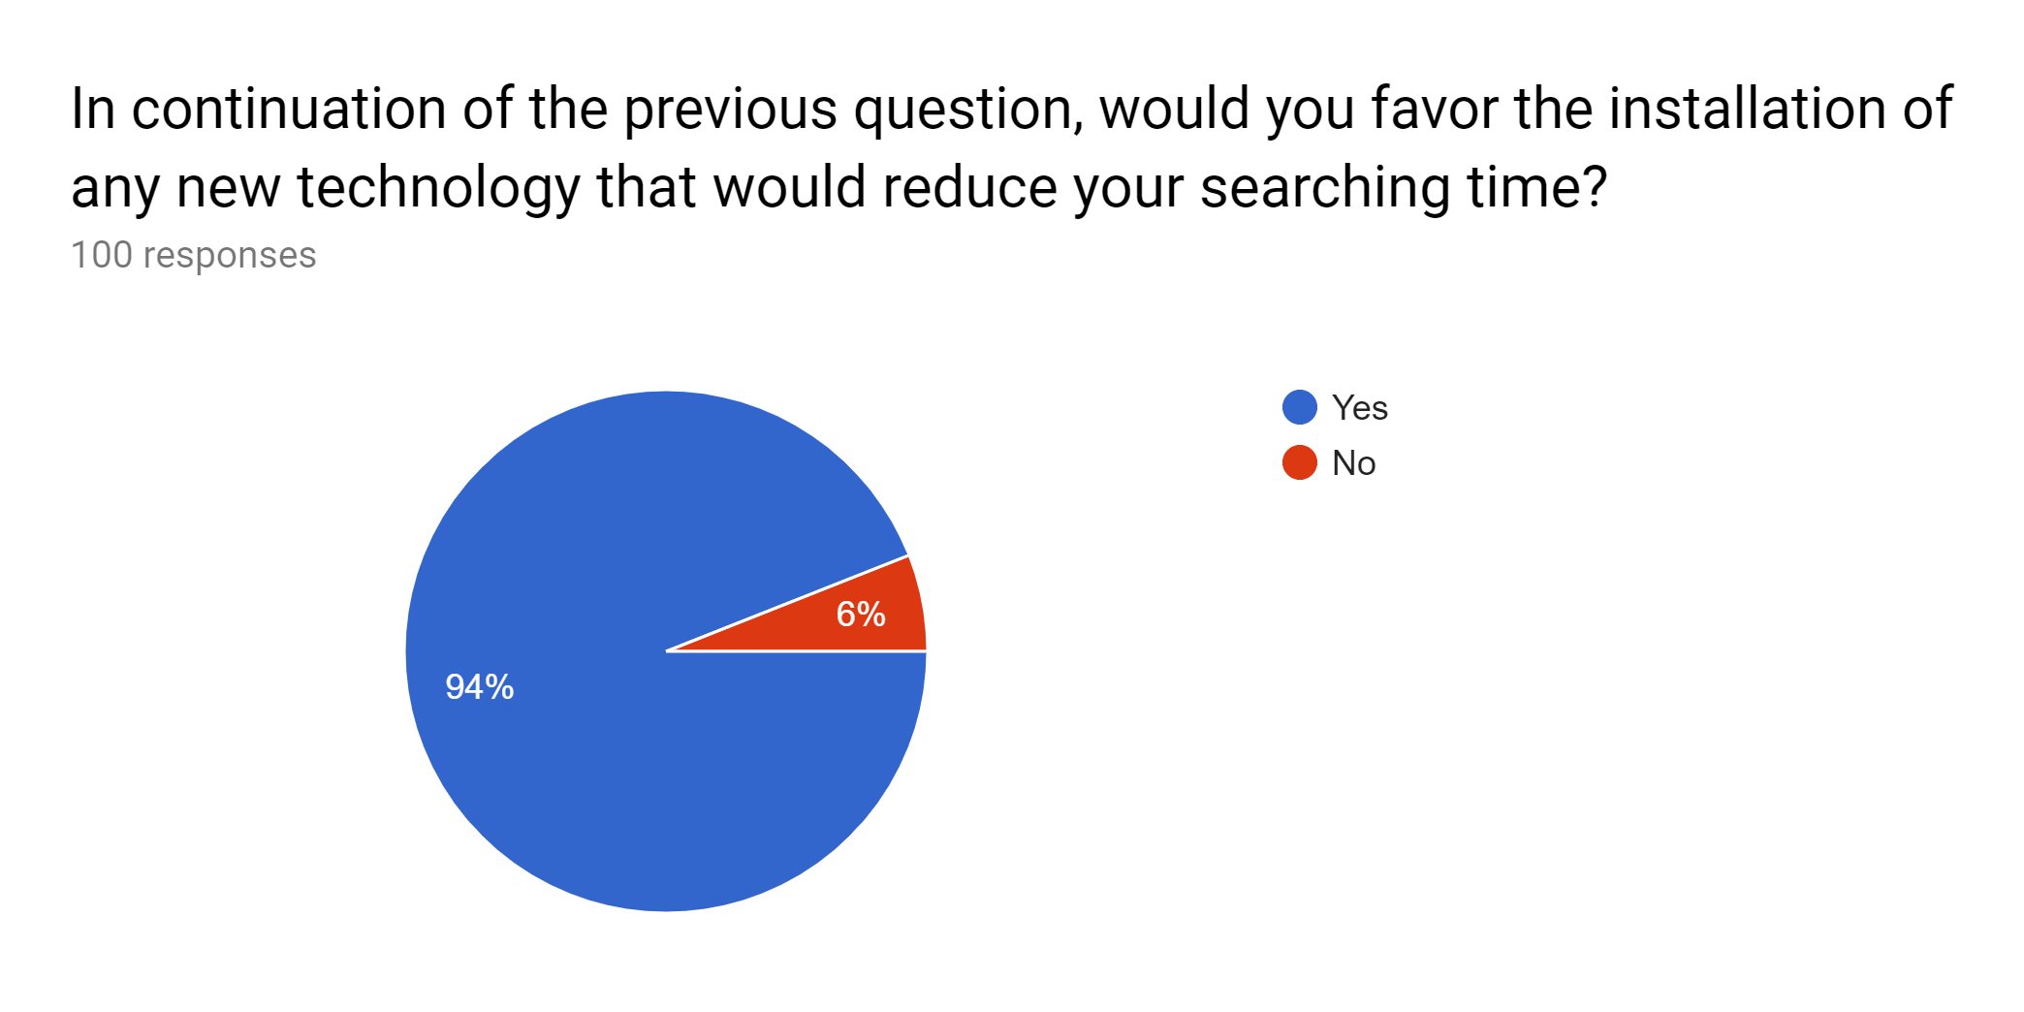

Slide 6
End Product
A person entering CSC will need to enter the number of seats required for seating purpose, the system will do a quick computation of the best suitable arrangement for the group of students.
The best possible defragmentation will be done dynamically for the occupation of contiguous seating locations.
A SBC with a 7” touch screen, attached with a 40-col printer (DMP/thermal) placed in a see-through enclosure deployed on a pilot basis in CSC.

