Slide 1

CAPSTONE PROJECT CAR PRICE PREDICTION
Presented By
Student Name: Bhumika sharma
College Name: college of education
Department: Business Administration (Finance)
Email ID: bhumikasharma1808@gmail.com
AICTE Student ID: STU67e82747ea75a1743267655

Slide 2
OUTLINE
Problem Statement
Proposed System/Solution
System Development Approach
Algorithm & Deployment
Result (Output Image)
Conclusion
Future Scope
References

Slide 3
Problem Statement
The process of pricing used cars is often challenging due to the presence of multiple factors that influence the final valuation. Car prices can vary significantly based on attributes such as brand reputation, model specifications, age, kilometers driven, fuel type, and market demand. The lack of a standardized pricing mechanism leads to uncertainty for both sellers and buyers, making negotiations difficult and subjective.
This project aims to develop a machine learning-based predictive system that helps estimate car prices accurately, leveraging historical data to identify pricing trends and key influential factors.
Expanding the scope further:
Sellers can use this model to determine competitive listing prices based on historical trends.
Buyers gain transparency into whether a car's asking price aligns with market valuation.
Dealerships can optimize resale strategies based on predicted Depreciation rates.
By addressing these challenges, the system ensures an objective, efficient, and intelligent approach to car price prediction, removing guesswork and enhancing overall market efficiency

Slide 4
Proposed Solution
Linear Regression is used within a Pipeline for streamlined feature transformation and prediction.
The proposed system aims to build a machine learning model that predicts car prices based on features like brand, model, year, kilometers driven, and fuel type. This helps individuals and businesses estimate fair prices for used cars.
The solution will consist of the following components:
Data Collection:
Gather historical data on dataset consisting historical car sales records, including relevant features.
Data Preprocessing:
Clean and preprocess the collected data to handle missing values, outliers, and inconsistencies.
One-Hot Encoding is used to handle categorical features (like brand and fuel type), while numerical data is scaled appropriately.
Machine Learning Algorithm :
Linear Regression is used within a Pipeline for streamlined features of Transformation and Prediction.
Deployment:
Developed a user-friendly desktop GUI application is developed using Python’s Tkinter library to allow users to input vehicle details and receive an instant price estimate..
The application features dropdowns for company, model, fuel type, and purchase year, with a text field for kilometers driven.
The entire solution runs locally without the need for internet, making it lightweight and easy to deploy on personal systems.
Can be extended to web-based deployment using Flask or Streamlit for broader accessibility.
Evaluation:
Functionality Testing: The application was tested across various combinations of inputs (brand, model, year, fuel type, kilometers driven) to verify that the GUI responds correctly and provides a price prediction without errors..
User Experience (UX) Feedback: Initial user feedback indicated the application was intuitive and easy to navigate. The dropdown-based selections helped reduce input errors.

Slide 5
System Approach
The "System Approach" section outlines the overall strategy and methodology for developing and implementing the car price prediction system. Here's a suggested structure for this section:
System requirements:
Library required to build the model
Operating System: Windows / Linux / macOS
Python Version: Python 3.7 or above
RAM: Minimum 4GB (Recommended: 8GB+)
Disk Space: At least 100MB for code and dataset
Display: Supports 1024x768 resolution or higher for GUI
tkinter – For GUI development ttk – For advanced GUI widgets (Combobox, etc.) messagebox – For user input validation alerts
pandas – For future integration with dataset (quikr_car.csv)
scikit-learn – For training Linear Regression or other ML models
pickle – For model dumping
numpy – For numerical operations

Slide 6
Algorithm & Deployment
In the Algorithm section, described the machine learning algorithm chosen for predicting car price:
Algorithm Selection:
Linear Regression was used as the predictive algorithm due to its simplicity, interpretability, and effectiveness for numeric target prediction (car prices).
It models the relationship between independent variables (features like kilometers driven, year, etc.) and the dependent variable (car price).
Data Input:
The input features used by the algorithm, such as sales data of sold cars, model, companies, fuel type , year of purchase and kms driven.
Categorical variables were label-encoded or one-hot encoded for compatibility with the regression model.
Training Process:
Linear Regression was trained on the data using scikit-learn’s LinearRegression().
Model evaluation included R2 accuracy score.
Prediction Process:
When a user selects the input values through the GUI, they are passed to the model, which returns a predicted car price..

Slide 7
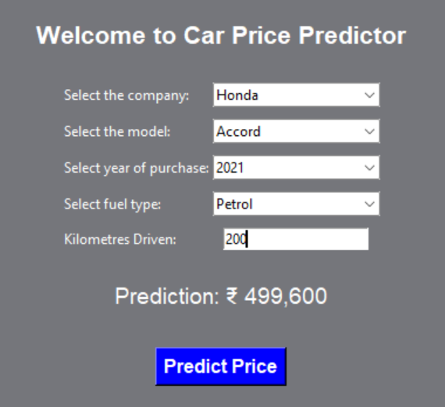
Result
After running 1000 iterations with different random_state values, the best performing Linear Regression model was selected.
The optimal random_state was 302, where the model achieved:
R² Score: 0.89
This indicates that the model explains 89% of the variance in car prices based on the input features.
Example Prediction: For a Honda accord (2021, 200 km, Petrol) ➤ Predicted Price: ₹ 4,99,600

Slide 8
Conclusion
A working Car Price Prediction System was developed using Python, Linear Regression, and Tkinter for GUI.
The model achieved a high accuracy with an R² score of 0.89, making it reliable for estimating second-hand car prices.
The GUI allows users to easily input vehicle data and get instant predictions, making it practical for general users or car resellers.
The approach used a well-structured ML pipeline with preprocessing and transformation included, improving model reliability.
The project lays the foundation for future upgrades using more advanced models (like Random Forest or XGBoost) and web deployment for wider access.

Slide 9
References
Project Guide:
https://youtu.be/iRCaMnR_bpA?si=j2p3uDeU-2S1Yalr
GitHub Link: https://github.com/Bhumika1808/Car-Price_Prediction

Slide 10
Thank you

