Slide 1
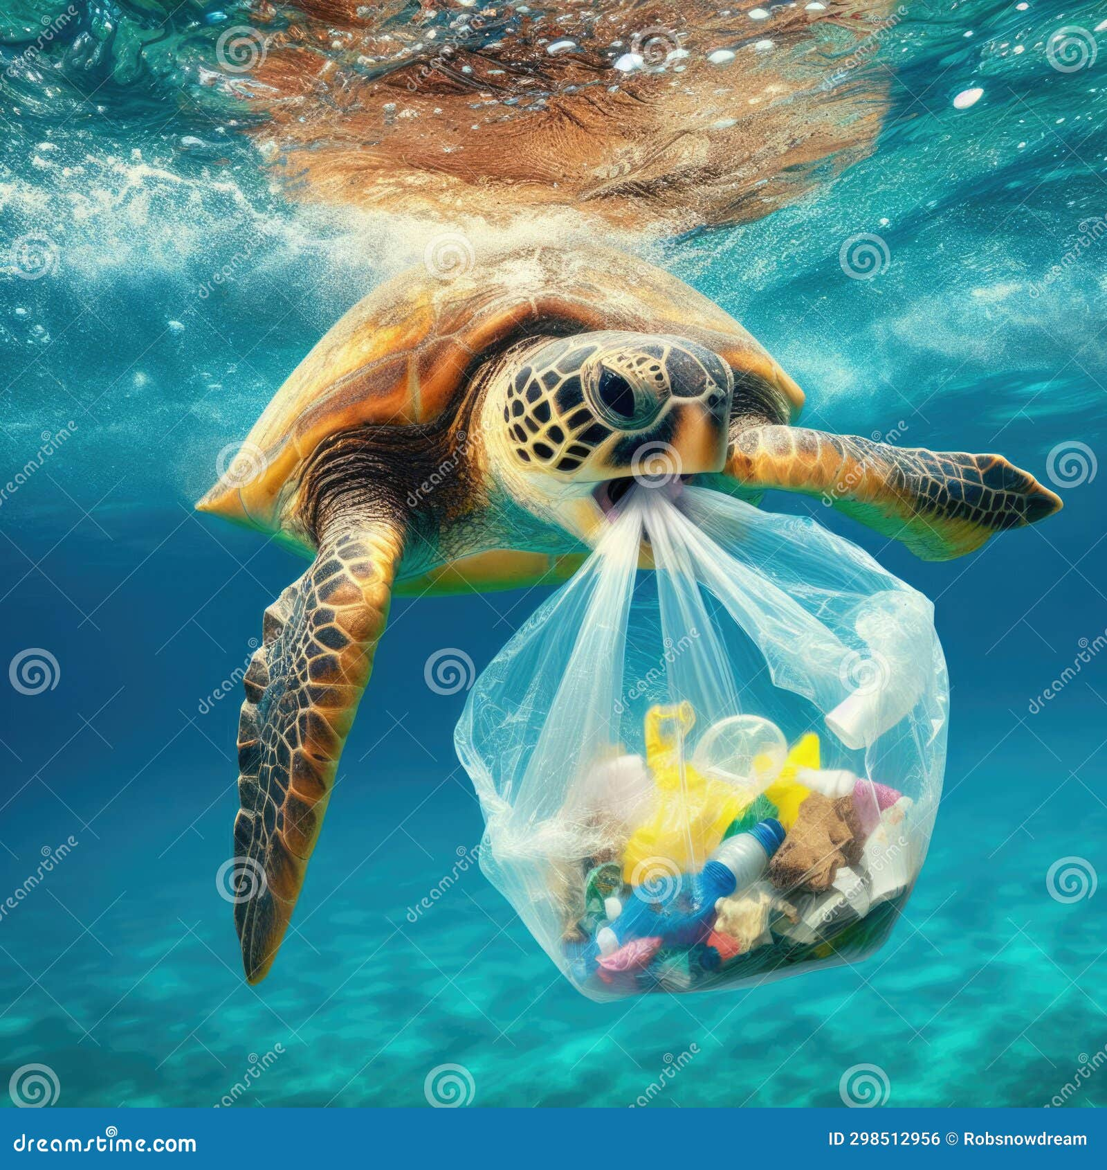
TEAM DETAILS
TEAM NAME : Gang Of Geeks
TEAM MEMBERS : Bhumika K N
Chethana Shree G
Asheeka H N
Bhavana M S
TITLE OF THE PROJECT: “AI-Powered Satellite Monitoring and
Rescue Network for Marine Pollution and Wildlife Protection”

Slide 2
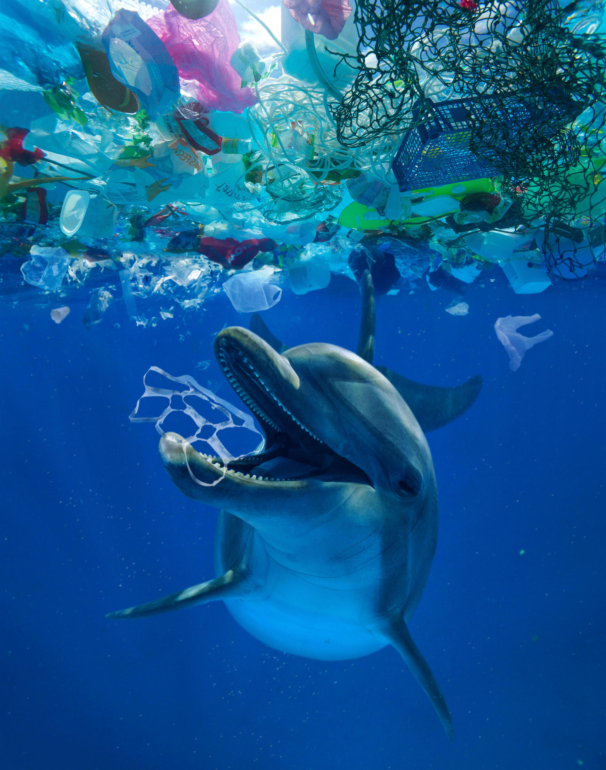
BREIF ABOUT THE IDEA
Describe the problem:
Develop an app that uses satellite imagery and AI to detect and track marine pollution,
Such as oil spills and plastic waste and connects volunteers and professionals for rescuing and rehabilitating injured marine animals
Outline the solution :
The solution leverages satellite imagery and AI to detect and track marine pollution, such as oil spills and plastic waste, in real time. Satellite data is processed through AI models to identify and assess pollution hotspots, providing timely alerts. The app also features a collaboration platform that connects volunteers, environmental professionals, and local authorities to respond to pollution incidents and rescue injured marine animals. It integrates mapping tools, wildlife rescue coordination, and educational resources to facilitate pollution cleanup efforts and animal rehabilitation, ensuring a comprehensive approach to marine conservation.

Slide 3
PROBLEMS OUR PROJECT AIMS TO SOLVE
Delayed Detection and Response to Marine Pollution: The app's real-time satellite monitoring and AI analysis provide
early detection, enabling faster response to minimize the impact on marine ecosystems.
Inadequate Coordination for Wildlife Rescue: Injured marine animals often suffer due to a lack of proper coordination
between volunteers, rescuers, and professionals.
Limited Public Engagement in Pollution Cleanup Efforts: By facilitating collaboration between local communities,
volunteers, and experts, the app empowers individuals to take part in cleanup and conservation initiatives, fostering
a more sustainable approach to marine protection.
SIGNIFICANCE
Enhanced Environmental Protection
Improved Wildlife Conservation
Public Engagement and Awareness
Data-Driven Decision Making

Slide 4
HOW DIFFERENT IS THIS FROM ANY OTHER EXISTING
IDEAS:
Comprehensive Approach Combining Pollution Detection and Wildlife Rescue: Unlike many existing solutions that
focus solely on detecting pollution or rescuing marine animals, this app integrates both functions.
AI-Driven Analysis for Precise Detection: While some solutions use satellite imagery for monitoring, this app
leverages advanced AI to accurately detect and differentiate between various types of marine pollution
Empowering Communities and Individuals: This app empowers local communities and individuals to actively
participate in both pollution cleanup and wildlife protection, democratizing marine conservation and fostering
greater public engagement.

Slide 5
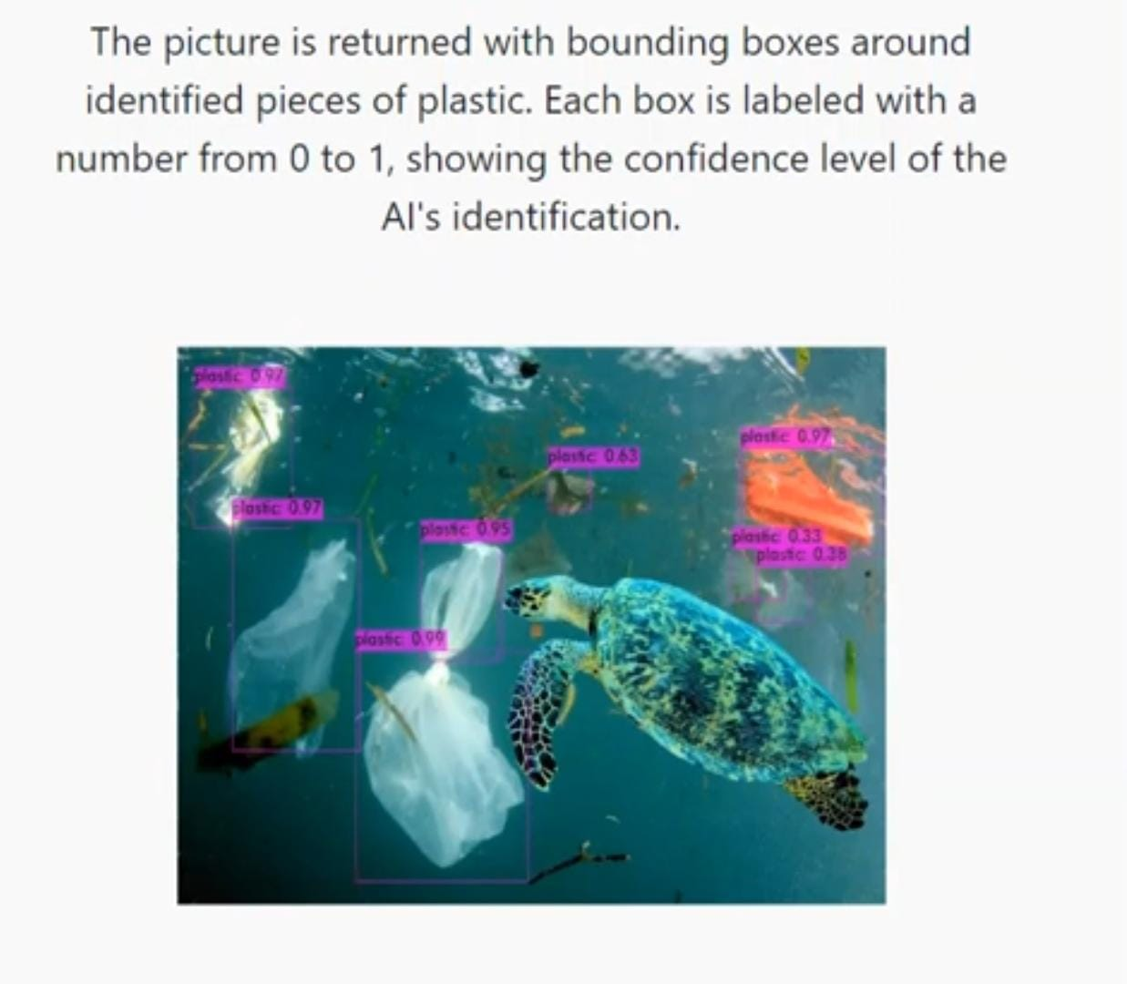
KEY FEATURES:
Satellite Imagery Integration: * Real-time Monitoring
* Pollution Detection Algorithms
* Historical Data
AI-Powered Pollution Tracking:* Oil Spill and Waste Identification
* Movement Prediction
Marine Animal Detection and Alerts:* Injured Animal Detection
* Location Tracking
Volunteer and Professional Network:* Rescue Coordination
* Location-Based Matching
* Skillset Filtering

Slide 6
Technologies to be used in the solution
Satellite Imagery and Data Processing
Sentinel Hub: Provides access to Sentinel-1, Sentinel-2, and Sentinel-3 satellite data.
Planet Labs: Offers high-resolution imagery from their satellite constellation.
AI and Machine Learning
TensorFlow: Popular open-source library for building and training machine learning models.
PyTorch: Another open-source machine learning library known for its flexibility and ease of use.
OpenCV: Library for computer vision tasks, including image processing and object detection.
Backend Development
Node.js: JavaScript runtime for building scalable network applications.
Django (Python): High-level Python web framework for rapid development.
Flask (Python): Lightweight Python web framework for simpler applications.
Development Tools
Visual Studio Code: Popular code editor with extensive support for various programming
languages and extensions.
PyCharm: IDE for Python development.
IntelliJ IDEA: IDE for Java and other languages.

Slide 7
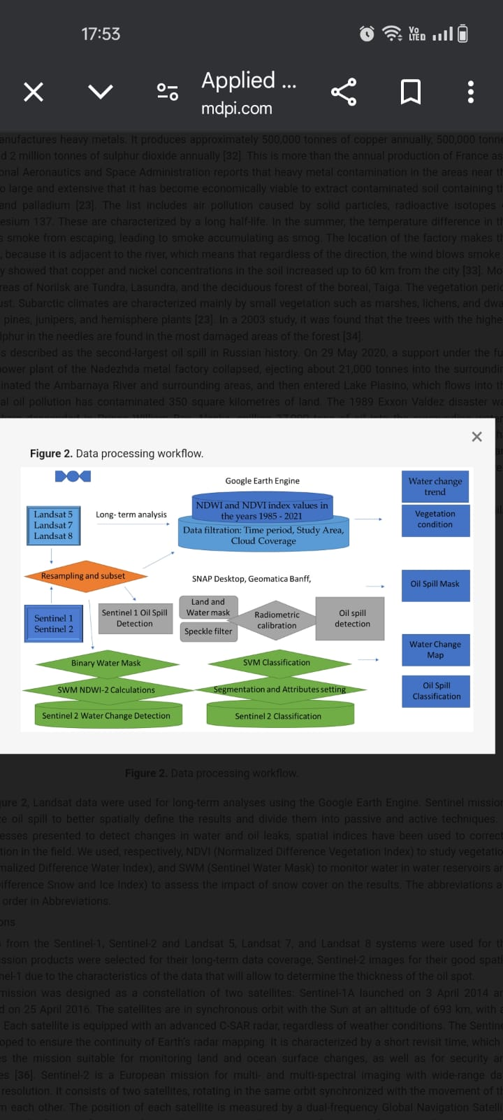
Architecture diagram of the proposed solution

Slide 8
Team Members Details
Team Member 2
Team Member1
Name :Bhumika K N
College :Reva University
Email :bhumireddy2004@gmail.com
Name : Chethana Shree G
College : Reva University
Email:chetanashree200@gmail.com
Team Member 3
Team Member 4
Name : Asheeka H N
College : Reva University
Email : asheekahn333@gmail.com
Name : Bhavana M S
College : Reva University
Email:bhavana141116@gmail.com

Slide 9


