Slide 1

Project Title -Seasonal Agriculture Performance Analysis
Student Name: Bhumika Bindagi
College Name: RNS Institute of Technology
AICTE STU ID : STU6a69ae0d88fc91785310733

Slide 2

PROBLEM STATEMENT
Agricultural activities are influenced by seasonal variations in environmental conditions,
farming practices, resource availability and market conditions. As a result, agricultural
performance may differ from one season to another.
However, raw agricultural data does not clearly explain how agricultural performance changes
across seasons or what patterns can be observed in different seasonal conditions.
The problem is to analyze the given agricultural dataset and investigate seasonal differences
in agricultural performance by identifying meaningful patterns, trends, relationships and
variations within the available data.

Slide 3
Project Description
This project compares and contrasts agricultural data from the three seasons of Kharif, Rabi and Zaid to determine agricultural productivity gaps, resource use, environmental factors and economic performance. The analysis includes data exploration, preprocessing, statistical analysis and visualization for comparing the seasonal patterns of crop and region. Factors like yield, production, water use, water-use efficiency, disease/pest risks, revenue, cost and profit are analyzed to find significant differences and unusual patterns. The results offer evidence-based information to inform season-specific agricultural planning, resource management, crop selection, and regional decision making.

Slide 4

WHO ARE THE END USERS?
Farmers & Farm Managers — for season-wise crop and resource planning
Agricultural Planners — for data-driven seasonal planning and decision-making
Agricultural Researchers — to study seasonal, crop, and regional patterns
Agricultural Extension Officers — to provide evidence-based recommendations to farmers
Government & Policy Makers — for resource allocation and agricultural policy planning
Agri-businesses & Cooperatives — to support crop selection and profitability decisions

Slide 5

Technology Used
Python — Core programming and data analysis
Pandas & NumPy — Data cleaning, preprocessing, and numerical analysis
Matplotlib & Seaborn — Data visualization and seasonal comparisons
SciPy — Statistical analysis and Kruskal–Wallis testing
Google Colab — Analysis and documentation environment
CSV Dataset — Source format for agricultural performance data

Slide 6
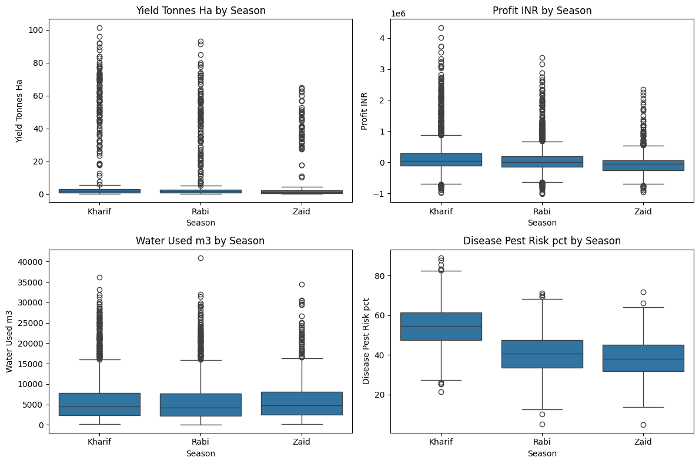
RESULTS-Seasonal Performance Comparison
Yield: Kharif highest; Zaid lowest.
Profit: Kharif highest; Zaid negative.
Water: Zaid uses the most.
Risk: Kharif has highest pest risk.

Slide 7
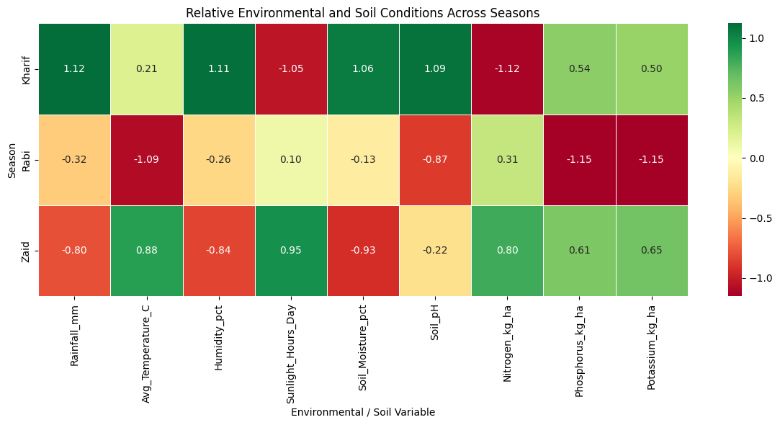
RESULTS-Environmental & Soil Conditions
Rainfall: Highest in Kharif.
Temperature: Highest in Zaid.
Humidity: Highest in Kharif.
Soil moisture: Highest in Kharif.
Sunlight: Highest in Zaid.
Nutrients: Mostly stable across seasons.

Slide 8
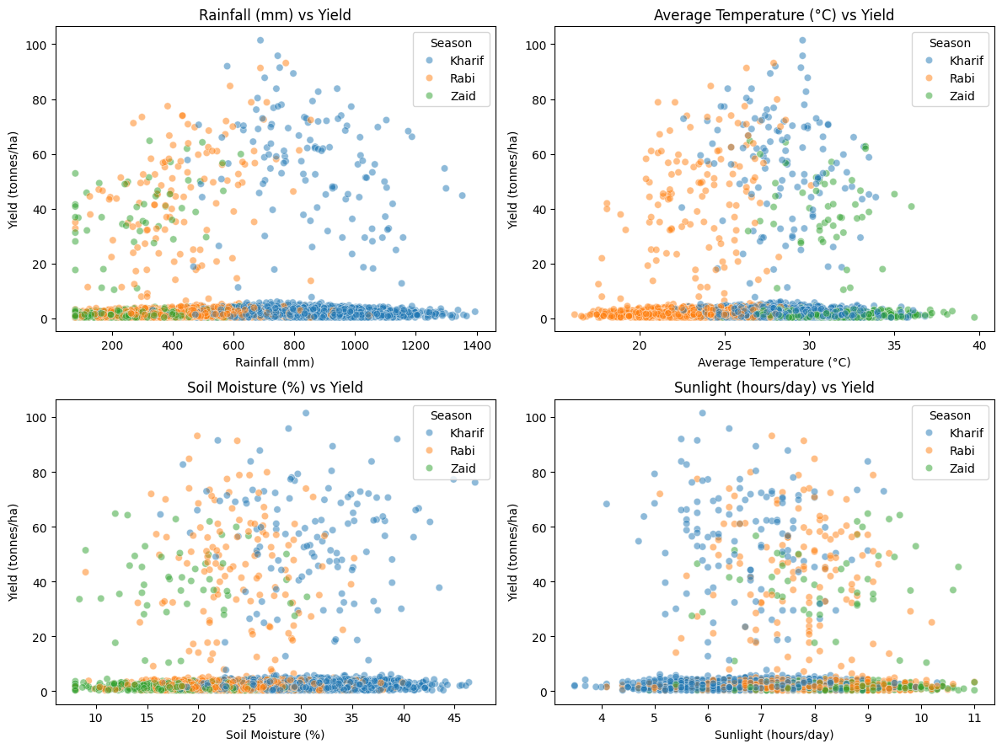
RESULTS-Environmental Factors vs Yield
Rainfall: Very weak relationship with yield.
Temperature: Very weak relationship with yield.
Soil moisture: No meaningful linear relationship.
Sunlight: Very weak relationship with yield.

Slide 9
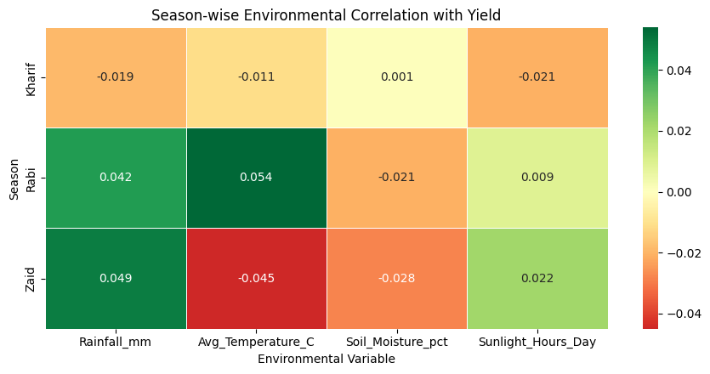
RESULTS-Season-wise Environmental Correlation
Kharif: Negligible correlations with yield.
Rabi: Very weak correlations with yield.
Zaid: Very weak correlations with yield.
Overall: Environment alone does not explain yield variation.

Slide 10
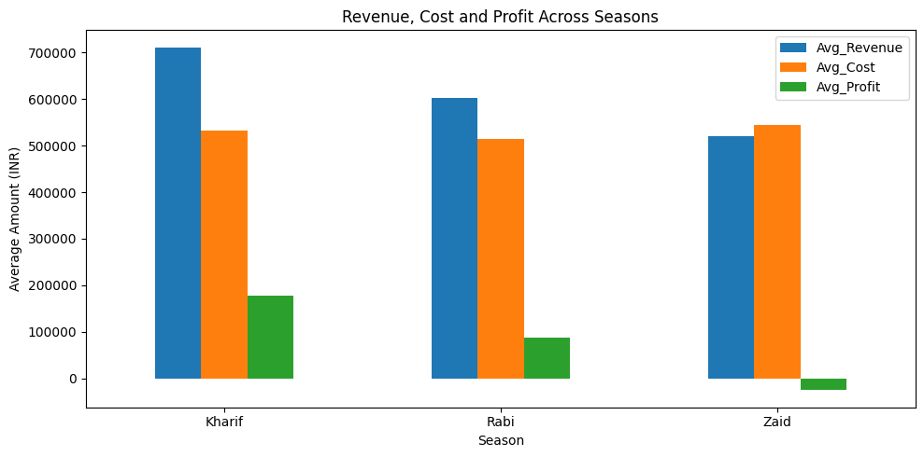
RESULTS-Economic Performance Across Seasons
Revenue: Highest in Kharif.
Cost: Highest in Zaid.
Profit: Kharif highest; Zaid negative.
Overall: Kharif is most profitable.

Slide 11
Future scope
Predictive Modeling — Predict season yield and profitability.
Crop Recommendation — Recommend crops for each area and time of year.
Real-time data — Connect real-time weather and soil data.
Smart Resource Planning — Optimize water, fertilizer and pesticide use.
Early Risk Detection - Forecast disease and pest risks.
DSS — Build farmer-friendly dashboard for actionable insights.

Slide 12
GitHub Link
🔗 View Project on GitHub
https://github.com/BhumikaBindagi06/seasonal-agriculture-performance-analysis.git

Slide 13
VOIS Course completion certificate - Course name- Data Visualization

Slide 14
Thank you
.
.

