Slide 1
American Express.
Business Review — June 2026

Slide 2
Agenda

Slide 3
Dedicated Partnership Team

Slide 5
Mutual Value Plan Summary

Slide 6
Key Metrics
TOTAL ACCOUNT ARR
$0
No telemetry found
NEXT RENEWAL ACV
$0
Upcoming Target
TOTAL OPP VALUE
$0
Active Pipeline
FORECAST ACV
$0
Forecasted Value
PRODUCT FOOTPRINT
None
Categorization
DATA STATUS
Verified
Refreshed from BigQuery

Slide 7
CASB Overview

Slide 8
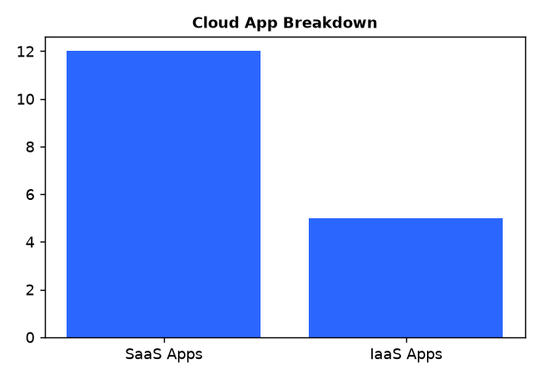
CASB Adoption Analytics

Slide 9
Slide 9: Security Adoption Heatmap

Slide 10
Slide 10: Security Adoption Heatmap

Slide 11
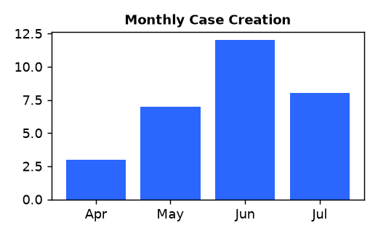

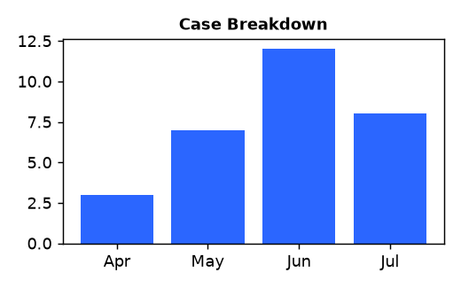

Support Health

Slide 12
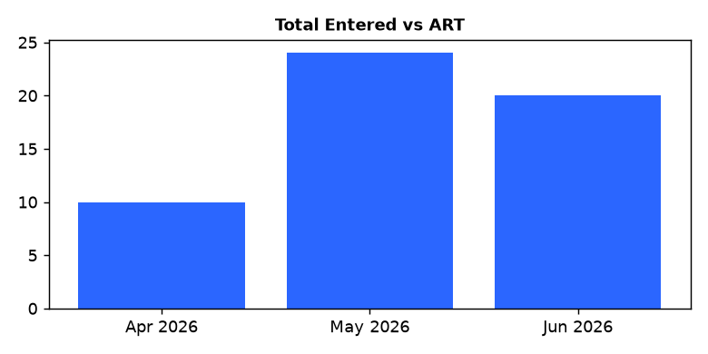
Support Engagement

