Slide 1
Quarterly Business Review
Majid Al Futtaim Management Services Llc
Prepared by CS Team | June 2026

Slide 2
Agenda
• Team Introduction
• Executive Summary
◦ Mutual Value Plan Summary
◦ Services & Engagement
◦ Voice of Customer
◦ Next Steps
• Operational Metrics
◦ Support Engagement
◦ Adoption Map
◦ Shadow Summary
• What's Next?
◦ Why DSPM?

Slide 3
Dedicated Partnership Team
Divya Singh
Customer Success Manager
Technical Specialist
CS Consultant / Architect
Account Executive
Commercial Manager
Support Engineer
Lead Technical Support

Slide 4
Executive Summary

Slide 5
Mutual Value Plan Summary
Goal / Objective | Value Delivered & Progress | Status
Shadow IT Visibility | Configured risk rules and audited 100+ cloud services. | Completed
CASB User Onboarding | Scaled active user base to targets across Q2. | In Progress
DLP Policy Enforcement | Enforced policy checks across core tenant instances. | On Track

Slide 6
Key Operational Metrics
USERS PROTECTED
25,000
SSE Advanced
RENEWAL ACV TARGET
$300,200
ARR Optimization
PIPELINE ACV VALUE
$3,267,169
Growth Opportunities
PRODUCT FOOTPRINT
Both (CASB + SWG)
Active Entitlements
ACTIVE POLICIES
2,113
DLP Protection
CONFIGURED AUDIT RULES
110
Health Audit Passed

Slide 7
CASB Adoption KPIs & Summary
TOTAL ACCOUNT ARR
$1,261,061
ACTIVE USERS
28,000
112.0% Active
LICENSED USERS
25,000
ACTIVE APPS (EXCL MS)
9
Account Name | Active Users | Licensed Users | User Adoption Tier | CASB Feature Tier
Majid Al Futtaim Management Services Llc | 28,000 | 25,000 | High | High

Slide 8
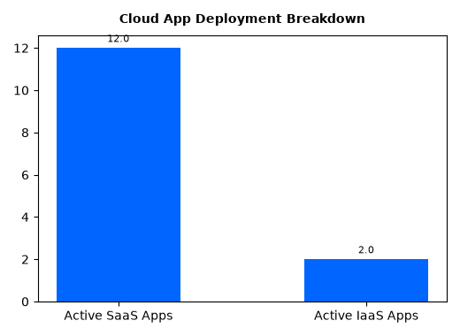
CASB Cloud Tenant & Feature Deployment Analytics
Tenant Name | Environment | SaaS Active | IaaS Active
MAJID AL FUTTAIM MANAGEMENT SERVICE S LLC | usprod | 12 | 2

Slide 9
Product Adoption Map — Part 1

Slide 10
Product Adoption Map — Part 2

Slide 11
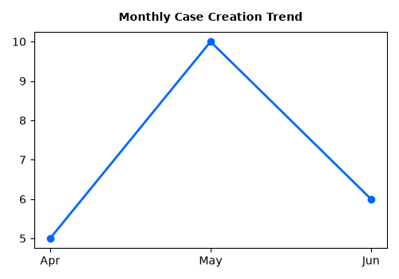
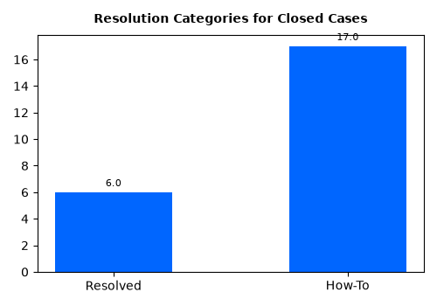
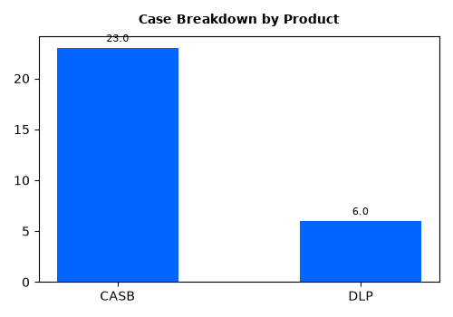
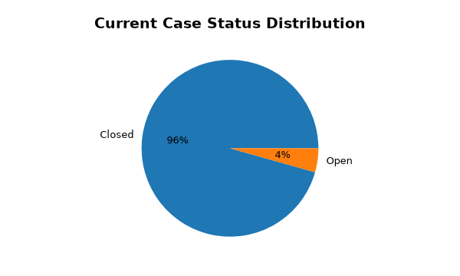
Support Health
Health Trend: Case creation peaked in April 2026 with 17 cases but has since stabilized. Currently, about 64% of cases are resolved, while a small portion remains 'With Engineering' or 'Work in Progress,' indicating a healthy throughput.
Key Patterns and Themes
An analysis of the case summaries reveals recurring themes related to user access and identity management. Key terms frequently appearing include:
• Users/User: Mentioned in 14 cases
• Login/Access: Mentioned in 11 cases
• Tenant/Portal: Mentioned in 9 cases
• Certificate: Mentioned in 3 cases

Slide 12
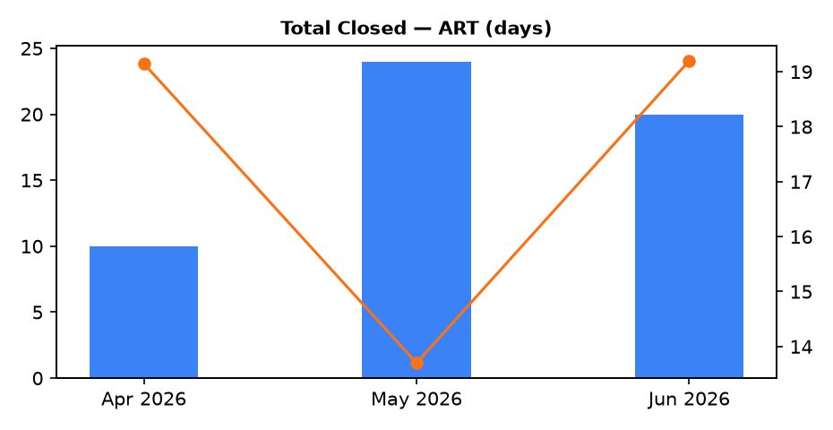
Support Engagement
• Case Volume:
1. 54 new cases entered, with 51 cases closed.
2. Entered incident volume remained stable.
• Resolution Times:
1. Average Resolution Time (ART): 17 days.
• Case Severity:
High-severity incidents dropped significantly.
Month | Total Entered | Total Closed | ART
Apr 2026 | 10 | 12 | 19.1
May 2026 | 24 | 16 | 13.7
Jun 2026 | 20 | 23 | 19.2

Slide 13
What's Next

Slide 14
Thank you!

