Slide 1

SAMSUNG PRISM
Generative AI
Hackathon
3rd Edition 2026 – 27
Theme ID -02
Team Name -Team Noir
College Name -SRM Institute of Science and Technology Kattankulathur
Member Name & Email 1- Bhumika Rajput(br7758@srmist.edu.in)
Member Name & Email 2-Hardik Upadhyay(hu2490@srmist.edu.in)
Member Name & Email 3- Divyanshi Shishodia(ds9340@srmist.edu.in)
Submission Github link - https://github.com/BhumikaRajput28/FixPath-Smart-Troubleshooting

Slide 2

Theme
Key Objectives
● Problem Statement
Smartphone users often describe technical issues in informal, vague language, making it difficult for support systems to identify and resolve problems efficiently.
Query Understanding
Convert informal complaints into structured technical queries.
01
Automated Troubleshooting
Extract relevant actions and organize them into clear steps.
02
★ Our Solution: FixPath
An automated troubleshooting engine that transforms vague Galaxy device complaints into structured, validated, and actionable troubleshooting plans.
Deeplink Integration
Provide verified, one-tap navigation to device settings.
03
Safe Action Sequencing
Prioritize non-disruptive steps before critical operations.
Expected Outcome
Reduce manual troubleshooting effort and simplify device issue resolution through accurate, accessible, and actionable guidance.
04
Fast Responses
Deliver cached troubleshooting plans in under 300 ms.
05

Slide 3
Existing Solutions & Gaps
THE GAP: Users need more than raw information — they need a validated path from “Something is wrong” → “Here is exactly what to do next.”
FixPath bridges this gap by combining Natural-Language Understanding, Grounded Troubleshooting, Verified Deeplinks, and Safe Action Sequencing.
Current Limitations in Existing Solutions
Experience Comparison
Search Engines
Returns many unrelated results; user must identify the correct solution manually.
Traditional Support Flow
EXAMPLE COMPLAINT:
“My phone screen suddenly went completely black.”
Search → Articles → Read → Find Section → Manual Settings
Samsung Support Articles
Information is reliable but can be lengthy and difficult to follow during an active issue.
Generic AI Assistants
Can provide useful explanations but may generate unsupported or hallucinated steps.
★ FixPath Streamlined Path
ACTIONABLE RESOLUTION:
Direct, validated diagnosis and guided step execution
Complaint → Understand → Diagnose → Guided Actions → Result
Manual Device Navigation
Users must search through multiple complex settings menus on their own.
Traditional Troubleshooting
Often presents rigid steps without adapting to the user's specific context or complaint.

Slide 4
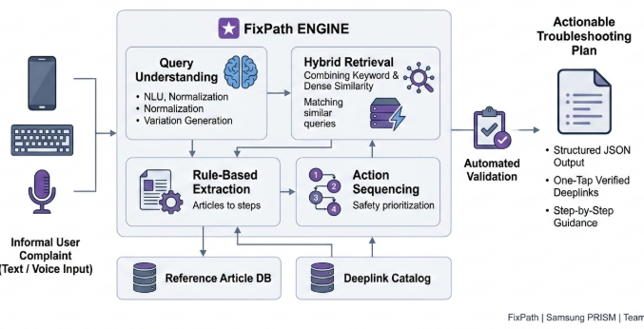
Our Solutions & Architecture Diagram
Core Pipeline
01
Input
User describes the problem using text or voice.
02
Understanding
The complaint is normalized into a structured technical query.
03
Retrieval
Hybrid retrieval identifies relevant reference info & actions.
04
Planning
Instructions are converted into an ordered troubleshooting plan.
05
Validation
Output is checked against predefined schema & deeplinks.
Guidance
User receives safe, step-by-step troubleshooting instructions.
Reference-grounded • Validated • Deterministic • Fast
This is consistent with your existing architecture/technical description, including hybrid retrieval, semantic caching, rule-based extraction and validation.
06

Slide 5
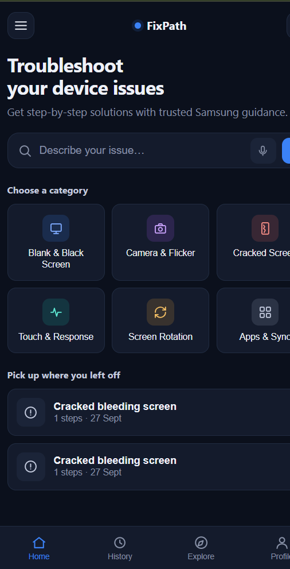
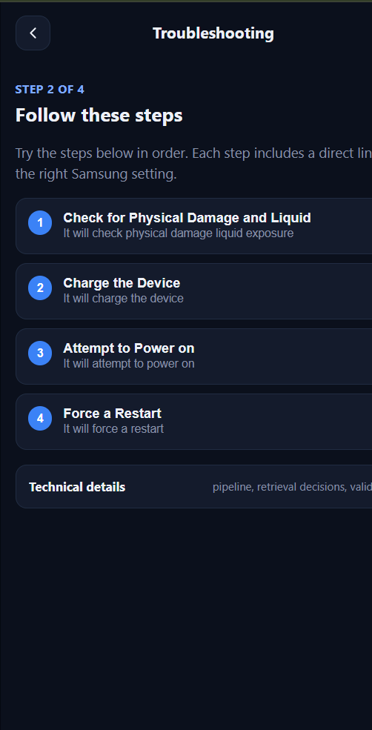
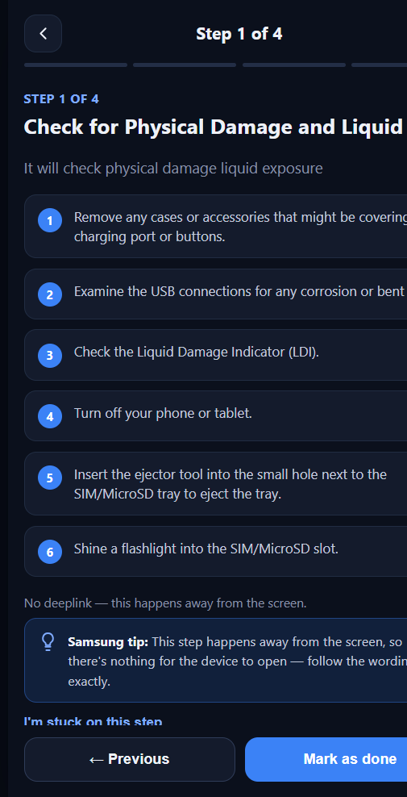
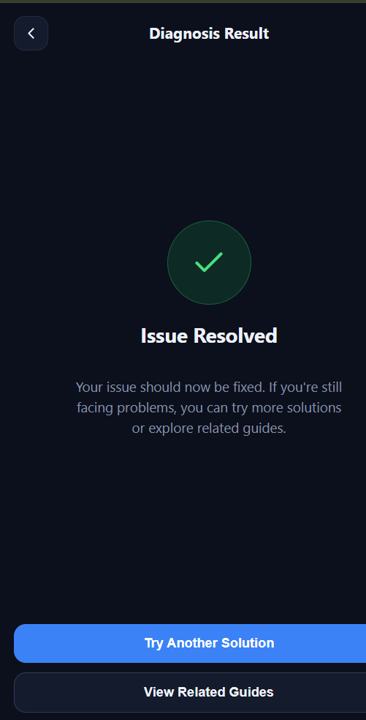
Demo & Product Walkthrough
DEMO SCENARIO: Blank / Black Screen Resolution —“My Samsung phone screen is completely black.”
01
Describe the Issue
User enters: "My Samsung phone screen is completely black."
02
Issue Understanding
Identifies display fault & presents underlying causes.
03
Troubleshooting Plan
Generates 4 safe steps: Damage, Charge, Power, Restart.
04
Guided Execution
Step-by-step instructions, Samsung guidance & deeplinks.
1. Home
2. Troubleshooting
3. Step Execution
4. Issue Resolution
05
Resolution & Next Steps
Issue Resolved. Options to explore related guides or history.
Recommended Sequence: Home → Diagnose → Follow Steps → Guided Actions → Resolution
★ Instant Understanding & Guided Execution
Converts complex support documentation into an interactive, step-by-step diagnostic workflow in seconds.

Slide 6

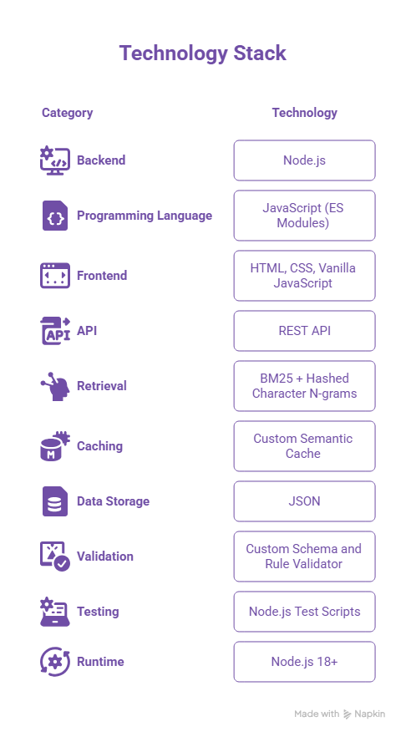
Tools and tech stack used
Key Technical Components
Node.js HTTP Server
Handles API requests and serves the web interface.
Hybrid Retrieval
Combines keyword-based and dense similarity signals.
Semantic Cache
Supports exact, variation-based, and fuzzy query matching.
Rule-Based Extraction
Converts reference articles into structured troubleshooting plans.
Automated Validation
Ensures output compliance before returning results.
Deployment
Zero npm dependencies and no external API keys required.

Slide 7
Impact & Use case
POTENTIAL IMPACT
CURRENT LIMITATIONS
Catalog Dependency:Deeplink coverage is strictly limited to available catalog items.
Single Intent Focus:Complex multi-intent complaints are not yet fully supported.
Software Variations:Device settings hierarchies differ across OS versions & models.
Quality Grounding:Troubleshooting quality relies heavily on underlying source documentation.
01. Improved User Experience
Converts lengthy support articles into structured, easy-to-follow troubleshooting steps. Simplifies navigation and helps users resolve device issues independently.
02. Reliable Troubleshooting
Uses reference articles as the primary source of troubleshooting instructions. Prevents unsupported instructions through structured extraction and validation.
03. Faster Responses
Uses semantic caching to retrieve previously generated troubleshooting plans. Eliminates external model inference during request processing.
04. Safer Navigation
Uses only deeplinks available in supplied catalog. Avoids incorrect settings navigation through accurate screen-level matching and prioritizes less disruptive actions.
INNOVATION HIGHLIGHTS
Natural Language & Voice Input — Users can describe or speak complaints naturally.
Semantic Matching & Grounding — Maps similar complaints to grounded reference steps.
Screen-Level Deeplinks — Connects directly to exact device setting screens.
Safe Action Sequencing — Prioritizes non-disruptive steps before critical operations.
Validated Outputs & Caching — Reuses validated plans and prevents broken links.

Slide 8
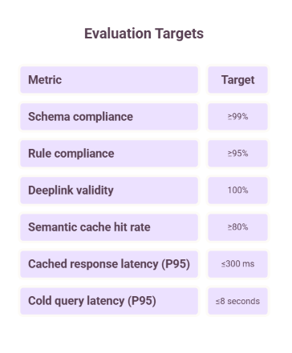
Innovation highlights, results and limitations
Innovation Highlights
Semantic Query Matching: Recognizes different phrasings of the same complaint.
Hybrid Retrieval: Combines BM25 and semantic similarity for deeplink mapping.
Action Sequencing: Prioritizes less disruptive actions.
Catalog Integrity: Prevents fabricated or modified deeplinks.
Fast-Path Caching: Avoids repeated processing for matching queries.
Voice Assistant Integration: Enables spoken complaint processing and generates relevant troubleshooting steps.
Limitations
Incomplete deeplink catalog coverage.
Unhandled multi-intent complaints.
Variations in device settings hierarchies.
Dependence on the quality of reference articles.

Slide 9
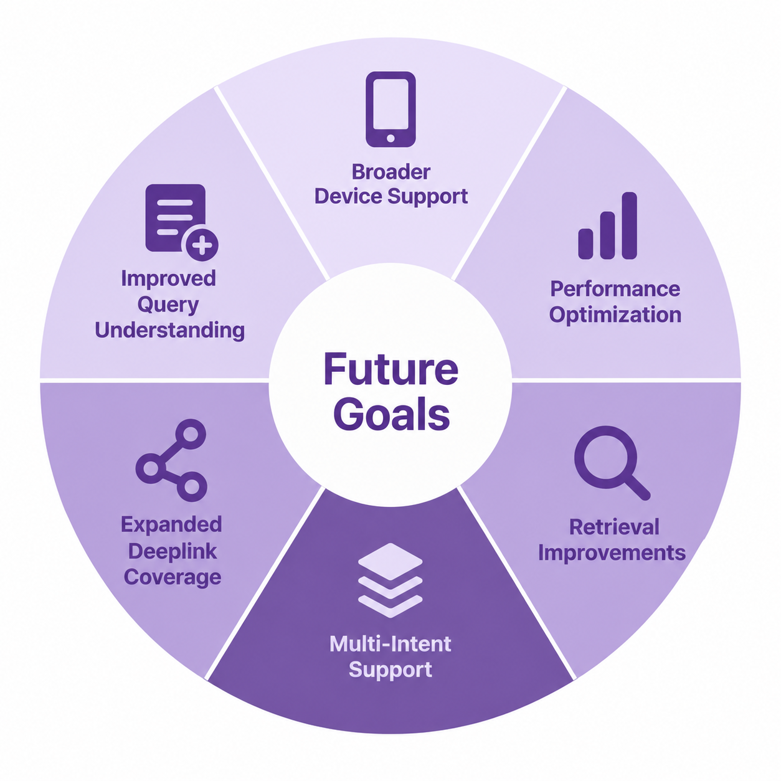
What’s next?
1. Improved Query Understanding
Enhance the interpretation of ambiguous and informal user complaints.
Generate diverse query variations to improve matching accuracy.
2. Expanded Deeplink Coverage
Extend deeplink catalog for wider device settings and troubleshooting.
Improve screen-level matching for accurate navigation.
3. Multi-Intent Support
Identify and process multiple issues within a single complaint.
Generate separate, structured plans for each identified issue.
4. Retrieval Improvements
Enhance semantic and keyword retrieval matching accuracy.
Minimize incorrect parent-menu matches for relevant screens.
5. Performance Optimization
Improve semantic caching efficiency for faster responses.
Optimize cold-query processing to reduce latency.
6. Broader Device Support
Extend troubleshooting capabilities to wider device models.
Adapt instructions and deeplinks across software versions.

Slide 10
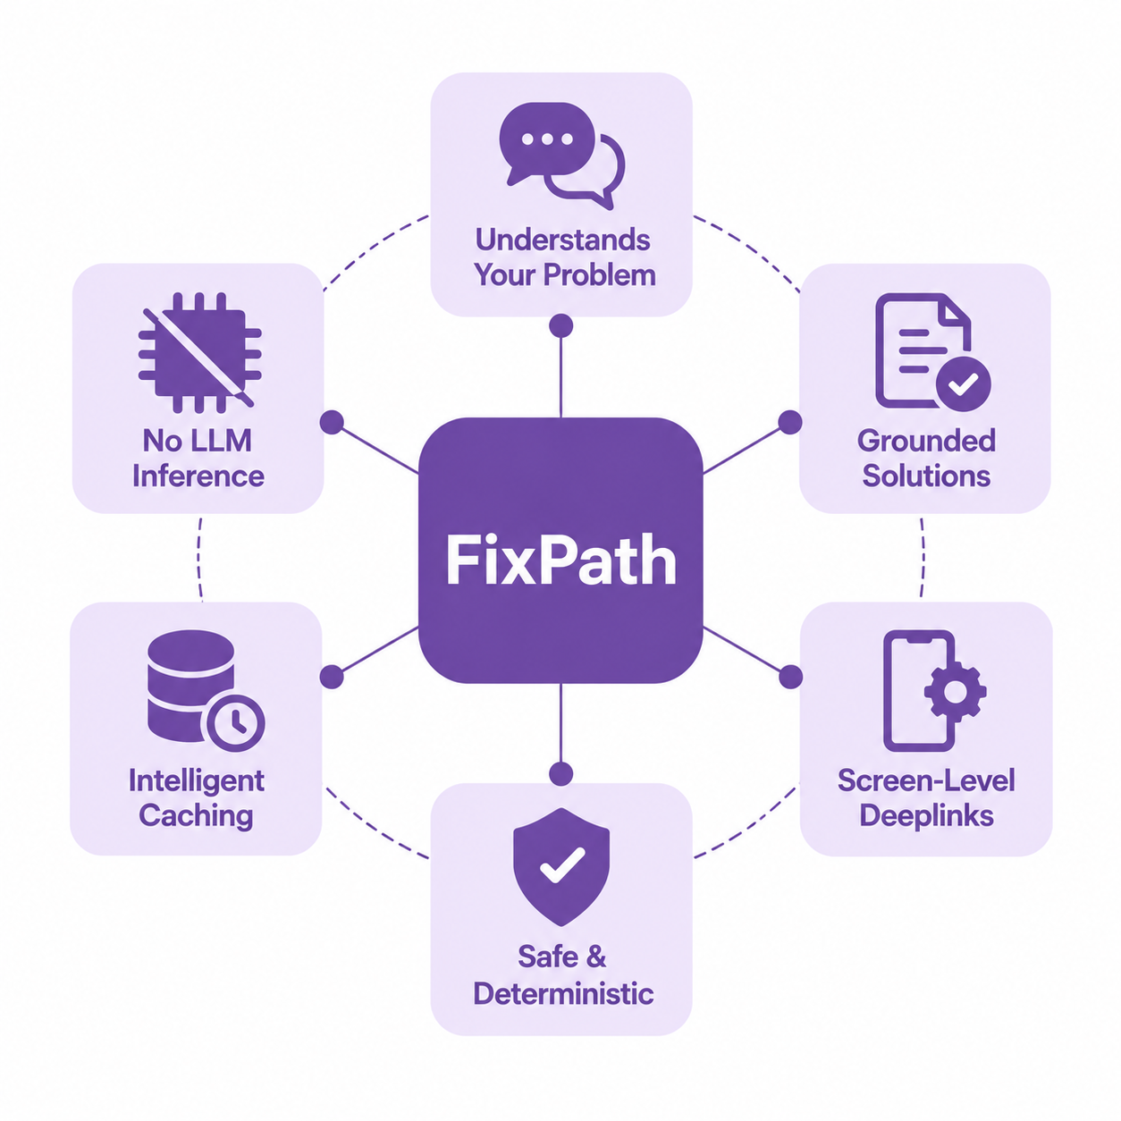
Brownie points slide( differentiation)
What Makes FixPath Different?
Semantic Understanding
Interprets informal complaints using query normalization and multiple variations instead of relying on exact keyword matches.
Grounded Troubleshooting
Extracts instructions from reference articles rather than generating potentially unsupported solutions.
Screen-Level Deeplinks
Maps individual troubleshooting actions to specific settings screens instead of providing general navigation instructions.
Safety-First Sequencing
Prioritizes less disruptive actions and places critical operations, such as factory resets, last.
Strict Output Validation
Enforces a predefined JSON schema and prevents fabricated or modified URLs.
Intelligent Semantic Caching
Recognizes similar queries and retrieves previously validated plans instead of repeatedly processing them.
Deterministic Responses
Produces consistent, structured outputs rather than relying on probabilistic text generation.
Zero LLM Inference
Eliminates external LLM inference during request processing, reducing dependency on model availability and costs.

Slide 11
Checklist - Updated on Public GitHub
Working Prototype Code
Hosted on a public or shared GitHub repository
Status: Y
README Documentation
Includes reproducible setup and installation instructions
Status: Y
Demo Video
Max 5 minutes length (YouTube or Google Drive link)
Link Provided
Presentation File
Final presentation deliverable in PPT or PDF format
Status: Y

Slide 12

Thank You
FixPath
From “Something is wrong” to “Here’s what to do next.”
Guided Grounded Safe Actionable
Organised by the Language AI Team and the PRISM Team, Samsung R&D Institute India
Notes:
Closing slide. Add the Google Form URL and a contact email before sharing. Edition 2 organising team for reference: Language AI - Sourabh Tiwari, Gaurav, Sanjeeth Pothireddy, Gorang Maniar; PRISM - Binny Lakra, Prakhar Chandrakar, Vishu Kumar; Kick-off and mentors - Giridhar Jakki, Deepraj Prabhakar Patkar (Language AI), Srimanu Prasad Nagaraju, Ashish Kumar (Tech Strategy).

