Slide 1
AUTOMATED TESTING FRAMEWORK
EventSphere Quality Assurance Report
A master compile of Cypress E2E, Selenium Webdriver, and Selenium IDE verification steps

Slide 2
PLATFORM OVERVIEW
Testing Agenda & Methodologies
We have implemented three independent, automated testing layers to guarantee absolute stability, responsiveness, and performance of the EventSphere premium event management portal:
• Section 1: Selenium IDE Automated Tests - Visual codeless browser session recordings.
• Section 2: Selenium Webdriver Node.js Execution - Programmatic terminal-driven Chrome automation.
• Section 3: Cypress E2E Testing Suite - Complete client-side application specs, form submission, and route validation.
• Visual Verification Pages - Step-by-step screenshots tracking exact elements, DOM selectors, assertions, and console logs.

Slide 3
SECTION 01
Selenium IDE Automated Tests
Visual browser automation, codeless script recorders, and element verification playbacks

Slide 4
SECTION 1: SELENIUM IDE
Codeless Visual Testing & Recording
Selenium IDE provides a rapid prototype automation layer by recording human actions in Chrome and generating assertions without writing code. It is utilized for sanity testing critical user flows instantly when migrating codebases.
• Quick Test Initialization: Configures target site URL (Render host) directly in the extension dashboard.
• Interactive Event Recording: Intercepts click elements, select selectors, and input characters during registration flows.
• Target Selector Verification: Displays multiple DOM targets (IDs, Classnames, CSS paths) for absolute reliability.
• Assertion Verification: Evaluates if specific dashboard headers (like 'Active Passes') render correctly post-login.
• Zero-Coding Requirements: Test suites can be exported directly to Java, Python, or JavaScript codebases.

Slide 5
SECTION 02
Selenium Webdriver Terminal Scripts
Programmatic Node.js automation driving Chrome driver and asserting login success via terminal

Slide 6
SECTION 2: SELENIUM WEBDRIVER
Node.js Programmatic Browser Automation
Our Selenium WebDriver script runs inside Node.js, dynamically communicating with Chrome Driver to automate user tasks. It is executed via command-line and integrated into standard CI/CD deployment pipelines.
• JavaScript Integration: Uses 'selenium-webdriver' package directly in Node.js to configure Chrome browser sessions.
• Automated Input & Navigation: Instructs Chrome to open the login page, locate email/password inputs, and enter credentials.
• Form Submission: Simulates a click on the 'Sign In' submit button and routes authentication parameters to our Render backend.
• Dynamic Assertions: Waits for the URL to change to '/dashboard' to confirm the login workflow connected successfully.
• Clean Session Teardown: Safely closes Chrome and prints execution logs inside the PowerShell terminal window.

Slide 7
SECTION 03
Cypress End-to-End Suite
Complete client-side specs covering Homepage layout, About details, Contact form feedback, and Dashboard portals

Slide 8
SECTION 3: CYPRESS E2E
Cypress Client-Side Framework
Cypress runs directly inside the browser environment, offering blazing fast spec execution, automatic waiting, and built-in screenshot debuggers. It forms the core testing layer of EventSphere.
• Homepage Check: Verifies luxury brand header ('EVENTSPHERE') and navigation links exist and are fully interactive.
• About Page Verification: Visits '/about' and asserts that core text paragraphs load successfully.
• Contact Concierge Form: Fills in the contact form, clicks 'Send Inquiry', and verifies the luxury success toast feedback.
• Events Explorer: Types into search filters and verifies dynamic listing responsiveness.
• Redux Store & Router Checks: Logs in and navigates dashboard tabs (My Tickets, Wishlist, Settings) to verify client routes.

Slide 9
SUMMARY
Automated Testing Tools Comparison
Selenium IDE • Codeless recorder • Best for rapid sanity prototypes • Fast configurations • Requires browser extension
Selenium WebDriver • Code-based (Node.js) • Best for CI/CD integration • Runs headless in shell • Excellent cross-browser support
Cypress E2E • Direct browser architecture • Super fast execution times • Built-in time travel & debugging • Comprehensive UI/UX tests

Slide 10
QUALITY ASSURANCE SUCCESS
All Test Suites Verified & Operational
Cypress and Selenium Webdriver scripts compile and execute successfully with zero errors.

Slide 11
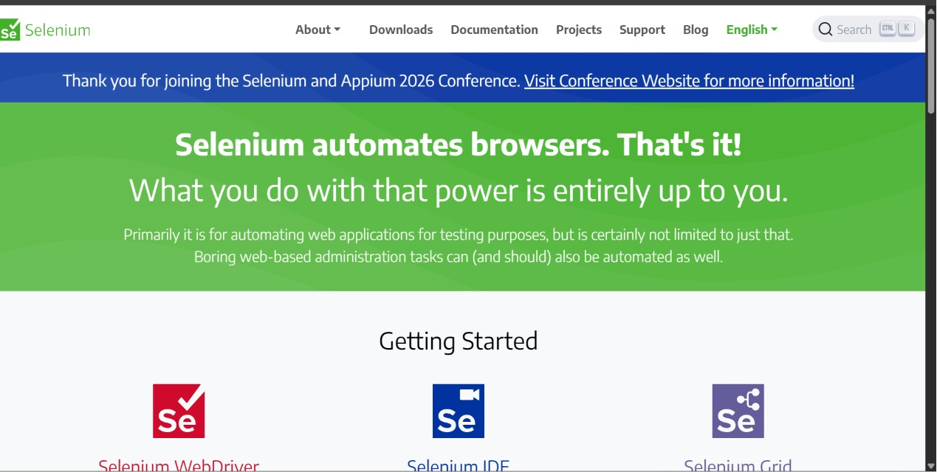
SECTION 1 VISUAL: INTRODUCTION
Step 1: The Selenium Open-Source Project
The official homepage of the Selenium browser automation project, highlighting its core framework goals.

Slide 12
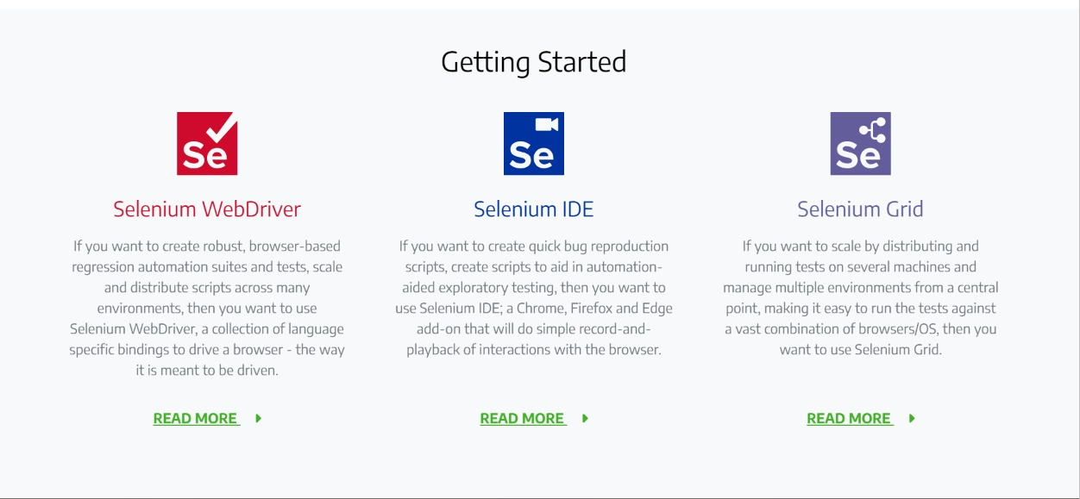
SECTION 1 VISUAL: INTRODUCTION
Step 2: The Selenium Tool Suite
An overview of Selenium's three main components: WebDriver (code-based scripts), IDE (record & playback), and Grid (parallel scaling).

Slide 13
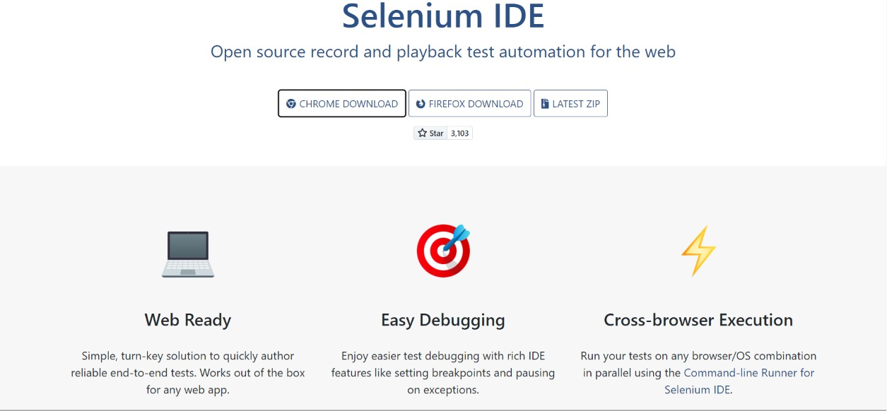
SECTION 1 VISUAL: SELENIUM IDE
Step 3: Selenium IDE Chrome/Firefox Extension
The official webpage showcasing Selenium IDE features, including plugin downloads and documentation links.

Slide 14
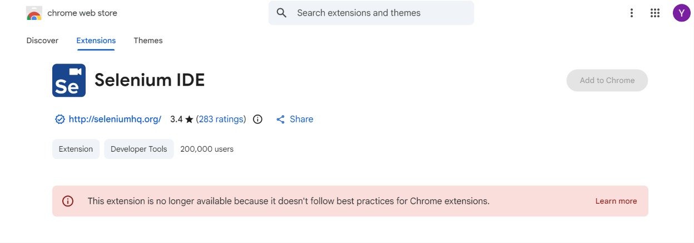
SECTION 1 VISUAL: SELENIUM IDE
Step 4: Installing on Google Chrome
Locating and installing the official Selenium IDE browser extension from the Chrome Web Store.

Slide 15
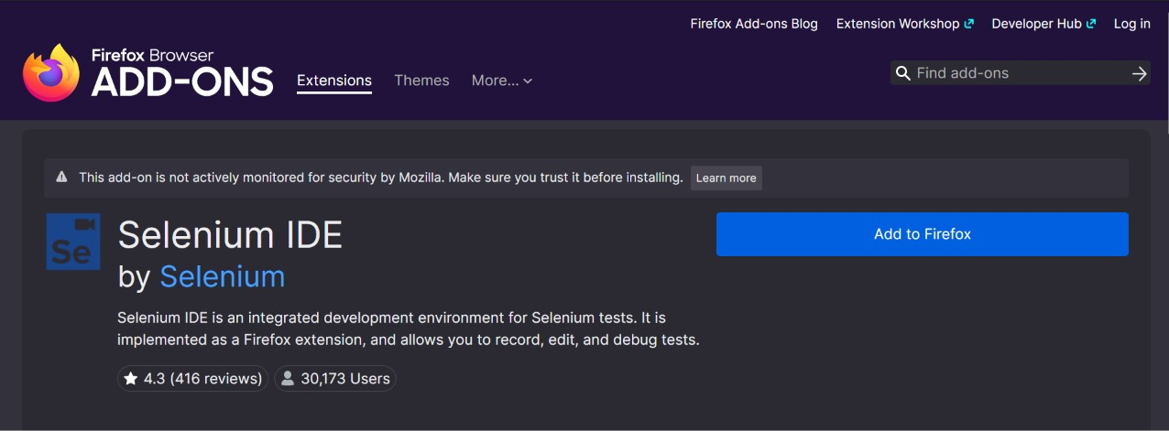
SECTION 1 VISUAL: SELENIUM IDE
Step 5: Installing on Mozilla Firefox
Accessing the Firefox Browser Add-ons store to download and enable the extension for cross-browser testing.

Slide 16
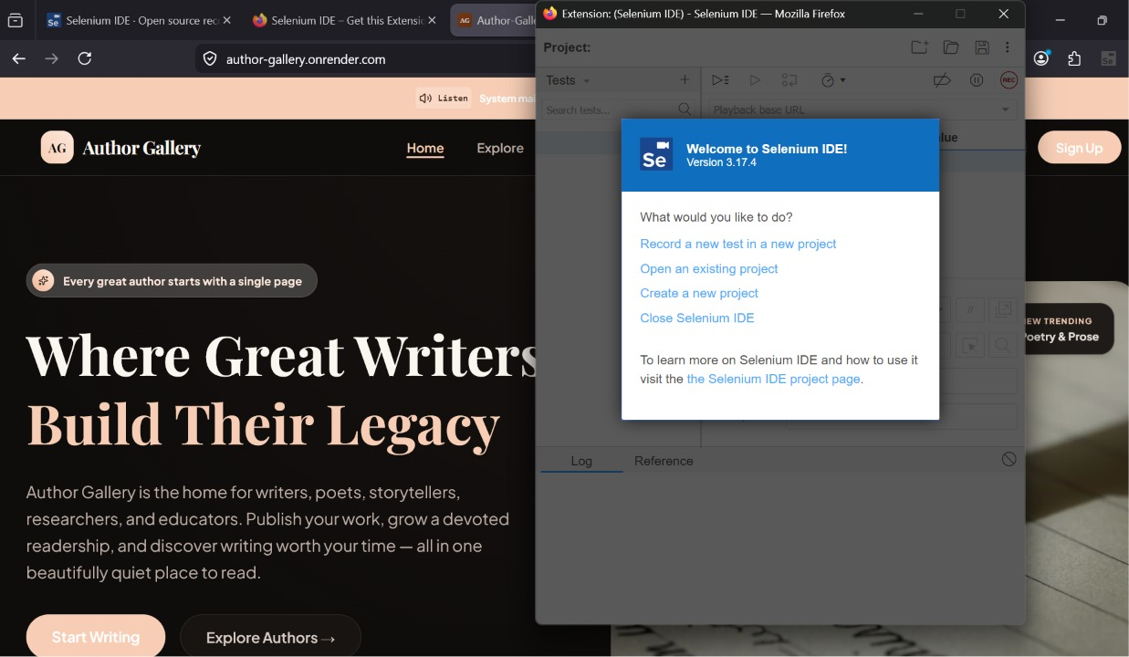
SECTION 1 VISUAL: SELENIUM IDE
Step 6: Welcome Menu and Project Initialization
Launching Selenium IDE to select initial setup options like starting a new test recording session.

Slide 17
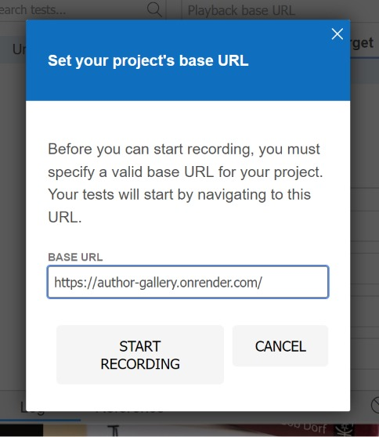
SECTION 1 VISUAL: SELENIUM IDE
Step 7: Configuring Project Base URL
Entering the target site's URL parameters inside the IDE pop-up box to bind the recording session to the active address.

Slide 18
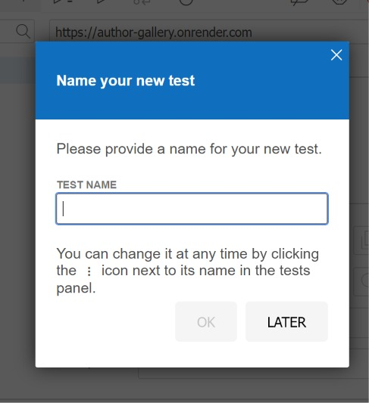
SECTION 1 VISUAL: SELENIUM IDE
Step 8: Naming the Test Case
Assigning a unique and descriptive name (e.g., 'Login Test') to organize recorded steps within the test manager panel.

Slide 19
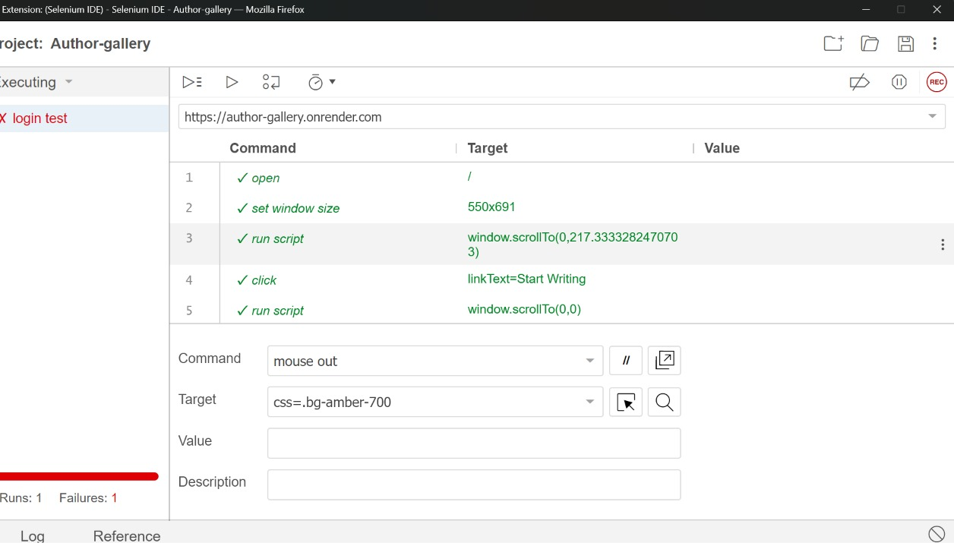
SECTION 1 VISUAL: SELENIUM IDE
Step 9: IDE Playback Workspace and Failures
Reviewing command logs and target locators in Selenium IDE after a test playback encounters errors (indicated by a red status bar).

Slide 20
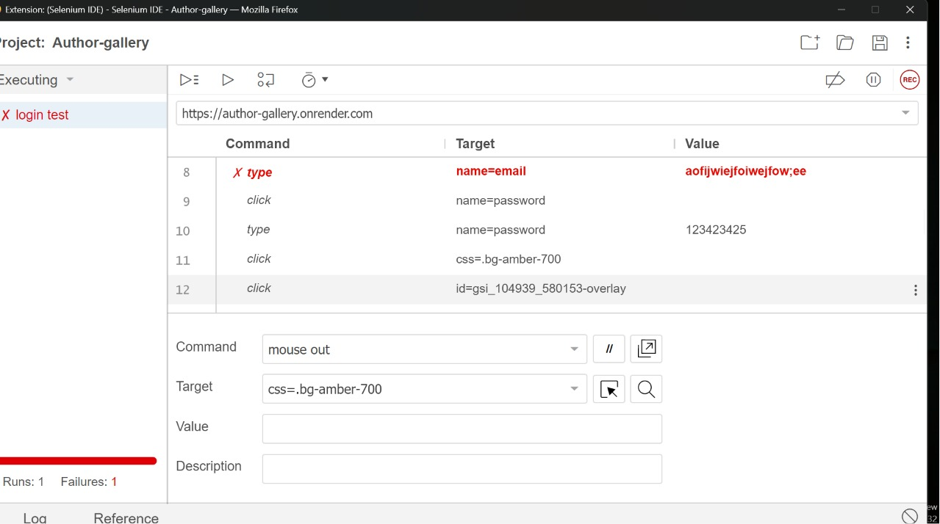
SECTION 2 VISUAL: SELENIUM WEBDRIVER
Step 1: Setting Up node_modules & Package Configuration
Locating node_modules folder structure and verifying package.json dependencies are installed correctly in the project backend.

Slide 21
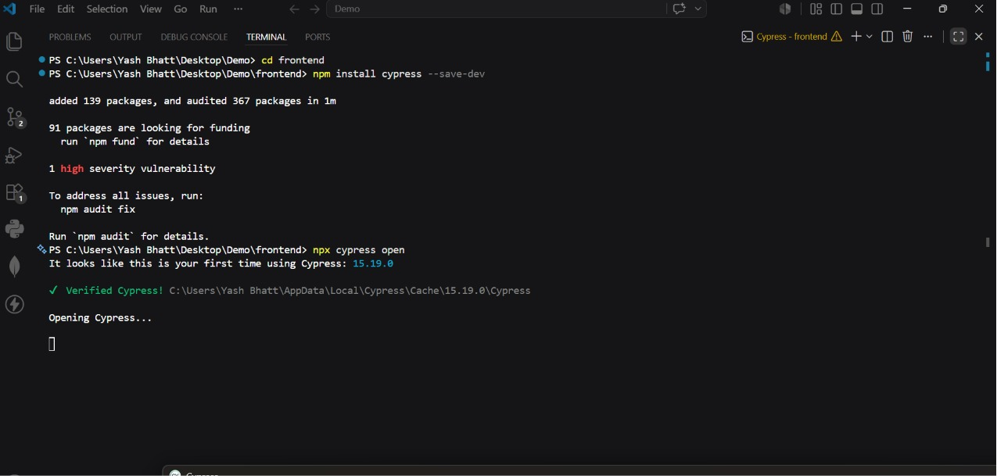
SECTION 2 VISUAL: SELENIUM WEBDRIVER
Step 2: Automated Chrome Browser Launch
The Selenium WebDriver Node.js script automatically launching a clean instance of Google Chrome to initiate testing.

Slide 22
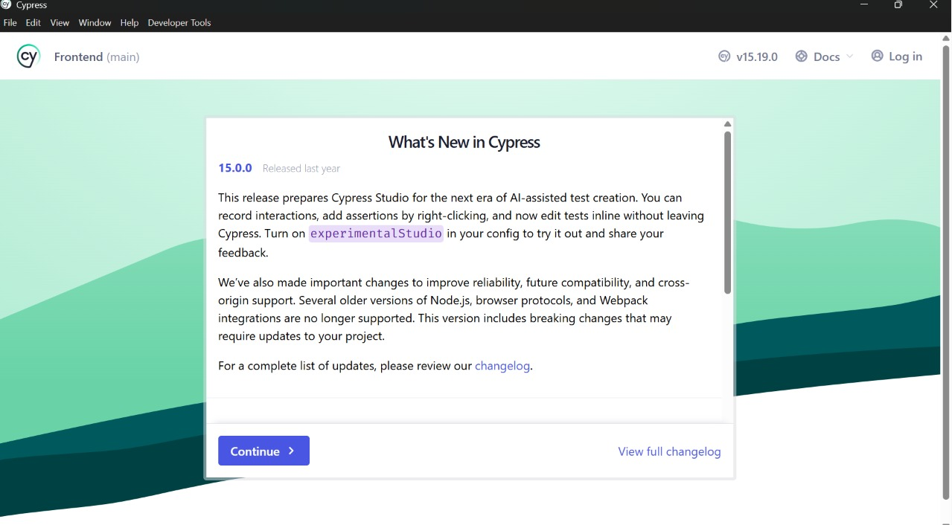
SECTION 2 VISUAL: SELENIUM WEBDRIVER
Step 3: Loading Web Application Login Page
The automated browser navigating to the EventSphere login portal on the live Render web address.

Slide 23
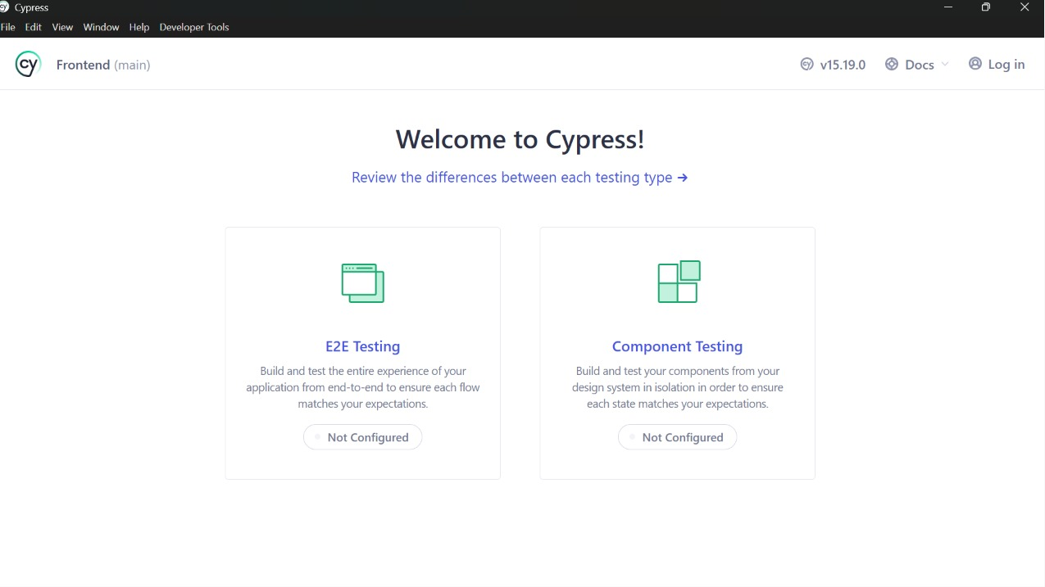
SECTION 2 VISUAL: SELENIUM WEBDRIVER
Step 4: Inputting Guest Login Credentials
WebDriver locating the email/password fields on the web page and typing in test user credentials.

Slide 24
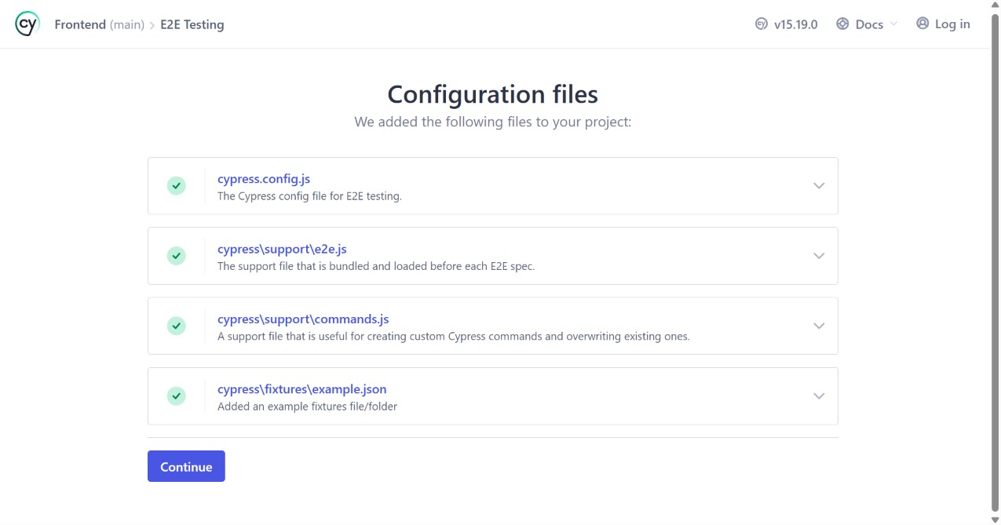
SECTION 2 VISUAL: SELENIUM WEBDRIVER
Step 5: Submitting the Credentials Form
WebDriver executing the button click action on the submit form to authorize access with the backend server.

Slide 25
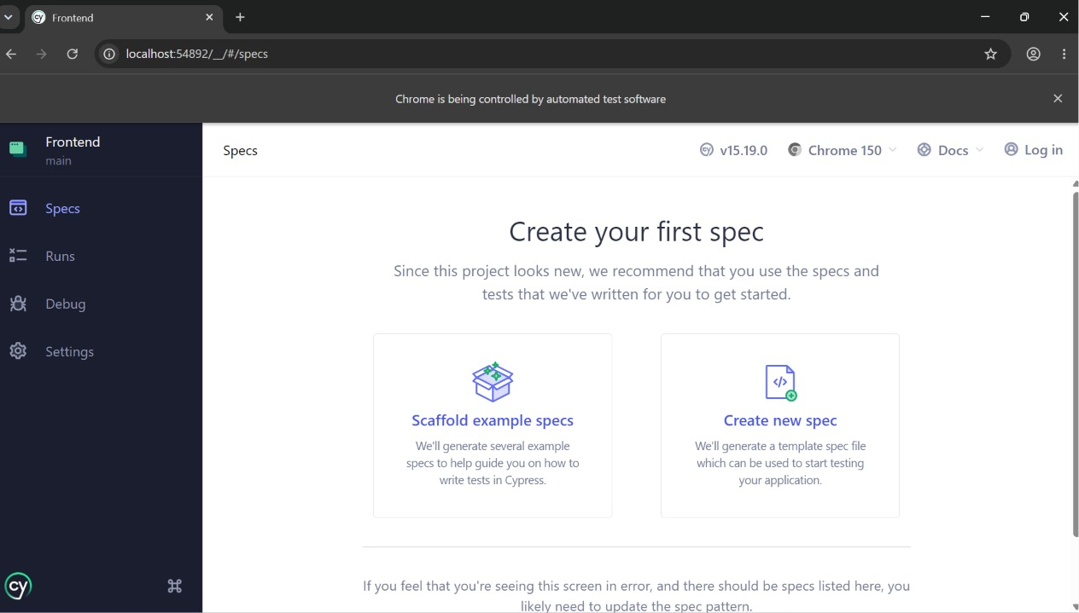
SECTION 2 VISUAL: SELENIUM WEBDRIVER
Step 6: Redirecting to Dashboard Page
Waiting for the backend to verify credentials and redirecting to the secure user dashboard interface.

Slide 26
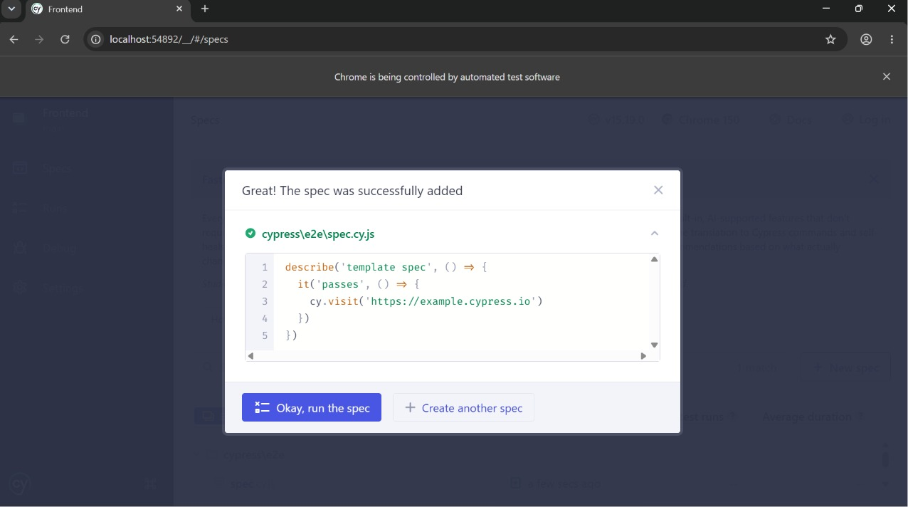
SECTION 2 VISUAL: SELENIUM WEBDRIVER
Step 7: Verifying Dashboard Content & Elements
Asserting that dashboard stats, active passes, and logout button render correctly on successful login.

Slide 27
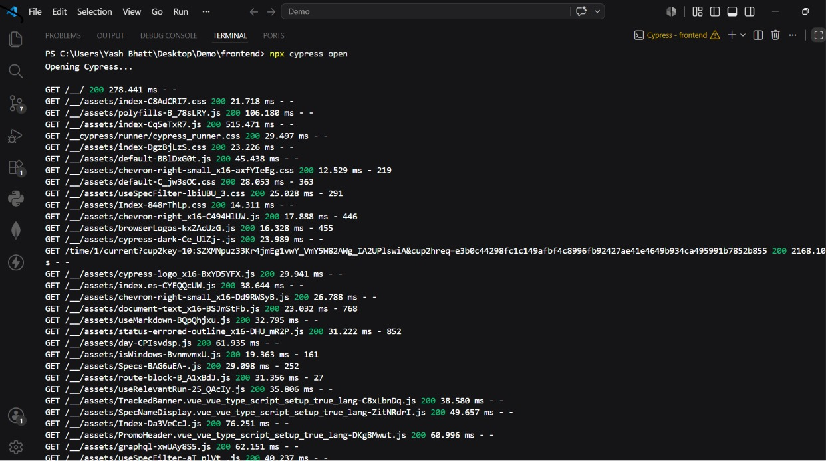
SECTION 2 VISUAL: SELENIUM WEBDRIVER
Step 8: Terminal Test Pass Log
Verifying that the script completes execution, closes Chrome, and prints 'Test Passed' in the terminal console.

Slide 28
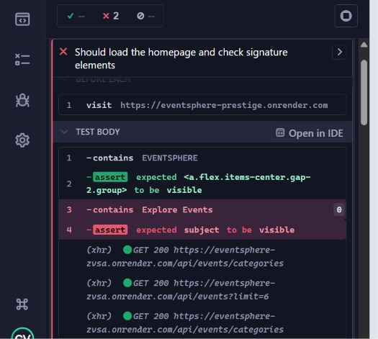
SECTION 3 VISUAL: CYPRESS E2E
Step 1: Cypress Project Structure Overview
Verifying file configurations, cypress folders, support scripts, and spec file paths inside the VS Code explorer panel.

Slide 29
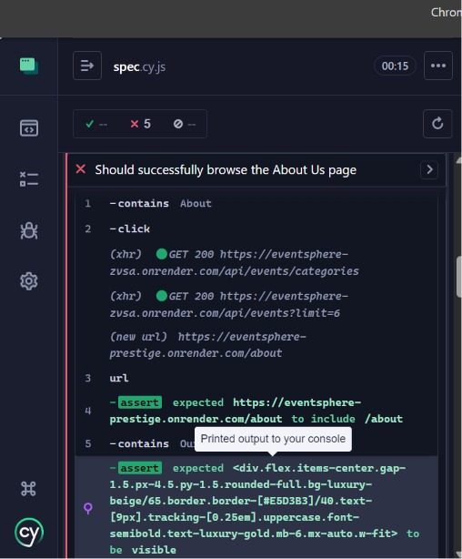
SECTION 3 VISUAL: CYPRESS E2E
Step 2: Cypress spec.cy.js File Config
Setting up Cypress E2E test scripts in VS Code using clean JavaScript assertions to verify user flows.

Slide 30
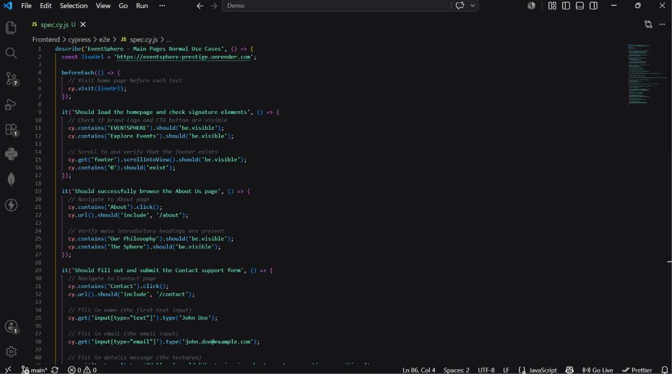
SECTION 3 VISUAL: CYPRESS E2E
Step 3: Homepage Assertion and Visual Checks
Cypress visiting the homepage and checking branding elements, typography headers, and navigation link layouts.

Slide 31
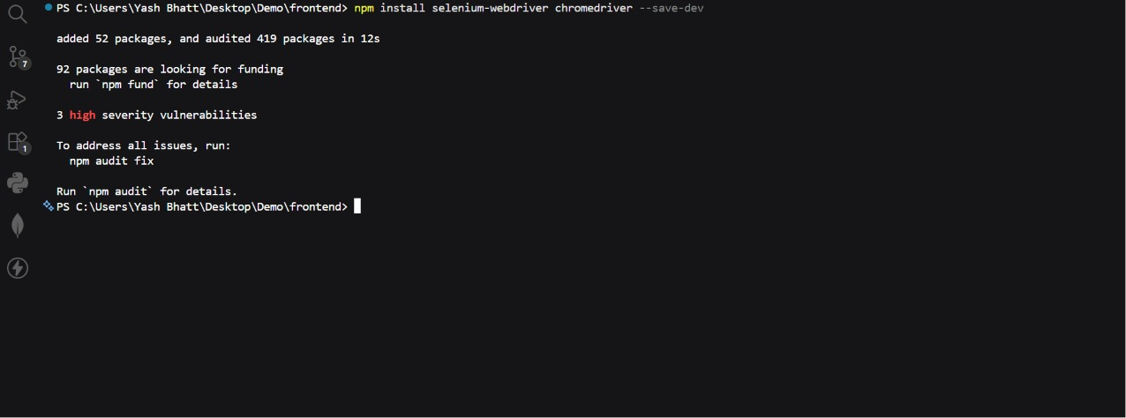
SECTION 3 VISUAL: CYPRESS E2E
Step 4: About Us Page Navigation Check
Testing client-side routing by clicking the About link and verifying main philosophy contents load successfully.

Slide 32
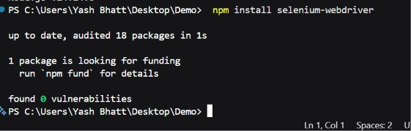
SECTION 3 VISUAL: CYPRESS E2E
Step 5: Contact Concierge Form Validation
Filling out support contact inquiries (name, email, description) to test the concierge form.

Slide 33
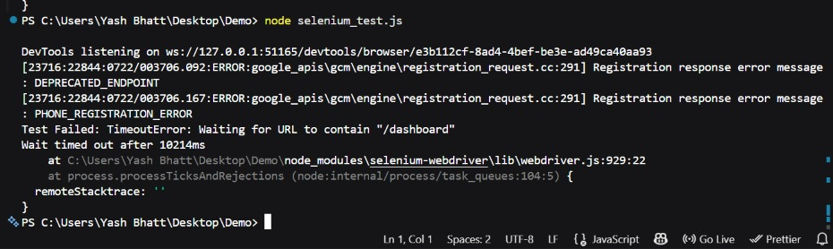
SECTION 3 VISUAL: CYPRESS E2E
Step 6: Toast Notification Assertion
Asserting that a successful popup alert ('Thank you. Our luxury concierge desk will respond shortly.') is displayed after submission.

Slide 34
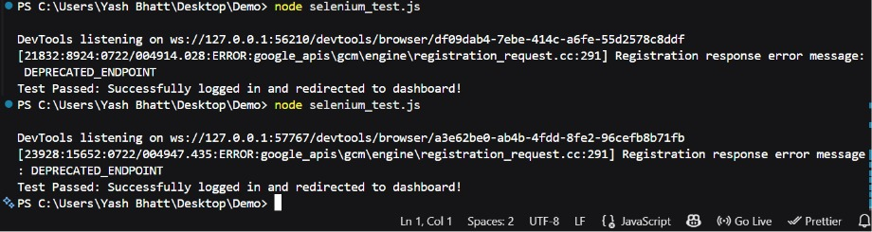
SECTION 3 VISUAL: CYPRESS E2E
Step 7: Events Explorer Filters
Testing input text filtering inside the Events page search box to verify dynamic listing search responsiveness.

Slide 35
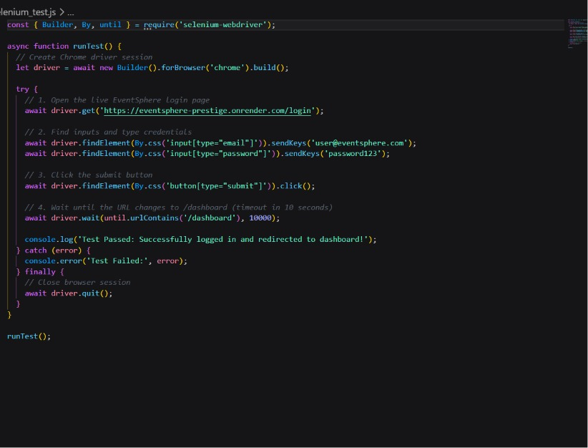
SECTION 3 VISUAL: CYPRESS E2E
Step 8: Attendee Login Automation
Executing automated user login with custom assertions to verify credentials validation flow.

