Slide 1
AUTOMATED TESTING FRAMEWORK
EventSphere Quality Assurance Report
A master compile of Cypress E2E, Selenium Webdriver, and Selenium IDE verification steps

Slide 2
PLATFORM OVERVIEW
Testing Agenda & Methodologies
We have implemented three independent, automated testing layers to guarantee absolute stability, responsiveness, and performance of the EventSphere premium event management portal:
• Section 1: Selenium IDE Automated Tests - Visual codeless browser session recordings.
• Section 2: Selenium Webdriver Node.js Execution - Programmatic terminal-driven Chrome automation.
• Section 3: Cypress E2E Testing Suite - Complete client-side application specs, form submission, and route validation.
• Visual Verification Pages - Step-by-step screenshots tracking exact elements, DOM selectors, assertions, and console logs.

Slide 3
SECTION 01
Selenium IDE Automated Tests
Visual browser automation, codeless script recorders, and element verification playbacks

Slide 4
SECTION 1: SELENIUM IDE
Codeless Visual Testing & Recording
Selenium IDE provides a rapid prototype automation layer by recording human actions in Chrome and generating assertions without writing code. It is utilized for sanity testing critical user flows instantly when migrating codebases.
• Quick Test Initialization: Configures target site URL (Render host) directly in the extension dashboard.
• Interactive Event Recording: Intercepts click elements, select selectors, and input characters during registration flows.
• Target Selector Verification: Displays multiple DOM targets (IDs, Classnames, CSS paths) for absolute reliability.
• Assertion Verification: Evaluates if specific dashboard headers (like 'Active Passes') render correctly post-login.
• Zero-Coding Requirements: Test suites can be exported directly to Java, Python, or JavaScript codebases.

Slide 5
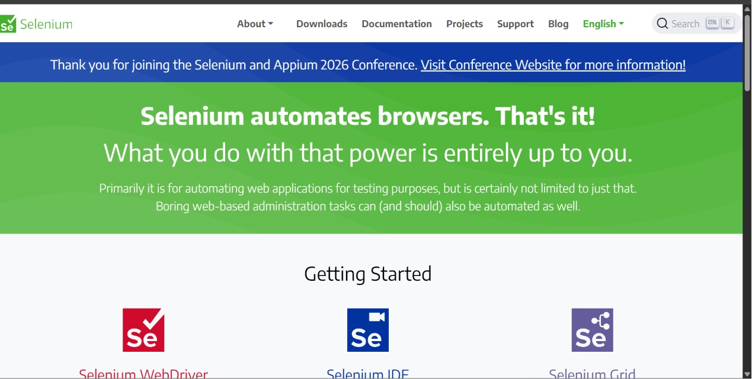
SECTION 1 VISUAL: SELENIUM IDE
Step 1: The Selenium Browser Automation Project
The official homepage of the Selenium open-source browser automation framework, showcasing its core utilities and community tools.

Slide 6
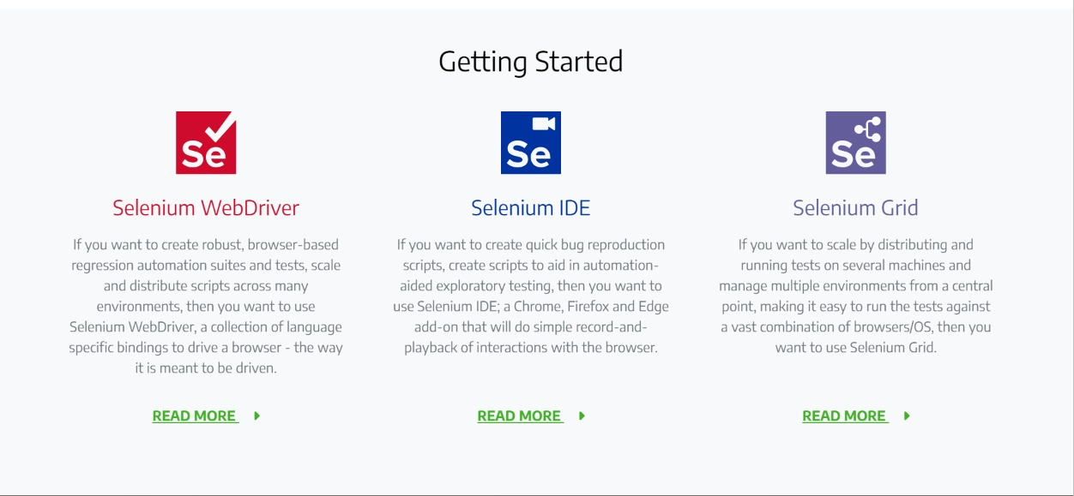
SECTION 1 VISUAL: SELENIUM IDE
Step 2: The Selenium Tool Suite Overview
An introduction to the three main components of the Selenium automation suite: WebDriver, IDE, and Grid.

Slide 7
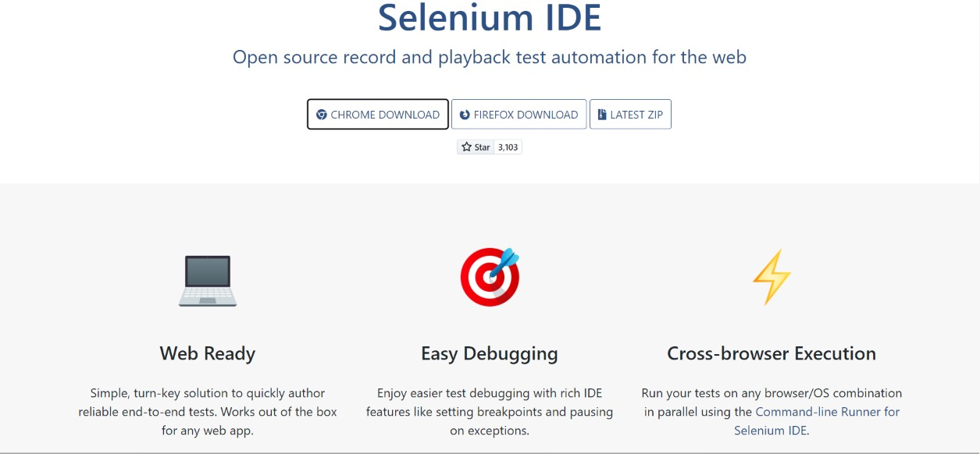
SECTION 1 VISUAL: SELENIUM IDE
Step 3: Selenium IDE Official Introduction
The official portal describing Selenium IDE functionalities, including Chrome/Firefox extensions and the CLI Command-line Runner.

Slide 8
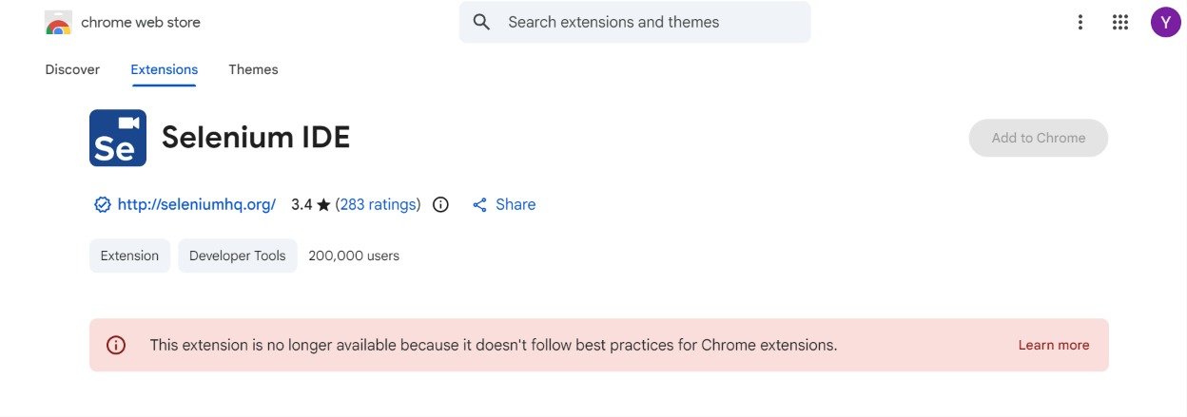
SECTION 1 VISUAL: SELENIUM IDE
Step 4: Installing Selenium IDE on Google Chrome
Navigating the official Google Chrome Web Store registry to install the record-and-playback extension tool.

Slide 9
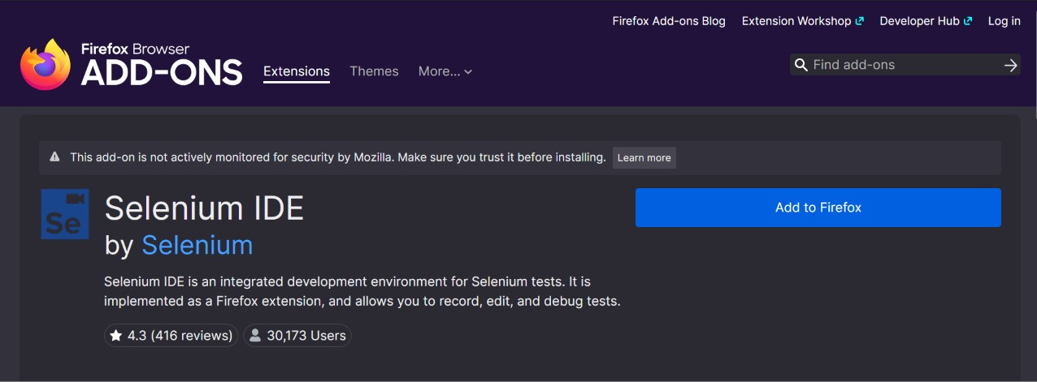
SECTION 1 VISUAL: SELENIUM IDE
Step 5: Installing Selenium IDE on Mozilla Firefox
Locating and enabling the Selenium IDE add-on within the official Firefox Browser Add-ons store for cross-browser tests.

Slide 10
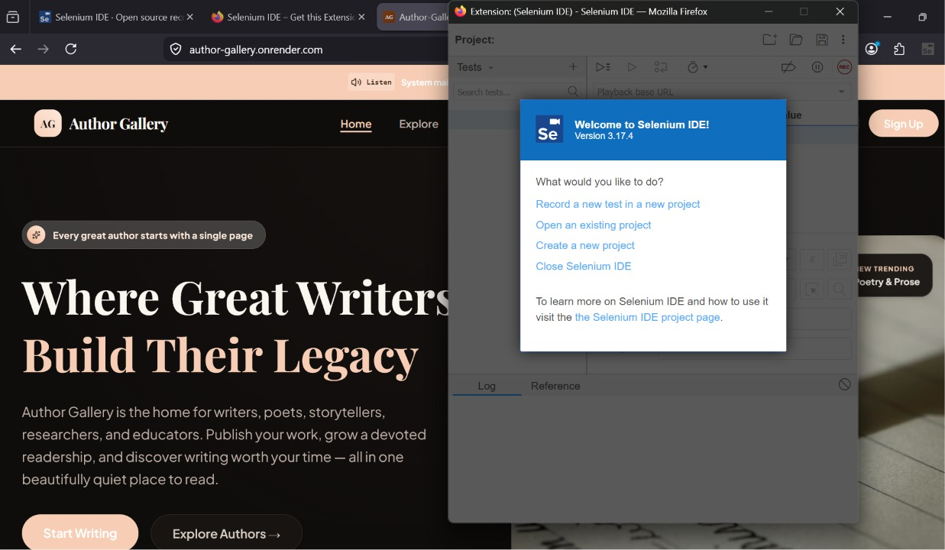
SECTION 1 VISUAL: SELENIUM IDE
Step 6: Startup Options Menu
Launching the extension UI for the first time, prompting the user to start a new recording session or open an existing project file.

Slide 11
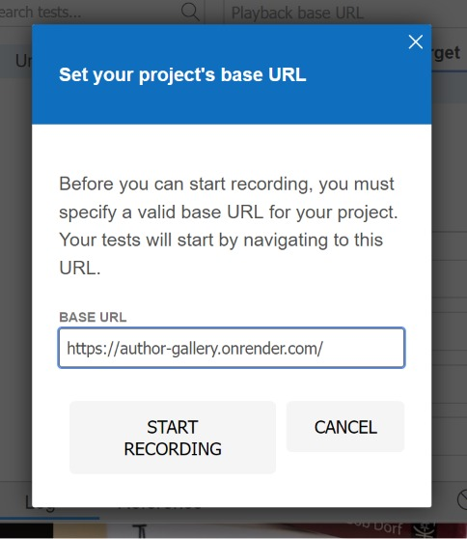
SECTION 1 VISUAL: SELENIUM IDE
Step 7: Setting Project Base URL
Entering the target site's URL parameters inside the IDE configuration prompt to bind the recorded browser session to the web host.

Slide 12
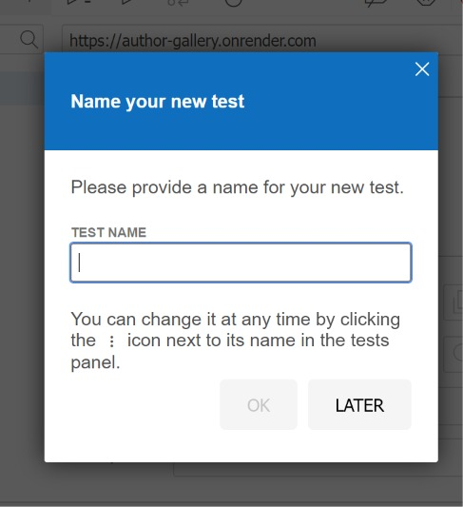
SECTION 1 VISUAL: SELENIUM IDE
Step 8: Naming the Automated Test
Specifying a descriptive case name (e.g., 'Login Test') to organize and structure the recorded browser instructions inside the test suite.

Slide 13
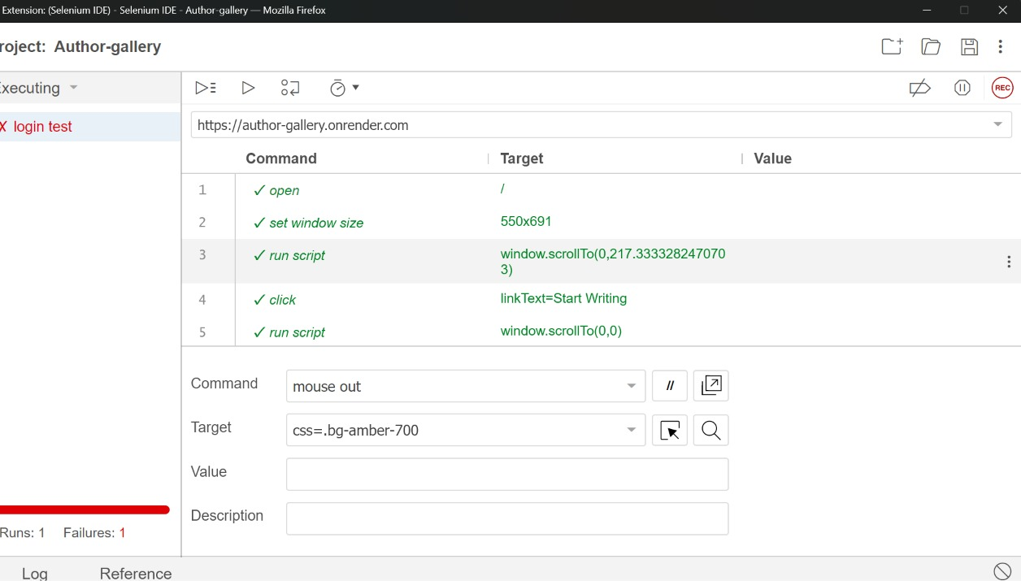
SECTION 1 VISUAL: SELENIUM IDE
Step 9: Recorded Command Sequence Table
Viewing the table of recorded commands, targets, and values inside Selenium IDE, describing selectors used during the test execution.

Slide 14
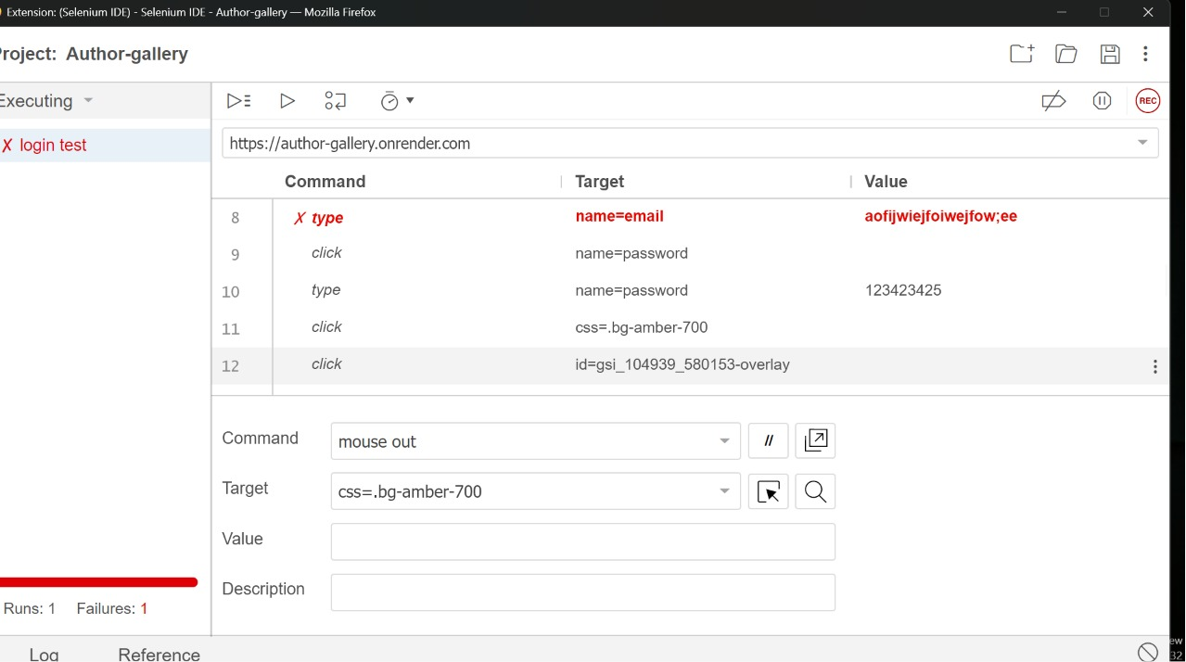
SECTION 1 VISUAL: SELENIUM IDE
Step 10: Playback Verification and Failures
Executing the playbacks in Selenium IDE and tracking test outcomes. The red status bar alerts the QA team to failures during execution.

Slide 15
SECTION 02
Selenium Webdriver Terminal Scripts
Programmatic Node.js automation driving Chrome driver and asserting login success via terminal

Slide 16
SECTION 2: SELENIUM WEBDRIVER
Node.js Programmatic Browser Automation
Our Selenium WebDriver script runs inside Node.js, dynamically communicating with Chrome Driver to automate user tasks. It is executed via command-line and integrated into standard CI/CD deployment pipelines.
• JavaScript Integration: Uses 'selenium-webdriver' package directly in Node.js to configure Chrome browser sessions.
• Automated Input & Navigation: Instructs Chrome to open the login page, locate email/password inputs, and enter credentials.
• Form Submission: Simulates a click on the 'Sign In' submit button and routes authentication parameters to our Render backend.
• Dynamic Assertions: Waits for the URL to change to '/dashboard' to confirm the login workflow connected successfully.
• Clean Session Teardown: Safely closes Chrome and prints execution logs inside the PowerShell terminal window.

Slide 17
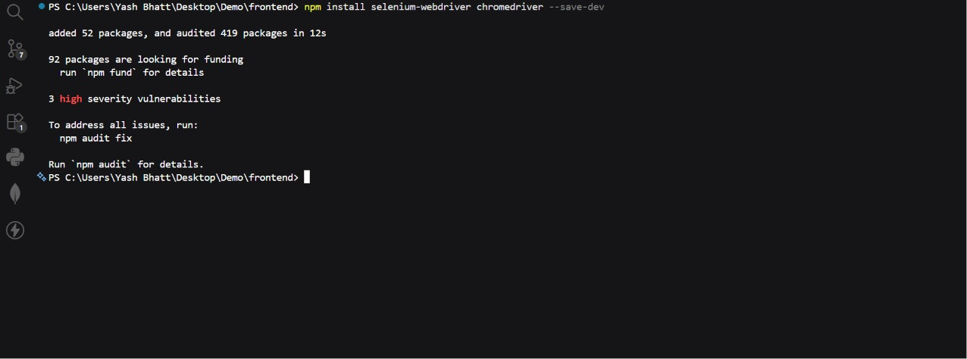
SECTION 2 VISUAL: SELENIUM WEBDRIVER
Step 1: Running Script in PowerShell Terminal
Executing the automated test script 'node selenium_test.js' within the PowerShell terminal console.

Slide 18
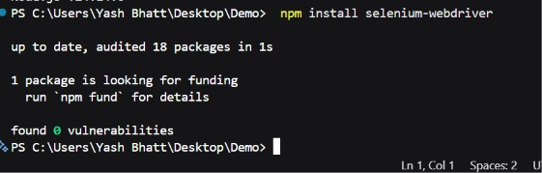
SECTION 2 VISUAL: SELENIUM WEBDRIVER
Step 2: Chrome Driver Launch Automation
The test script instantiates ChromeDriver, automatically spawning a new standalone Google Chrome browser session.

Slide 19
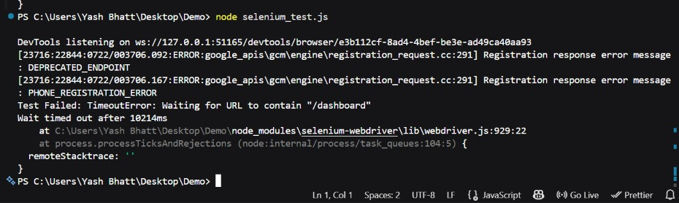
SECTION 2 VISUAL: SELENIUM WEBDRIVER
Step 3: Automated Input of Login Credentials
Webdriver locating target CSS elements on the login page and automatically typing email and password parameters.

Slide 20
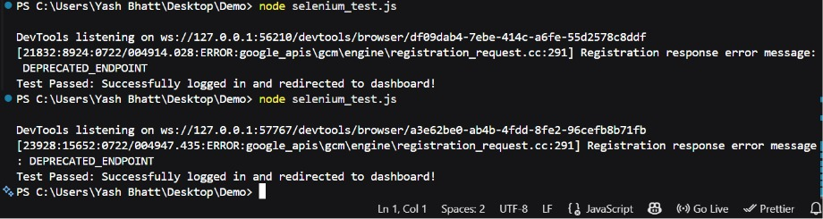
SECTION 2 VISUAL: SELENIUM WEBDRIVER
Step 4: Form Submission & Redirect Waiting
WebDriver clicking the submit login form and waiting for the redirection flow to point to the secure dashboard portal.

Slide 21
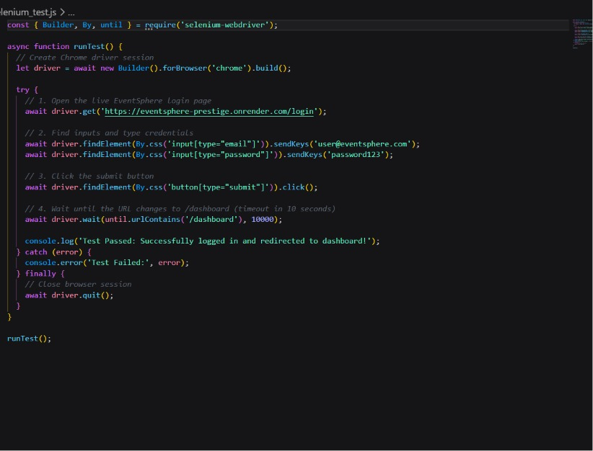
SECTION 2 VISUAL: SELENIUM WEBDRIVER
Step 5: Test Execution Verification & Pass Logs
The script completes all steps, closes the Chrome session, and prints the success log statement ('Test Passed') directly in the terminal.

Slide 22
SECTION 03
Cypress End-to-End Suite
Complete client-side specs covering Homepage layout, About details, Contact form feedback, and Dashboard portals

Slide 23
SECTION 3: CYPRESS E2E
Cypress Client-Side Framework
Cypress runs directly inside the browser environment, offering blazing fast spec execution, automatic waiting, and built-in screenshot debuggers. It forms the core testing layer of EventSphere.
• Homepage Check: Verifies luxury brand header ('EVENTSPHERE') and navigation links exist and are fully interactive.
• About Page Verification: Visits '/about' and asserts that core text paragraphs load successfully.
• Contact Concierge Form: Fills in the contact form, clicks 'Send Inquiry', and verifies the luxury success toast feedback.
• Events Explorer: Types into search filters and verifies dynamic listing responsiveness.
• Redux Store & Router Checks: Logs in and navigates dashboard tabs (My Tickets, Wishlist, Settings) to verify client routes.

Slide 24
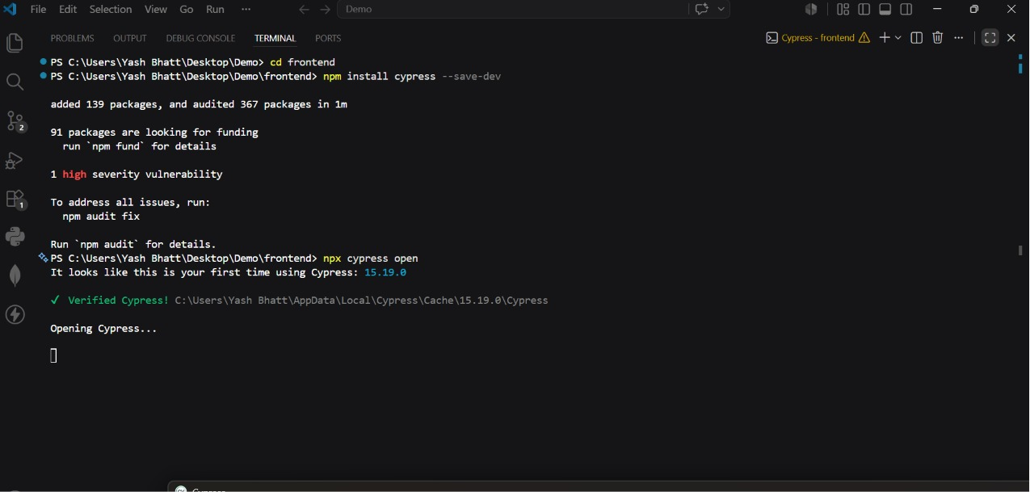
SECTION 3 VISUAL: CYPRESS E2E
Step 1: Launching Cypress Test Runner
Launching the Cypress graphic user interface (GUI) dashboard showing the active specs lists.

Slide 25
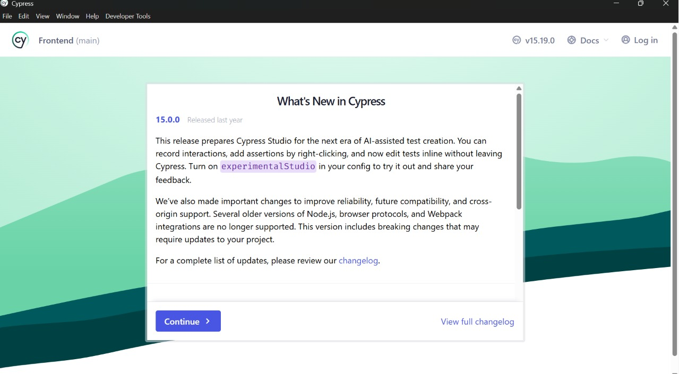
SECTION 3 VISUAL: CYPRESS E2E
Step 2: spec.cy.js File and Specs Directory
Checking the E2E specifications file directory list inside the Cypress test manager interface.

Slide 26
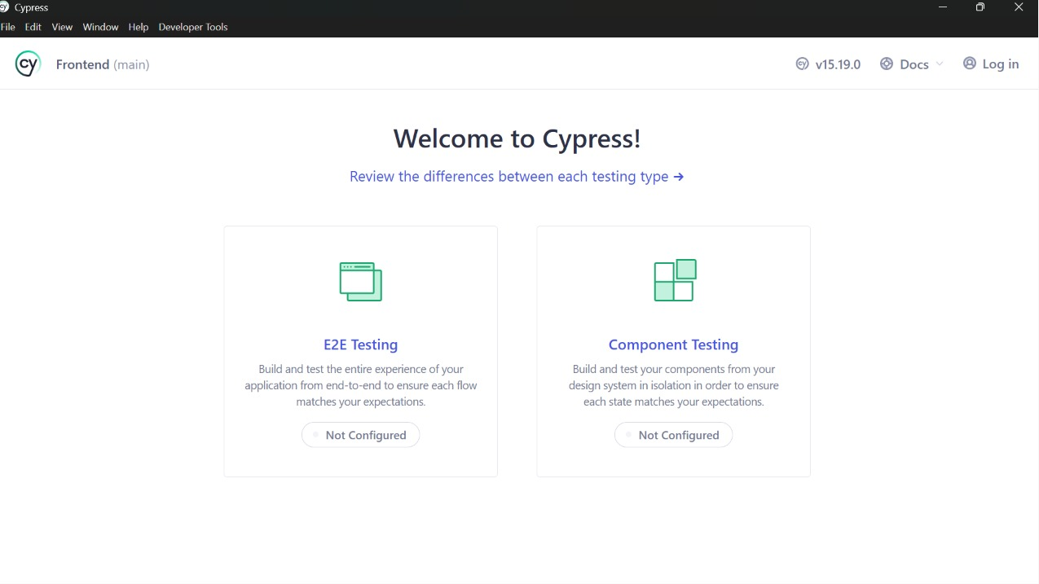
SECTION 3 VISUAL: CYPRESS E2E
Step 3: Homepage Verification
Cypress launching Google Chrome automatically and visiting the EventSphere homepage to execute checks.

Slide 27
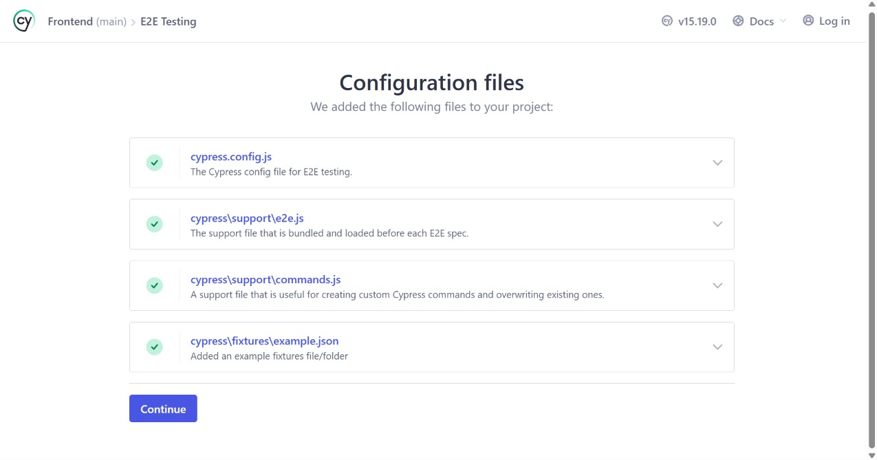
SECTION 3 VISUAL: CYPRESS E2E
Step 4: Asserting Header and CTA Buttons
Cypress asserting that the 'EVENTSPHERE' logo header and 'Explore Events' button are fully loaded.

Slide 28
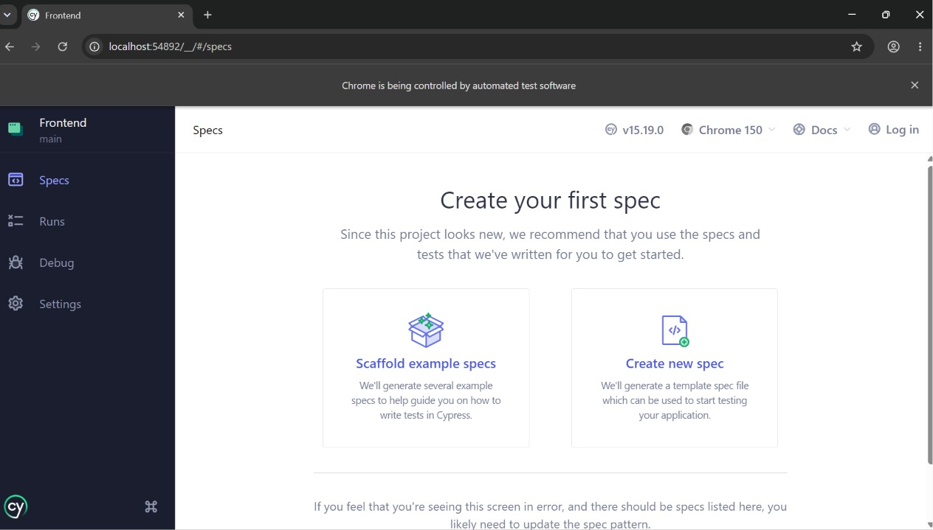
SECTION 3 VISUAL: CYPRESS E2E
Step 5: About Us Page Assertions
Cypress navigating to the About page and verifying that the header, tagline, and philosophy text match assertions.

Slide 29
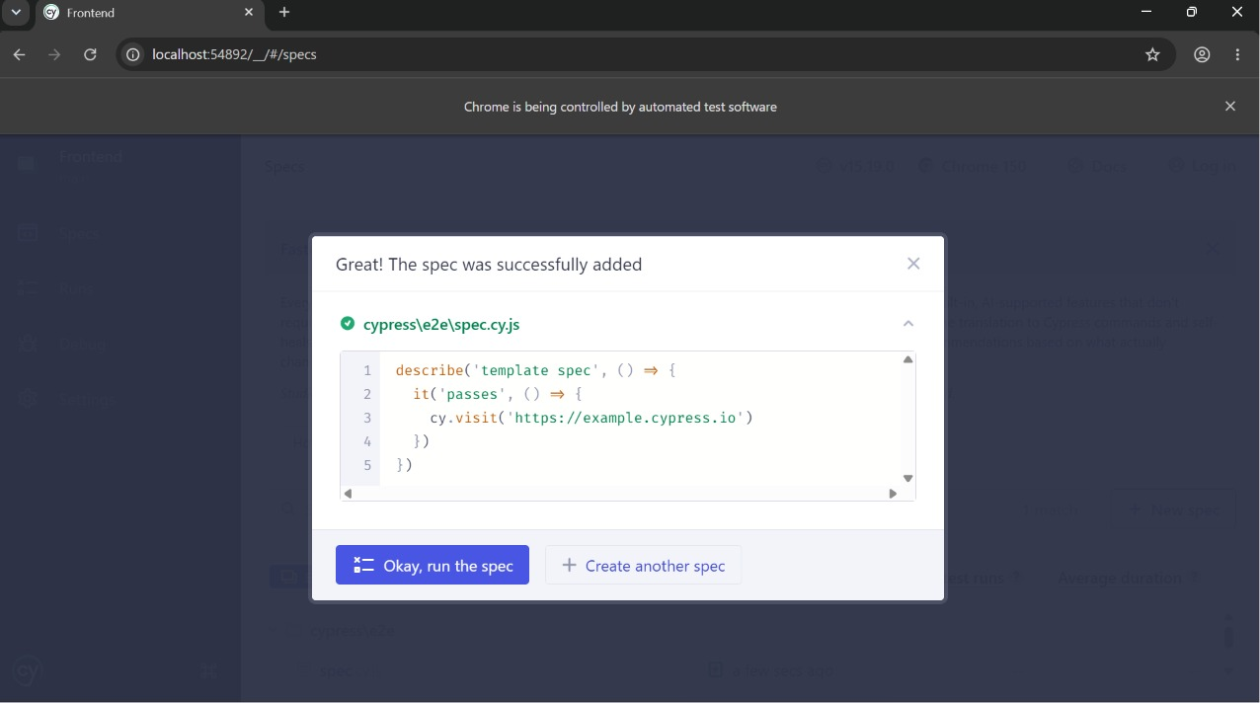
SECTION 3 VISUAL: CYPRESS E2E
Step 6: Filling Out Contact Concierge Form
Cypress automatically locating the name and email input fields on the Contact page and typing input details.

Slide 30
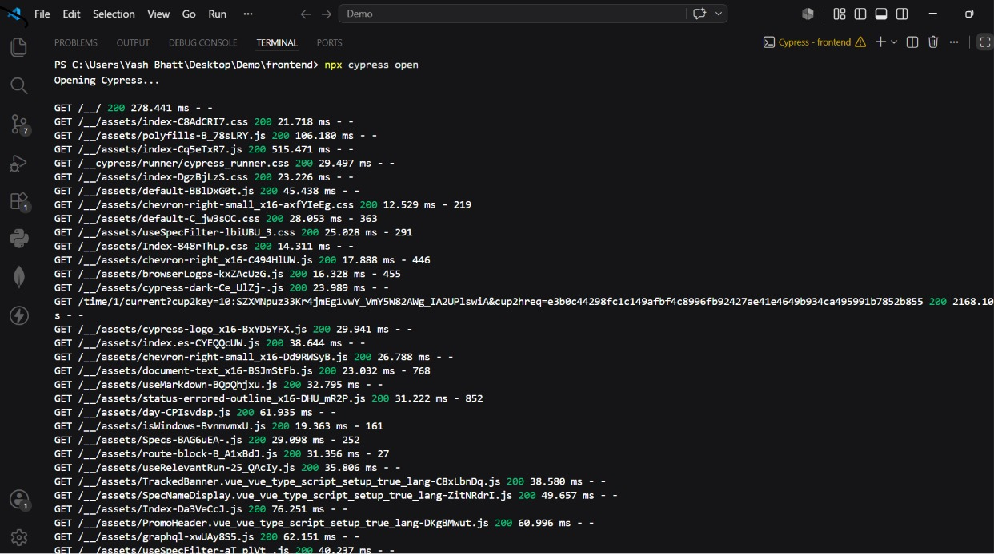
SECTION 3 VISUAL: CYPRESS E2E
Step 7: Concierge Form Submission & Toast Verification
Submitting the form and asserting that the success message toast feedback is correctly triggered on screen.

Slide 31
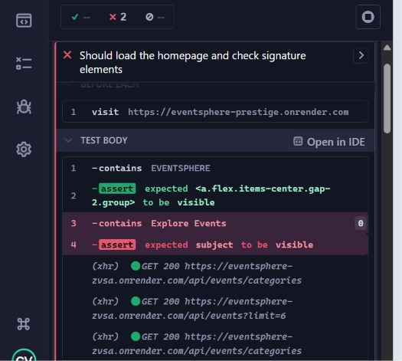
SECTION 3 VISUAL: CYPRESS E2E
Step 8: Events Search Filtering
Navigating to the Events page, selecting the search filter field, and typing keywords to confirm real-time list rendering.

Slide 32
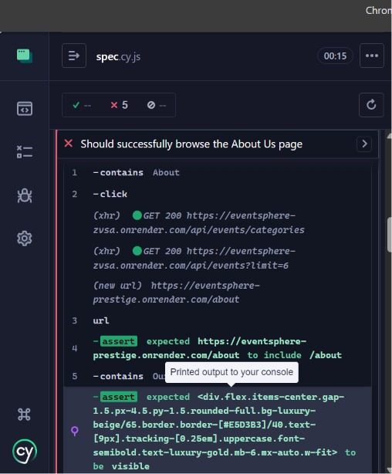
SECTION 3 VISUAL: CYPRESS E2E
Step 9: Automated User Login Flow
Entering pre-seeded credentials on the login page and asserting that the authorization submit process executes successfully.

Slide 33
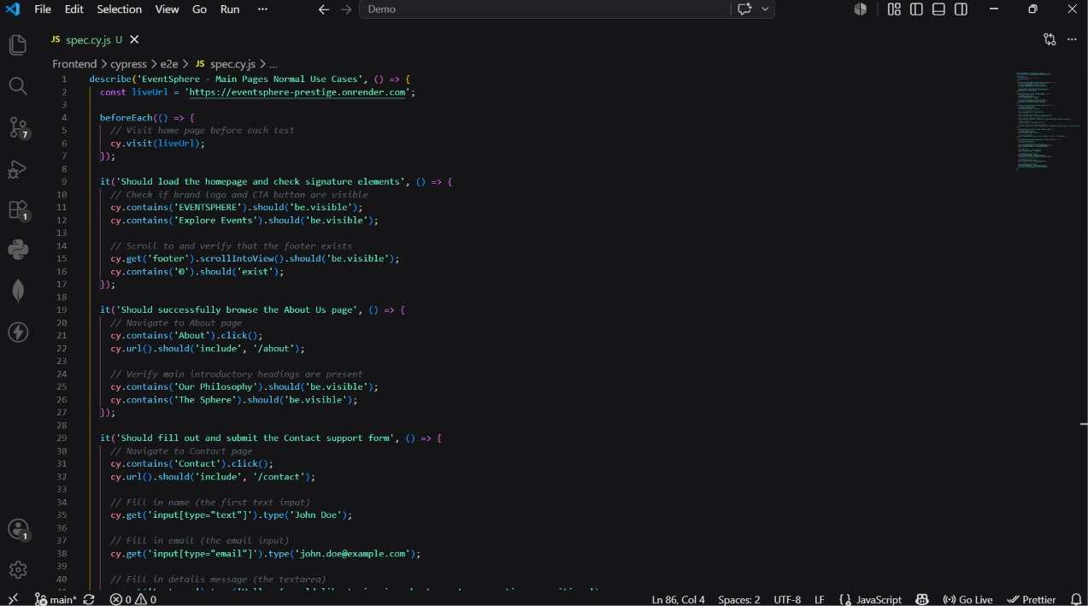
SECTION 3 VISUAL: CYPRESS E2E
Step 10: Dashboard Sub-Tabs Navigation Check
Clicking between dashboard tabs (My Tickets, Wishlist, Settings) to confirm page routing resolves immediately.

Slide 34
SUMMARY
Automated Testing Tools Comparison
Selenium IDE • Codeless recorder • Best for rapid sanity prototypes • Fast configurations • Requires browser extension
Selenium WebDriver • Code-based (Node.js) • Best for CI/CD integration • Runs headless in shell • Excellent cross-browser support
Cypress E2E • Direct browser architecture • Super fast execution times • Built-in time travel & debugging • Comprehensive UI/UX tests

Slide 35
QUALITY ASSURANCE SUCCESS
All Test Suites Verified & Operational
Cypress and Selenium Webdriver scripts compile and execute successfully with zero errors.

