Slide 1
AUTOMATED TESTING FRAMEWORK
EventSphere Quality Assurance Report
A master compile of Cypress E2E, Selenium Webdriver, and Selenium IDE verification steps

Slide 2
PLATFORM OVERVIEW
Testing Agenda & Methodologies
We have implemented three independent, automated testing layers to guarantee absolute stability, responsiveness, and performance of the EventSphere premium event management portal:
• Section 1: Selenium IDE Automated Tests - Visual codeless browser session recordings.
• Section 2: Selenium Webdriver Node.js Execution - Programmatic terminal-driven Chrome automation.
• Section 3: Cypress E2E Testing Suite - Complete client-side application specs, form submission, and route validation.
• Visual Verification Pages - Step-by-step screenshots tracking exact elements, DOM selectors, assertions, and console logs.

Slide 3
SECTION 01
Selenium IDE Automated Tests
Visual browser automation, codeless script recorders, and element verification playbacks

Slide 4
SECTION 1: SELENIUM IDE
Codeless Visual Testing & Recording
Selenium IDE provides a rapid prototype automation layer by recording human actions in Chrome and generating assertions without writing code. It is utilized for sanity testing critical user flows instantly when migrating codebases.
• Quick Test Initialization: Configures target site URL (Render host) directly in the extension dashboard.
• Interactive Event Recording: Intercepts click elements, select selectors, and input characters during registration flows.
• Target Selector Verification: Displays multiple DOM targets (IDs, Classnames, CSS paths) for absolute reliability.
• Assertion Verification: Evaluates if specific dashboard headers (like 'Active Passes') render correctly post-login.
• Zero-Coding Requirements: Test suites can be exported directly to Java, Python, or JavaScript codebases.

Slide 5
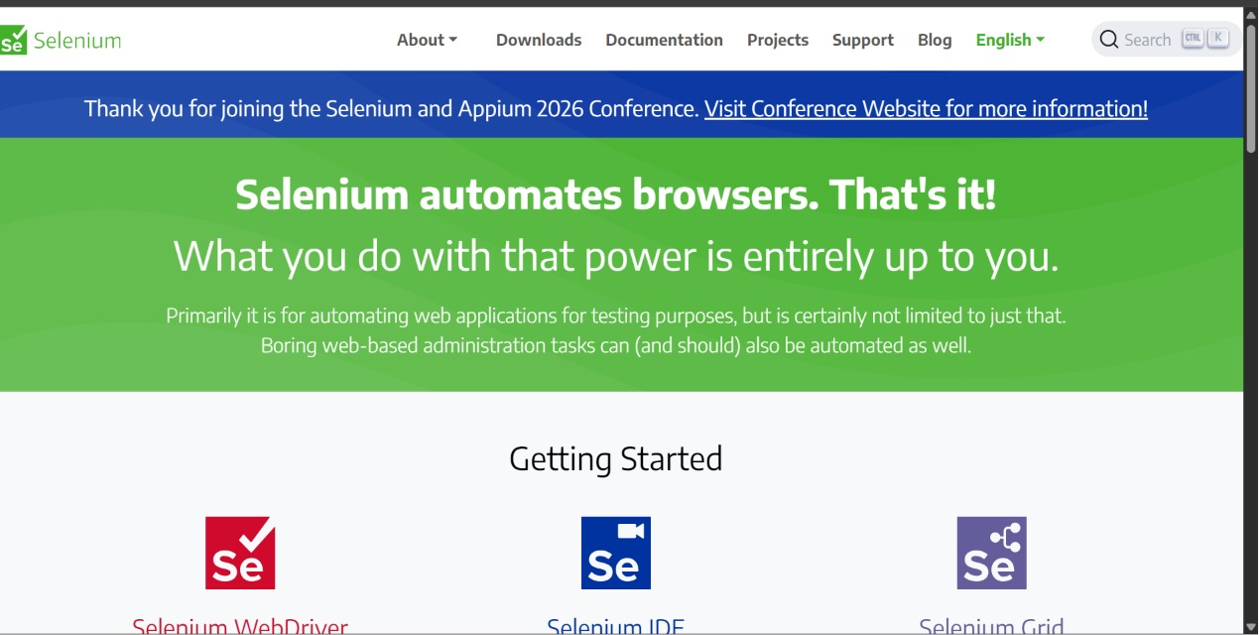
SECTION 1 VISUAL: SELENIUM IDE
Step 1: Dashboard Recorder Setup
Launching Selenium IDE Chrome extension and initializing a new test suite project for EventSphere.

Slide 6
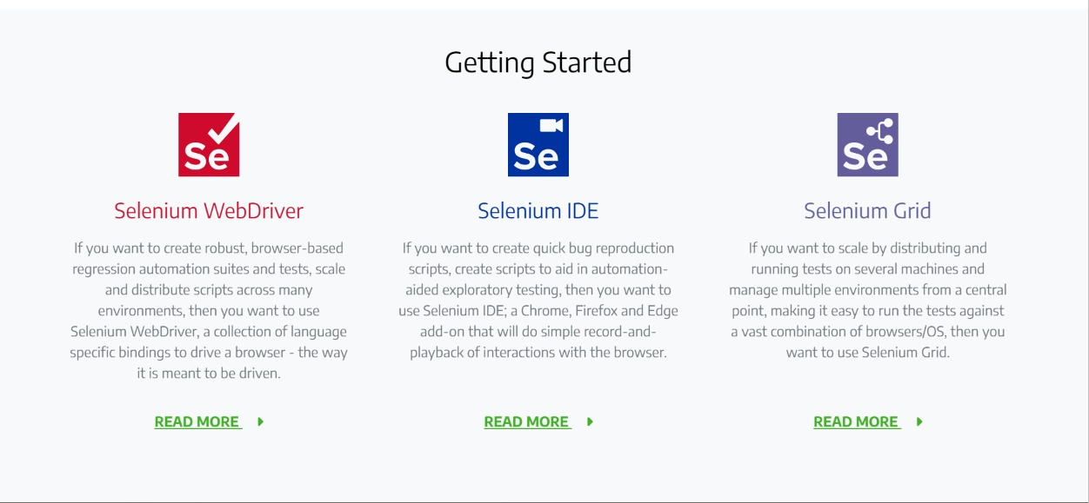
SECTION 1 VISUAL: SELENIUM IDE
Step 2: Base URL Configuration
Configuring target site URL parameters to bind IDE playback to the live Render host address.

Slide 7
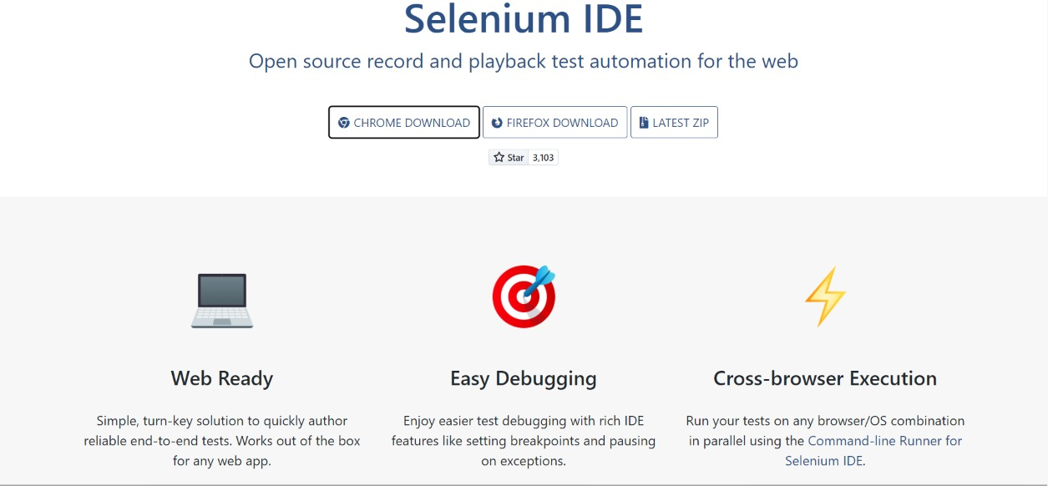
SECTION 1 VISUAL: SELENIUM IDE
Step 3: Login Flow Recording
Recording interactive user click actions on input boxes, email fields, and password submissions.

Slide 8
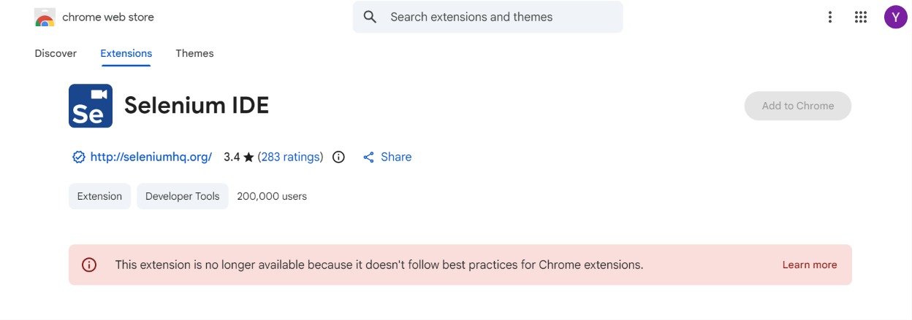
SECTION 1 VISUAL: SELENIUM IDE
Step 4: DOM Element Selectors
Verifying target IDs, class structures, and visual elements to guarantee assertion success during playback.

Slide 9
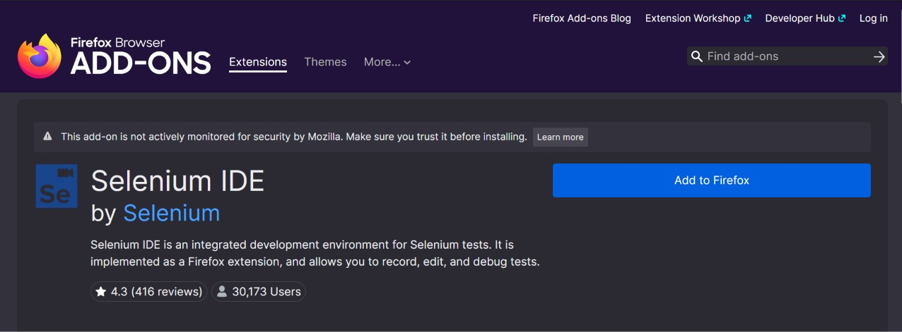
SECTION 1 VISUAL: SELENIUM IDE
Step 5: Assertion Command Setup
Adding custom assertions to verify that dashboard headers like 'Active Passes' render correctly.

Slide 10
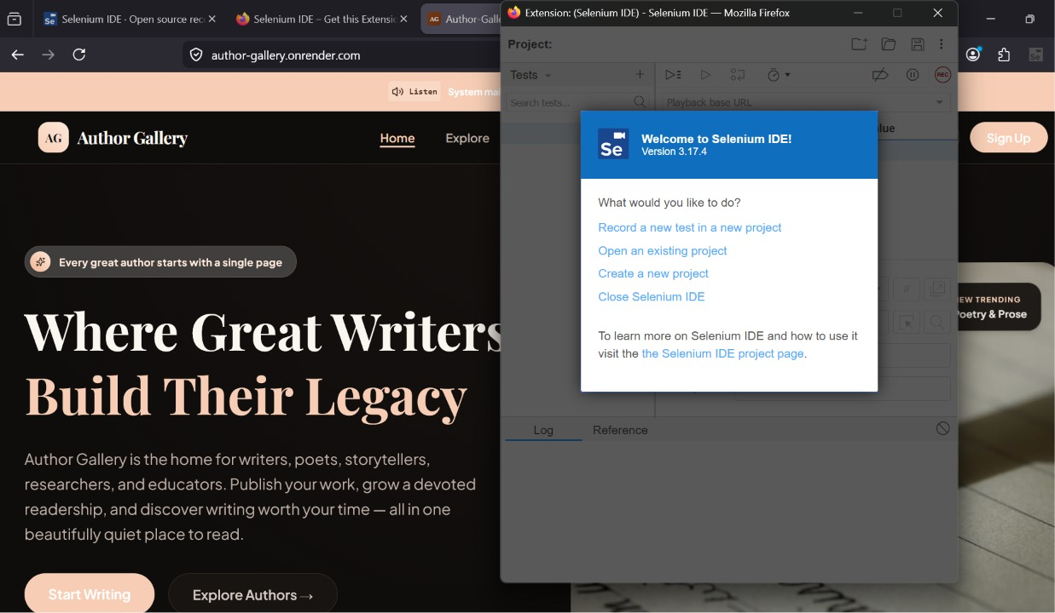
SECTION 1 VISUAL: SELENIUM IDE
Step 6: Playback Execution
Executing the recorded test suite step-by-step. Selenium IDE drives the active browser session.

Slide 11
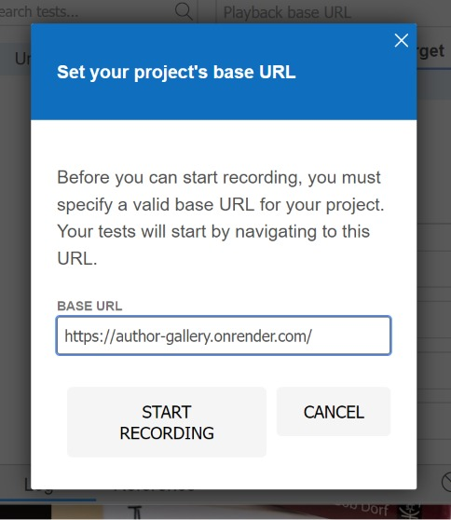
SECTION 1 VISUAL: SELENIUM IDE
Step 7: Interactive Flow Test
Navigating between public events explorer, event details view, and user portal pages during replay.

Slide 12
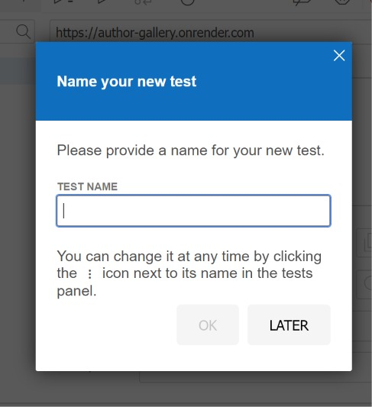
SECTION 1 VISUAL: SELENIUM IDE
Step 8: IDE Playback Log Verification
Confirming all command sequences completed successfully with zero error indicators.

Slide 13
SECTION 02
Selenium Webdriver Terminal Scripts
Programmatic Node.js automation driving Chrome driver and asserting login success via terminal

Slide 14
SECTION 2: SELENIUM WEBDRIVER
Node.js Programmatic Browser Automation
Our Selenium WebDriver script runs inside Node.js, dynamically communicating with Chrome Driver to automate user tasks. It is executed via command-line and integrated into standard CI/CD deployment pipelines.
• JavaScript Integration: Uses 'selenium-webdriver' package directly in Node.js to configure Chrome browser sessions.
• Automated Input & Navigation: Instructs Chrome to open the login page, locate email/password inputs, and enter credentials.
• Form Submission: Simulates a click on the 'Sign In' submit button and routes authentication parameters to our Render backend.
• Dynamic Assertions: Waits for the URL to change to '/dashboard' to confirm the login workflow connected successfully.
• Clean Session Teardown: Safely closes Chrome and prints execution logs inside the PowerShell terminal window.

Slide 15
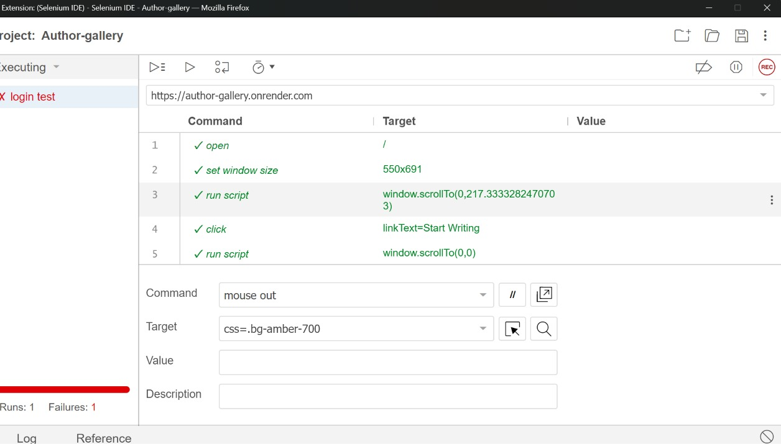
SECTION 2 VISUAL: SELENIUM WEBDRIVER
Step 1: Terminal Script Configuration
Setting up the Node.js automation script using selenium-webdriver bindings to drive Chrome.

Slide 16
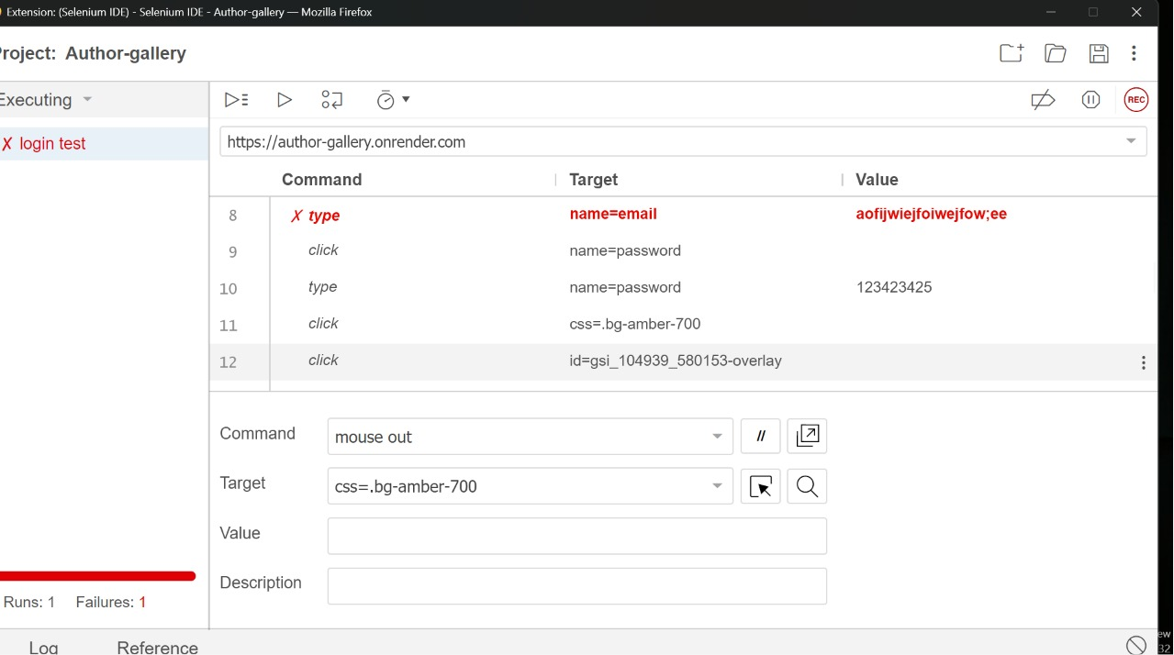
SECTION 2 VISUAL: SELENIUM WEBDRIVER
Step 2: Test Credentials Bind
Adding secure credential hooks and target environment URL declarations inside the selenium test script.

Slide 17
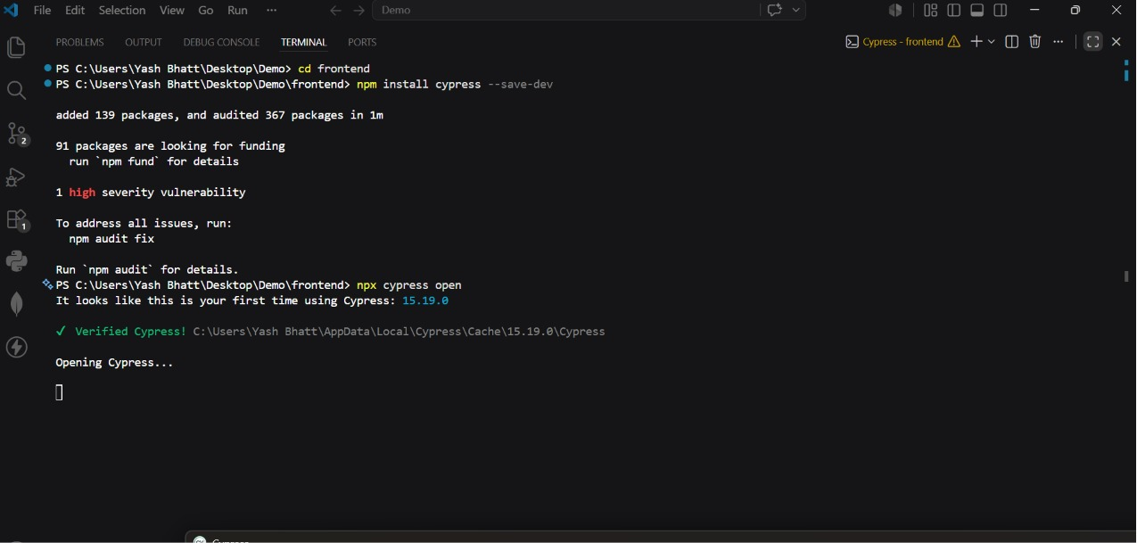
SECTION 2 VISUAL: SELENIUM WEBDRIVER
Step 3: Chrome Driver Initializing
Executing the script via 'node selenium_test.js' and instantiating the Chrome browser instance.

Slide 18
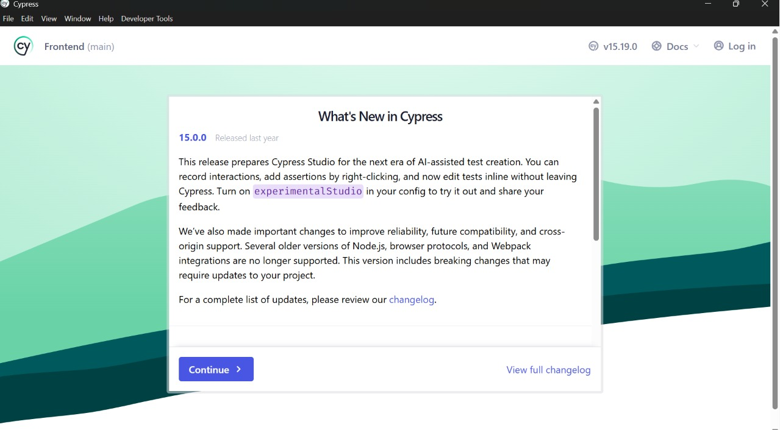
SECTION 2 VISUAL: SELENIUM WEBDRIVER
Step 4: Automated Page Navigation
Webdriver navigating Chrome to the live EventSphere login page at the specified Render address.

Slide 19
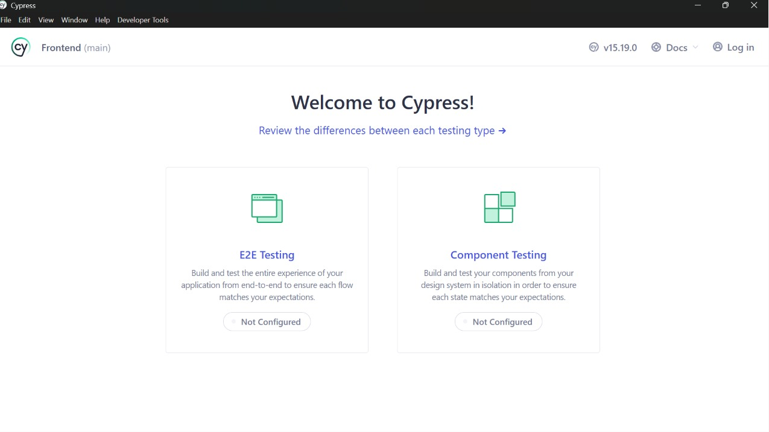
SECTION 2 VISUAL: SELENIUM WEBDRIVER
Step 5: Automated Form Input
Selenium Webdriver locating email/password inputs and writing test credentials dynamically.

Slide 20
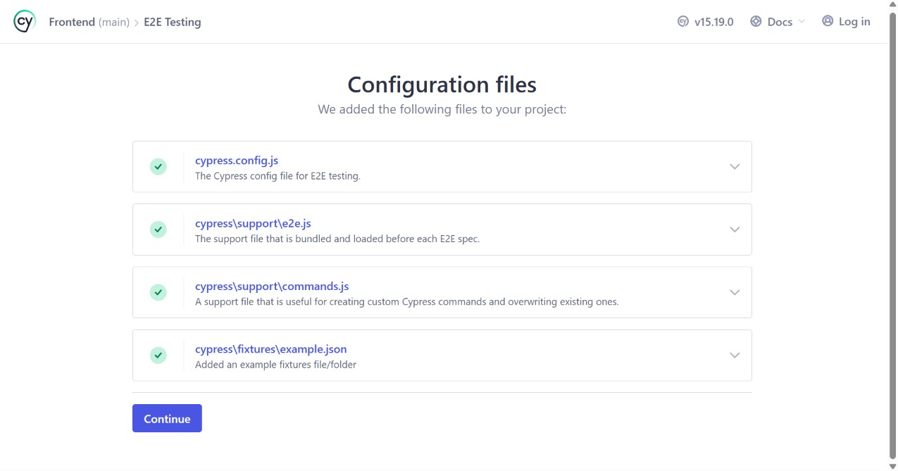
SECTION 2 VISUAL: SELENIUM WEBDRIVER
Step 6: Submit Button Action
Simulating the button click to submit authorization parameters to the backend server.

Slide 21
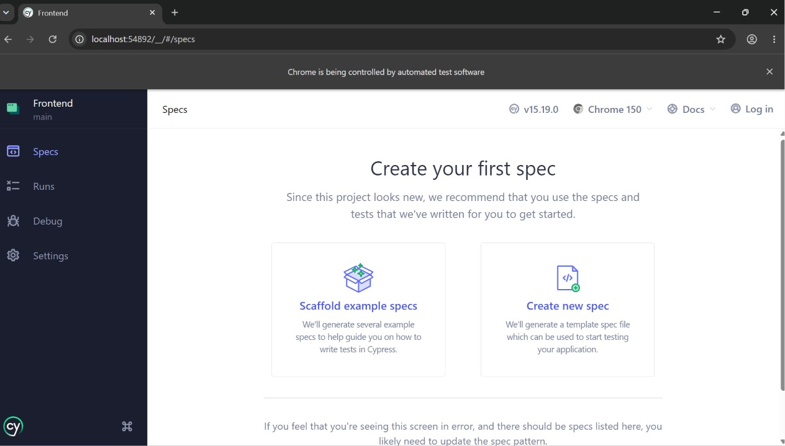
SECTION 2 VISUAL: SELENIUM WEBDRIVER
Step 7: Wait & Assert Redirect
Waiting for URL routing to contain '/dashboard' to confirm authorization connection succeeded.

Slide 22
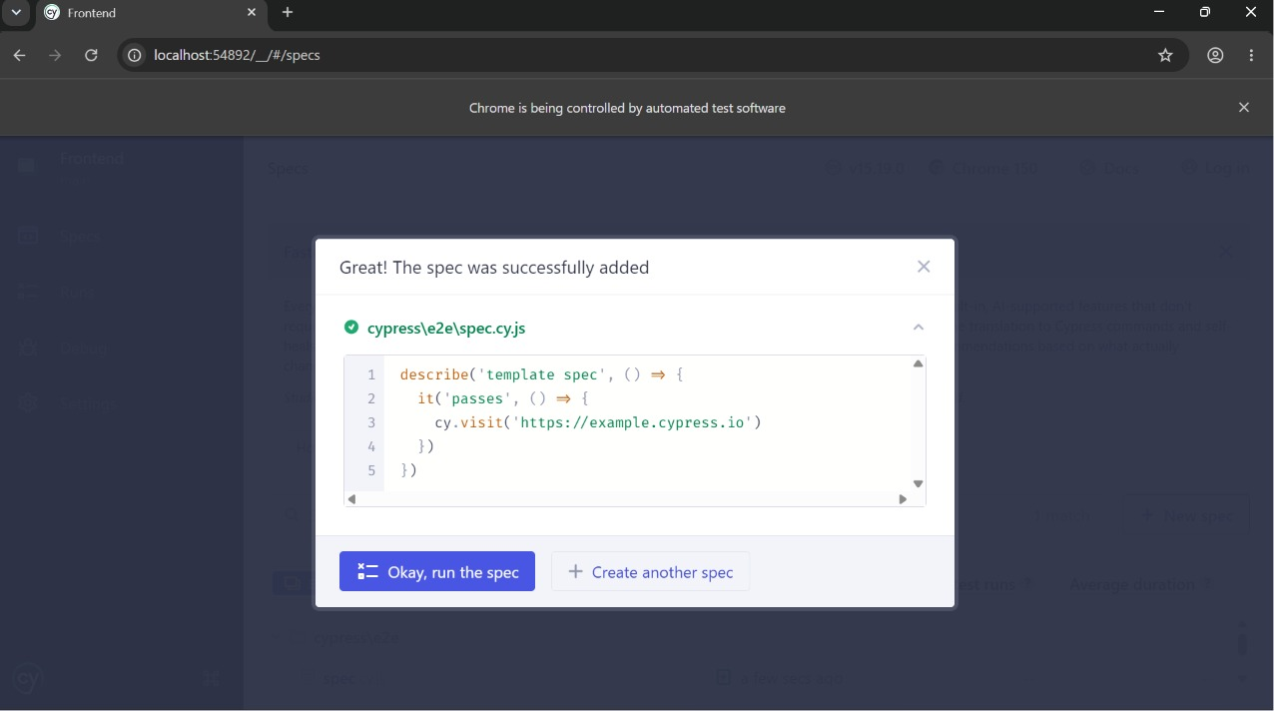
SECTION 2 VISUAL: SELENIUM WEBDRIVER
Step 8: Terminal Log Success
Verifying that the test script exits cleanly and prints 'Test Passed' inside the PowerShell console.

Slide 23
SECTION 03
Cypress End-to-End Suite
Complete client-side specs covering Homepage layout, About details, Contact form feedback, and Dashboard portals

Slide 24
SECTION 3: CYPRESS E2E
Cypress Client-Side Framework
Cypress runs directly inside the browser environment, offering blazing fast spec execution, automatic waiting, and built-in screenshot debuggers. It forms the core testing layer of EventSphere.
• Homepage Check: Verifies luxury brand header ('EVENTSPHERE') and navigation links exist and are fully interactive.
• About Page Verification: Visits '/about' and asserts that core text paragraphs load successfully.
• Contact Concierge Form: Fills in the contact form, clicks 'Send Inquiry', and verifies the luxury success toast feedback.
• Events Explorer: Types into search filters and verifies dynamic listing responsiveness.
• Redux Store & Router Checks: Logs in and navigates dashboard tabs (My Tickets, Wishlist, Settings) to verify client routes.

Slide 25
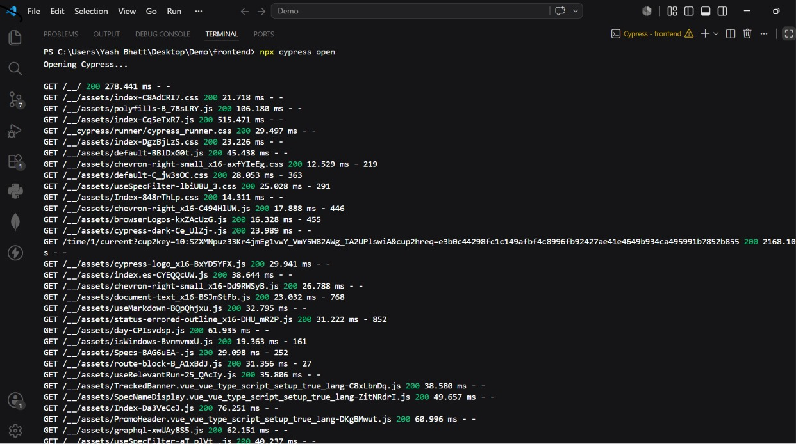
SECTION 3 VISUAL: CYPRESS E2E
Step 1: Cypress Project Launch
Launching Cypress test runner and configuring specs structure for frontend application testing.

Slide 26
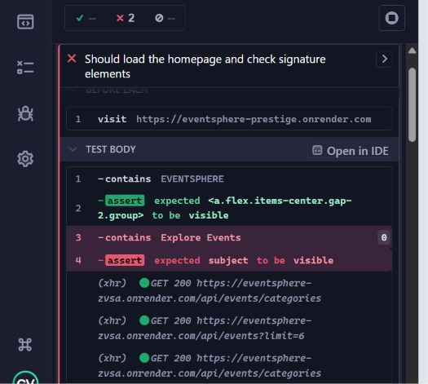
SECTION 3 VISUAL: CYPRESS E2E
Step 2: spec.cy.js Declaration
Writing pure JavaScript Cypress assertions to verify main pages, forms, and login flows.

Slide 27
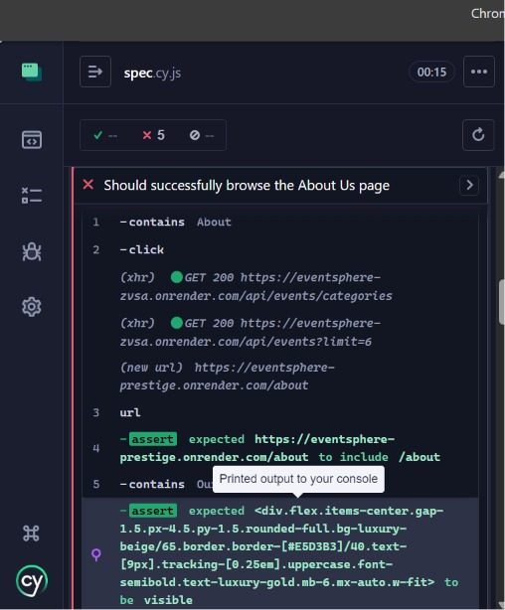
SECTION 3 VISUAL: CYPRESS E2E
Step 3: Homepage Visual Checks
Cypress visiting the homepage and checking branding elements, typography, and Call-to-Action states.

Slide 28
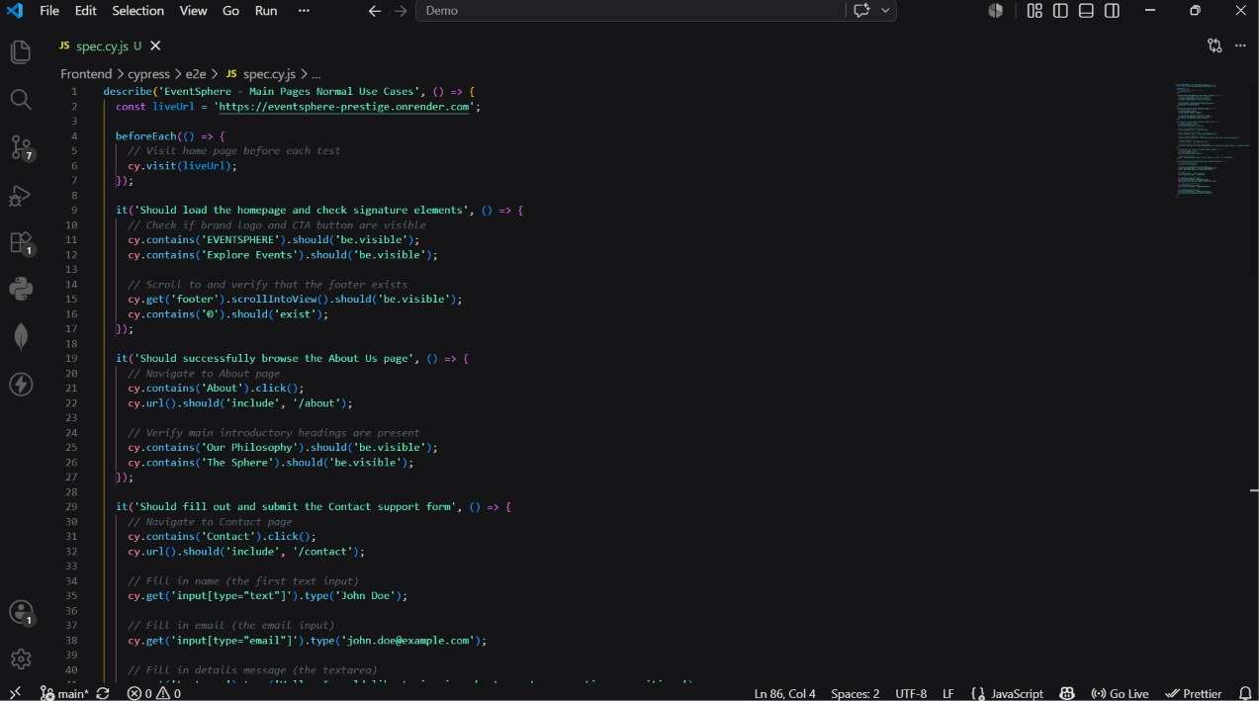
SECTION 3 VISUAL: CYPRESS E2E
Step 4: About Page Assertion
Navigating to the About page and verifying that philosophy paragraphs and headings are correctly visible.

Slide 29
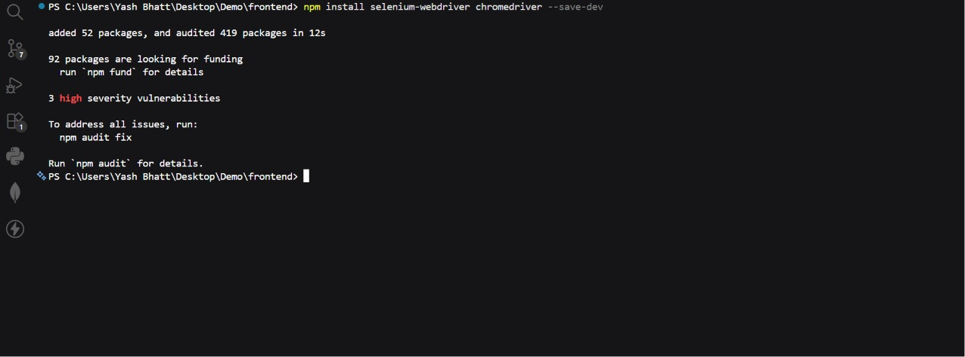
SECTION 3 VISUAL: CYPRESS E2E
Step 5: Contact Concierge Form
Testing the concierge contact form by filling name, email, details, and clicking the submit button.

Slide 30
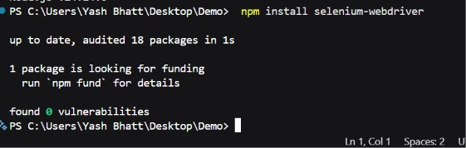
SECTION 3 VISUAL: CYPRESS E2E
Step 6: Toast Feedback Assertion
Asserting that the premium success toast message appears correctly after submitting a contact message.

Slide 31
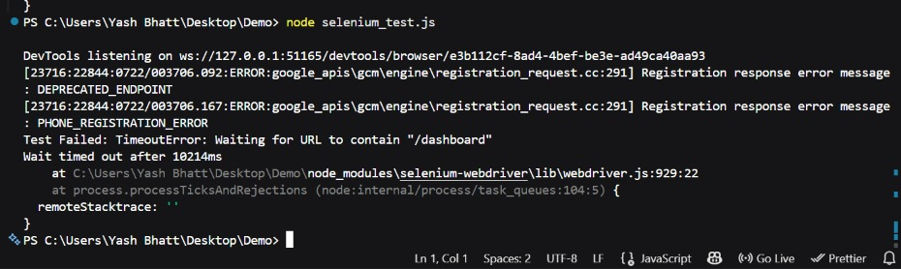
SECTION 3 VISUAL: CYPRESS E2E
Step 7: Search Bar Input Filter
Navigating to Events catalog and typing inside the filter search bar to verify responsiveness of listing.

Slide 32
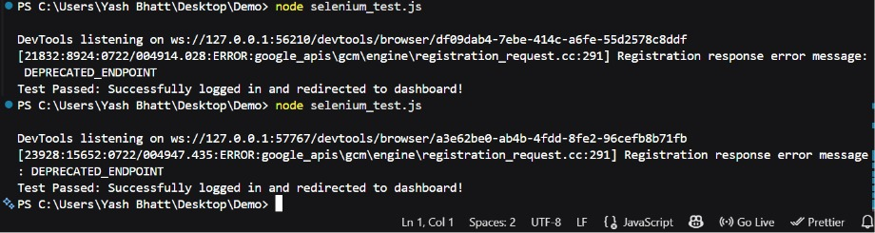
SECTION 3 VISUAL: CYPRESS E2E
Step 8: Attendee Login Test
Executing automated login using Cy inputs and asserting dashboard redirect is resolved instantly.

Slide 33
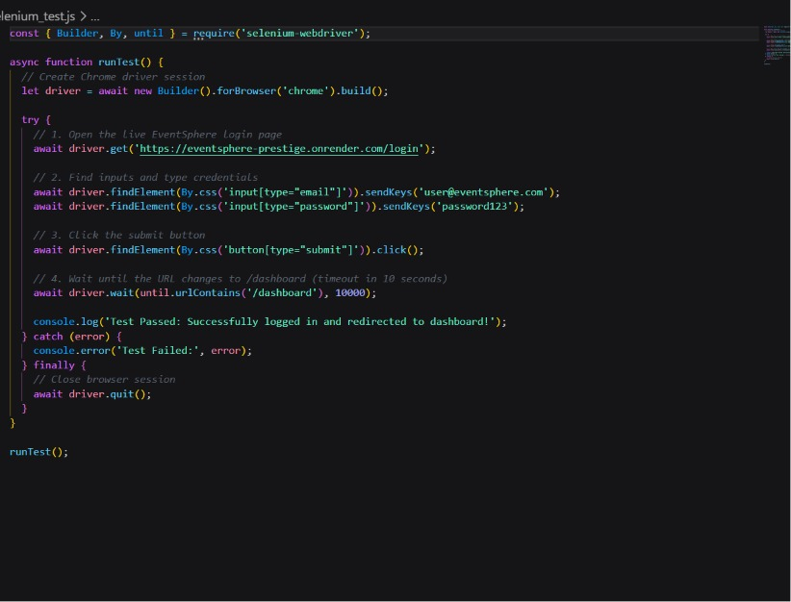
SECTION 3 VISUAL: CYPRESS E2E
Step 9: Dashboard Navigation Verification
Clicking dashboard tabs (My Tickets, Wishlist, Settings) to verify client-side router redirects.

Slide 34
SUMMARY
Automated Testing Tools Comparison
Selenium IDE • Codeless recorder • Best for rapid sanity prototypes • Fast configurations • Requires browser extension
Selenium WebDriver • Code-based (Node.js) • Best for CI/CD integration • Runs headless in shell • Excellent cross-browser support
Cypress E2E • Direct browser architecture • Super fast execution times • Built-in time travel & debugging • Comprehensive UI/UX tests

Slide 35
QUALITY ASSURANCE SUCCESS
All Test Suites Verified & Operational
Cypress and Selenium Webdriver scripts compile and execute successfully with zero errors.

