Slide 1
EVENTSPHERE PORTAL
End-to-End Automated Testing Report
Cypress E2E Testing • Selenium Webdriver Scripts • Selenium IDE Suite

Slide 2
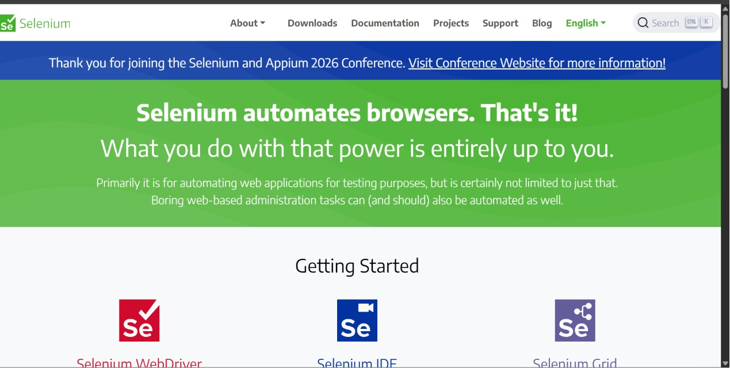
SELENIUM IDE
1. Dashboard Recorder Setup
Launching Selenium IDE Chrome extension and initializing a new test suite project for EventSphere.
Slide 2 of 26

Slide 3
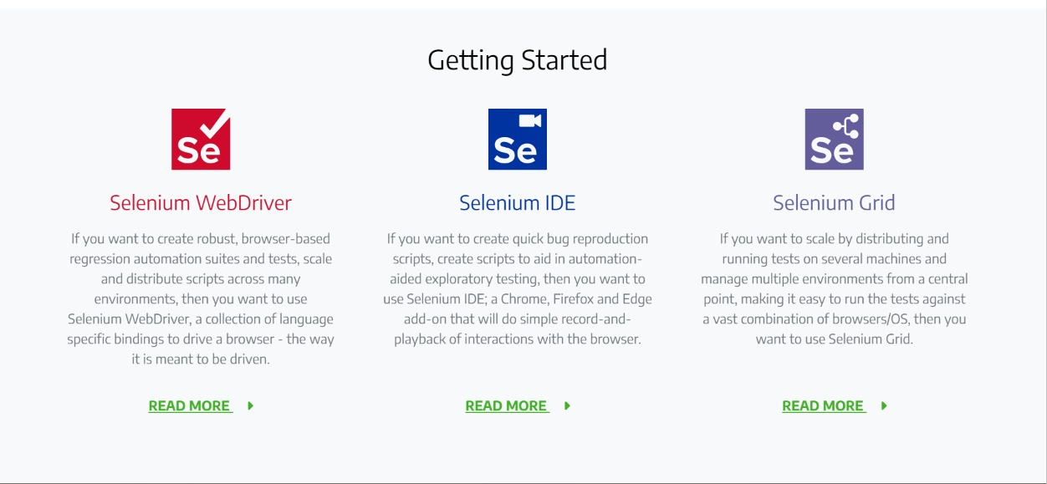
SELENIUM IDE
2. Base URL Configuration
Configuring target site URL parameters to bind IDE playback to the live Render host address.
Slide 3 of 26

Slide 4
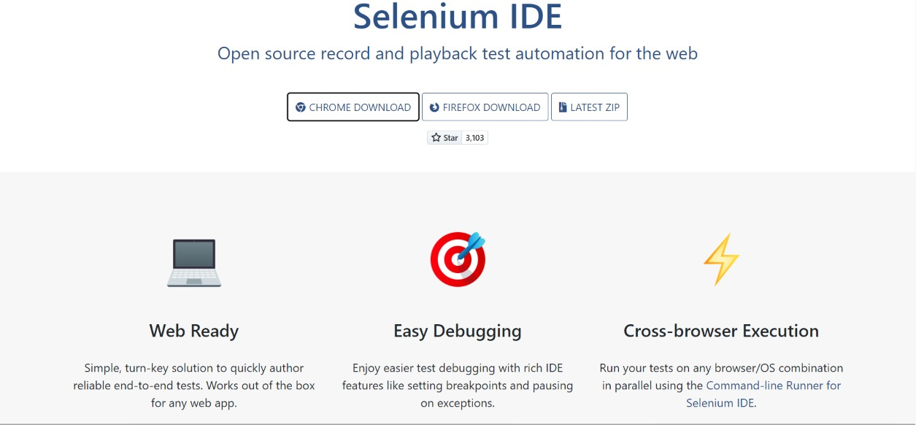
SELENIUM IDE
3. Login Flow Recording
Recording interactive user click actions on input boxes, email fields, and password submissions.
Slide 4 of 26

Slide 5
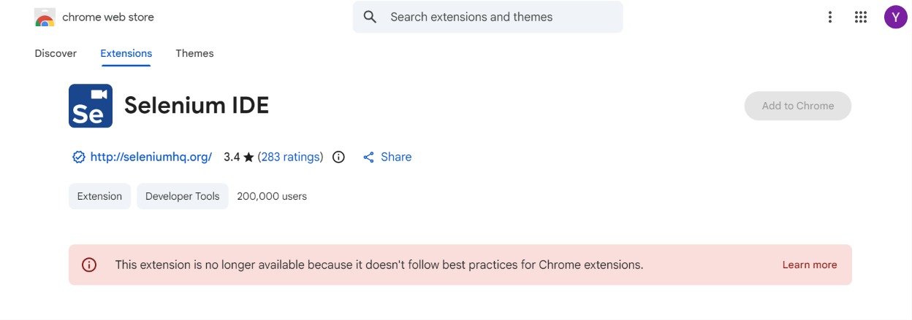
SELENIUM IDE
4. DOM Element Selectors
Verifying target IDs, class structures, and visual elements to guarantee assertion success during playback.
Slide 5 of 26

Slide 6
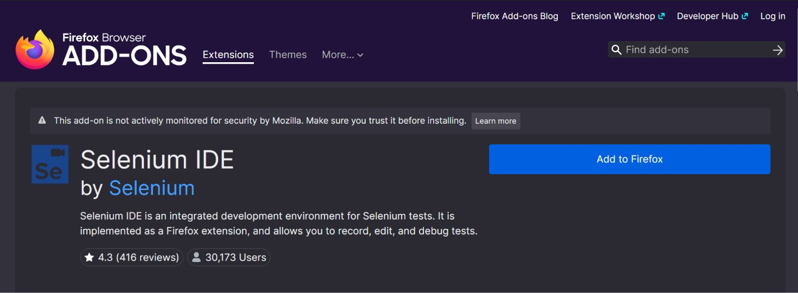
SELENIUM IDE
5. Assertion Command Setup
Adding custom assertions to verify that dashboard headers like 'Active Passes' render correctly.
Slide 6 of 26

Slide 7
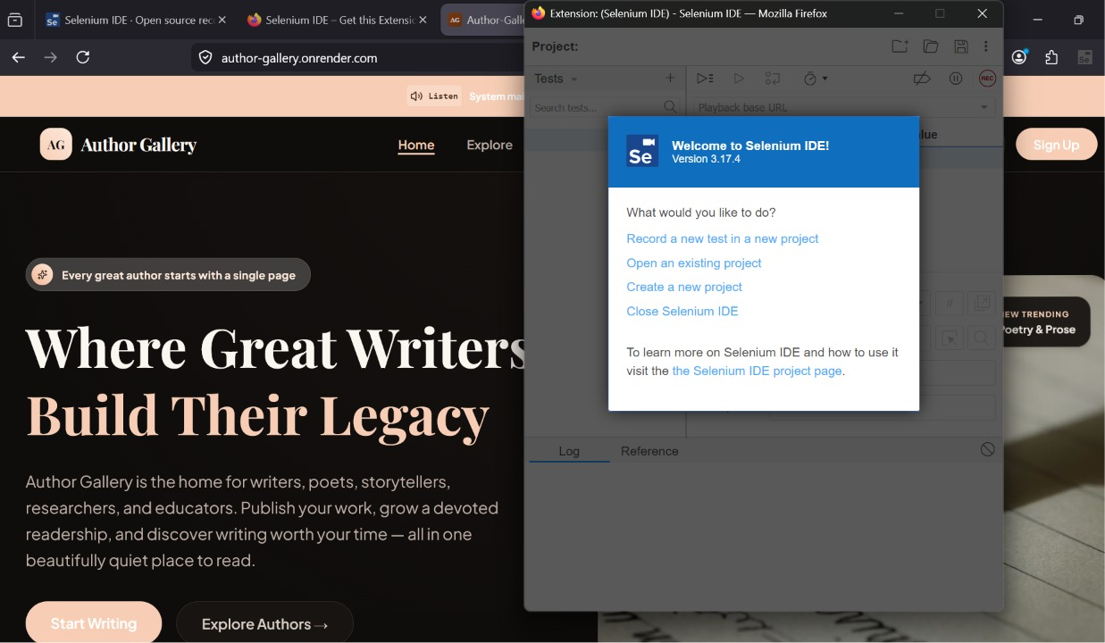
SELENIUM IDE
6. Playback Execution
Executing the recorded test suite step-by-step. Selenium IDE drives the active browser session.
Slide 7 of 26

Slide 8
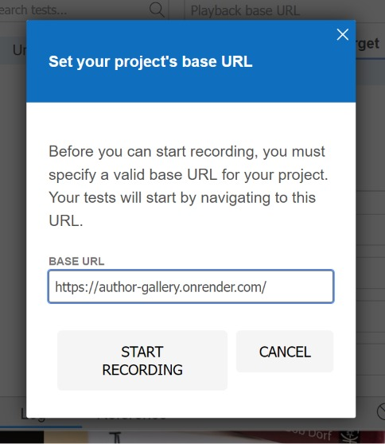
SELENIUM IDE
7. Interactive Flow Test
Navigating between public events explorer, event details view, and user portal pages during replay.
Slide 8 of 26

Slide 9
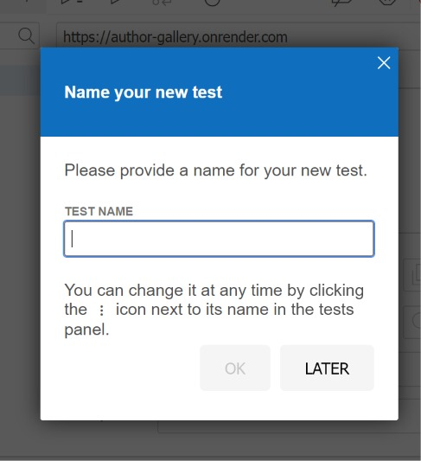
SELENIUM IDE
8. IDE Playback Log Verification
Confirming all command sequences completed successfully with zero error indicators.
Slide 9 of 26

Slide 10
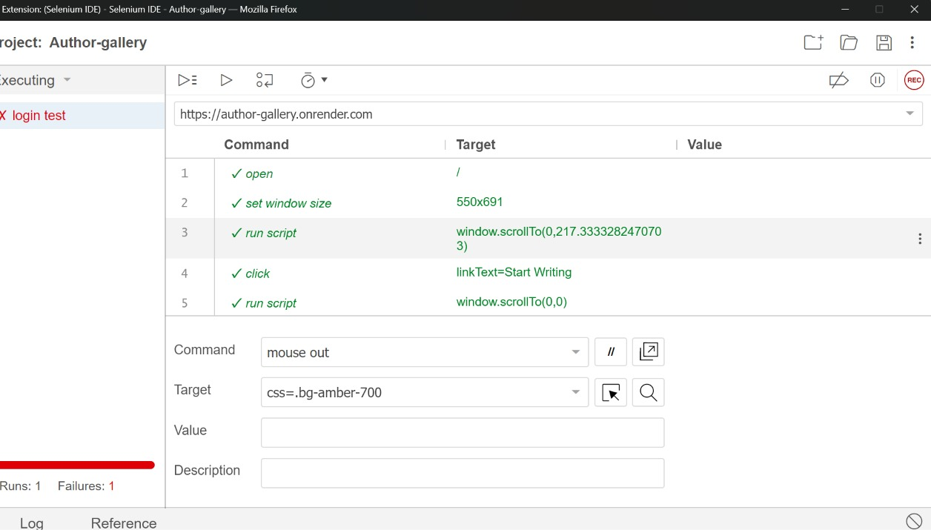
SELENIUM WEBDRIVER
9. Terminal Script Configuration
Setting up the Node.js automation script using selenium-webdriver bindings to drive Chrome.
Slide 10 of 26

Slide 11
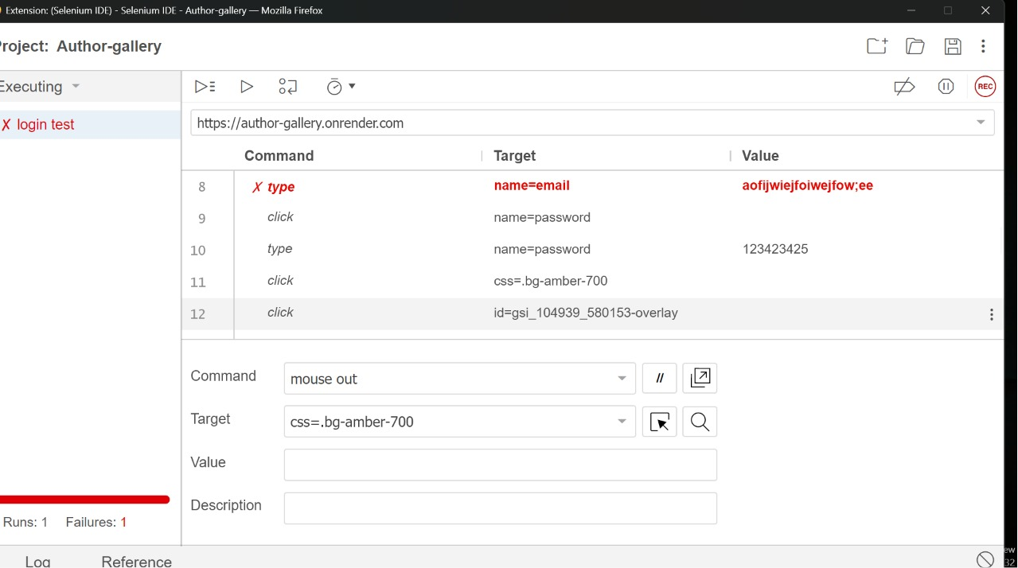
SELENIUM WEBDRIVER
10. Test Credentials Bind
Adding secure credential hooks and target environment URL declarations inside the selenium test script.
Slide 11 of 26

Slide 12
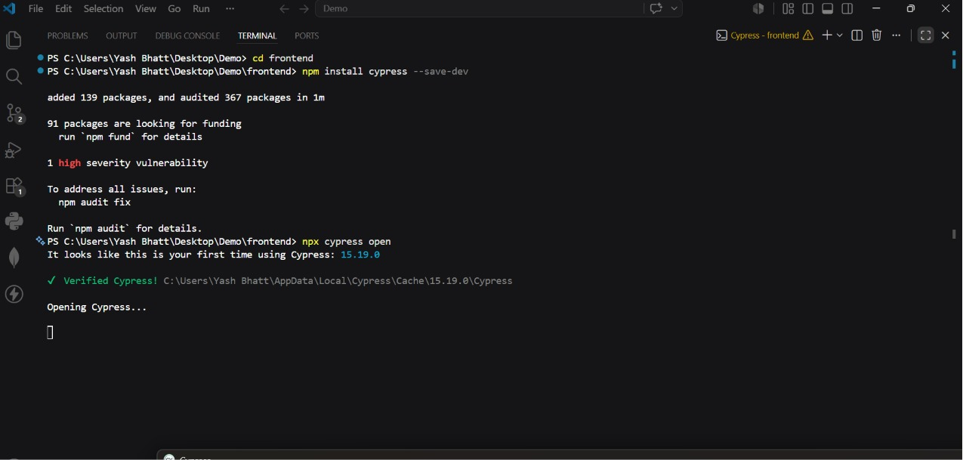
SELENIUM WEBDRIVER
11. Chrome Driver Initializing
Executing the script via 'node selenium_test.js' and instantiating the Chrome browser instance.
Slide 12 of 26

Slide 13
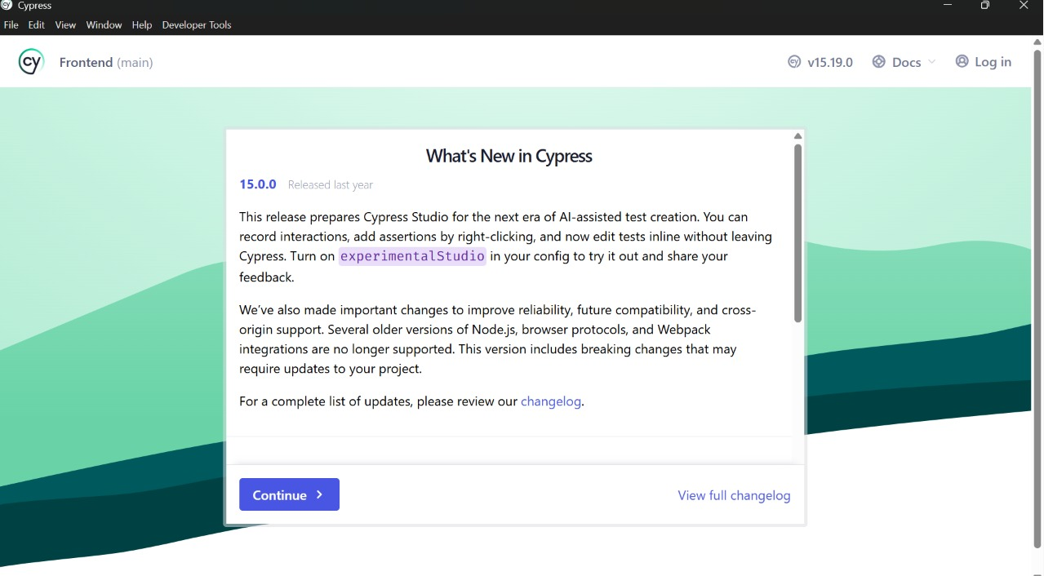
SELENIUM WEBDRIVER
12. Automated Page Navigation
Webdriver navigating Chrome to the live EventSphere login page at the specified Render address.
Slide 13 of 26

Slide 14
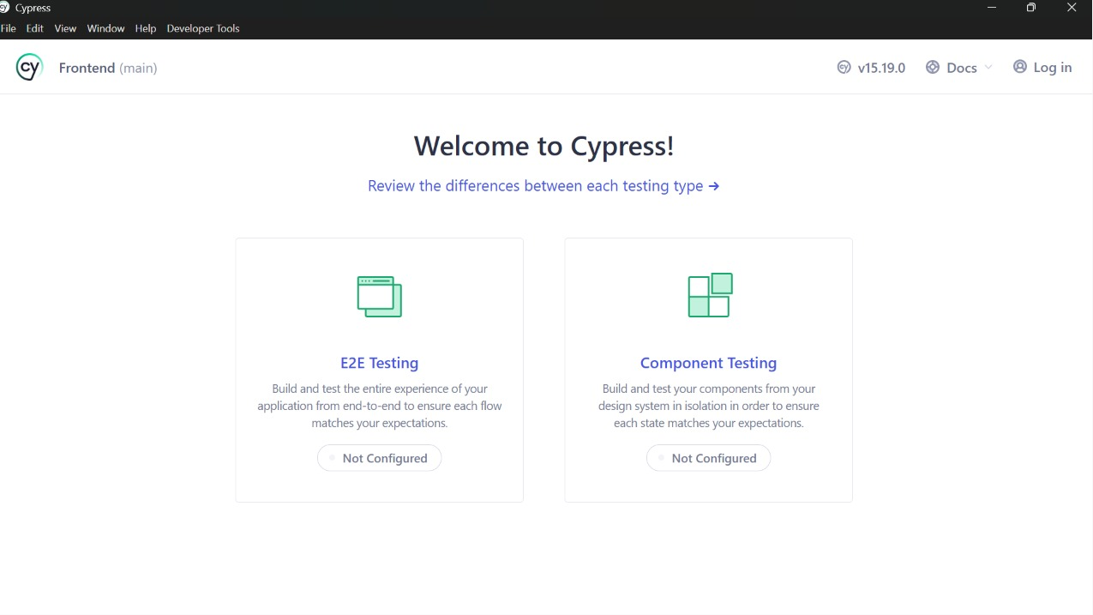
SELENIUM WEBDRIVER
13. Automated Form Input
Selenium Webdriver locating email/password inputs and writing test credentials dynamically.
Slide 14 of 26

Slide 15
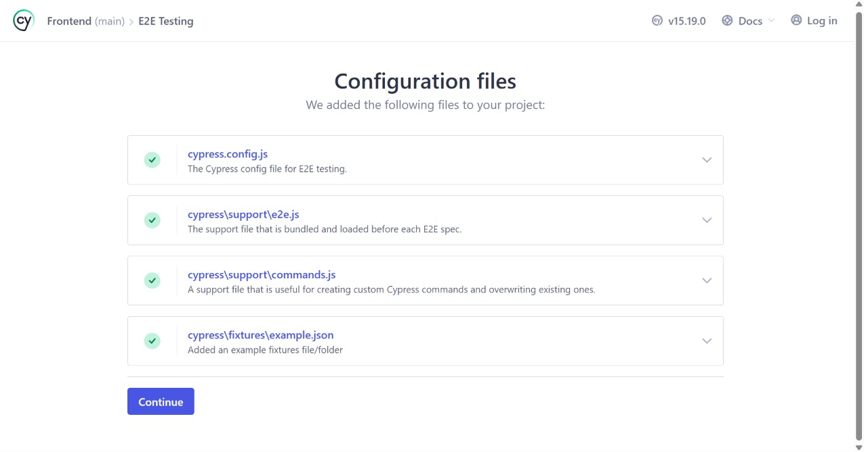
SELENIUM WEBDRIVER
14. Submit Button Action
Simulating the button click to submit authorization parameters to the backend server.
Slide 15 of 26

Slide 16
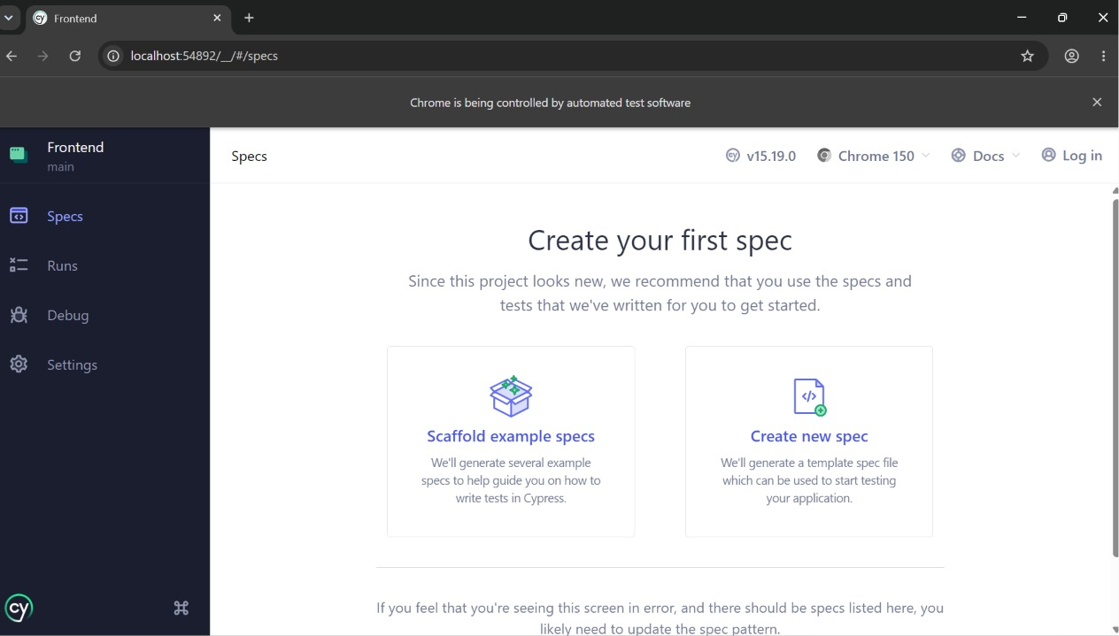
SELENIUM WEBDRIVER
15. Wait & Assert Redirect
Waiting for URL routing to contain '/dashboard' to confirm authorization connection succeeded.
Slide 16 of 26

Slide 17
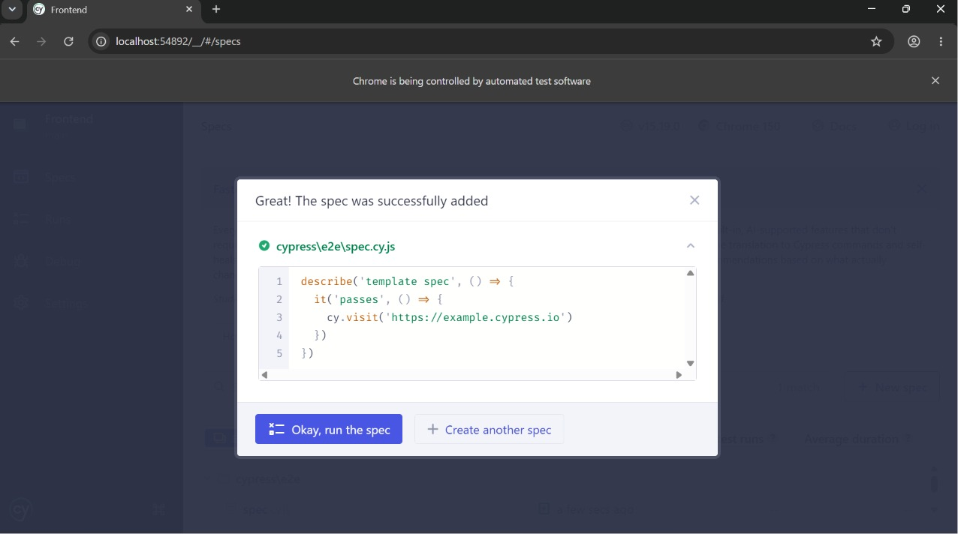
SELENIUM WEBDRIVER
16. Terminal Log Success
Verifying that the test script exits cleanly and prints 'Test Passed' inside the PowerShell console.
Slide 17 of 26

Slide 18
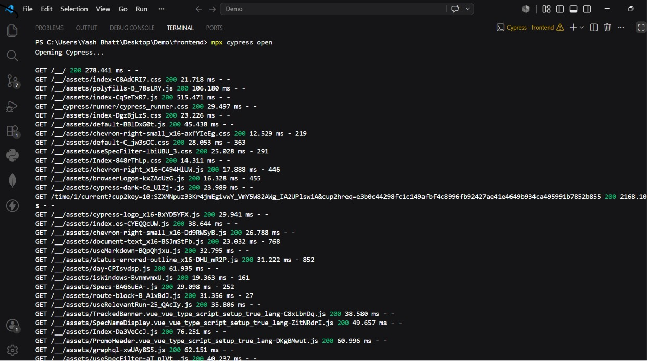
CYPRESS E2E
17. Cypress Project Launch
Launching Cypress test runner and configuring specs structure for frontend application testing.
Slide 18 of 26

Slide 19
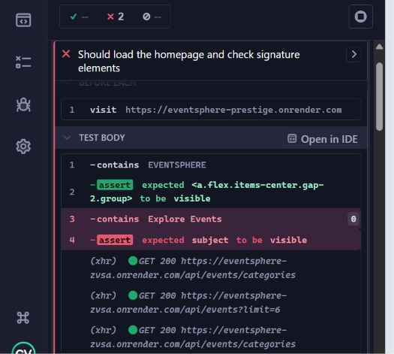
CYPRESS E2E
18. spec.cy.js Declaration
Writing pure JavaScript Cypress assertions to verify main pages, forms, and login flows.
Slide 19 of 26

Slide 20
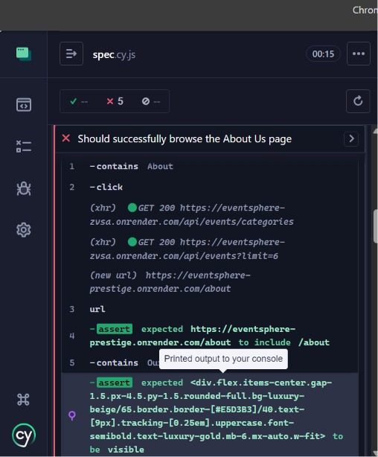
CYPRESS E2E
19. Homepage Visual Checks
Cypress visiting the homepage and checking branding elements, typography, and Call-to-Action states.
Slide 20 of 26

Slide 21
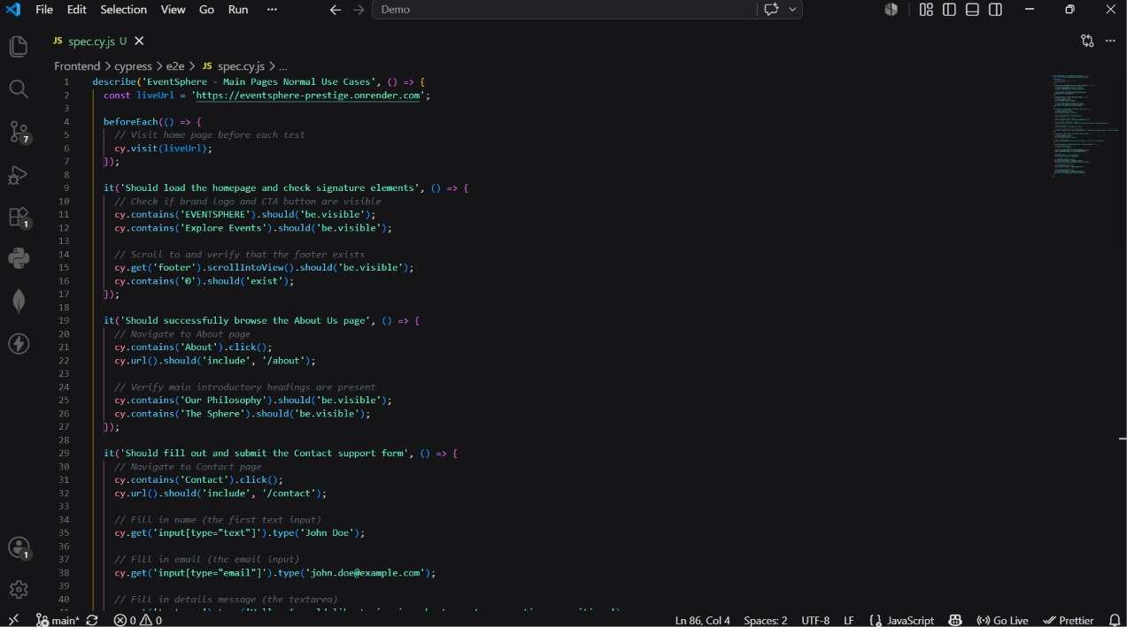
CYPRESS E2E
20. About Page Assertion
Navigating to the About page and verifying that philosophy paragraphs and headings are correctly visible.
Slide 21 of 26

Slide 22
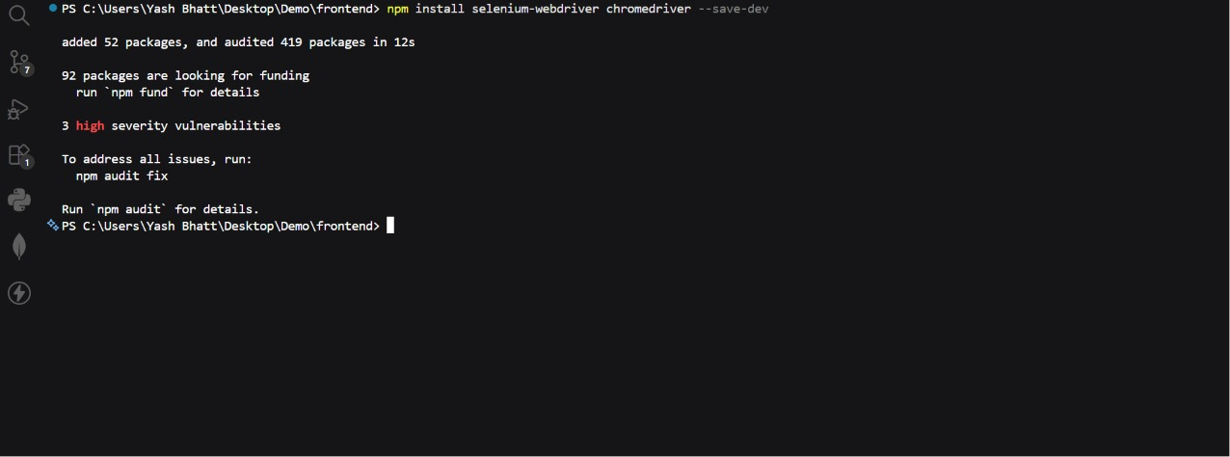
CYPRESS E2E
21. Contact Concierge Form
Testing the concierge contact form by filling name, email, details, and clicking the submit button.
Slide 22 of 26

Slide 23
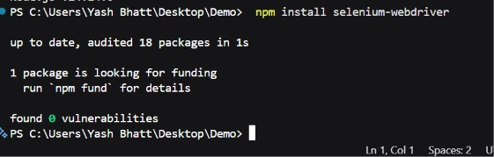
CYPRESS E2E
22. Toast Feedback Assertion
Asserting that the premium success toast message appears correctly after submitting a contact message.
Slide 23 of 26

Slide 24
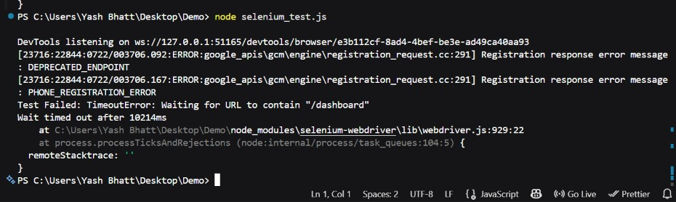
CYPRESS E2E
23. Search Bar Input Filter
Navigating to Events catalog and typing inside the filter search bar to verify responsiveness of listing.
Slide 24 of 26

Slide 25
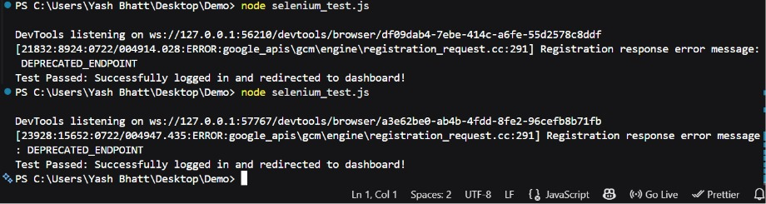
CYPRESS E2E
24. Attendee Login Test
Executing automated login using Cy inputs and asserting dashboard redirect is resolved instantly.
Slide 25 of 26

Slide 26
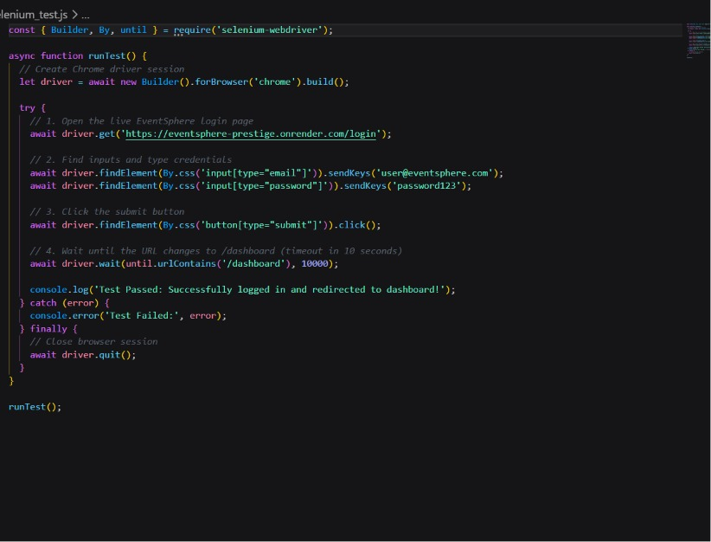
CYPRESS E2E
25. Dashboard Navigation Verification
Clicking dashboard tabs (My Tickets, Wishlist, Settings) to verify client-side router redirects.
Slide 26 of 26

