Slide 1
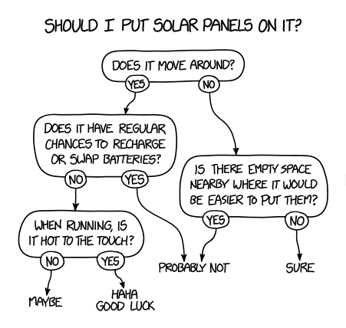

Our mission
Tree Based Methods
Agenda
Information / entropy
Decision Trees
Random Forests
Boosting
Bagging

Slide 2
Day | Outlook | Temperature | Humidity | Wind | PlayTennis
D1 | Sunny | Hot | High | Weak | No
D2 | Sunny | Hot | High | Strong | No
D3 | Overcast | Hot | High | Weak | Yes
D4 | Rain | Mild | High | Weak | Yes
D5 | Rain | Cool | Normal | Weak | Yes
D6 | Rain | Cool | Normal | Strong | No
D7 | Overcast | Cool | Normal | Strong | Yes
D8 | Sunny | Mild | High | Weak | No
D9 | Sunny | Cool | Normal | Weak | Yes
D10 | Rain | Mild | Normal | Weak | Yes
D11 | Sunny | Mild | Normal | Strong | Yes
D12 | Overcast | Mild | High | Strong | Yes
D13 | Overcast | Hot | Normal | Weak | Yes
D14 | Rain | Mild | High | Strong | No

Slide 3

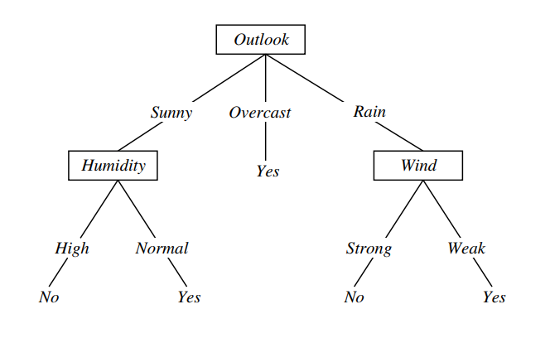
Representation of Decision Tree
Each internal node tests an attribute
Each branch corresponds to a value
Each leaf node assigns a classification value

Slide 4
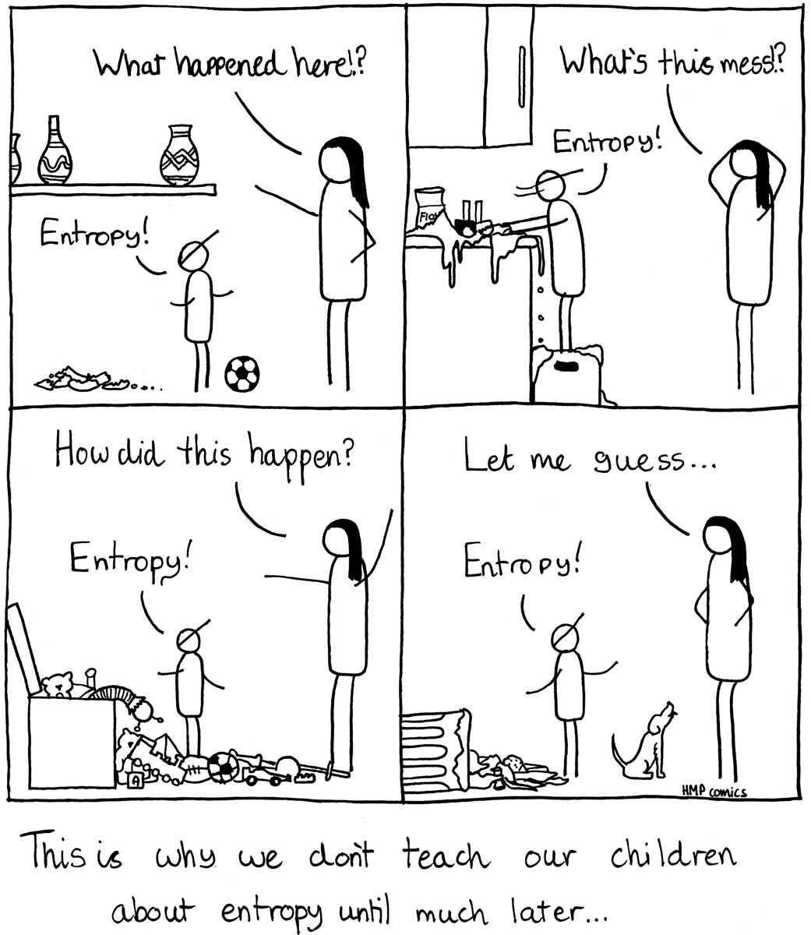
Entropy/Information
Entropy(S)
expected number of bits needed to encode class ( or ) of randomly drawn member of S (under the optimal, shortest-length code)
Why? Information theory:
optimal length code assigns log₂p bits to message having probability p.

Slide 6
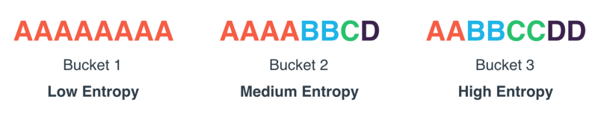
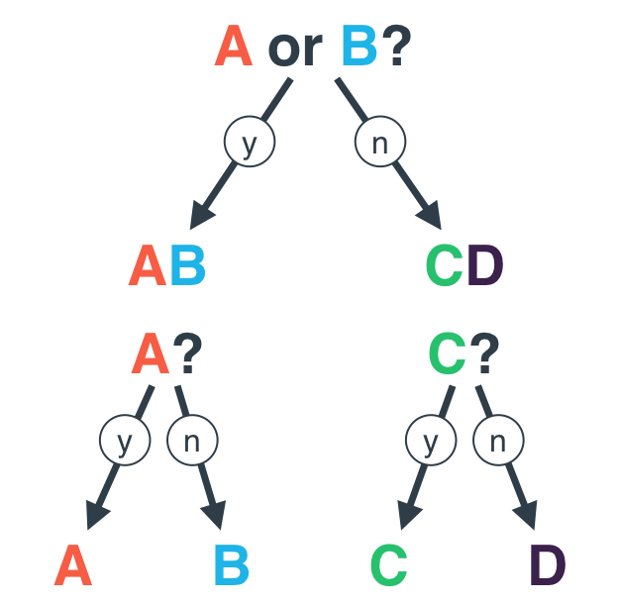


Slide 7
Gain(S; A) = expected reduction in entropy due to sorting on A Gain(S; A) Entropy(S) X v2V alues(A) jSvj jSj Entropy(Sv)
http://www.cs.cmu.edu/afs/cs.cmu.edu/project/theo-20/www/mlbook/ch3.pdf

Slide 8
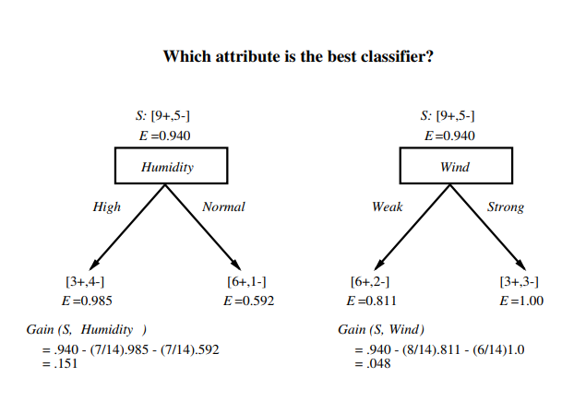
Day | Outlook | Temperature | Humidity | Wind | PlayTennis
D1 | Sunny | Hot | High | Weak | No
D2 | Sunny | Hot | High | Strong | No
D3 | Overcast | Hot | High | Weak | Yes
D4 | Rain | Mild | High | Weak | Yes
D5 | Rain | Cool | Normal | Weak | Yes
D6 | Rain | Cool | Normal | Strong | No
D7 | Overcast | Cool | Normal | Strong | Yes
D8 | Sunny | Mild | High | Weak | No
D9 | Sunny | Cool | Normal | Weak | Yes
D10 | Rain | Mild | Normal | Weak | Yes
D11 | Sunny | Mild | Normal | Strong | Yes
D12 | Overcast | Mild | High | Strong | Yes
D13 | Overcast | Hot | Normal | Weak | Yes
D14 | Rain | Mild | High | Strong | No

Slide 9
Top-Down Induction of Decision Trees
Main Loop:
A ← The best decision attribute for next node.
Assign A as decision attribute for node
For each value of A, create new descendant of node
Sort training examples to leaf nodes
If training examples perfectly classified, Then STOP, Else iterate over new leaf nodes

Slide 10
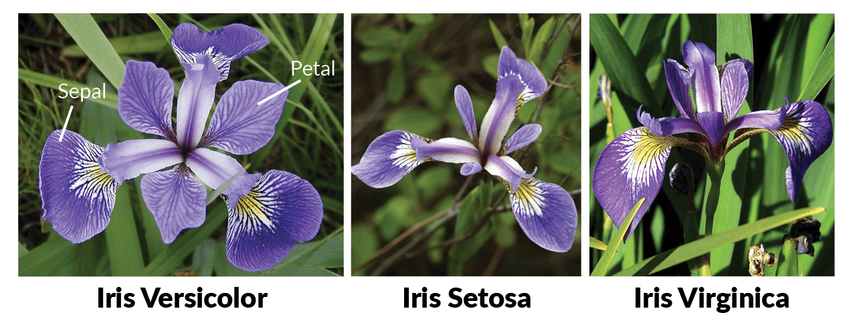

Slide 11
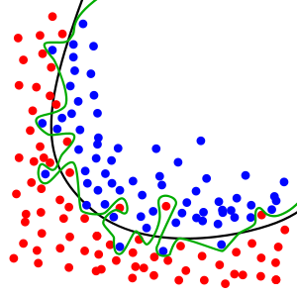
Overfitting

Slide 12
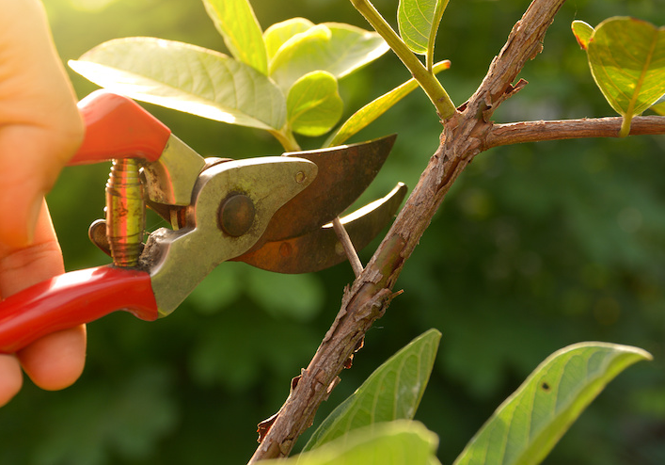
Pruning
Pre-pruning
Halting sub-tree construction at some node after checking some measures
Max-depth, min-entropy, min_samples_split, max-features, ….
Post-pruning
Grow Decision Tree Entirely and trim nodes in bottom up fashion in way that it doesn’t hurt the predictive power
Hold a pruning/validation set and trim until classification error increases

Slide 13
Ensemble Learning
Random Forest
Bagging
Boosting
Ensemble Learning
Averaging/Bagging
Boosting
Pasting
Bagging
Random sub-space
Random patches
Random Forest
Adaboost
Gadient Tree boosting

Slide 14
Two families of ensemble methods are usually distinguished:
In averaging methods, the driving principle is to build several estimators independently and then to average their predictions. On average, the combined estimator is usually better than any of the single base estimator because its variance is reduced.
Examples: Bagging methods, Forests of randomized trees, …
Bagging methods come in many flavours but mostly differ from each other by the way they draw random subsets of the training set:
When random subsets of the dataset are drawn as random subsets of the samples, then this algorithm is known as Pasting [B1999].
When samples are drawn with replacement, then the method is known as Bagging [B1996].
When random subsets of the dataset are drawn as random subsets of the features, then the method is known as Random Subspaces [H1998].
Finally, when base estimators are built on subsets of both samples and features, then the method is known as Random Patches [LG2012].

Slide 15
By contrast, in boosting methods, base estimators are built sequentially and one tries to reduce the bias of the combined estimator. The motivation is to combine several weak models to produce a powerful ensemble.
Examples: AdaBoost, Gradient Tree Boosting, …

Slide 16
The core principle of AdaBoost is to fit a sequence of weak learners (i.e., models that are only slightly better than random guessing, such as small decision trees) on repeatedly modified versions of the data. The predictions from all of them are then combined through a weighted majority vote (or sum) to produce the final prediction. The data modifications at each so-called boosting iteration consist of applying weights , , …, to each of the training samples. Initially, those weights are all set to , so that the first step simply trains a weak learner on the original data. For each successive iteration, the sample weights are individually modified and the learning algorithm is reapplied to the reweighted data. At a given step, those training examples that were incorrectly predicted by the boosted model induced at the previous step have their weights increased, whereas the weights are decreased for those that were predicted correctly. As iterations proceed, examples that are difficult to predict receive ever-increasing influence. Each subsequent weak learner is thereby forced to concentrate on the examples that are missed by the previous ones in the sequence [HTF].

Slide 17
Gradient Tree Boosting or Gradient Boosted Regression Trees (GBRT) is a generalization of boosting to arbitrary differentiable loss functions. GBRT is an accurate and effective off-the-shelf procedure that can be used for both regression and classification problems. Gradient Tree Boosting models are used in a variety of areas including Web search ranking and ecology.

