Slide 1
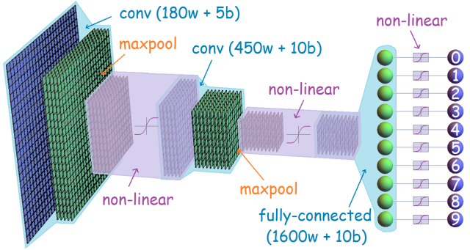
Convolutional Neural Networks
A generic overview
Prathmesh R Madhu
InFoCusp

Slide 2
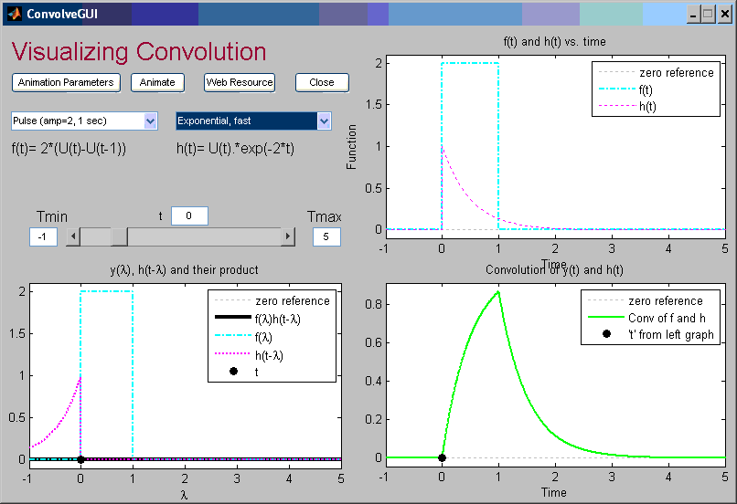
Background
Part1 - Background - CIKM14_tutorial
Convolution -

Slide 3
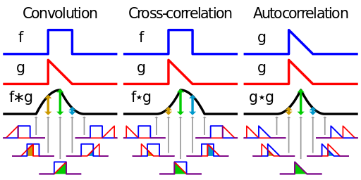
Difference

Slide 4
What are CNN's?
A Convolutional neural network (CNN) architecture is formed by a stack of distinct layers that transform the input volume into an output volume through a differentiable function in order to find the set of locally connected neurons.
Convolutional layer
  The layer's parameters consist of a set of filters (weight).
  During the forward pass, each filter is convolved across the input, computing the dot product between the entries of the filter and the input is producing an activation map of that filter.
Pooling layer
  It is a form of non-linear down-sampling.
  Max/Average Pooling are the most common approaches
Fully-connected layer
  It is a layer similar to the layers used in conventional neural network where each neuron of the current layer is connected to the all neurons of previous layer.
  Generally, it is at the output of the CNN.
Notes:
Pooling partitions the input into a set of non-overlapping rectangles and, for each such sub-region, outputs the maximum/average value.

Slide 5
Where are CNN's used?
Computer Vision
  Object classification and detection
  Face detection and verification
Speech Processing
Natural Language Processing
Security systems
Search and Recommender Systems
...

Slide 6
When are CNN's used?
A very broad question
The standard answer : “It depends upon the data, you know the heuristics of the parameters help decide whether the CNNs will work for a particular application or not.”
So a better answer could be -- “When the data seems to be correlated and little complex, CNNs might work. One must experiment and find out”

Slide 7
How do CNNs work?
For a layman, it is purely a black box. However, one who understands a little mathematics and Machine learning (ML), understands that it is purely a mathematical/statistical model
One can describe the working of CNN (rather any deep neural network) in three stages :
  Forward Propagation
  Back-propagation
  Weights updating process

Slide 8
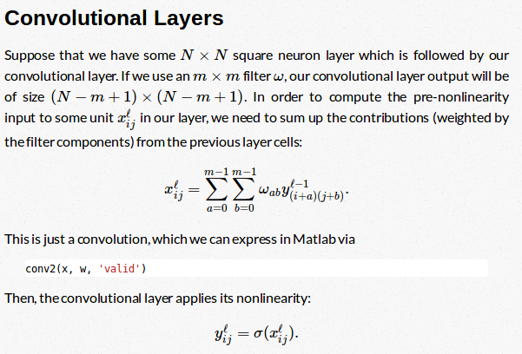
Forward Propagation
All possible non-linearities : Sigmoid, Tanh, Rectified linear units (ReLUs), Exponential linear units (ELUs), Maxout

Slide 9
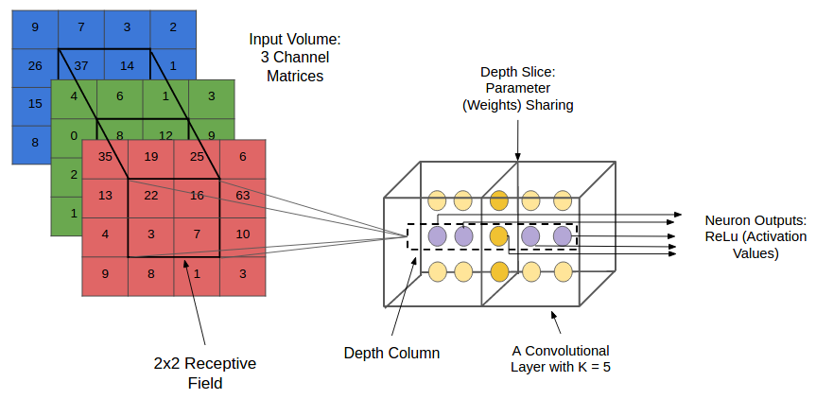

Slide 10
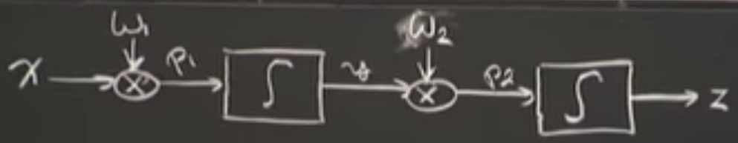
Back-propagation
A way of computing gradients of expressions through recursive application of chain rule.
We will derive the equation for an easiest neural network to get an intuition and it can be extended or CNNs.
The derivative on each variable tells you the sensitivity of the whole expression on its value.
You can also find the derivation for CNNs on andrew gibiansky's blog.

Slide 11
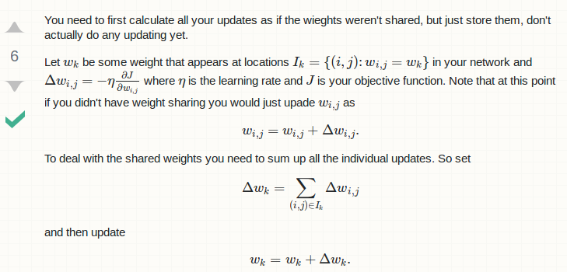
Weights updating process
From one of the discussion on stackexchange

Slide 12
CNNs for Computer Vision
CNN - Deep learning for Computer Vision - ml-lecture-3

Slide 13
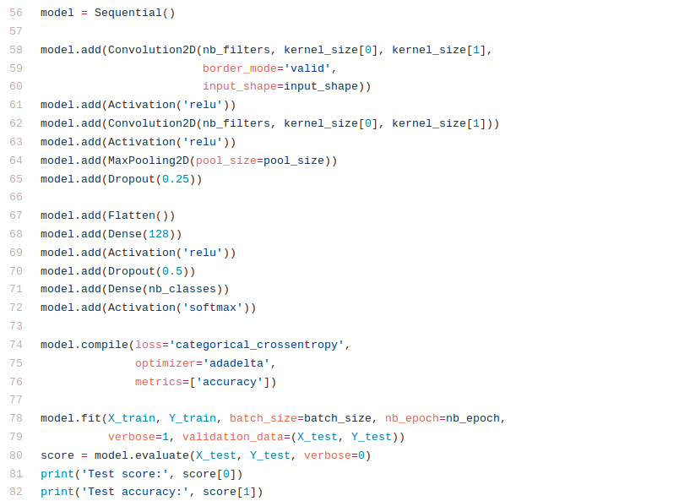
How simple it looks these days?

Slide 14
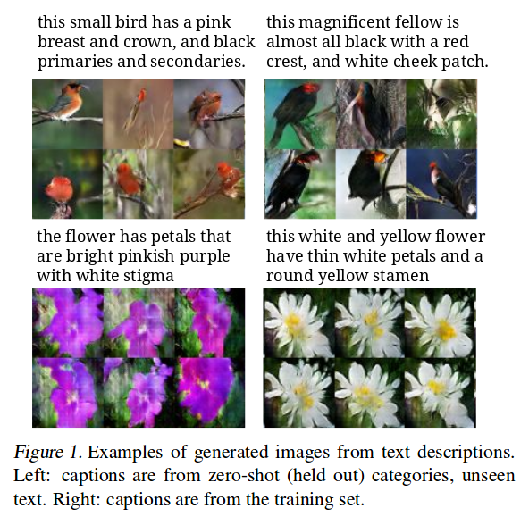
Meanwhile, CNNs + GANs combined did this

Slide 15
Further readings
1. Excellent vision course : http://cs231n.github.io/
2. Neural networks understanding : https://ocw.mit.edu/courses/electrical-engineering-and-computer-science/6-034-artificial-intelligence-fall-2010/lecture-videos/lecture-12a-neural-nets/

