Slide 1

Support Vector Machines

Slide 2
Table of contents
What is support vector Machine
Support Vectors
Linear Separability
Kernels

Slide 3
What is Support Vector Machine
Support Vector Machine (SVM) is a classifier which tries to find a separating hyperplane. In other words, given labeled training data (supervised learning), the algorithm outputs an optimal hyperplane which categorizes new examples.
In two dimensional space this hyperplane is a line dividing a plane in two parts where in each class lay in either side.

Slide 4
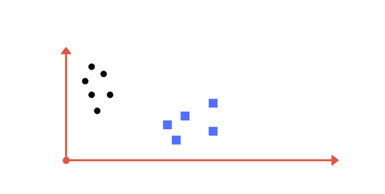
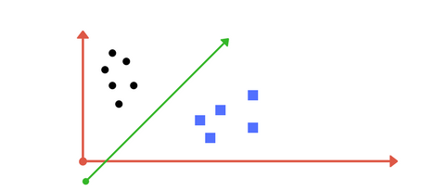
What is Support Vector Machine
Separation of classes. That’s what SVM does. It finds out a line/ hyper-plane (in multidimensional space that separate outs classes).

Slide 5
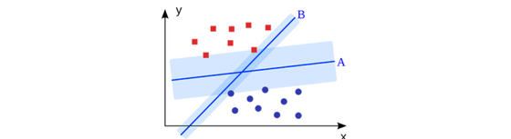
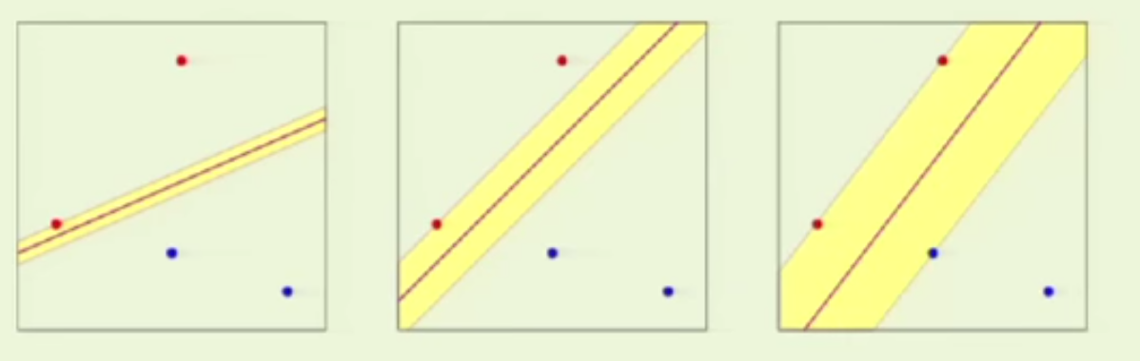
Which line to choose?

Slide 6
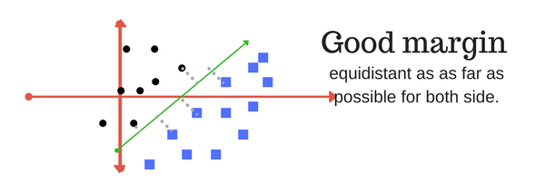
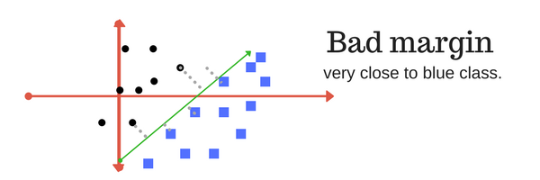
Margin
SVM to core tries to achieve a good margin.
A margin is a separation of line to the closest class points.
A good margin is one where this separation is larger for both the classes. Images below gives to visual example of good and bad margin. A good margin allows the points to be in their respective classes without crossing to other class.

Slide 7
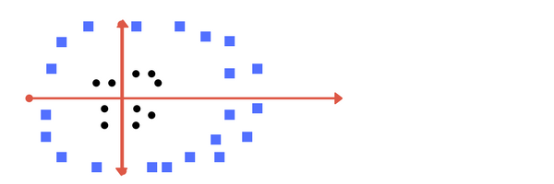
What if the data isn’t linearly separable?

Slide 8
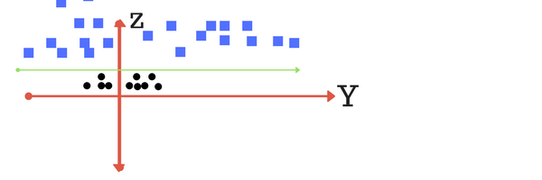
What if the data isn’t linearly separable?
Make it linearly separable and apply the kernel trick
Z = x²+y²

Slide 9
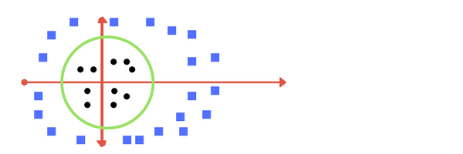
The kernel trick
When we transform back this line to original plane, it maps to circular boundary as shown in image E. These transformations are called kernels.

Slide 10
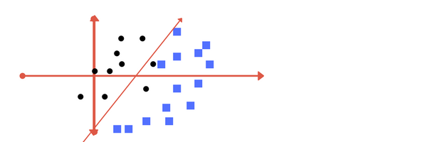
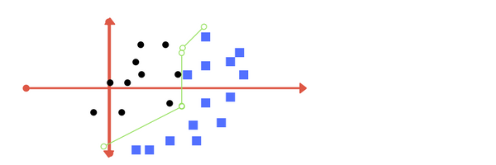
Regularization parameter C
In a SVM you are searching for two things: a hyperplane with the largest minimum margin, and a hyperplane that correctly separates as many instances as possible. The problem is that you will not always be able to get both things. The c parameter determines how great your desire is for the latter.

Slide 11
Kernel Selection
For linear kernel the equation for prediction for a new input using the dot product between the input (x) and each support vector (xi) is calculated as follows:
f(x) = B(0) + sum(ai * (x,xi))
This is an equation that involves calculating the inner products of a new input vector (x) with all support vectors in training data. The coefficients B0 and ai (for each input) must be estimated from the training data by the learning algorithm.
The polynomial kernel can be written as K(x,xi) = 1 + sum(x * x_{i}) + sum(x*x_{i})²
Polynomial and exponential kernels calculates separation line in higher dimension.

