Slide 1

Cultivating Prosperity: A fusion of IoT data with machine learning and deep learning for precision crop recommendations
Team Details
Team Number:4
Sl.Num. | Student Name | USN | Roll Num. | Division
01 | Bhumika F | 01FE21BCI006 | 106 | F
02 | Sakshi A | 01FE21BCI022 | 121 | F
03 | Abhishek A | 01FE21BCI004 | 104 | F
04 | Yash H | 01FE21BCS005 | 105 | F
Guide: Sneha Varur

Slide 2

INTRODUCTION
Agriculture has played a pivotal role throughout history, sustaining civilizations by providing essential food resources and influencing economies.
It is deeply intertwined with societal and cultural aspects, impacting GDP, employment, and trade.- Maintaining optimal environmental conditions, such as light, humidity, and soil quality, is crucial for productivity and sustainable farming practices.
Thoughtful crop selection is essential to mitigate wastage and economic setbacks, especially in challenging circumstances like drought.
The advent of IoT technology enables real-time monitoring of crop health and environmental conditions, facilitating data-driven decision-making and precision farming.
Machine learning models analyze vast historical data to accurately predict crop yields, reducing uncertainties and optimizing agricultural practices.
Leveraging insights from these models aims to enhance agricultural sustainability by enabling informed decision-making and promoting sustainable practices.

Slide 3
LITERATURE SURVEY
1.Smart Crop Recommender System-A Machine Learning Approach
This paper explores the integration of machine learning, particularly deep learning, to address agricultural problems with a specific focus on crop optimization.
The researchers proposed a three-stage system comprising preliminary data gathering, distribution analysis, and performance evaluation.
Through correlation analysis, distribution analysis, co-sharing, and majority voting, the researchers approved 22 products.
Naive Bayes emerged as the most accurate model, achieving a remarkable accuracy rate of 99.54%.
Interestingly, Naive Bayes outperformed the majority voter, which achieved an accuracy rate of 98.52%.
This study highlights the potential of machine learning in agriculture and offers insights for future research directions.
Future research avenues include the integration of deep neural networks and in-flight applications to enhance predictive capabilities.

Slide 4
LITERATURE SURVEY
2. Automatic Crop Expert System Using Improved LSTM with Attention Block
The study introduced a novel stitching method consisting of 27 layers, including a LSTM model and color blocking.
This new method demonstrated superior performance compared to existing approaches.
Specifically, it accurately identified the most suitable crop among 22 varieties with a high accuracy rate of 97.26%.
Additionally, the model exhibited impressive sensitivity (96.9%), F1 score (95.69%), and recall rate (96.56%).
Future plans outlined in the study include sharing business intelligence with business customers.
The study also aims to develop mobile applications and web interfaces to enhance trust and accessibility of the proposed method

Slide 5
LITERATURE SURVEY
3. Intelligent Crop Recommendation System using Machine Learning
The study proposed ensemble learning utilizing various methods, including decision trees (81% accuracy), KNN (85% accuracy), linear regression (88.26% accuracy), naive Bayes (82% accuracy), neural networks (89.88% accuracy), and SVM (78% accuracy).
Research focuses on addressing critical issues such as soil geography and environmental degradation to provide detailed crop management information to Indian farmers, aiming to reduce crop losses and failures.
Future plans include the development of a web interface and mobile app accessible to farmers nationwide.

Slide 6
LITERATURE SURVEY
4. Analysis of SVM and RNN-LSTM on Crop Datasets
The study addresses the impact of global population growth on food security, emphasizing the role of agricultural technology.
Machine learning methods, including SVM and RNN-LSTM, were evaluated for predicting historical crop data from an Indian government website.
SVM achieved slightly higher accuracy (78%) compared to RNN-LSTM (70%), attributed to real-world challenges.
The study demonstrates the potential of machine learning in processing crop data and its importance in accurate predictions.
It suggests the feasibility of using machine learning for crop and yield predictions, paving the way for future hybrid models combining SVM and RNN-LSTM.

Slide 7
PROBLEM STATEMENT
Build a predictive model employing both machine learning and deep learning techniques to determine the optimal crop choice based on diverse soil and environmental conditions .

Slide 8
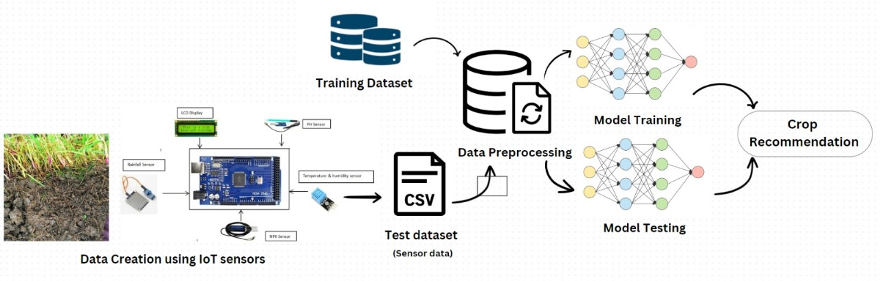
PROPOSED SYSTEM

Slide 9
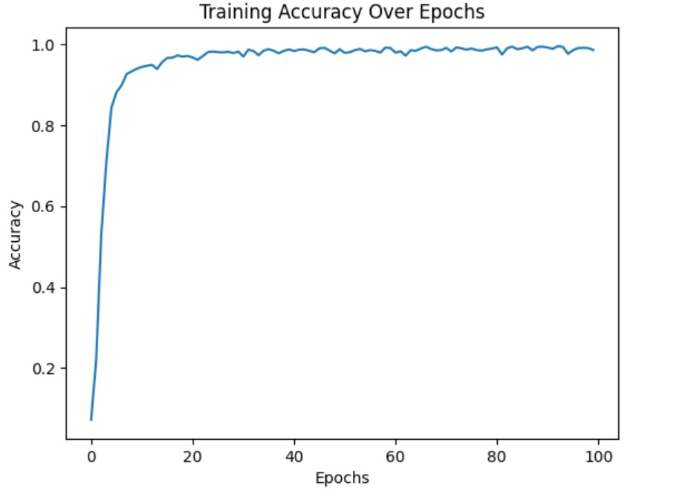
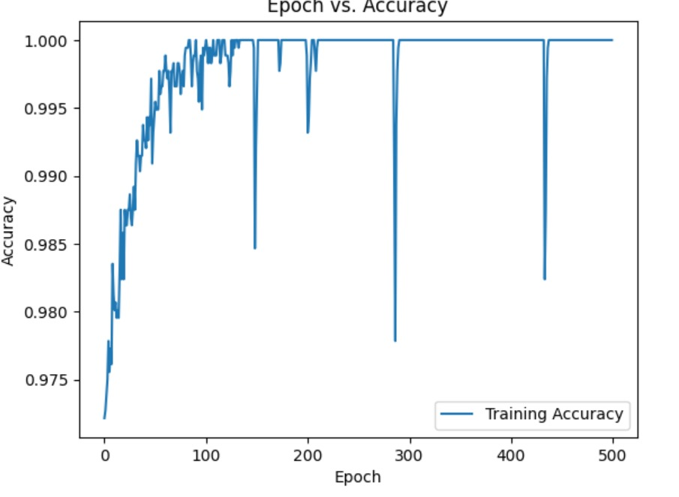
RESULTS AND DISCUSSION
The accuracy of the model steadily grows over the epochs, peaking around 98.25 percent in RNN-LSTM, and 97 percent in CNN. This implies that the model is generalizing well to new data and learning efficiently.

Slide 10
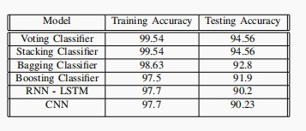
RESULT AND DISCUSSION
The below table showcases the training and testing accuracies for all the models used for crop recommendation.

Slide 11
CONCLUSION AND FUTURE SCOPE
CONCLUSION :
The development of crop recommendation classifiers yielded promising outcomes, particularly with the voting, stacking, and bagging classifiers achieving notably high training accuracy scores. Despite this success, it is notable that the boosting classifier, RNN-LSTM, and CNN exhibited lower training accuracies, indicating potential for improvement within crop recommendation systems. It is crucial to highlight that testing accuracies were slightly lower than training accuracies. This difference may be attributed to the dataset's limited size and focus, primarily on crops cultivated within the Hubbli-Dharwad region. The dataset's specificity may have constrained the models' ability to generalize to a broader range of crops and regions.
FUTURE SCOPE:
The study can be used to identify potential future advancements in crop recommendation systems. Integrating advanced sensors, harnessing big data analytics and AI, and incorporating genetic and crop variety data offer promising avenues. Enhancing personalization, integrating weather data, automation technologies, and sustainability metrics are key areas for improvement. Emphasizing data security, blockchain traceability, and regulatory compliance is essential. Additionally, fostering community engagement and incorporating market predictions will refine crop recommendations, enhancing agricultural sustainability and profitability.

Slide 12
REFERENCES
https://ieeexplore.ieee.org/document/9734173
https://www.techscience.com/csse/v47n2/53626
https://ieeexplore.ieee.org/document/9418375
https://cnre2023.ptu.ac.in/CNRE21/20.pdf

Slide 13
THANK YOU

