Slide 1
FLASHBOOK
Changing way of writing

Slide 2
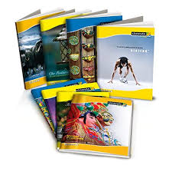
Conventional Notebook
General college student use approximately 15 pages for writing and 30 pages for photocopy, so total 45 pages per day.
8,000 A4-sized papers can be made by sacrificing one green tree.
So one student cut one tree
in 177 days.

Slide 3
Talking about engineering college, they have four years of bachelor course, so totally 1,460 days.
So doing calculations each person who have done any bachelor engineering course he or she might have cut 8.25 trees and needed 5,000 litres (if reusable water)or 98,550 litres (if non reusable water) of water in their four years duration.
This is not to this only, he or she would continue this till last day of his or her professional life.

Slide 4
And also an average student spend approx. 500 INR per semester on notebooks and 1,000 INR on photocopy, calculating... a student would spend 12,000 INR during whole course....

Slide 5
So what is a Solution?
As our main objective here is to find a solution which is eco friendly.
So we need to make “Something” which help to achieve our objective and also “Cost Effective”.
Because, however a thing is environment friendly people will going to buy it if and only if it will comparable or cheaper then existing thing.

Slide 6
So what is a Solution?
A solution is that to make something like screen which is permanent and using finger gestures or something pointy to go next or previous page.

Slide 7
Let’s Begin...
First of all it is going to take place of existing conventional notebook, so “Flashbook” should feel like conventional book.
So its page should turn like physical book.

Slide 8
Attributes of A4 sized paper
Physical size: 29.7 * 21 cm(11.7 0 * 8.26 inch)
Spacing between two lines: 0.8 cm
Heading space: 3.1 cm
Starting space:2.5 cm
Spacing between two red lines: 0.1 cm
Total number of lines in a page: 32
Ending space: 0.9 cm

Slide 9
Attributes of “Flashpaper”
Physical size: 29.7 * 21 cm or may be more
Spacing between two lines: 0.8 cm
Heading space: 3.1 cm
Starting space:2.5 cm
Spacing between two red lines: 0.1 cm
Total number of lines in a page: 32
Ending space: 0.9 cm

Slide 10
Attributes of “Flashbook”
There shall be two modes, pen and pencil.
Character shall be in black colour in pencil mode and blue(or may any other colour) in pen mode.
A person can write on screen using pencil sized-shaped tool.
Difference between pencil and pen is that you can erase things which are written in pencil mode, but can not in pen mode.

Slide 11
Hardware
It would have glossy like screen which is seen and felt like normal paper.

Slide 12
Entering into the “Flashbook”
It will password protected.
You can set a character password.

Slide 13
Start Writing
Starting of any new notebook, “Flashbook” will ask, would you like to have
cover page
index
automatic generated page number
number of pages it shall contain
type of ruling
Class book/ Homework book
pen or pencil or both

Slide 14
Cover page
One can set cover page one likes.
Broad variety of cover pages will be stored
inside “Flashbook” itself.

Slide 15
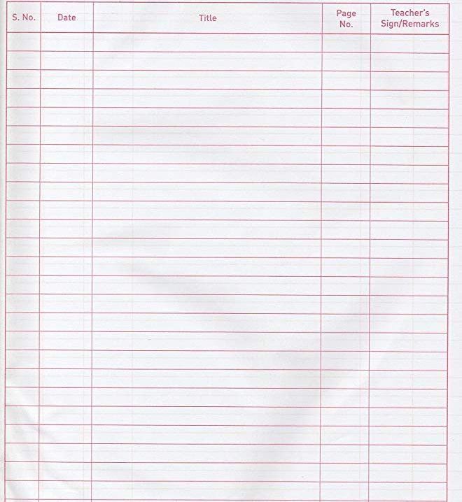
Index
You can also put index
in starting of any book,
if you want.
Index will contain
column like ‘Serial No.’,
‘Date’, ‘Title’ , ‘Page No.’
,‘Teacher’s sign’.

Slide 16
Automatic generated page number
“Flashbook” can automatically generate page number.
Generated page number will be displayed at top right corner of any page.

Slide 17
Number of pages
By default “Flashbook” will generate 100 pages in any new book.
But if you want to increase number of pages, you can.

Slide 18
Type of ruling
Single line notebook
Double line notebook
Square line notebook
Four lined-English notebook
Blank notebook
You can select any one of them.
One can use only one type of ruling in a book

Slide 19
Class book/ Homework book
You can select you want to make your notebook as class book or as a homework book.
Difference between class book and homework book will be that you can’t do operation like copy, cut, paste, sharing in homework book. There will be also trade mark like symbol on every page of homework notebook which will indicate that this book is homework book.
So faculty no need to worry that students will copy paste their homework from others. And without worry you can take homework from “Flashbook”.

Slide 20
Pen or Pencil or both
We all know difference between pen and pencil mode.
One can put restriction of usage of pen or pencil in a particular notebook.
One can’t use pen in pencil mode selected book and vice versa.
But one can use both pen and pencil if one have selected both mode.

Slide 21
Start drawing
We can also draw straight horizontal or vertical lines without using any type of scale, like use of “shift” key in Microsoft paint.
There won’t be need of external mathematical instruments.
They all are inbuilt as we will see further.

Slide 22
Jumping
You can also jump from one page to any other page just by writing the page number, if page number is allocated.
Additionally it will remember three pages for you, one of them might be first page, and two other might be whatever you want.
There will be icon of all three pages, just by clicking on icon you will arrived on that page.
On the opening existed book, it will directed to last left page.

Slide 23
Bookmark
One can also bookmark some important pages.
On touching on some point you will be provided with the list of all bookmarks within that book.

Slide 24
Digging in-between
Unlike our usual notebook, in “Flashbook” you can add new page in-between two pages.
Page numbers will also adjust accordingly.

Slide 25
Functions
Copy
Cut
Paste
Delete
These all functions have their usual operation.

Slide 26
Start reading
You can excess PDF format in “Flashbook”.
You can’t change data of text contained in PDF.
But you can write on PDF using pen or pencil mode.

Slide 27
File management
You can make folders inside the folder like in windows OS.
We can also copy, cut, paste, delete files from folders.

Slide 28
Device storage
“Flashbook” will have some internal RAM.
It will also store written data in its ROM.
You can also expand ROM memory using SD card slot up to some extend.

Slide 29
Settings
You can vary brightness according to your convenient.
Notes:
convenience

Slide 30
Sharing
I don’t know much about this thing.
Is there need of this function or not ?
And if it needed then how to implement it.(bluetooth)

Slide 31
Connecting to Internet
Wifi card

Slide 32
Cloud storage
You lost your “Flashbook”, then don’t worry.
Cloud service will provide you your data as it is, you just need to login in another “Flashbook” using your username and password.

Slide 33
Power Supply
We can charge our “Flashbook” using mobile adaptor.
In advancement we can also put solar cells in its flip cover to use solar energy to power up “Flashbook”.

Slide 34
Advantages
No need of compass box
No external calculator needed
Very less weight in respect of bag full of books

Slide 35
No compass box
In traditional manner we need a compass box containing ruler, protractor, rounder, divider, set square, pen, pencil, eraser, sharpener, etc.
But for “Flashbook” you don’t need any of them.

Slide 36
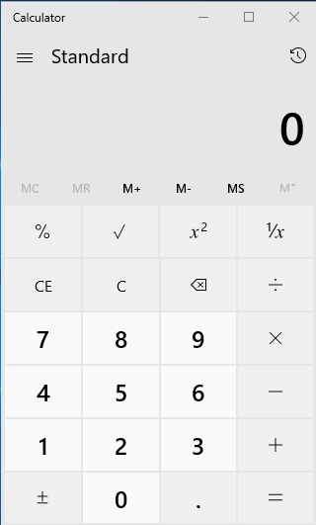
Calculator
It shall also contain in built
simple and scientific
calculator.

Slide 37

Weight
In every day life we see many college students and company employees walking and travelling with their heavy bags.
They have many notebooks, reference books, mathematical instruments,
compass box, etc. in their
bag.
But using “Flashbook” you
need to carry only 400-500
gram device.

Slide 38
Faculties no need to worry
As we know students can’t copy-paste their homework in “Flashbook”.
However smart phone is already allow in college class and one can’t do any thing in “Flashbook” more then reading novel during class!!
So it is very safe and secure.

Slide 39
School student
This is new concept related to education.
So we do not let school student to use it.
But first we let college student to use it, and will see result how much it is beneficial.

Slide 40
Professionals
Company employees and professionals can also use it very freely in their routine life.
“Flashbook” will also be beneficial to Professors and writers, who need to repeatedly insert pages in their write-up work, and without using physical file or diary one can easily organize their thesis.

Slide 41
How to make all this possible?
There is two things needed to start any new thing
Proper Planning
Funding

Slide 42
Planning
There are six modules in our project:
Big touch screen
Printed Circuit Board
Components on PCB
Software for Embedded System
Battery system
Plastic body

Slide 43
Big Touch Screen
From my side it is hard to find or develop that large sized screen and it might have largest part in the cost of device.
In beginning we shall buy it from vendor, but after getting success of our product we can think of manufacturing it by ourselves.
This will be recursive type of cost.

Slide 44
Printed Circuit Board
This is a hardware part of device.
In starting we need to choose right components for our system and develop the PCB design for it.
Selection of components should done in a manner that it cost us minimum, satisfying our requirement.
PCB design is one time cost.
But after designing we only have to give its manufacturing cost.

Slide 45
Components on PCB
This is also recursive cost.
We need to buy our components from vendor.
We need small work area to place components on PCB.
We decrease components cost by buying components in a lot.

Slide 46
Software
It is an one time cost.
We only require to built software one time.
And after that we can copy-paste it as many times as we want.

Slide 47
Battery System
We need to buy batteries from wholesaler.
After success of product we will make it by our own.

Slide 48
Plastic Body
Device need plastic back body and flip cover to organize all it’s systems in it.
There will be also flip cover to protect screen.

